Slide 1

Group and team theory
Session IV

Slide 2
Chapter outlines
15. Working in Diverse Teams
16. Conflict and Negotiation

Slide 3
Learning Objective
Describe how diversity can enhance decision-making and problem-solving
Identify challenges and best practices for working with multicultural teams
Define conflict
Differentiate between functional and dysfunctional conflict
Recognize various types of conflict in groups
Describe the conflict process
Identify and apply strategies for preventing or reducing conflict in groups

Slide 4
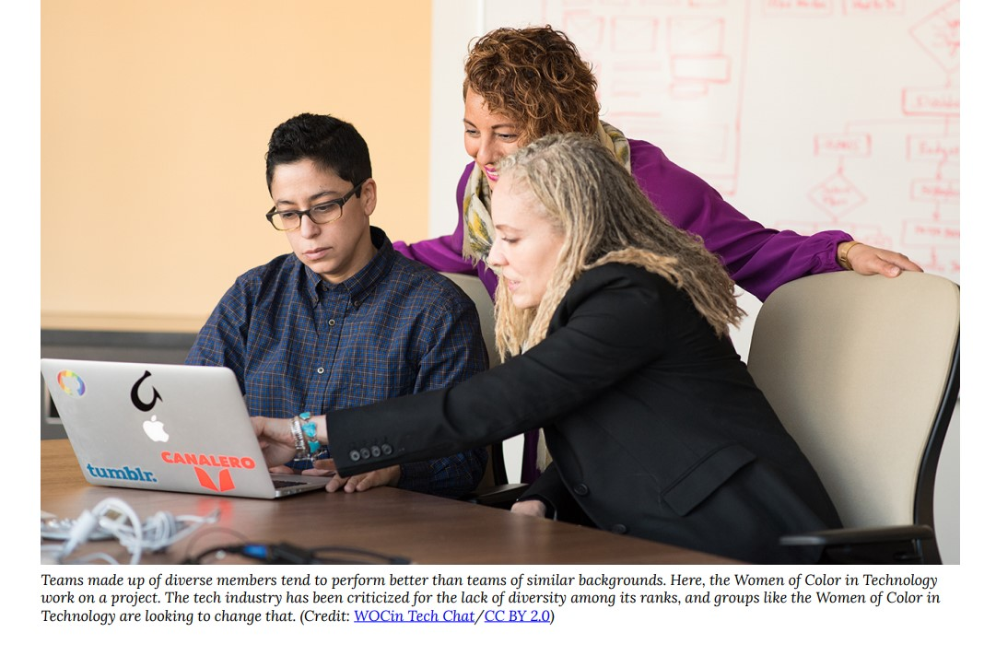
Does Team Diversity Enhance Decision Making and Problem Solving?

Slide 5
Challenges and Best Practices for Working with Multicultural Team
High-context communication
Low-context communication.
More indirect and ask questions rather than pointing our problems.
Direct and explicit

Slide 6
Developing Cultural Intelligence
Is a competency and a skill that enables individuals to function effectively in cross-cultural environments.
Aware of the influence of culture and more capable of adapting behavior to the norms of other cultures.

Slide 7
Article “Cultural Intelligence,” In the Harvard Business
Review three sources of cultural intelligence:
Head: learns about the beliefs, customs, and taboos of foreign cultures via the head.
Body: involves more commitment and experimentation with the new culture.
Heart: deals with a person’s own confidence in their ability to adapt to and deal well with cultures outside of their own

Slide 8
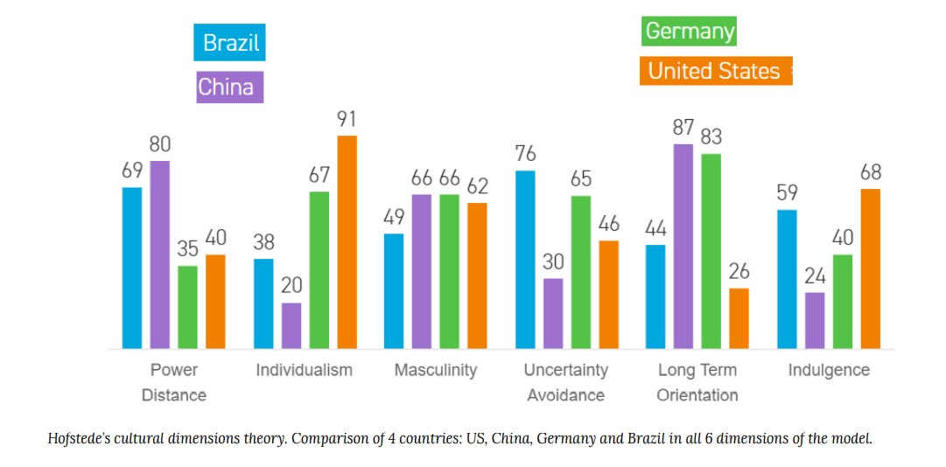
Divergent Cultural Dimensions

Slide 9
Homework: reading
Low-Power versus High-Power Distance
Masculine versus Feminine Orientation
Uncertainty-Accepting Cultures versus Uncertainty-Rejecting Cultures
Short-Term versus Long-Term Orientation
Time Orientation

Slide 10
Review & Reflection Questions
Why are diverse teams better at decision-making and problem-solving? 1
What are some of the challenges that multicultural teams face?
How might you further cultivate your own cultural intelligence?
What are some potential points of divergence between cultures?

Slide 11
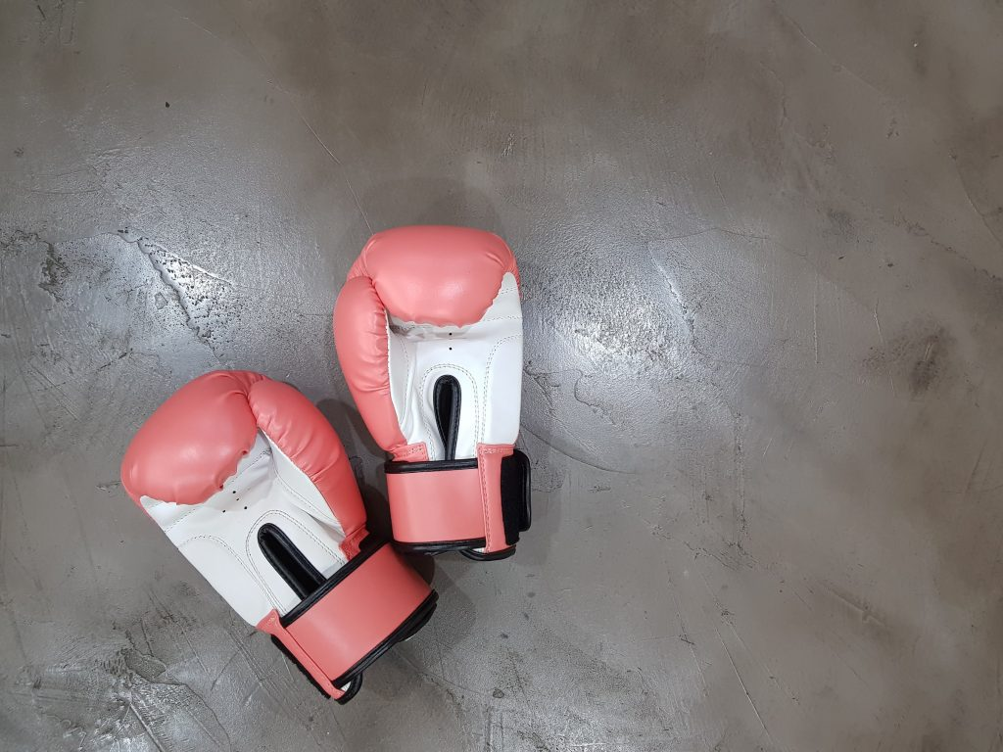
16. Conflict and Negotiation

Slide 12
Definitions of Conflict
As an expressed struggle between interdependent parties over goals which they perceive as incompatible or resources which they perceive to be insufficient. (Hocker and Wilmot (2001)
First of all, conflict must be expressed.
Second, conflict takes place between or among parties who are interdependent—that is, who need each other to accomplish something.
Finally, conflict involves clashes over what people want or over the means for them to achieve it.

Slide 13
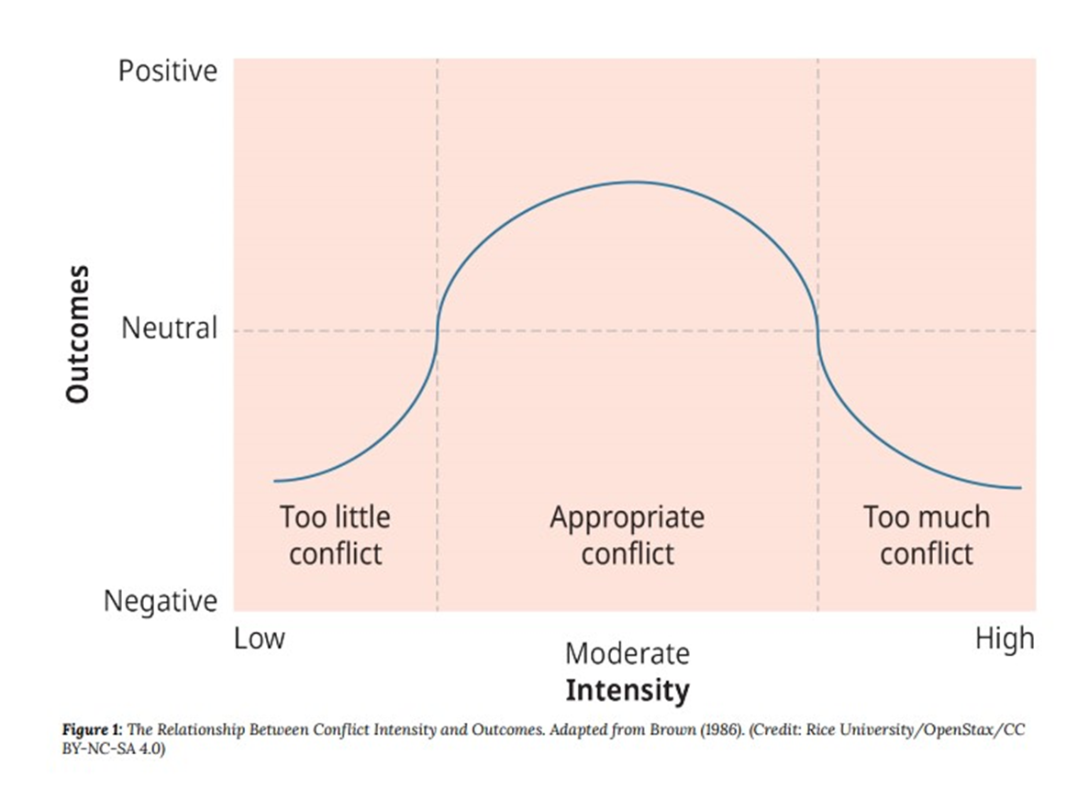
The Positive and Negative Sides of Conflict

Slide 14
Types of Conflict
Conflicts of substance.
Conflicts of value
Conflicts of process
Conflicts of misperceived differences
Relationship conflicts

Slide 15
A Model of the Conflict Process
Stage 1: Frustration
Stage 2: Conceptualization
Stage 3: Behavior
Stage 4: Outcome

Slide 16
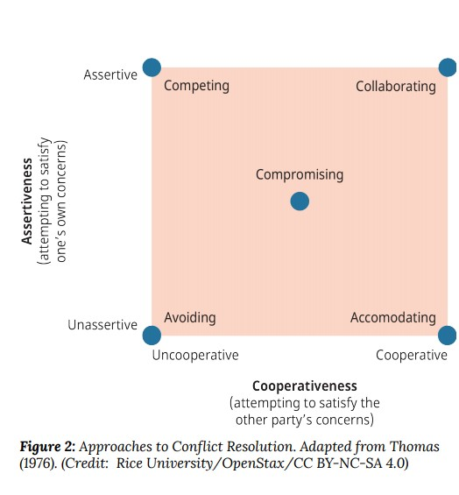
Five Modes of Resolving Conflict

Slide 17
Strategies for Conflict Prevention
Strategies for Conflict Prevention
Strategies for Conflict Prevention
Facilitating dialogue
Facilitating dialogue

Slide 18
Preventing and Reducing Conflict
Strategies for Conflict Prevention
Strategies for Conflict Reduction

Slide 19
Strategies for Conflict Reduction
Physical separation
Use of rules and regulations
Limiting intergroup interaction
Use of integrators
Confrontation and negotiation
Third-party consultation
Rotation of members
Identification of interdependent tasks and superordinate goals
Use of training

Slide 20
Strategies for Conflict Prevention
Emphasizing group goals and effectiveness
Providing stable, well-structured tasks
Facilitating dialogue
Avoiding win-lose situations

Slide 21
Facilitating dialogue
Physical separation.
Use of rules and regulations.
Limiting intergroup interaction.
Use of integrators.
Confrontation and negotiation
Third-party consultation
Identification of interdependent tasks and superordinate goals.
Identification of interdependent tasks and superordinate goals.

Slide 22
Review & Reflection Questions
Is conflict in groups good or bad? Why?
Identify the types of conflict and provide examples of each.
What modes of conflict resolution do you find yourself using when faced with a conflict in a group?
What modes have you observed at work in your current group?
What strategies could you use to prevent or reduce conflict in your group?

