Slide 1

GROUP & TEAM OVERVIEW
Session I

Slide 2
CHAPTER OUTLINE
3. Social Comparison
4. The Psychology of Groups

Slide 3
LEARNING OBJECTIVES
Understand the reasons people make social comparisons.
Identify consequences of social comparison
Understand the Self-Evaluation Maintenance Model.
Explain situational factors that can affect social comparison.
Review the evidence that suggests humans have a fundamental need to belong to groups.
Compare the sociometer model of self-esteem to a more traditional view of self-esteem.
Describe how groups change over time.
Apply the theory of groupthink to a well-known decision-making group

Slide 4
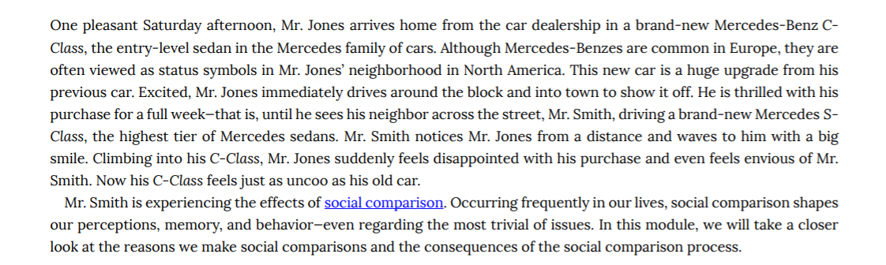
Introduction: Social Comparison

Slide 5
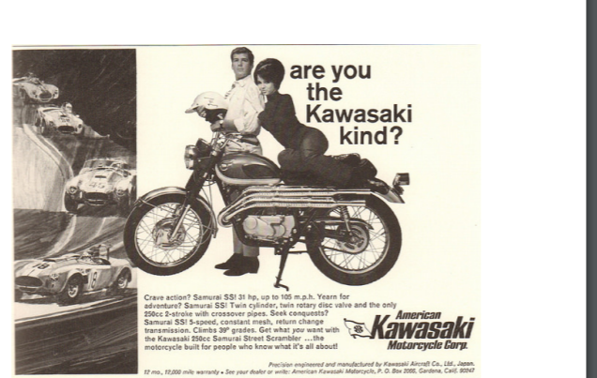
Social Comparison: Basics
Social comparison is a well-known concept to advertisers. They create idealized images that influence consumers’ self-perceptions as well as the things they feel they must buy in order to be satisfied
[Image: SenseiAlan, http://goo.gl/XOwjq5, CC BY 2.0, http://goo.gl/ T4qgSp]

Slide 6
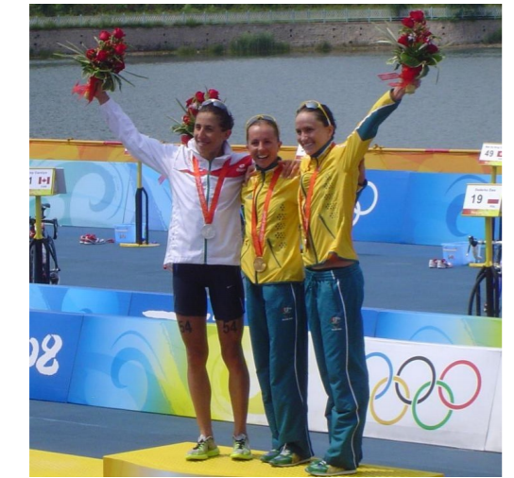
When comparing, similarity is important. A professional athlete is
far more likely to compare his or her own performance against that
of other professional athletes than that of an amateur.
[Image: Doma-w, https://goo.gl/2NM9Ii, CC BY 3.0, https://goo.gl/b58TcB]

Slide 7
Relevance and Similarity
The performance dimension has to be relevant to the self (Festinger, 1954)
For example, if excelling in academics is more important to you than excelling in sports, you are more likely to compare yourself with others in terms of academic rather than athletic performance

Slide 8
Direction of Comparison
Social comparison is a bi-directional phenomenon where we can compare ourselves to people who are better than us or worse than us
“upward comparisons”
“downward comparisons.

Slide 9
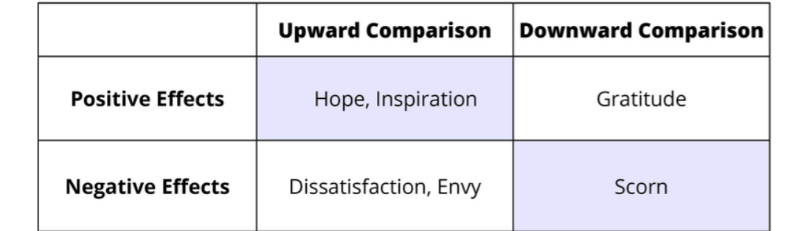
The effects of social comparison.

Slide 10
Consequences of Social Comparison
impact self-esteem:
For example, having the best final score in a class can increase your self-esteem quite a bit
lead to feelings of regret & envy:
as when someone with thinning hair envies the thick hair of a colleague.
behave more competitively:
For example, you are among the top 10% on your class
mid-term you might feel competitive with the other top
students.

Slide 11

Consequences of Social Comparison
Comparing your behavior to that of other people might make you jealous, regretful or more motivated. Lapel stickers and online badges that proclaim “I voted” or “I gave blood” are common examples of leveraging social comparison to achieve positive social outcomes.
[Image: CAVE CANEM, http://goo.gl/ifKSiE, CC BY 2.0, http://goo.gl/v4Y0Zv]

Slide 12
Self-Evaluation Maintenance Model
The self-evaluation maintenance (SEM; Tesser, 1988) model builds on social comparison theory.
SEM points to a range of psychological forces that help and maintain our self-evaluation and self-esteem.
SEM reveals the importance of relationship closeness: affects self-evaluations

Slide 13
Experiment of Self-Evaluation Maintenance Model
For example, in one study, Tesser and Smith (1980) asked people to play a verbal game in which they were given the opportunity to receive clues from a partner. These clues could be used to help them guess the correct word in a word game. Half the participants were told the game was related to intelligence whereas the other half were not. Additionally, half the participants were paired with a close friend but the other half played with a stranger. Results show that participants who were led to believe the task was self-relevant or having to do with intelligence provided more difficult clues when their partner was a friend versus a stranger—suggesting a competitive uptick associated with relationship closeness. However, when performance was implied to be irrelevant to the self, partners gave easier clues to friends than strangers.

Slide 14
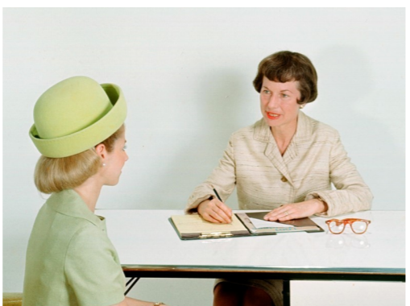
The SEM model suggests that managers may prefer sub-optimal
candidates who aren’t likely to challenge their standing in the
organization.

Slide 15
Individual Differences
The social comparison and its effects on self-evaluation will often depend on personality and individual differences
For example, people with mastery goals may not interpret an upward comparison as a threat to the self but more as challenge, and a hopeful sign that one can achieve a certain level of performance.

Slide 16
Situational factors
Number
Local
Proximity to a Standard
Social Category Lines

Slide 17
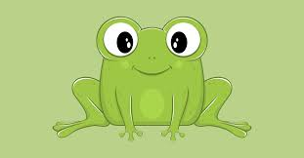
Related Phenomena
FROG POND EFFECT
as a frog, would you rather be in a small pond where you’re a big frog, or a large pond where you’re a small frog?
ACCORDING TO MARSH, TRAUTWEIN, LUDTKE AND KOLLER (2008):
people in general had a better academic self-concept if they were a big frog in a small pond (e.g., the top student in their local high school) rather than a small frog in a large one (e.g., one of many good students at an Ivy League university).

Slide 18
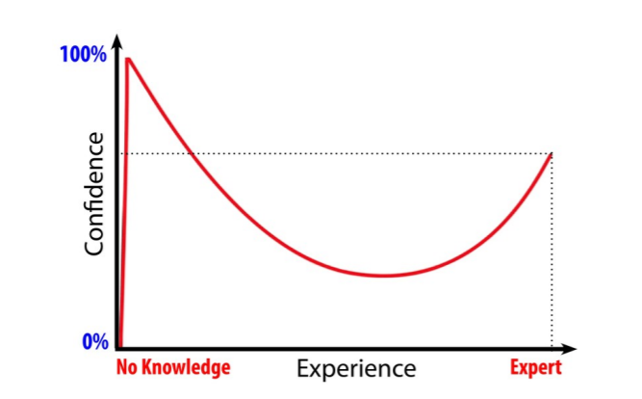
Related Phenomena
THE DUNNING-KRUGER EFFECT
The Dunning-Kruger Effect shows that the least experienced and least knowledgeable people are over-confident. These people don’t know what they don’t know and are more likely to overestimate their own abilities.

Slide 19
Discussion Questions
1. On what do you compare yourself with others? Qualities such as attractiveness and intelligence? Skills such as school performance or athleticism? Do others also make these same types of comparisons or does each person make a unique set? Why do you think this is?
2. How can making comparisons to others help you?
3. One way to make comparisons is to compare yourself with your own past performance. Discuss a time you did this. Could this example be described as an “upward” or “downward” comparison? How did this type of comparison affect you?

Slide 20
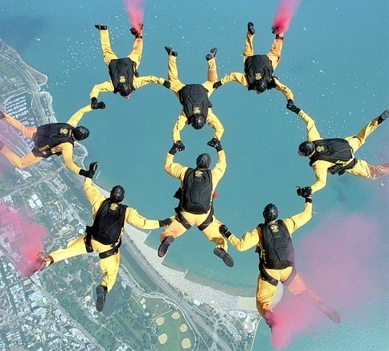
4. The Psychology of Groups
Most of us live out our lives in groups, and these groups have a profound impact on our thoughts, feelings, and actions.

Slide 21
What is the psychological significance of groups?
“I must be myself. I will not hide my tastes or aversions . . . . I will seek my own”. People are capable of living separate and apart from others
But
They join with others because groups meet their psychological and social needs.

Slide 22
The Need to Belong
87.3% of Americans reported that they lived with other people
(family members, partners, and roommates, Davis & Smith, 2007)
50% to 80%, reported regularly doing things in groups
(such as attending a sports event together, visiting one another for the evening, sharing a meal together, or going out as a group to see a movie, Putnam, 2000).

Slide 23
Affiliation in Groups
Groups provide members with information, assistance, and social support.
Leon Festinger’s theory of social comparison (1950, 1954) suggested that in many cases people join with others to evaluate the accuracy of their personal beliefs and attitudes.

Slide 24
Identity and Membership
Groups help us answer the existentially significant question, “Who am I?”
People are defined not only by their traits, preferences, interests, likes, and dislikes, but also by their friendships, social roles, family connections, and group memberships.
The self is not just a “me,” but also a “we.”

Slide 25
Evolutionary Advantages of Group Living
Groups may be humans’ most useful invention, for they provide us with the means to reach goals that would elude us if we remained alone.
“People become dependent on one another for the satisfaction of their needs”
(theory of social integration, Moreland)

Slide 26
Motivation and Performance
Social Facilitation in Groups: Do people perform more effectively when alone or when part of a group?
Social Loafing: Groups usually outperform individuals. “Many hands make light the work” (Littlepage, 1991; Steiner, 1972)
Can be a problem
One way to overcome it is by recognizing that each group member has an important part to play in the success of the group
But

Slide 27
Teamwork
Researchers have identified two key ingredients to effective teamwork:
a shared mental representation of the task
and group unity.
Teams improve their performance over time as they develop a shared understanding of the team and the tasks they are attempting.

Slide 28
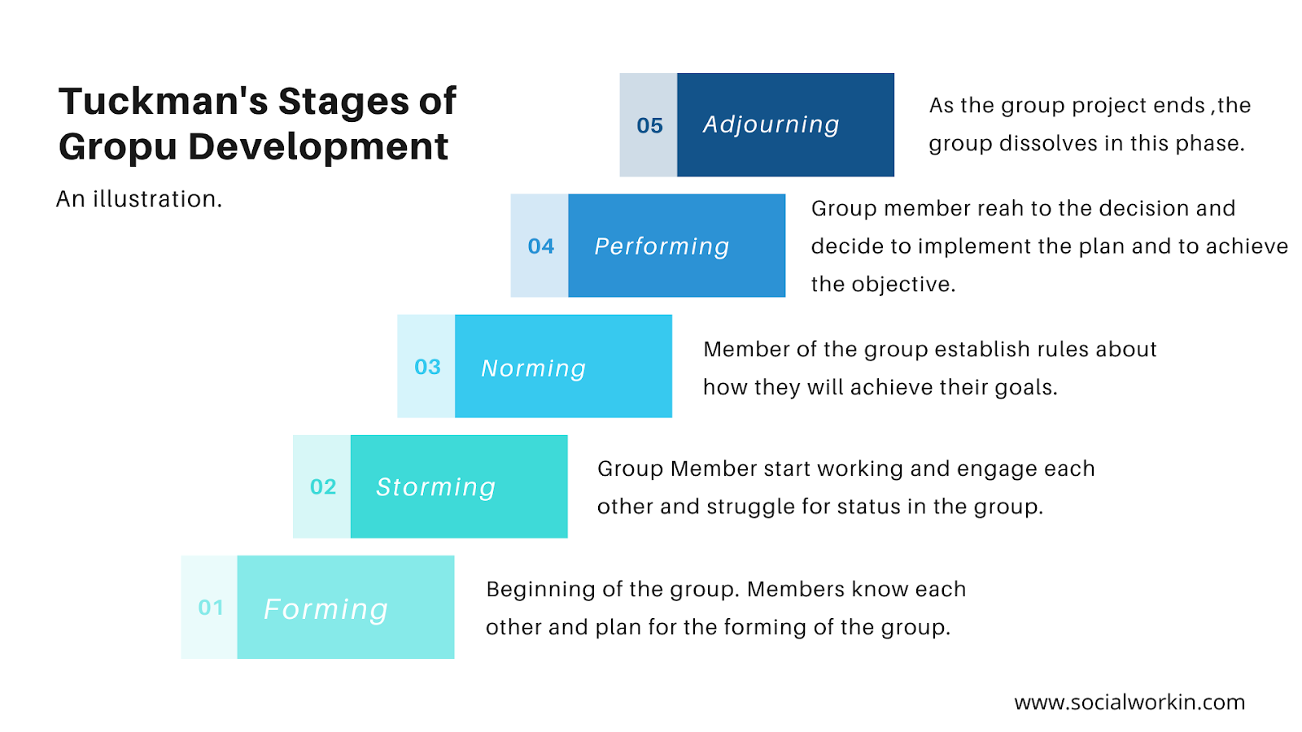
Group Development

Slide 29
Making Decisions in Groups
For groups can draw on more resources than can a lone individual.
More ideas and possible solutions by discussing the problem.
A group’s decision will be superior to an individual’s decision.
however, groups do not always make good decisions

Slide 30
Group Polarization
Common sense notions suggest that groups exert a moderating, subduing effect on their members.
Many groups shift toward more extreme decisions rather than less extreme decisions after group interaction
Let’s say you are part of a group assigned to make a presentation. One of the group members suggests showing a short video that, although amusing, includes some provocative images. Even though initially you think the clip is inappropriate, you begin to change your mind as the group discusses the idea.

Slide 31
Common Knowledge Effect or Shared Information Bias
Researchers have studied this bias using the hidden profile task. On such tasks, information known to many of the group members suggests that one alternative, say Option A, is best. However, Option B is definitely the better choice, but all the facts that support Option B are only known to individual groups members—they are not common knowledge in the group. As a result, the group will likely spend most of its time reviewing the factors that favor Option A, and never discover any of its drawbacks. In consequence, groups often perform poorly when working on problems with nonobvious solutions that can only be identified by extensive information sharing.

Slide 32
Groupthink
GROUPS SOMETIMES MAKE SPECTACULARLY BAD DECISIONS
FOUR GROUP-LEVEL FACTORS THAT COMBINE TO CAUSE GROUPTHINK:
Cohesion
Isolation
Biased leadership
Decisional stress

Slide 33
You and Your Groups
1. What are the advantages and disadvantages of sociality? Why do people often join groups?
2. Is self-esteem shaped by your personality qualities or by the value and qualities of groups to which you belong?
3. In what ways does membership in a group change a person’s self-concept and social identity?
4. What steps would you take if you were to base a self-esteem enrichment program in schools on the sociometer model of self-worth?
5. If you were a college professor, what would you do to increase the success of in-class learning teams?
6. What are the key ingredients to transforming a working group into a true team?
7. Have you ever been part of a group that made a poor decision and, if so, were any of the symptoms of groupthink present in your group?
Discussion Questions

Slide 34


