Slide 1

Group and Team overview
Session I

Slide 2
Learning Objectives
Understand about shared Information Bias
Learn about inattentional blindness and why it occurs.
Identify ways in which failures of awareness are counterintuitive.
Better understand the link between focused attention and failures of awareness.

Slide 3
5. Shared Information Bias
Shared information bias (also known as the collective information sampling bias) is thus a tendency for group members to spend more time and energy discussing information that multiple members are already familiar with (i.e., shared information)
To be associated with group member perceptions of competence, knowledge, and credibility (Wittenbaum & Park, 2001)

Slide 4
Causes
However, if members are concerned with making the best decision possible, this bias becomes less salient
because their goal is to reach consensual agreement than to distinguish a correct solution
For example, some group members tend to seek group support for their own personal opinions.
To be motivated by a desire to reach closure (e.g., a desire imposed by time constraints), their bias for discussing shared information is stronger
To be strongest for group members working on ambiguous, judgment-oriented tasks
Response to the interpersonal and psychological needs of individual group members.

Slide 5
Avoidance strategies to reduce group focus on discussing shared information
Avoid time pressure or time constraints
Make effort to spend more time actively discussing collective decisions
Include more group members who have task-relevant experience
Clarify to group members when certain individuals have relevant expertise
Make effort to avoid generalized discussions by increasing the diversity of opinions within the group
Technology
Introduce the discussion of a new topic to avoid returning to previously discussed items among member

Slide 6

6. Inattentional Blindness
Some researchers contend that there really is no such thing as multi-tasking. Instead, people are just rapidly switching their attention between tasks, rather than holding those tasks in their attention at the same time.
[Image: Mike Licht, https://goo.gl/z7rkve, CC BY 2.0, https://goo.gl/v4Y0Zv]

Slide 7
Discussion Questions
1. Many people, upon learning about inattentional blindness, try to think of ways to eliminate it, allowing themselves complete situation awareness. Why might we be far worse off if we were not subject to inattentional blindness?
2. If inattentional blindness cannot be eliminated, what steps might you take to avoid its consequences?
3. Can you think of situations in which inattentional blindness is highly likely to be a problem? Can you think of cases in which inattentional blindness would not have much of an impact?

Slide 8
7. Teams as Systems

Slide 9
Creating successful teams: A holistic view
This section focuses on an open systems’ approach to teamwork – a helpful approach which encourages teams to consider the context in which they works.
The approach considers team processes, which are divided into three parts:
Inputs
Throughputs
Outputs.

Slide 10
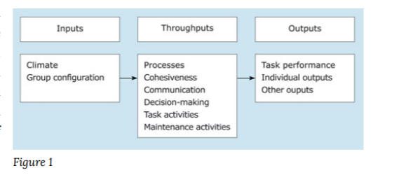
The open systems approach to team working

Slide 11

Inputs are often controlled or influenced by management
The way a team is put together and will function is influenced by the organization’s values, vision and strategy, and its practices and procedures.

Slide 12
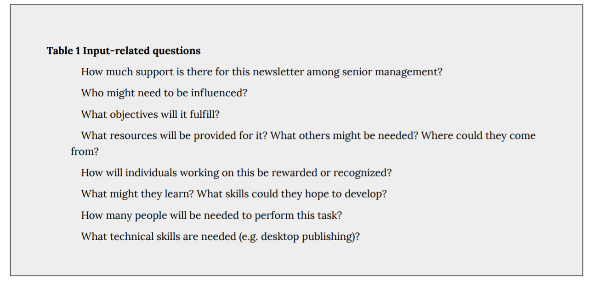
Inputs

Slide 13
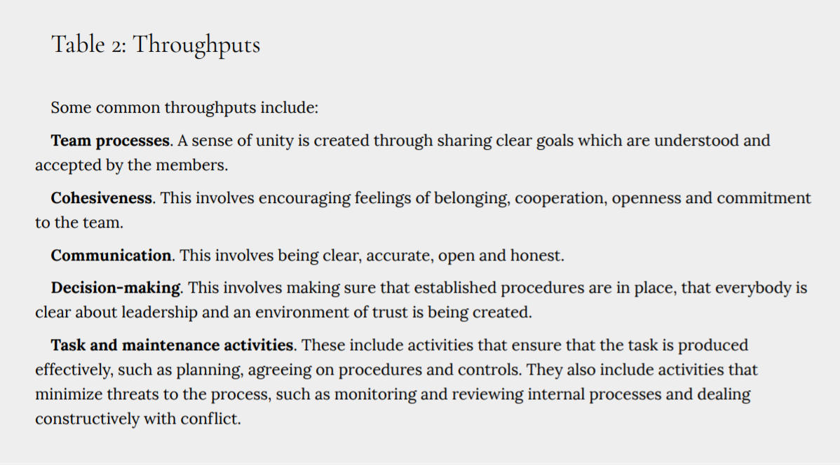
Throughputs

Slide 14
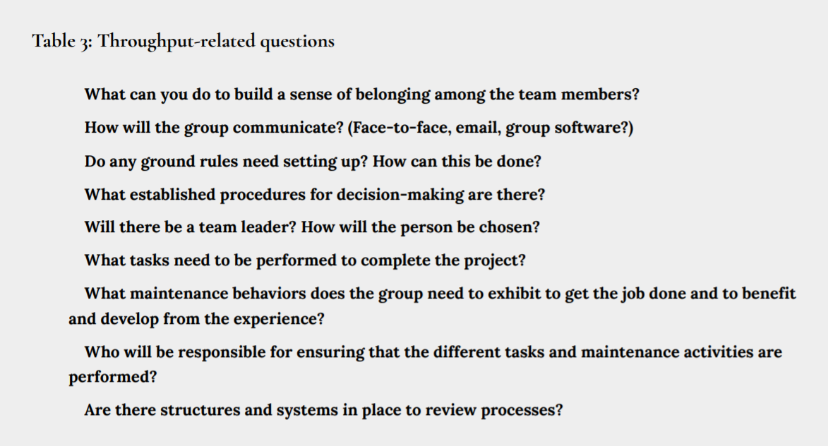
Throughputs

Slide 15

Task performance. Individual outputs. Other outcomes
Outcomes can be examined in terms of:

Slide 16
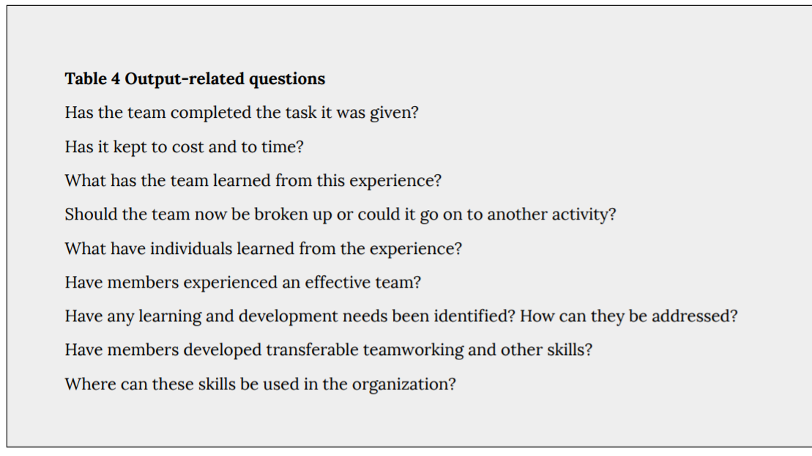
Outputs

Slide 17
Group size
To be effective it should be neither too large nor too small.
The numbers most commonly quoted for effective group size in a face-to-face team are between 5 and 10
Reducing the number of interactions and lessening the risk of conflict.
The breakdown of large groups into sub-groups and cliques may not help a team achieve its goals.

Slide 18
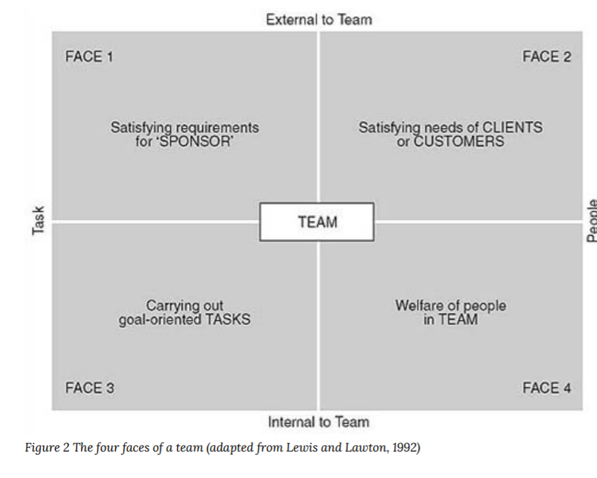
Managing group membership

Slide 19
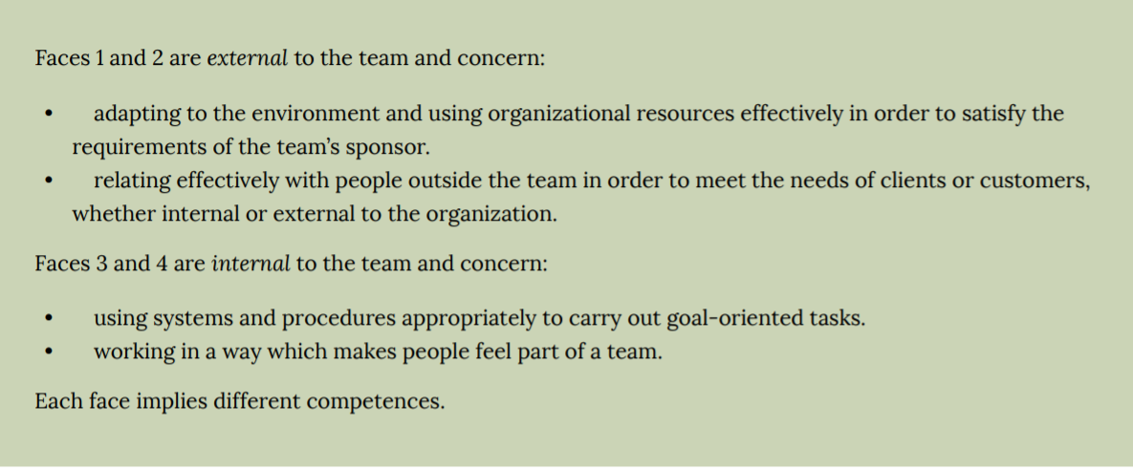
Managing group membership
Figure 2 provides a useful way of weighing up the mixture of ‘task’ and ‘people’ functions (or ‘faces’) of a team.

Slide 20
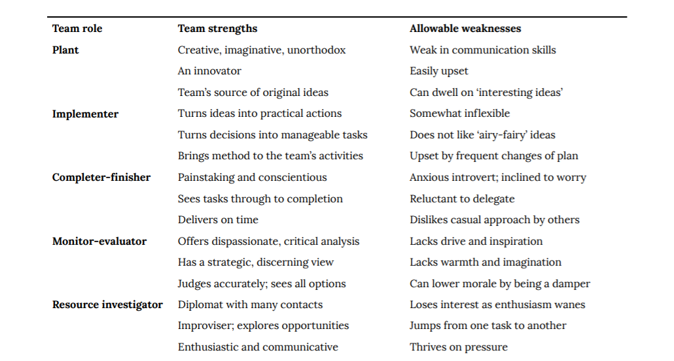
Functional and team roles

Slide 21
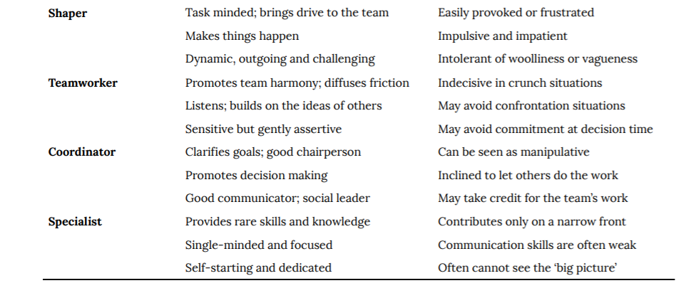
Functional and team roles

Slide 22


