Slide 1

THINKING AND ANALYSIS
SESSION II

Slide 2

Chapter outlines
1. Patterns of thought
2. Creative Thinking Skills

Slide 3
LEARNING OBJECTIVES
By the end of this section, you will be able to:
Identify different patterns of thought, such as those found in Bloom’s taxonomy
Discuss the relationship of each thought pattern to education
Define creative thinking
Identify the value of creative thinking in education
Describe the impact of limitations (such as rules) on creative thinking

Slide 4
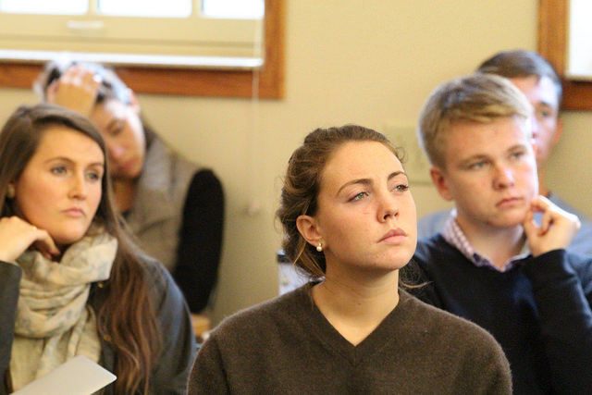
1. Patterns of thought

Slide 5
What Is Thought?
We exist, and we are aware that we exist, because we think. Without thought or the ability to think, we don’t exist.
Do you agree?
“Cogito ergo sum.”
= “I think, therefore I am.”
(philosopher René Descartes, French, the early 1600s)

Slide 6
Definitions
Thinking
Thought
Is the mental process you use to form associations and models of the world. When you think, you manipulate information to form concepts, to engage in problem-solving, to reason, and to make decisions.
Be described as the act of thinking that produces thoughts, which arise as ideas, images, sounds, or even emotions.

Slide 7
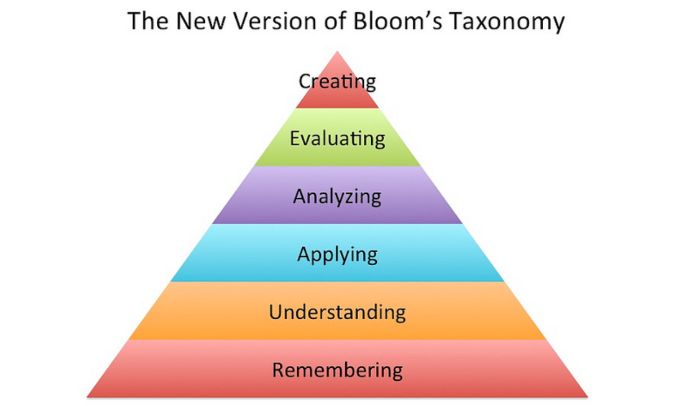
The Cognitive Domain of Learning

Slide 8

2. Creative Thinking Skills
Everybody has a creative potential and from the moment you can express this creative potential, you can start changing the world.
—Paulo Coelho, author and lyricist

Slide 9
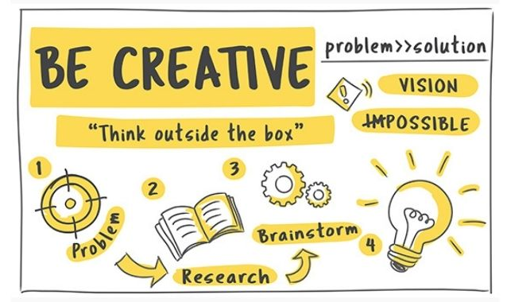
Everyone has creative abilities: It’s true of everyone who fully expresses creative abilities as well as those who express them very little or not at all.
All humans are innately creative, especially if creativity is understood as a problem-solving skill.
Creativity is inspired when there is a problem to solve. As a creative thinker, you are curious, optimistic, and imaginative

Slide 10
ACTIVITY: ASSESS YOUR CREATIVE PROBLEM-SOLVING SKILLS
Objective
Evaluate your attitude toward problem-solving in the context of cultivating creative thinking.
Directions:
Access Psychology Today’s Creative Problem-Solving Test at the Psychology Today Web site.
Read the introductory text, which explains how creativity is linked to fundamental qualities of thinking, such as flexibility and tolerance of ambiguity.
Then advance to the questions by clicking on the “Take The Test” button. The test has 20 questions and will take roughly 10 minutes.
After finishing the test, you will receive a Snapshot Report with an introduction, a graph, and a personalized interpretation for one of your test scores.
Complete any further steps by following your instructor’s directions.

Slide 11
Creative Thinking in Education
Design sample exam questions to test your knowledge as you study for a final.
Devise a social media strategy for a club on campus.
Propose an education plan for a major you are designing for yourself.
Prepare a speech that you will give in a debate in your course.
Develop a pattern for a costume in a theatrical production.
Arrange audience seats in your classroom to maximize attention during your presentation.
….,etc…
College is great ground for enhancing creative thinking skills:

Slide 12
How to Stimulate Creative Thinking
Sleep on it
Go for a run or hit the gym.
Allow your mind to wander a few times every day.
Keep learning.
Put yourself in nerve-racking situations once in a while to fire up your brain.
Keep a notebook with you so you always have a way to record fleeting thoughts.
Six strategies to stimulate your creative thinking.

Slide 13
A Brainstorm of Tips for Creative Thinking
1. Sensing
Use all your senses—see, taste, smell, touch, hear, think, speak.
Be a good observer of people, nature, and events around you.
2. Thinking
Engage thinking on the right side of your brain (intuition, open-mindedness, visual perception, rhythm . . .).
Change your interpretation of an event, situation, behavior, person, or object.
Allow ideas to incubate.
Be open to insight as ideas pop into your mind.
The best way to have a good idea is to have lots of ideas.
—Linus Pauling, double Nobel Laureate, chemist, biochemist, and peace campaigner

Slide 14
A Brainstorm of Tips for Creative Thinking
3. Imagining
Brainstorm by generating ideas with a group of people.
Ask, “What would happen if . . .”
Ask, “In how many different ways . . .”
Develop ideas and expand their possibilities.
Envision the future.
4. Speaking and Writing
Use your words and your “voice” when conveying your original ideas.
Avoid using clichés or overly familiar responses to questions or problems.
Explain how your ideas move beyond the status quo and contribute to a discussion.
Take notes.

Slide 15
A Brainstorm of Tips for Creative Thinking
5. Drawing
Use mind-mapping to capture ideas; start with a key concept and write it in the center of your page; use connecting lines, radiating from the central concept, and write down any connected or related ideas that come to you.
Create pictures or drawings of situations (“rich pictures”) to show them in a different way.
6. Learning
Find ways to demonstrate your personal investment in projects.
Gather knowledge and conduct research.
Have more fun learning!

Slide 16

A Brainstorm of Tips for Creative Thinking
7. Moving
Do physical activities to engage the creative areas of your brain and think differently.
8. Resting
Take breaks.

Slide 17
Creative Thinking Fiction and Facts
Every problem has only one solution (or one right answer)
Most problems can be solved in any number of ways.
Other people may think up solutions that differ from yours, but that doesn’t make your solution wrong or unimportant.

Slide 18
Creative Thinking Fiction and Facts
The best answer or solution or method has already been discovered
Look at the history of any solution and you’ll see that improvements, new solutions, and new right answers are always being found.
The ox or horse, the cart, the wagon, the train, the car, the airplane, the jet, the space shuttle? What is the best and last?

Slide 19
Creative Thinking Fiction and Facts
Creative answers are technologically complex
Only a few problems require complex technological solutions.
Most problems you’ll encounter need only a thoughtful solution involving personal action and perhaps a few simple tools.

Slide 20
Creative Thinking Fiction and Facts
Ideas either come or they don’t. Nothing will help— certainly not structure.
There are many successful techniques for generating ideas.
One important technique is to include structure.

Slide 21
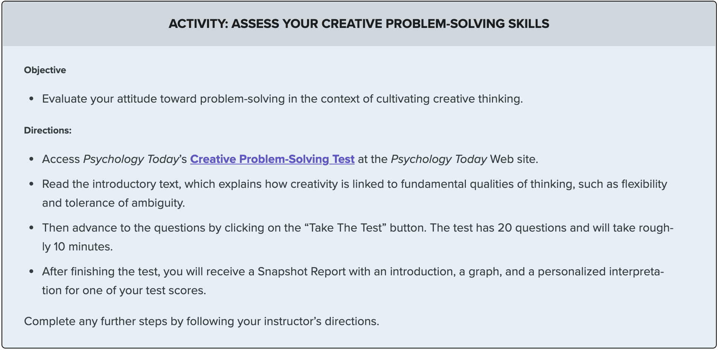
Link: https://www.psychologytoday.com/ca/tests/career/creative-problem-solving-test

Slide 22


