Slide 1

THINKING AND ANALYSIS
SESSION II

Slide 2

Chapter outlines
2. Creative Thinking Skills (cont.)
Problem-Solving with Creative Thinking
3. Thinking with technology

Slide 3
LEARNING OBJECTIVES
By the end of this section, you will be able to:
Describe the role of creative thinking skills in problem-solving
Identify technology tools that enhance student learning
Explain how technology skills relate to critical/creative thinking skills
Examine online learning in the context of organizing, communicating, reading, and researching online
Assess student readiness to use technology

Slide 4
Problem-Solving with Creative Thinking
Creative problem-solving is a type of problem-solving
Searching for new and novel solutions to problems.
Unlike critical thinking, which scrutinizes assumptions and uses reasoning, creative thinking is about generating alternative ideas— practices and solutions that are unique and effective.

Slide 5

Activity 1: Brainstorming
Project start up "Social initiative":
Discuss in small groups, propose a creative social initiative, to solve any problem in today's society
Note: work in your small group, which has been established since the very first lessons

Slide 6
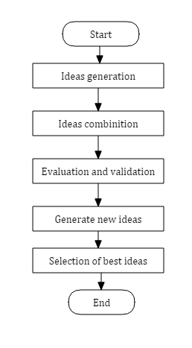
Brainstorming technique

Slide 7
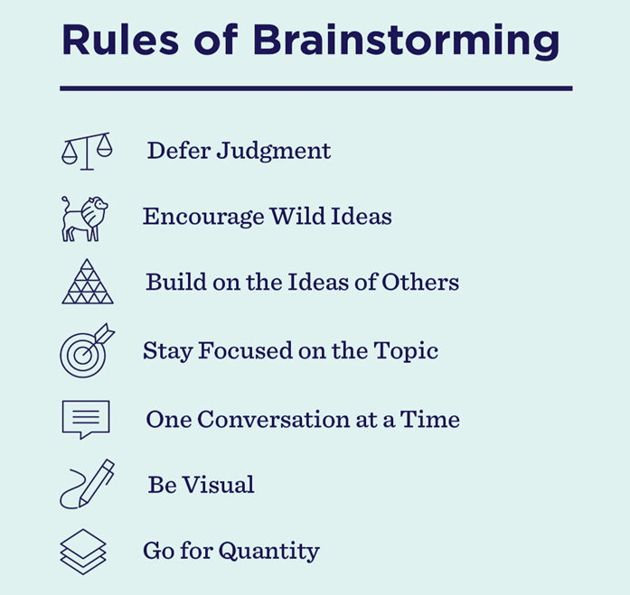

Slide 8
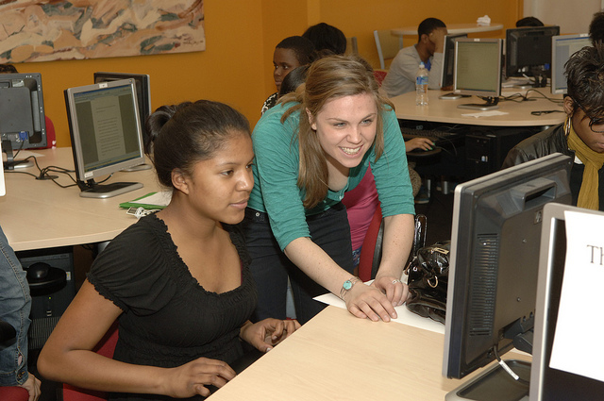
3. Thinking with Technology

Slide 9

Benefit of information technology
It empowers people to do what they want to do.
It lets people be creative. It lets people be productive.
It lets people learn things they didn’t think they could learn before
And so in a sense it is all about potential.

Slide 10
Technology for College Learning
85% of college-bound students say technology in the classroom and the availability of online classes are their top determinants in choosing a college.
"Digital Capabilities at Universities Key to Draw Students." CareerIndia. 28 Nov 2014. Web. 16 Feb 2016.

Slide 11

Discussion
Did technology influence your college decision?

Slide 12

Critical and Creative Thinking with Technology
Computer software and Internet resources
Digital camcorders
Interactive whiteboards
Student-response systems, like clickers
Blogs
Discussion boards
Wikis .

Slide 13
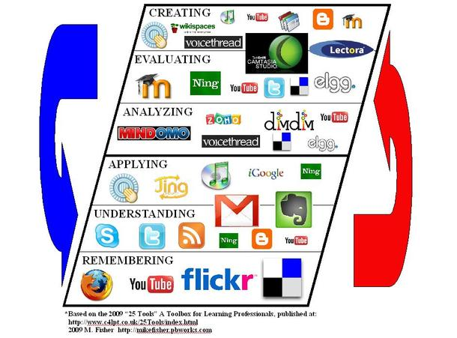
How different digital technologies can help faculty and students with critical and creative thinking
correspond with Bloom’s taxonomy
correspond with Bloom’s taxonomy
Notes:
The red and blue arrows outside the diagram indicate the fluidity with which the tools can travel through the different levels in the taxonomy.

Slide 14
It is specially designed to help California’s online community college students
Getting Tech-Ready:
https://apps.3cmediasolutions.org/oei/modules/tech/
Introduction to Online Learning: https://apps.3cmediasolutions.org/oei/modules/intro/
Organizing with Technology
https://apps.3cmediasolutions.org/oei/modules/organizing/
Communicating with Technology:
https://apps.3cmediasolutions.org/oei/modules/communication/
Reading and Researching with Technology:
https://apps.3cmediasolutions.org/oei/modules/reading/

Slide 15
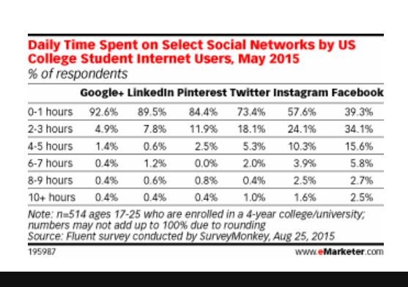
Mobile Learning and Social Networking
Mobile Learning: By the time the class of 2016 graduates, close to 91.4 percent of U.S. college students will own a smartphone (17 million).
Social Networking: See the eMarketer.com data graph showing the daily time spent on select social networks by U.S. college student Internet users, as of May 2015.
Social networking can readily facilitate learning.

Slide 16


