Slide 1

BUSINESS PROPOSAL
Session III. Business Writing in Action

Slide 2
LEARNING OBJECTIVES
1. Describe the basic elements of a business proposal.
2. Discuss the main goals of a business proposal.
3. Identify effective strategies to use in a business proposal.

Slide 3

INTRODUCTION
In order to be successful in business and industry, you should be familiar with the business proposal.
Business proposals are documents designed to make a persuasive appeal to the audience to achieve a defined outcome, often proposing a solution to a problem.

Slide 4
COMMON PROPOSAL ELEMENTS

Slide 5

IDEA
Effective business proposals are built around a great idea or solution.
What makes your idea different or unique?
How can you better meet the needs of the company that other vendors?
What makes you so special?

Slide 6

PRACTICE: CHOOSE IDEA FOR "SOCIAL INITIATIVE” PROJECT
Decide on an idea your team will work on, make sure it's a creative, groundbreaking idea.

Slide 7
TRADITIONAL CATEGORIES OF PROPOSAL
Cover Page
Executive Summary
Background
Proposal
Market Analysis
6. Benefits
7. Timeline
8. Marketing Plan
9. Finance
10. Conclusion

Slide 8
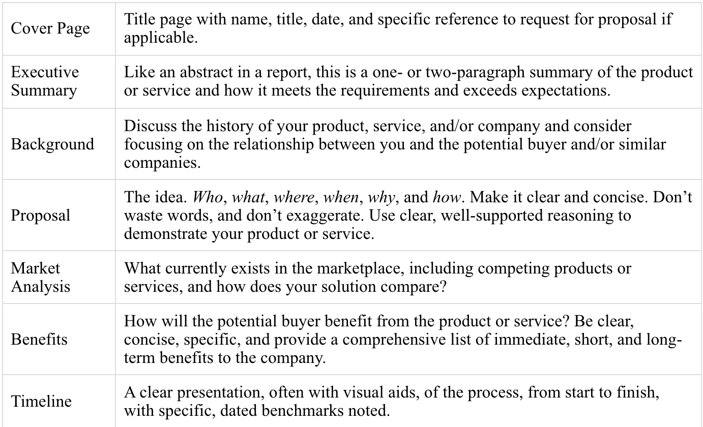
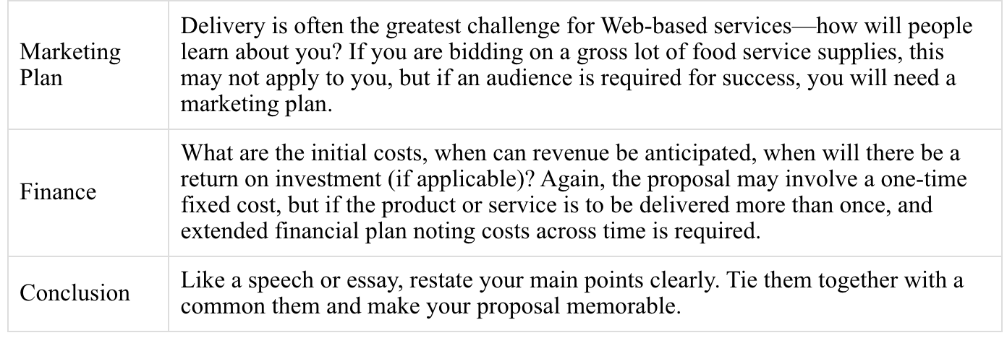
TRADITIONAL CATEGORIES OF PROPOSAL

Slide 9
LET'S START PRACTICING
Small group (5-7 members): Write a proposal from an idea of "Social initiative" project

Slide 10
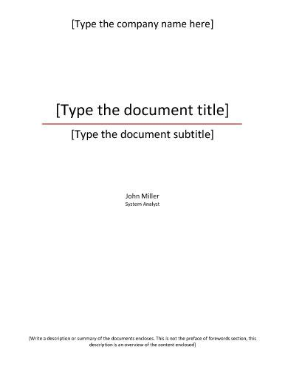
1. COVER PAGE
Title page with name, title, date, and specific reference to request for proposal if applicable.

Slide 11
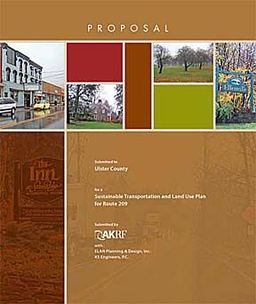

EXAMPLES

Slide 12
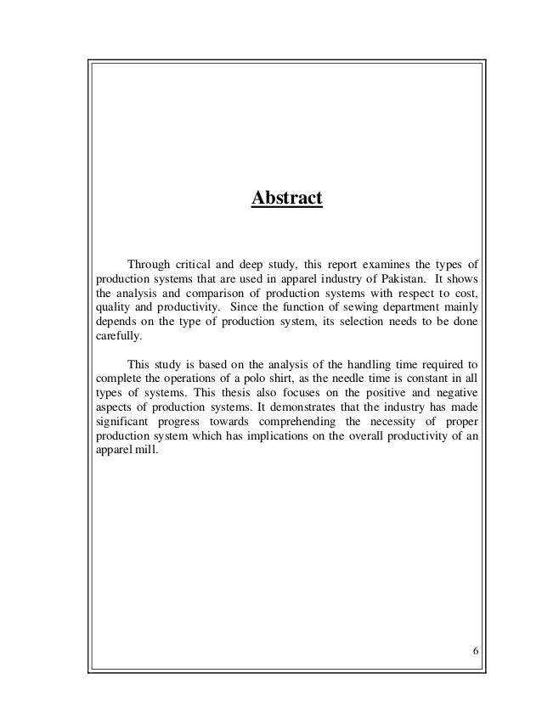
2. EXECUTIVE SUMMARY
Like an abstract in a report, this is a one- or two-paragraph summary of the product or service and how it meets the requirements and exceeds expectations.

Slide 13
3. BACKGROUND
Discuss the history of your product, service, and/or company and consider focusing on the relationship between you and the potential buyer and/or similar companies.

Slide 14

PRACTICE
Compose and design the cover page, excutive summary and background for your goup project.

Slide 15
4. PROPOSAL
who
Make it clear and concise.
Don’t waste words,
Don’t exaggerate.
Use clear, well-supported reasoning to demonstrate your product or service.
How
what
The idea
Why
Where
When

Slide 16
5. MARKET ANALYSIS
What currently exists in the marketplace, including competing products or services, and how does your solution compare?

Slide 17
6. BENEFITS
How will the potential buyer benefit from the product or service?
Clear
Concise
Specific
Short
Provide a comprehensive list of immediate
and long-term benefits

Slide 18

PRACTICE
Identifying and drafting proposals, market analysis and benefits.

Slide 19


