Slide 1

BUSINESS PROPOSAL
Session III. Business Writing in Action

Slide 2
7. Timeline
A clear presentation, often with visual aids, of the process, from start to finish, with specific, dated benchmarks noted.

Slide 3
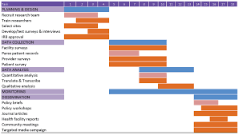
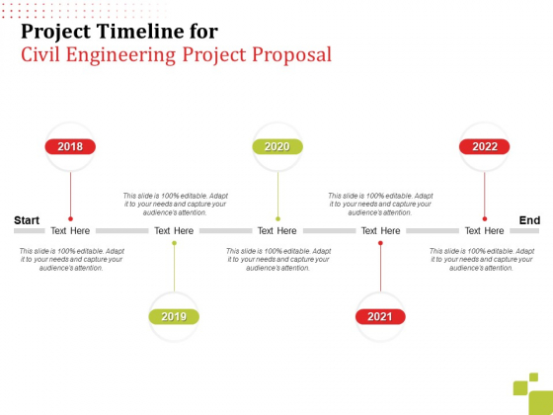
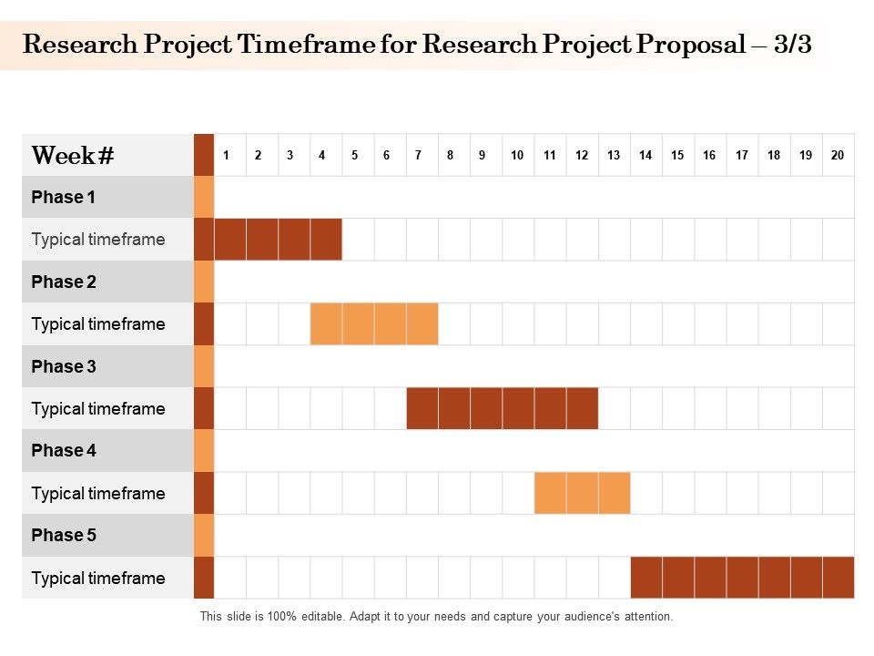
Example

Slide 4
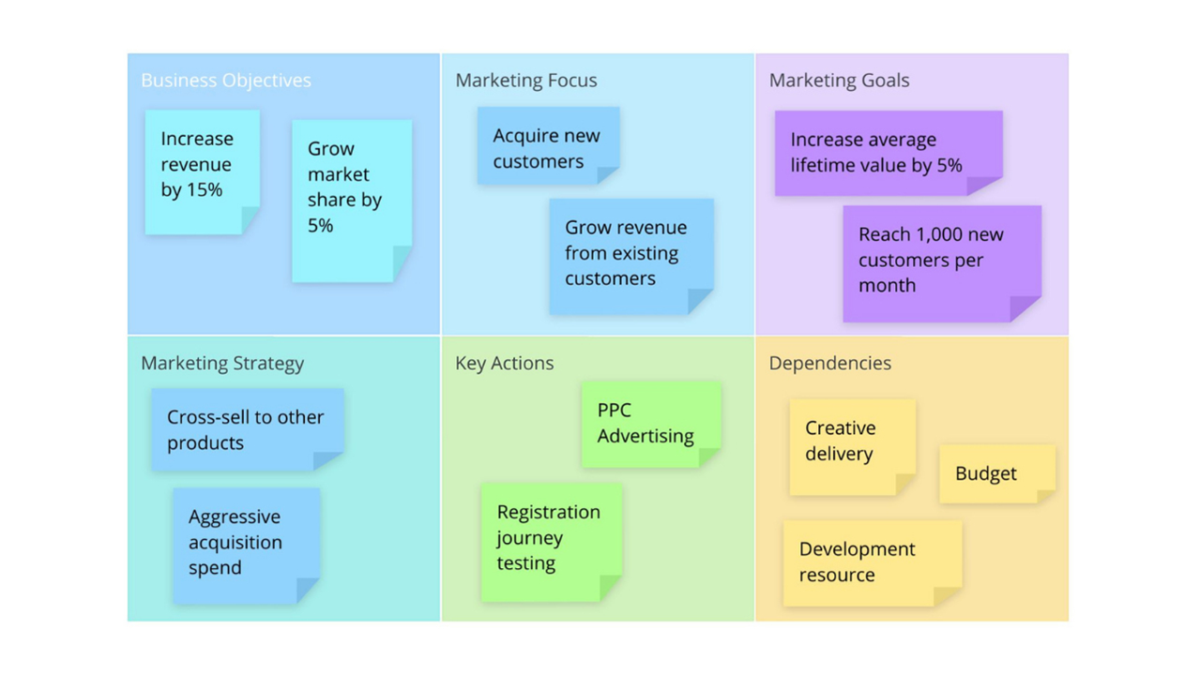
8. Marketing Plan
Delivery is often the greatest challenge for Web-based services—how will people learn about you?
If you are bidding on a gross lot of food service supplies, this may not apply to you, but if an audience is required for success, you will need a marketing plan.

Slide 5
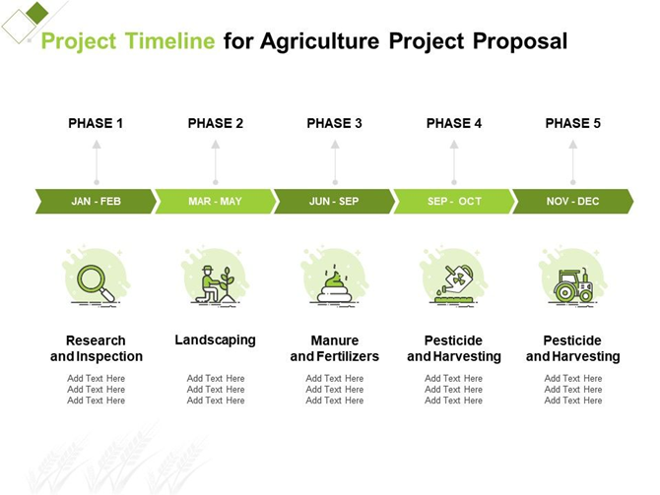
Practice
Discuss and write the timeline and market plan of the project

Slide 6
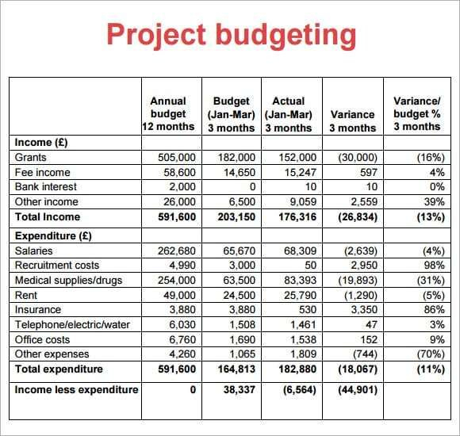
9. Finance
What are the initial costs, when can revenue be anticipated, when will there be a return on investment (if applicable)?
Again, the proposal may involve a one-time fixed cost, but if the product or service is to be delivered more than once, and extended financial plan noting costs across time is required.

Slide 7
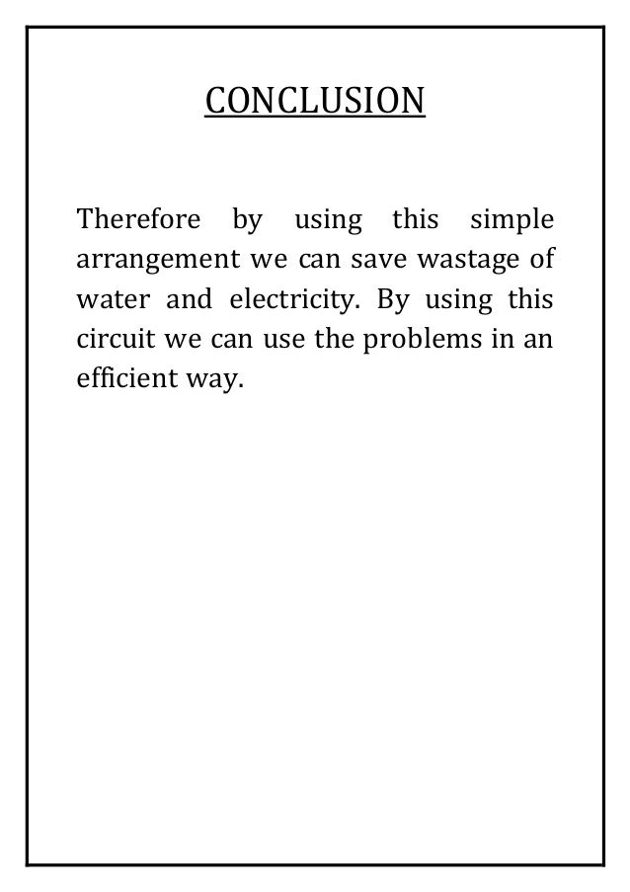
10. Conclusion
Like a speech or essay, restate your main points clearly.
Tie them together with a common them and make your proposal memorable.

Slide 8

Practice
Discuss and compose the finance and conclusion of the project

Slide 9
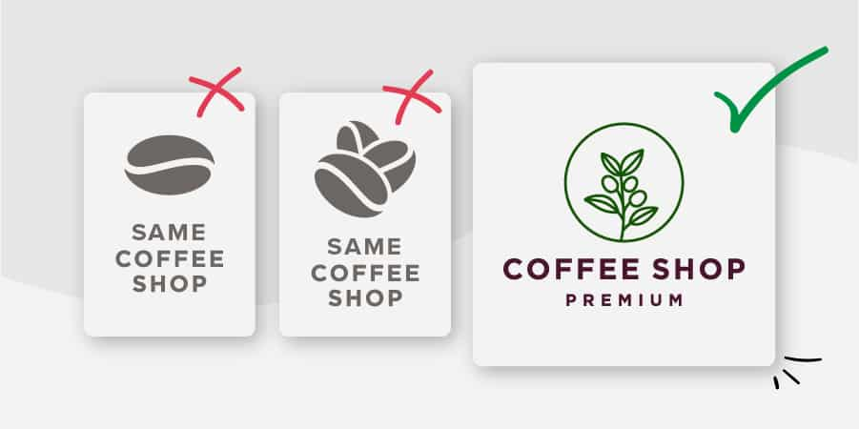
Ethos, Pathos, and Logos
Ethos refers to credibility
Pathos to passion and enthusiasm
Logos to logic or reason.
PRACTICE: Create your own business logo

Slide 10
Professional
A professional document is a base requirement:
Should be no errors in spelling or grammar
Be concise, accurate, and clearly referenced
Should be easy to find and clearly relevant, including contact information.

Slide 11
Persuasive proposals
Are often brief, even limited to one page:
“The one-page proposal has been one of the keys to my business success, and it can be invaluable to you too. Few decision-makers can ever afford to read more than one page when deciding if they are interested in a deal or not. This is even more true for people of a different culture or language,”
Adnan Khashoggi, a successful multibillionaire (Riley, 2002)

Slide 12
Two Types of Business Proposals
Solicited
Unsolicited
If you have been asked to submit a proposal it is considered solicited.
May come in the form of a direct verbal or written request
Unsolicited proposals are the “cold calls” of business writing.
Required a thorough understanding of the market, product and/or service, and their presentation is typically general rather than customer-specific

Slide 13
Sample Business Proposal
The Writing Help Tools Center is a commercial enterprise, and offers a clear (and free) example of a business proposal here:
http://www.writinghelp-central.com/sample-business-proposal.html

Slide 14
Finalize your project proposal
Prepare a business proposal in no more than two pages. Do not include actual contact information. Just as the example has employees named after colors, your (imaginary) company should have contact information that does not directly link to real businesses or you as an individual.

Slide 15


