Slide 1
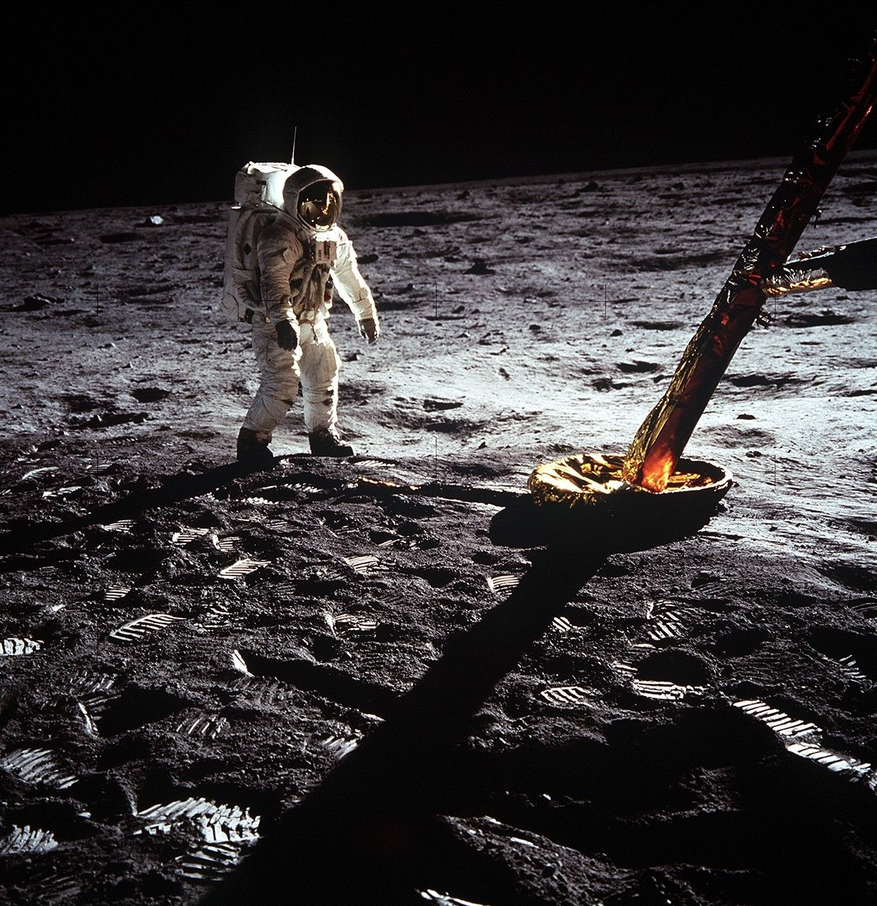
APOLLO 11
The Guidance
Experience
Original flight software.
Hands-on engineering.
JUDGES’ DEMONSTRATION
Notes:
VOICEOVER
We’re building an Apollo learning experience where students operate original flight software and understand the engineering behind each task. I’ll demonstrate a complete alignment task, then show separate guidance and control experiments.
SCREEN ACTIONS
Open the deck, then switch to the local application. Keep the introduction to about 20 seconds. The cover photograph is historical context, not an image of a simulated landing.
SOURCES AND SCOPE
https://science.nasa.gov/resource/apollo-11-buzz-aldrin/
Cover image: NASA, AS11-40-5902. Photographer Neil Armstrong. Historical lunar-surface photograph.
Project scope: docs/SUBMISSION_GUIDE.md and docs/P52_PLAYER_GUIDE.md.

Slide 2
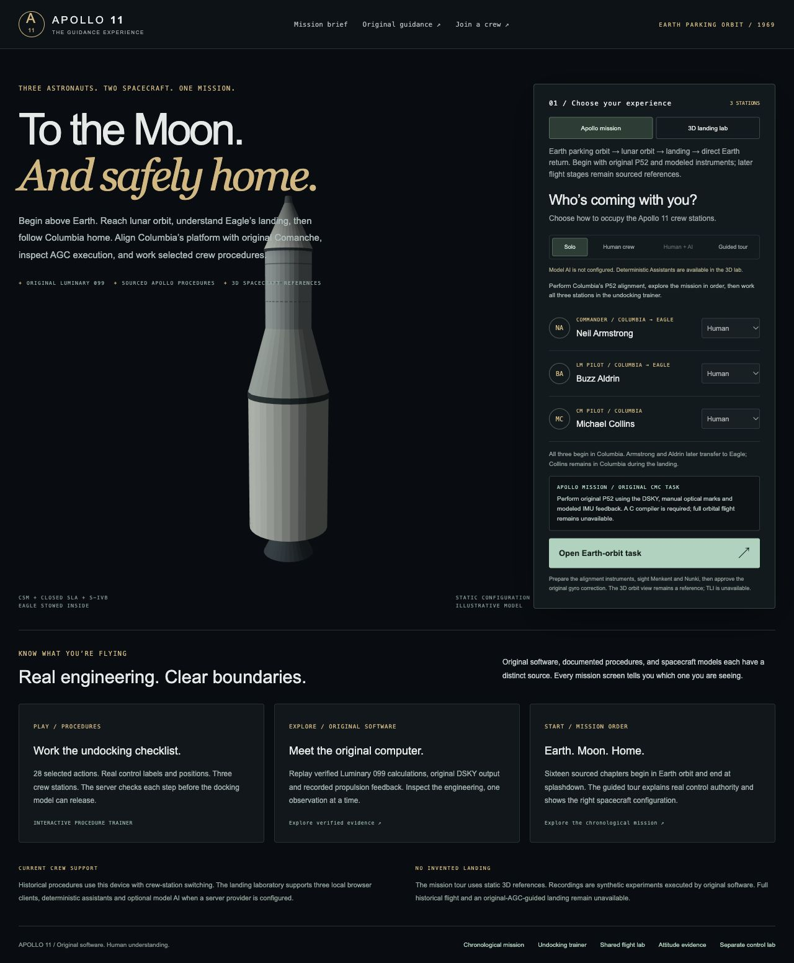
01 CREW SETUP
Three people, three responsibilities
Neil Armstrong
Commander
Buzz Aldrin
Lunar Module Pilot
Michael Collins
Command Module Pilot
INDEX.HTML / HISTORICAL ROLES
02
Notes:
VOICEOVER
There are three crew positions. Armstrong commands the mission, Aldrin is the Lunar Module Pilot, and Collins is the Command Module Pilot. Armstrong and Aldrin later move into Eagle. Collins remains with Columbia while they land. For this demonstration, I work the stations myself.
SCREEN ACTIONS
1. Open http://127.0.0.1:4173/.
2. Select Apollo mission.
3. Select Solo.
4. Point at the three named seats.
5. Click Open Earth-orbit task.
Use the actual server port if it differs. Historical procedures use station switching on one device. Local multi-client and assistant options belong to the separate lab. Model AI requires an explicitly configured provider.
SOURCES AND SCOPE
https://www.nasa.gov/missions/apollo/apollo-11-mission-overview/
frontend/dist/index.html
docs/SUBMISSION_GUIDE.md
Screenshot: .build/apollo-presentation/assets/home-current.png, captured from the current application.

Slide 3
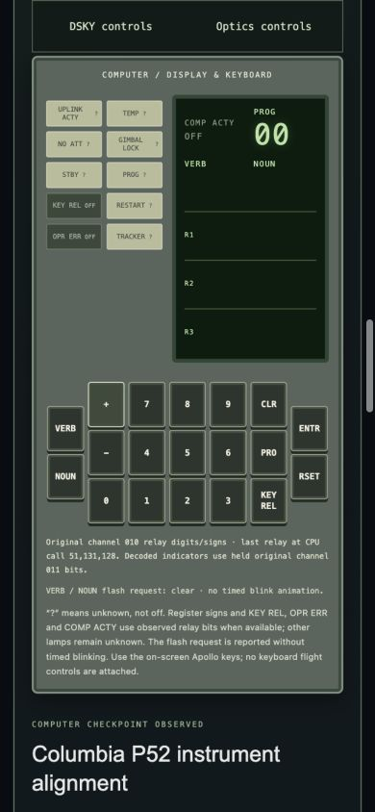
02 ORIGINAL COMPUTER
Meet the Apollo computer
PROG
Which program is running
VERB and NOUN
Action and information
R1, R2 and R3
Numerical inputs and results
CAMPAIGN.HTML / COMANCHE 055 WITH MODELED INSTRUMENTS
03
Notes:
VOICEOVER
An emulator reproduces the computer’s operation so original Apollo software can run. This panel is the DSKY, its display and keyboard. PROG shows the program. VERB describes an action. NOUN identifies information. The registers show inputs and results. Columbia and Eagle had separate computers. Saturn’s launch-vehicle computer handled normal departure guidance.
SCREEN ACTIONS
1. Keep the automatic tour paused.
2. Click Play P52 alignment.
3. Point at the LIVE ORIGINAL CMC / MODELED INSTRUMENTS label.
4. Explain the DSKY labels.
5. Click Prepare alignment instruments or Restart alignment setup, then wait for enabled keys.
The setup runs original P51 through modeled optical inputs to establish a stationary training reference. No historical flight checkpoint is claimed.
SOURCES AND SCOPE
https://www.ibiblio.org/apollo/listings/Comanche055/MAIN.agc.html
https://apollojournals.org/afj/ap11fj/02earth-orbit-tli.html
docs/EARTH_ALIGNMENT_INTEGRATION.md
Screenshot: docs/frontend-p52-evidence/mobile-dsky.png, retained P52 evidence.

Slide 4
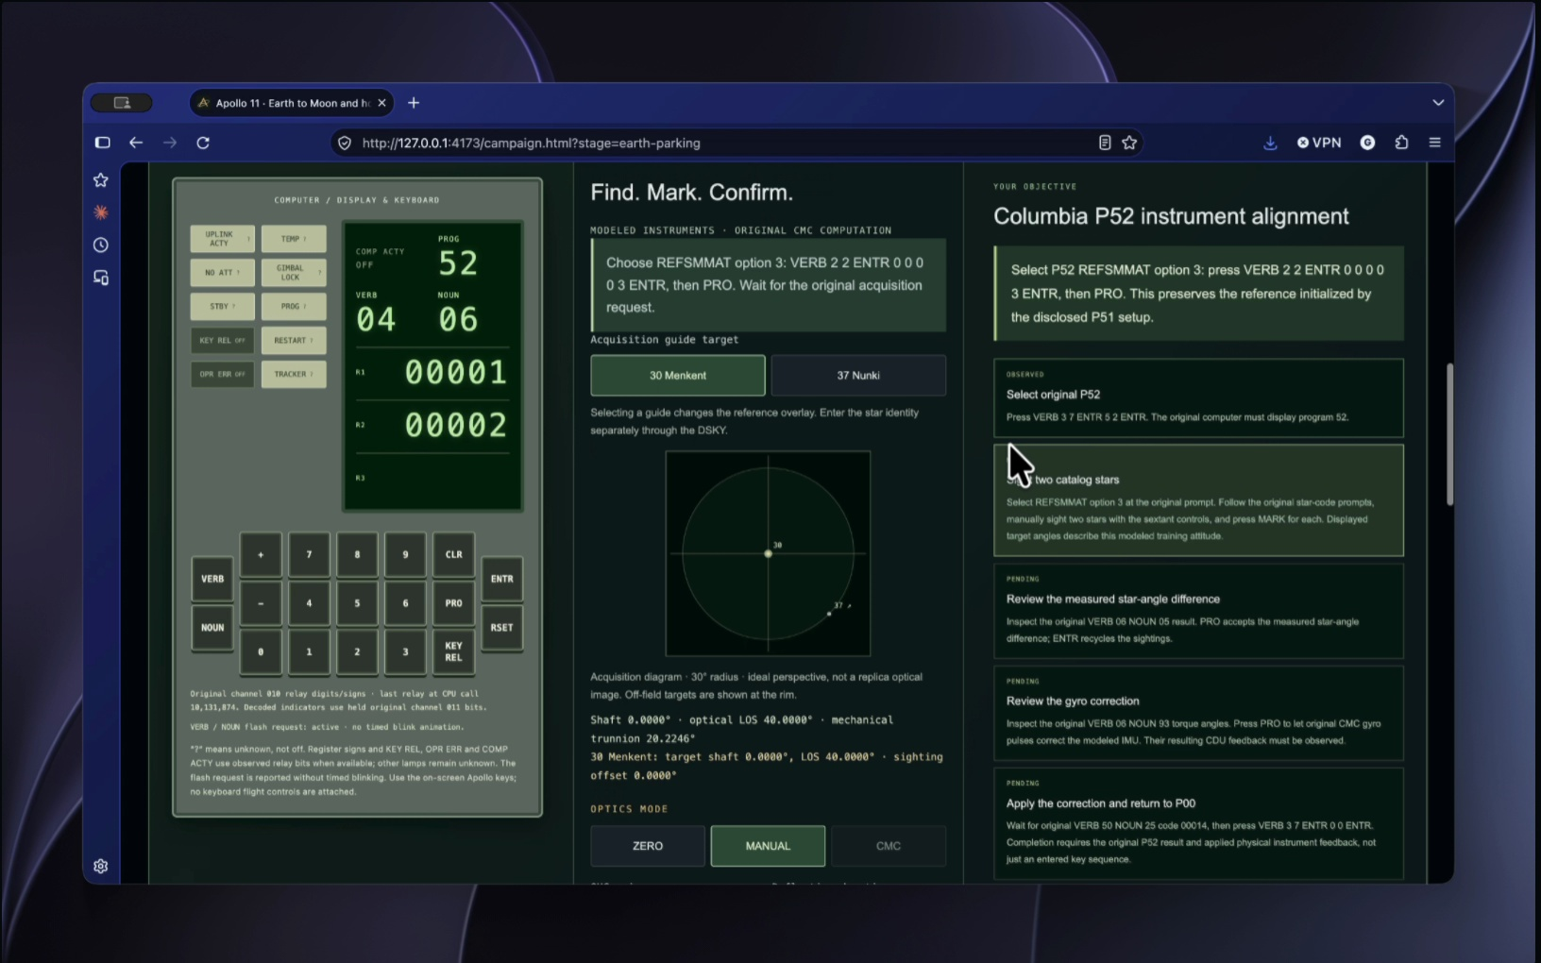
03 P52 ALIGNMENT
Alignment with two stars
Select P52
Use the original DSKY keys
Sight Menkent and Nunki
Center each star, then press MARK
Confirm each identity
The computer receives both sightings
LIVE ORIGINAL CMC / MODELED STAR FIELD AND OPTICS
04
Notes:
VOICEOVER
Before navigating, the computer needs a reliable reference for direction. We select program 52, identify Menkent and Nunki, and capture a sighting of each. The hand controller moves the optics. It does not steer the spacecraft.
SCREEN ACTIONS
Perform these original DSKY transactions one key at a time and wait for stable prompts.
1. VERB 3 7 ENTR 5 2 ENTR. Observe PROG 52 and NOUN 06.
2. VERB 2 2 ENTR 0 0 0 0 3 ENTR, then PRO. Wait for V50N25 / 00015.
3. ENTR. Wait for NOUN 70.
4. Select 30 Menkent guide. VERB 2 1 ENTR 0 0 0 3 0 ENTR, then PRO. Wait for VERB 51.
5. Keep OPTICS MODE MANUAL. Menkent starts centered in this fixture. Press Optics MARK.
6. At V50N25 / 00016, PRO. Verify 00030 at NOUN 71, then PRO. Wait for NOUN 70.
7. Select 37 Nunki guide. VERB 2 1 ENTR 0 0 0 3 7 ENTR, then PRO. Wait for VERB 51.
8. HIGH gain, duration 1: SHAFT + five times, reaching 100 degrees.
9. HIGH gain, duration 0.1: SHAFT + twice, reaching 104 degrees.
10. LOW gain, duration 1: SHAFT + twice, reaching 104.4 degrees. Keep optical LOS 40 degrees. Check sighting offset around 0.0013 degrees.
11. Press MARK, then PRO at 00016. Verify 00037 at NOUN 71, then PRO.
Selecting a star guide changes only the overlay. The CMC identity must be entered separately. The target angles belong to constructed training geometry. Read the current display, not the static slide screenshot.
SOURCES AND SCOPE
https://www.ibiblio.org/apollo/listings/Comanche055/P51-P53.agc.html
docs/P52_PLAYER_GUIDE.md
Screenshot: .build/demo-pitch-review/frame-180.jpg, supplied demo recording showing P52 selection and modeled optics.

Slide 5
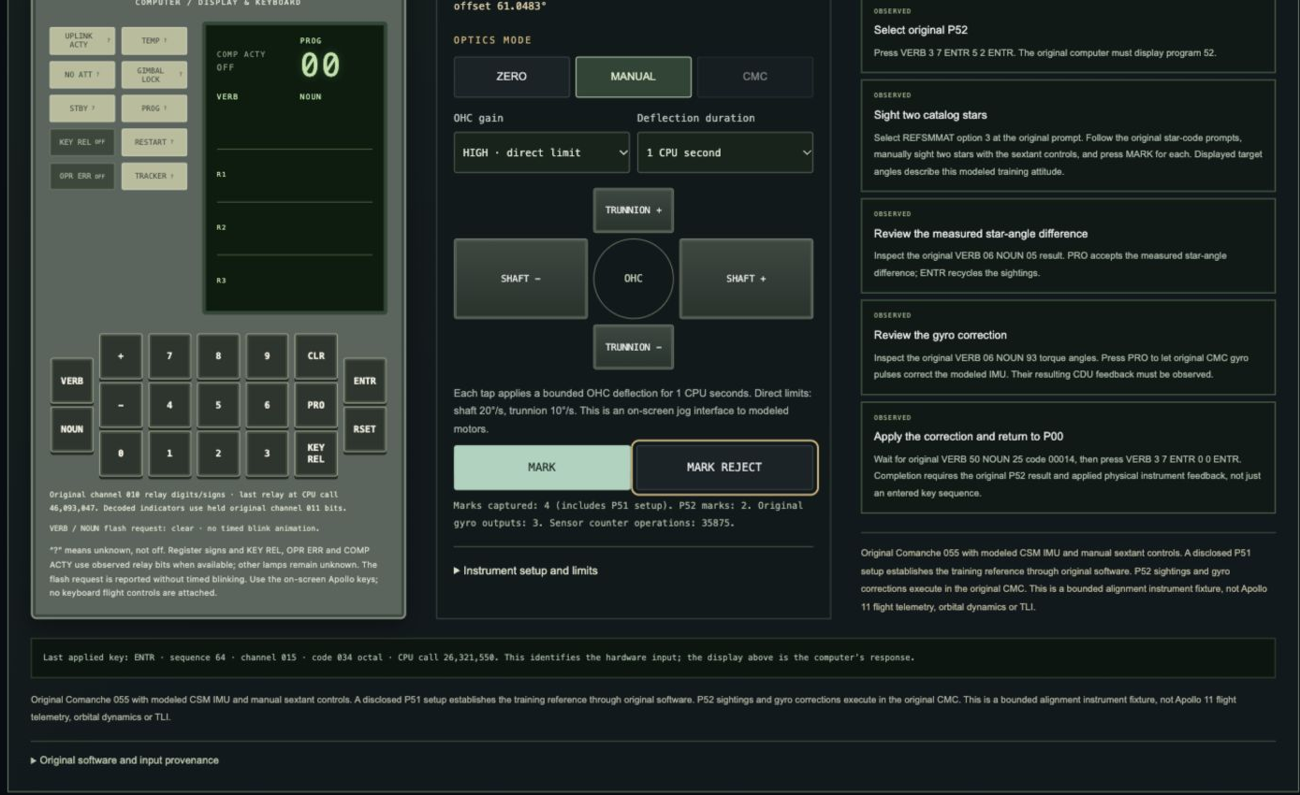
04 P52 RESULT
The computer calculates the correction
Review
Star fit and correction angles
Approve
Original gyro commands and feedback
Complete
Five observed checkpoints, then P00
LIVE TASK COMPLETION / STATIONARY INSTRUMENT FIXTURE
05
Notes:
VOICEOVER
The original computer compares our two star sightings and calculates the platform correction. We review the result and approve it. The computer sends gyro commands, and our instrument model returns measurements. When all five checkpoints show OBSERVED and we return to program zero, the alignment task is complete.
SCREEN ACTIONS
1. Wait for V06N05. R1 is in hundredths of a degree. Read the current result.
2. The exercise requires agreement within 0.05 degrees. PRO accepts. ENTR recycles the sightings.
3. Wait for stable V06N93. The three signed registers use 0.001-degree units.
4. Press PRO to authorize correction. Observe actual original gyro-output and sensor-operation counts.
5. Wait for V50N25 / 00014.
6. VERB 3 7 ENTR 0 0 ENTR.
7. Hold on all five OBSERVED checkpoints and the completion message for at least three seconds.
Do not describe selecting P52 alone as completed alignment. The screenshot is a retained completed run. Live N05 and N93 values depend on the current sightings.
SOURCES AND SCOPE
https://www.ibiblio.org/apollo/listings/Comanche055/P51-P53.agc.html
docs/P52_PLAYER_GUIDE.md
docs/frontend-p52-evidence/README.md
Screenshot: docs/frontend-p52-evidence/desktop-complete.png.

Slide 6
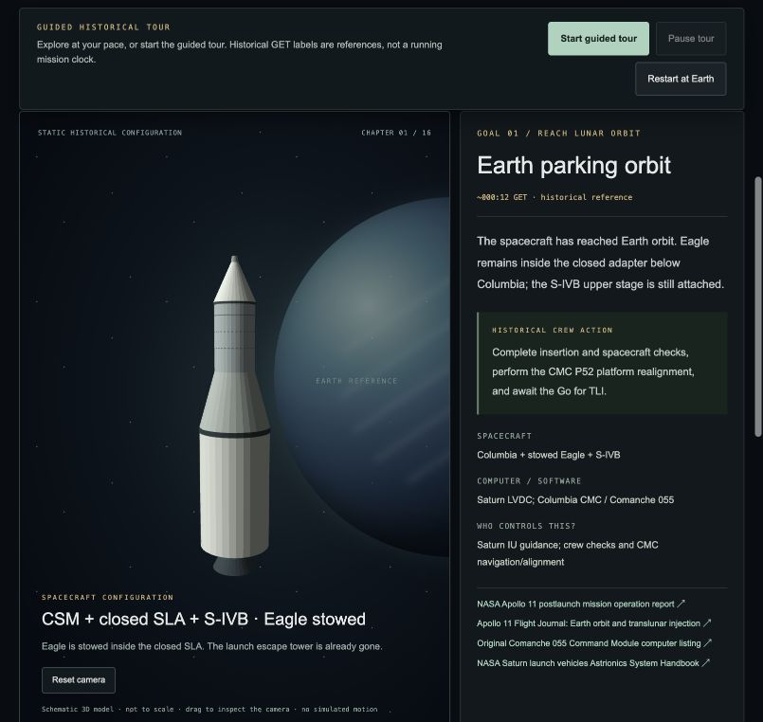
05 EARTH, MOON AND HOME
The historical mission order
Earth orbit and lunar arrival
Departure, coast and lunar capture
Eagle’s lunar mission
Undocking, descent and ascent
Reunion and Earth return
Rendezvous, entry and splashdown
CAMPAIGN CHAPTERS / HISTORICAL REFERENCE
06
Notes:
VOICEOVER
The wider experience explains the mission in its real order. After Earth orbit came departure, lunar arrival, Eagle’s landing, ascent and rendezvous, and the return home. Apollo 11 returned directly into Earth’s atmosphere and splashed down. The historical chapters explain these stages, rather than executing a continuous flight.
SCREEN ACTIONS
1. Keep the tour paused and use Next chapter at your pace.
2. Show Translunar injection: Saturn’s upper stage and its separate launch-vehicle computer.
3. Show Retrieve Eagle, navigation to the Moon and lunar arrival.
4. Show Eagle’s descent and ascent configurations.
5. End at Earth entry and splashdown.
Full original-computer flight remains unavailable. The normal TLI provider and S-IVB flight integration are missing. Collins remains in Columbia during the landing.
SOURCES AND SCOPE
https://www.nasa.gov/missions/apollo/apollo-11-mission-overview/
https://apollojournals.org/afj/ap11fj/02earth-orbit-tli.html
https://apollojournals.org/afj/ap11fj/27day9-entry.html
frontend/dist/data/apollo-campaign.json
Screenshot: docs/frontend-campaign-evidence/earth-orbit.png.

Slide 7
06 GUIDANCE COMPARISON
Three inputs, three recorded outcomes
Original Luminary 099 calculations
Synthetic starting case | Calculated ignition time | Recorded outcome
15 km orbit | 360.29 s GET | Crew review
16 km orbit | 360.44 s GET | Crew review
Missing landing site | No completed solution | Alarm 01406
Each row comes from its own retained execution.
GUIDANCE.HTML / VERIFIED RECORDED EXECUTION
07
Notes:
VOICEOVER
These are separate retained runs of original Luminary guidance with synthetic mission inputs. The 15-kilometer and 16-kilometer cases reach crew review with different calculated ignition times. Omitting the landing site leads to an original alarm and no completed ignition-time solution. The browser displays the original recorded answers.
SCREEN ACTIONS
1. Open guidance.html.
2. Select 15 km orbit, Start replay, Go to P63, View recorded result.
3. Select 16 km orbit, View recorded result.
4. Select Missing landing site, View recorded result.
5. Show Compare results and Evidence.
TIG means calculated time of ignition, an absolute time on the synthetic mission clock. These Phase 10 runs stop before ignition. The times do not describe historical Apollo 11 flight. No general altitude-to-ignition formula is inferred from two cases.
SOURCES AND SCOPE
docs/frontend-phase10-evidence/README.md
frontend/dist/data/guidance.json
https://www.ibiblio.org/apollo/Luminary.html

Slide 8
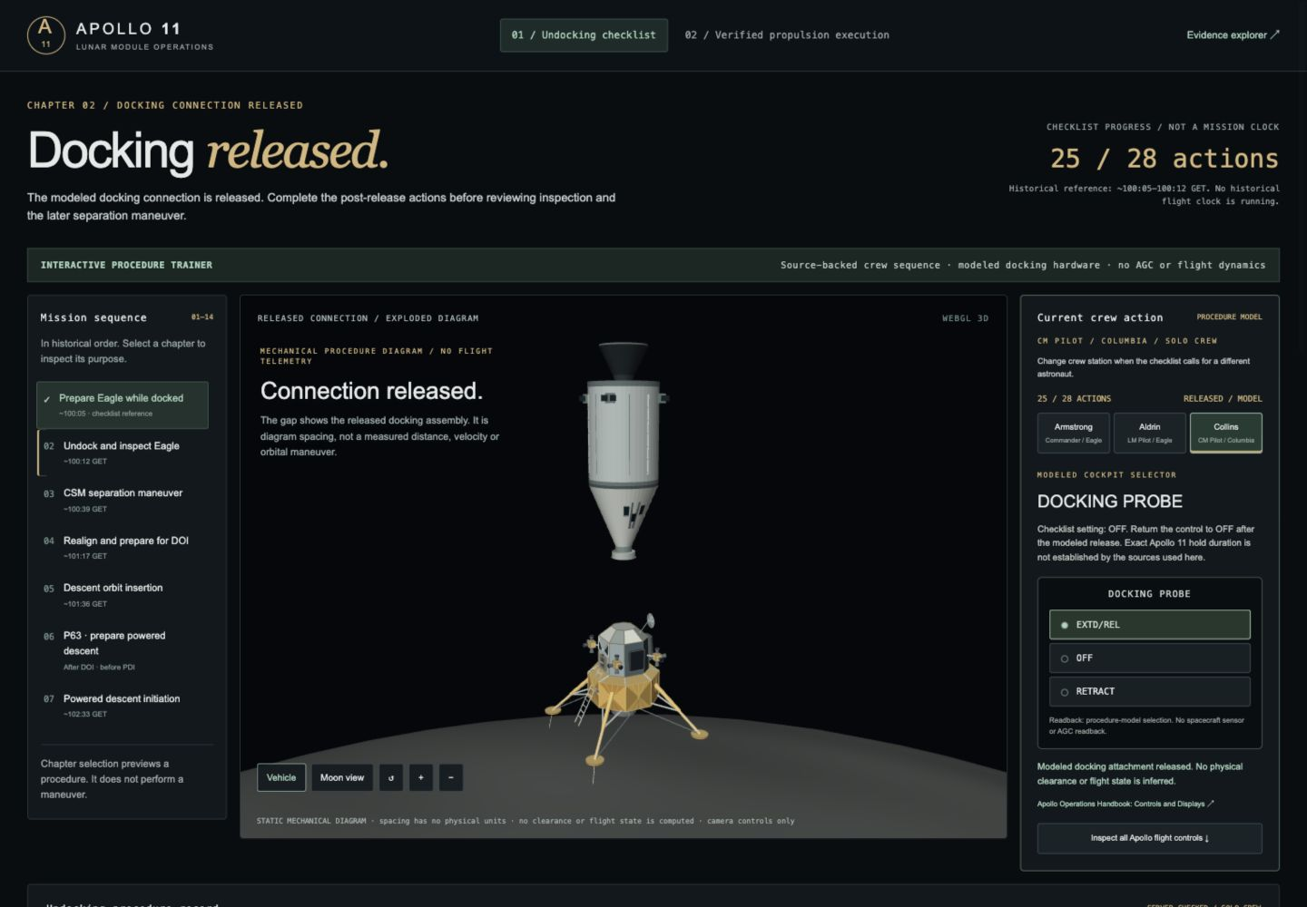
07 EAGLE RELEASE
Undocking is a crew procedure
28 selected actions
Correct crew station
Server checks who acts
Correct order and setting
Collins commands EXTD/REL, then OFF
PLAY.HTML / INTERACTIVE PROCEDURE TRAINER
08
Notes:
VOICEOVER
This trainer checks 28 selected crew actions in order. Armstrong and Aldrin prepare Eagle, then Collins operates Columbia’s docking-probe release. We return the control to Off, confirm release and hand off to inspection. The server checks station, order and switch setting. The expanded model illustrates the released connection.
SCREEN ACTIONS
Open play.html and select Begin undocking checklist. Perform the selected actions below, switching astronaut before each one.
1. CMP: Verify completed tunnel closeout — confirmed. Acknowledge the entry setup below. These earlier mechanical and pressure checks are assumed completed; this trainer does not simulate them.
2. LMP: Report LM helmets, gloves and communications ready — confirmed. Both LM crew have helmets and gloves on. Verify basic voice communication and the VHF B backup. This is a crew report.
3. CDR: Verify overhead hatch and cabin configuration — confirmed. Report hatch LOCKED, overhead relief/dump valve AUTO and regulators A/B CABIN. Mission/event timer setup is a reference, not a running historical clock.
4. CDR: GUID CONT — AGS. Select the abort guidance system for this pre-undocking configuration. This does not run an AGS emulator.
5. LMP: Verify the pre-undocking display selections — confirmed. Report the ACT-62 display configuration. These monitor selections do not establish a spacecraft attitude or navigation solution.
6. CDR: ATT/TRANSL — 2 JET.
7. CDR: BAL CPL — ON.
8. CDR: DEADBAND — MAX.
9. LMP: ATTITUDE CONTROL ROLL — PULSE. All three independent axis switches must be checked.
10. LMP: ATTITUDE CONTROL PITCH — PULSE. All three independent axis switches must be checked.
11. LMP: ATTITUDE CONTROL YAW — PULSE. All three independent axis switches must be checked.
12. LMP: MODE CONT PGNS — ATT HOLD. The checklist calls for BOTH guidance-mode switches at ATT HOLD.
13. LMP: MODE CONT AGS — ATT HOLD. The checklist calls for BOTH guidance-mode switches at ATT HOLD.
14. CDR: TTCA CDR — JETS. The checklist abbreviates this setting JET; the controller selector is JETS/THROTTLE.
15. LMP: TTCA LMP — JETS. The checklist abbreviates this setting JET; the controller selector is JETS/THROTTLE.
16. CDR: ACA/4 JET CDR — DISABLE. This is the separate 4-jet enable path; do not interpret DISABLE as all attitude control disabled.
17. LMP: ACA/4 JET LMP — DISABLE. This is the separate 4-jet enable path; do not interpret DISABLE as all attitude control disabled.
18. CDR: TTCA/TRANSL CDR — ENABLE.
19. LMP: TTCA/TRANSL LMP — DISABLE.
20. LMP: Report the remaining preparation items checked — confirmed. Report rendezvous radar SLEW, AOT heater breaker closed, camera mounted, COAS installed, and circuit breakers verified against the original charts. These are crew reports.
21. CMP: Report Columbia configured for undocking — confirmed. Report hand controllers adjusted/armed, THC power ON, GDC aligned and SCS/DAP/BMAG configuration checked using the flown Solo Book. CMC operations are not executed here.
22. CMP: DOCK PROBE MNA circuit breaker — IN. Both docking-probe circuit breakers are on CSM panel 8.
23. CMP: DOCK PROBE MNB circuit breaker — IN. Both docking-probe circuit breakers are on CSM panel 8.
24. CDR: Report Eagle ready to Mike — confirmed. Confirm the LM checklist is ready before Collins operates the probe control. This represents the crew readiness exchange, not an AI-generated radio response.
25. CMP: DOCKING PROBE - EXTD/REL — EXTD/REL. Collins operates Columbia's probe extend/release control. In this discrete procedure model it releases the modeled connection. No probe timing, flight motion or sensor indication is simulated.
26. CMP: DOCKING PROBE — OFF. Return the control to OFF after the modeled release. Exact Apollo 11 hold duration is not established by the sources used here.
27. LMP: Report separation visually confirmed — confirmed. Record a crew observation of release. The expanded 3D diagram shows the disconnected arrangement; it does not measure separation distance or velocity.
28. CMP: Hand off to the inspection chapter — confirmed. Next came relative-motion management and LM inspection, then the separate CSM separation maneuver, LM alignment, DOI and P63 preparation. Do not skip directly to powered descent.
For a short presentation, prepare steps 1–24 beforehand and say so explicitly. Perform EXTD/REL, OFF, release confirmation and inspection handoff live. Show 28/28 completion before leaving. The screenshot captures the release at 25/28, before the three post-release actions.
Scope: selected procedure trainer, assumed earlier tunnel/pressure preparation, some instructional LM hand assignments. No AGC/AGS execution, physical flyaway, pressure model or historical state vector.
SOURCES AND SCOPE
https://apollojournals.org/afj/ap11fj/pdf/a11_lm_systems_activation_checklist-19690708.pdf
https://apollojournals.org/afj/ap11fj/17day5-undock-doi.html
docs/FRONTEND_UNDOCKING.md
frontend/dist/data/undocking-procedure.json
Screenshot: docs/frontend-undocking-evidence/released.png.

Slide 9
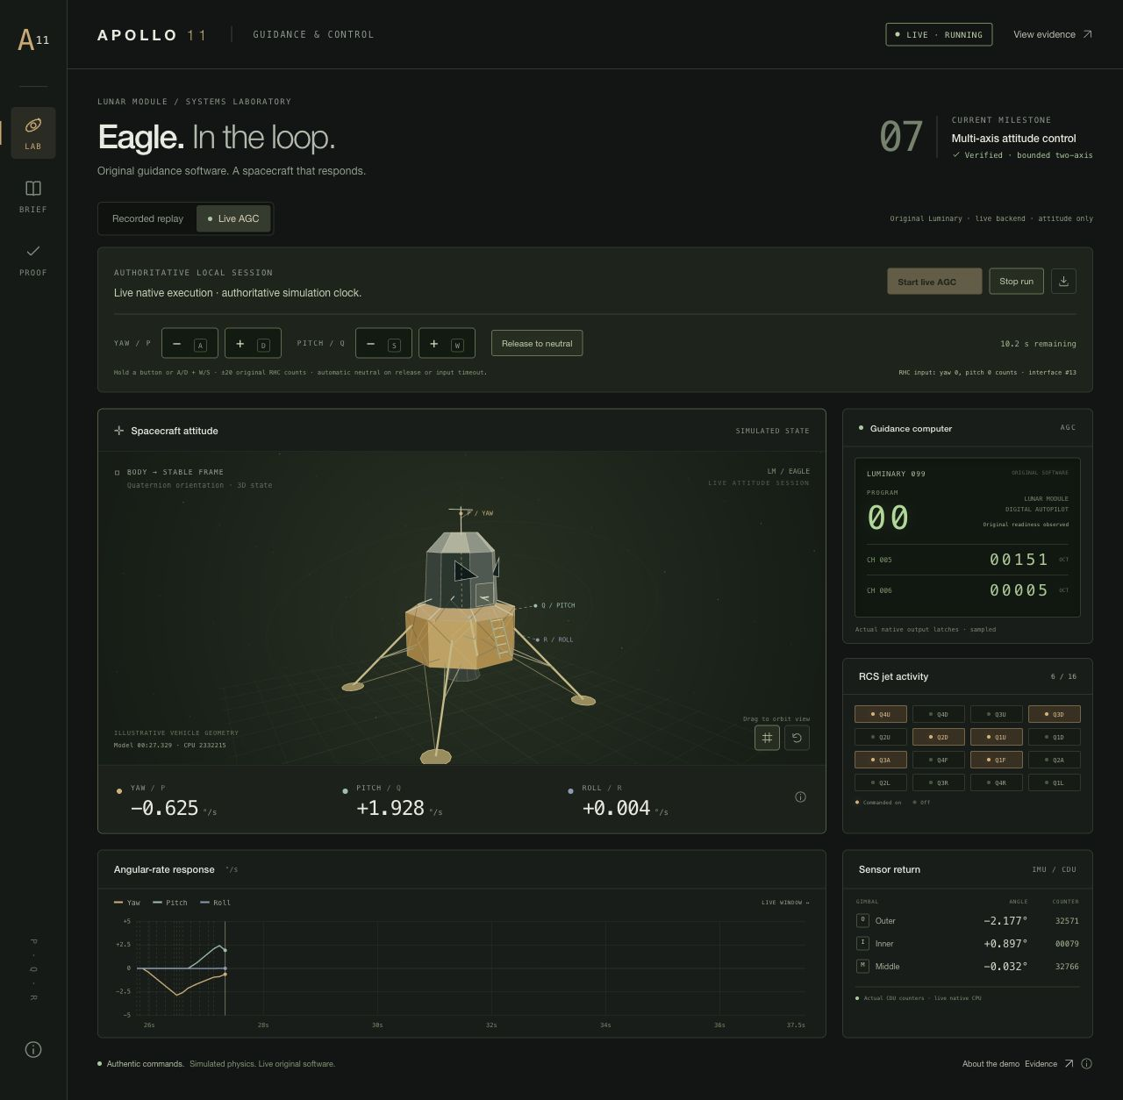
08 ATTITUDE EXPERIMENT
Original control outputs and feedback
Original output
Control-jet command bits
Modeled response
Rotation around supported axes
Sensor return
Measurements reach the computer
ATTITUDE-REPLAY.HTML / BOUNDED YAW AND PITCH
09
Notes:
VOICEOVER
This experiment connects original computer output to a modeled rotational response. The computer commands control jets. The model rotates, and instrument measurements return to the computer. The graph and jet indicators let us inspect that feedback loop. The verified control scope is bounded yaw and pitch.
SCREEN ACTIONS
1. Open attitude-replay.html.
2. Select Recorded replay, Yaw + pitch, Play replay.
3. Point to RCS jet activity, angular-rate response and sensor return.
4. Use Compare feedback to inspect recorded conditions.
Optional live step, only when available: Live AGC, Start live AGC, briefly hold one on-screen yaw/pitch button and release. Use Release to neutral and Stop run if still active.
On-screen inputs represent a modeled hand-controller interface. These are bounded tests, not general three-axis flight or a descent. Screenshot: retained native live-run evidence, not a current live status claim.
SOURCES AND SCOPE
docs/live-control-evidence/README.md
frontend/dist/attitude-replay.html
Screenshot: docs/live-control-evidence/release-checks/2026-10-17/browser/screenshots/desktop-buttons.jpg.

Slide 10
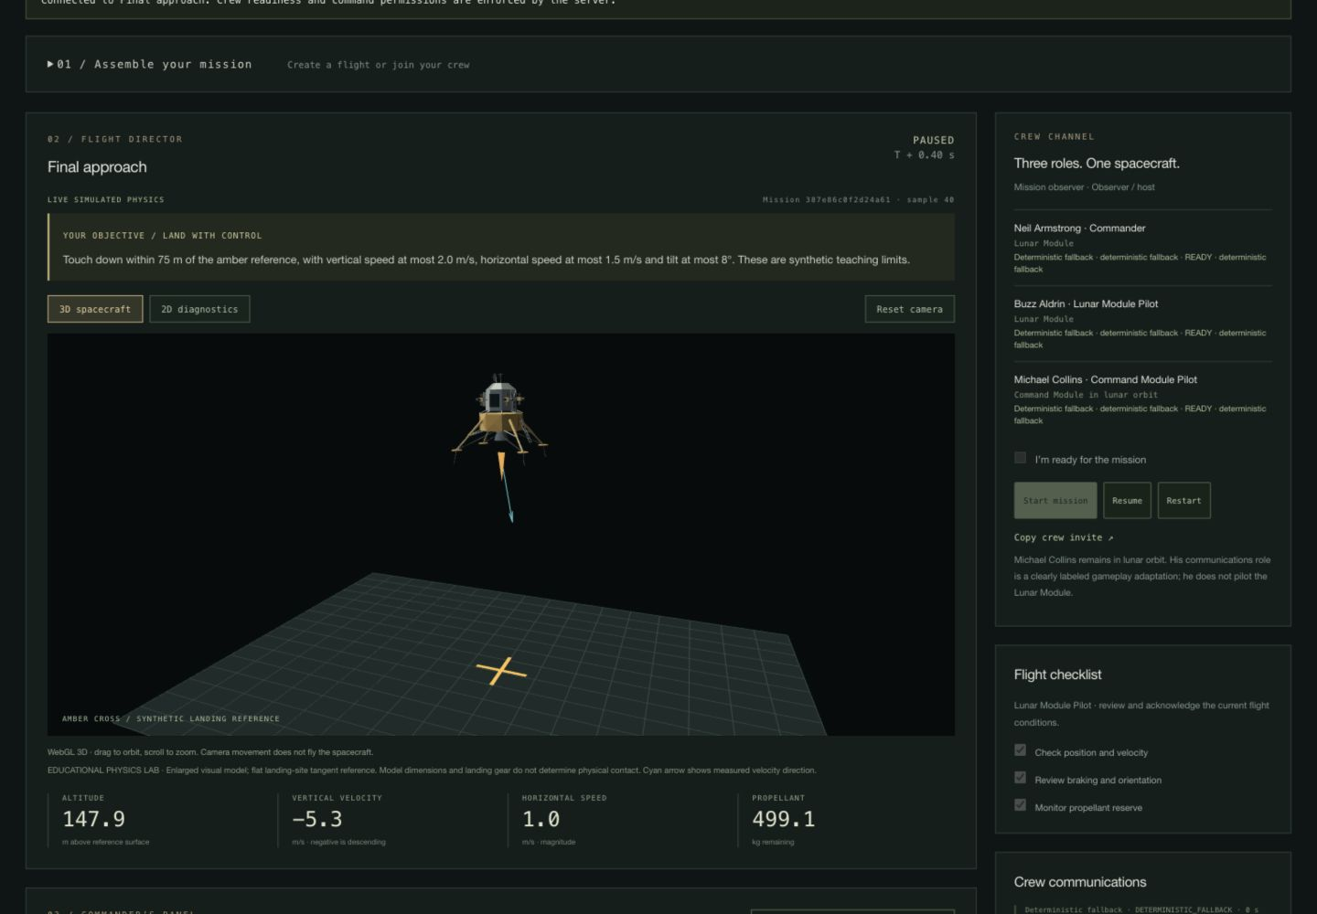
09 OPTIONAL HANDS-ON EXTENSION
A separate landing physics laboratory
Thrust and acceleration
Velocity responds over time
Fuel limits the maneuver
The server measures the outcome
MISSION.HTML / MODERN SYNTHETIC PHYSICS
10
Notes:
VOICEOVER
This optional laboratory teaches thrust, velocity and fuel management with modern controls. Increasing thrust changes acceleration. It does not instantly cancel a downward velocity. The server calculates motion, and both the 3D and 2D views display the same state. This laboratory does not use original Apollo landing guidance.
SCREEN ACTIONS
1. Open mission.html or choose 3D landing lab at the launcher.
2. Choose training and the Commander seat. Choose labeled deterministic assistants for the other two seats.
3. Create mission, mark yourself ready, then Start mission.
4. Point at altitude, vertical velocity, horizontal speed and propellant.
5. Adjust throttle briefly, then Pause before explaining.
6. Show pitch controls and the cyan velocity arrow.
7. Switch between 3D spacecraft and 2D diagnostics.
8. If Training assist is enabled, call it a modern teaching controller.
9. If continuing to contact, show the actual server debrief, including unsuccessful outcomes.
Programmed assistants are not model AI. Real model operation requires a configured provider and was not run in the documented delivery. Collins’s lab communications role is a teaching adaptation; he does not pilot Eagle.
SOURCES AND SCOPE
backend/physics_lab.py
docs/SUBMISSION_GUIDE.md
Screenshot: docs/frontend-submission-evidence/flight-3d.png.

Slide 11
10 EVIDENCE AND SCOPE
What each demonstration proves
Experience | Working demonstration | Source
P52 alignment | Sights, correction and feedback | Live original CMC
Guidance explorer | Calculated ignition-time outcomes | Recorded original LGC
Undocking trainer | Crew order and probe release | Procedure model
Attitude experiment | Yaw / pitch feedback loop | Original code + model
Landing laboratory | Thrust and touchdown exercise | Modern physics
Mission chapters | Sixteen chronological references | Historical illustration
FULL HISTORICAL FLIGHT REMAINS UNAVAILABLE
11
Notes:
VOICEOVER
We identify the source of every demonstration. P52 performs live original computer calculations with modeled instruments. Guidance recordings preserve actual original execution. Undocking checks a selected crew procedure. The optional landing lab teaches modern flight physics. The historical chapters explain the route between these separate demonstrations.
SCREEN ACTIONS
Use this slide if a judge asks what is authentic or what currently works. State the scope directly. Do not describe all six pages as a single continuous AGC-controlled flight. Original-code landing, original Saturn departure and full historical vehicle integration remain unavailable.
SOURCES AND SCOPE
docs/P52_PLAYER_GUIDE.md
docs/SUBMISSION_GUIDE.md
docs/frontend-phase10-evidence/README.md
docs/frontend-undocking-evidence/README.md

Slide 12
11 RESULT AND NEXT STEPS
Learning through original flight software
A complete alignment task
A visible calculation and feedback loop
Next integration
Validated instruments and vehicle dynamics
Additional mission stages with verified control authority
STUDENTS CONNECT THEIR ACTIONS TO COMPUTER RESULTS
12
Notes:
VOICEOVER
Our strongest live result is a complete original-computer alignment task connected to modeled instruments. Students can see their input, inspect the calculation and observe the feedback. Next, we need to validate more instruments and vehicle dynamics so additional mission stages become playable while preserving the original flight computations.
SCREEN ACTIONS
Close on the completed P52 result if switching back to the browser. Keep all five OBSERVED checkpoints visible. Do not finish on a setup form or an unfinished flight attempt. Invite questions about original code, procedure research or the separation between simulation and rendering. Full detailed click scripts remain in the notes of the relevant slides and docs/JUDGES_FULL_SCRIPT.md.
SOURCES AND SCOPE
docs/EARTH_ALIGNMENT_INTEGRATION.md
docs/FRONTEND_INTEGRATION_CONTRACT.md
docs/JUDGES_FULL_SCRIPT.md

Slide 13
APPENDIX A OPERATOR REFERENCE
Presenter’s demo order
Page | Action | Result to hold on screen
index.html | Apollo mission, Solo | Three crew positions
campaign.html | Complete P52 alignment | Five OBSERVED checkpoints
guidance.html | Compare the three runs | Original result and alarm
play.html | Complete selected checklist | 28 / 28 and inspection handoff
attitude-replay.html | Replay supported axes | Jet outputs and sensor return
mission.html | Optional modern lab | Actual measurements or debrief
SPEAKER NOTES CONTAIN THE CLICK-BY-CLICK SCRIPT
13
Notes:
VOICEOVER
This is a presenter reference slide. It is hidden from the normal slide show.
SCREEN ACTIONS
Start the server with make play. For another port: make play PORT=4180. Open the six pages in separate tabs before recording. Keep the tour paused during explanation. Complete a full rehearsal of P52 first. Read current numerical results from the screen. If shortening waits, label the edit. Use PowerPoint Notes or Presenter View for the narration and exact inputs. The appendix is hidden in the normal slide show; unhide it if desired.
SOURCES AND SCOPE
docs/JUDGES_FULL_SCRIPT.md
docs/P52_PLAYER_GUIDE.md
docs/SUBMISSION_GUIDE.md

Slide 14
APPENDIX B REFERENCES
Source material and demonstration boundaries
Original Command Module software
Comanche 055 listing and P51–P53 program
Original Lunar Module software
Luminary archive and retained experiment records
Mission chronology
NASA overview and Apollo Flight Journal
Undocking procedure
Apollo 11 activation checklist and crew records
Application evidence
P52, guidance, undocking and attitude reports
Historical photograph
NASA AS11-40-5902, photographed by Armstrong
DETAILED SOURCE LINKS APPEAR IN EACH SLIDE’S NOTES
14
Notes:
VOICEOVER
Source references for questions and independent inspection. This slide is hidden in the normal slide show.
SCREEN ACTIONS
Original computer source and historical accounts support the procedure descriptions. Repository evidence supports the application’s actual capabilities. All application images are retained screenshots or captures of the current app. The NASA cover photograph depicts the historical mission, not the simulator. This deck does not claim to reproduce every original flight instrument, every crew action or a complete lunar flight.
SOURCES AND SCOPE
https://www.ibiblio.org/apollo/listings/Comanche055/MAIN.agc.html
https://www.ibiblio.org/apollo/listings/Comanche055/P51-P53.agc.html
https://www.nasa.gov/missions/apollo/apollo-11-mission-overview/
https://apollojournals.org/afj/ap11fj/02earth-orbit-tli.html
https://apollojournals.org/afj/ap11fj/17day5-undock-doi.html
https://apollojournals.org/afj/ap11fj/pdf/a11_lm_systems_activation_checklist-19690708.pdf
https://www.ibiblio.org/apollo/Luminary.html
https://science.nasa.gov/resource/apollo-11-buzz-aldrin/

