Slide 1
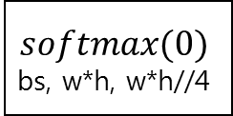
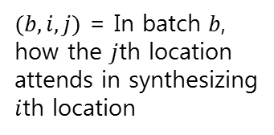
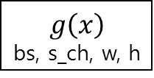
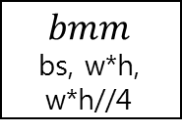
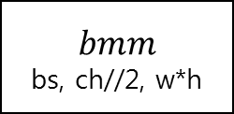
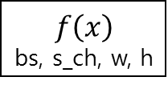
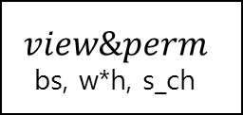
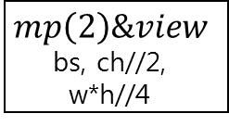
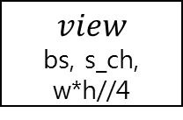
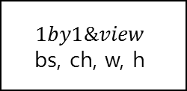
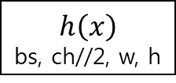
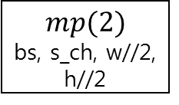
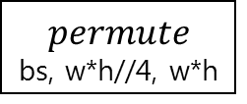

Self-attention
ch, s_ch = ch//8
X
bs, ch, w, h
$f, g, h$ are all 1by1 conv (channel compression)
Averaged over for each batch
$$f\left(x\right)$$ bs, s_ch, w, h
$$view\&perm$$
bs, w*h, s_ch
$$bmm$$
bs, w*h,
w*h//4
$$softmax(0)$$
bs, w*h, w*h//4
$(b, i, j)$ = In batch $b$, how the $j$th location attends in synthesizing $i$th location
$$mp(2)$$
bs, s_ch, w//2, h//2
$$view$$
bs, s_ch, w*h//4
$$g\left(x\right)$$ bs, s_ch, w, h
$$permute$$
bs, w*h//4, w*h
$$h\left(x\right)$$
bs, ch//2, w, h
$$mp\left(2\right)\&view$$
bs, ch//2, w*h//4
$$bmm$$
bs, ch//2, w*h
$$1by1\&view$$
bs, ch, w, h

