Slide 1
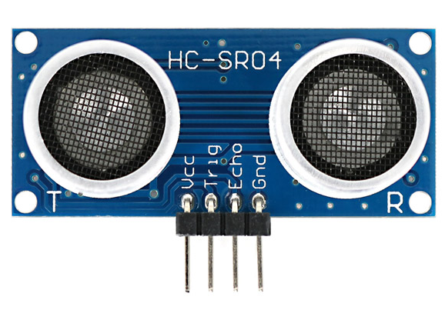

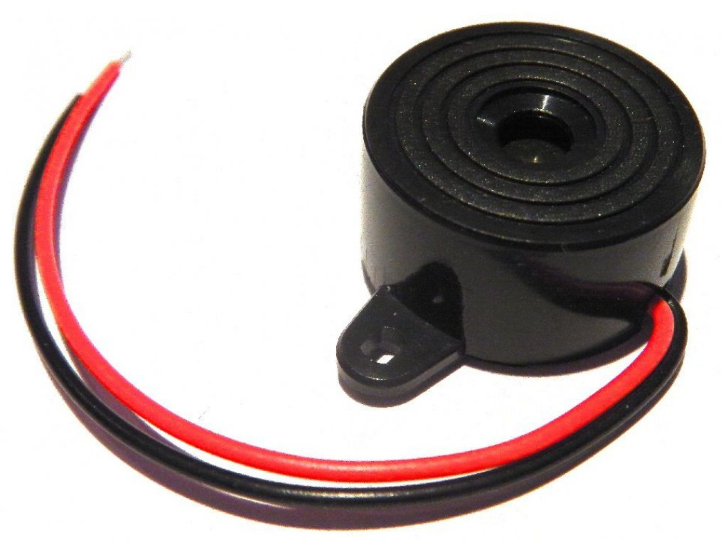



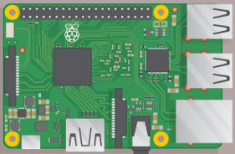





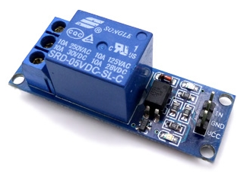
Ultrasonic Sensor
Time In and Out
Time In and Out
Buzzer
Remarks
Faculty
Responsive GUI
Announcements
On/Off Monitor
Exporting & Importing Data
in the Cloud
Relay

