Slide 1
IoT Based Faculty Managing System using Raspberry Pi with Distance and Time Activated Power Saving Monitor
AQUINO, TRINA RITCHELL
PAMBID, LUIS DANIEL

Slide 2
INTRODUCTION
Students who looks for professors happens inevitably
The system utilizes user authentication, displaying only information necessary for an individual’s duties.
This project focused on the development of an application that aids the university administrators to establish an efficient and effective system in managing faculty attendance.

Slide 3
INTRODUCTION
This design project focuses mainly on the software inside the raspberry pi, in which that software is used to monitor the attendance of faculty members and to give them an option to make an announcement.
For the mobile application that was made for faculty members to post remarks, an internet connection is needed for it to be accessed, moreover, it is only limited to phones that has an android operating system.

Slide 4
MAIN OBJECTIVES
Responsive GUI
Android Application
Database
Test the reliability

Slide 5
REVIEW OF RELATED LITERATURE
Raspberry Pi
Ultrasonic Sensor
Relay Module
Buzzer
Firebase Realtime Database
PyQT

Slide 6
FUNCTIONS PERFORMED BY THE USERS
Administrator
The only person who can access the Database Interface
The only person who can register a new faculty to the system
The only person who can access the Edit Interface, if a faculty member wants to edit his name or password, they need to contact the Administrator
The only person who can edit the time in and time out of the faculty members

Slide 7
FUNCTIONS PERFORMED BY THE USERS
Faculty Members
They can time in and time out for attendance purposes
They can post a remark for a specific course/section they are handling
Can view Attendance Interface
Can view Announce Interface

Slide 8
FUNCTIONS PERFORMED BY THE USERS
Students
Can view the Attendance Interface
Can access the Student Interface to check if their professors have some announcement
Can view the Announce Interface

Slide 9
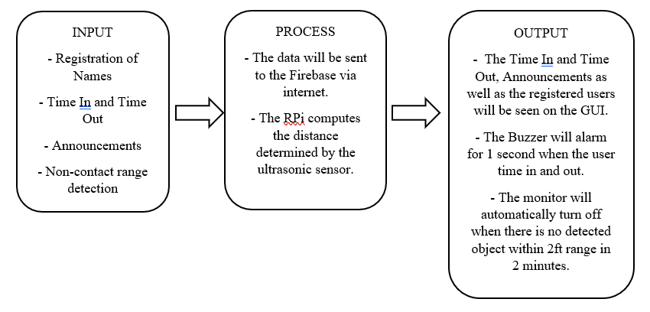
CONCEPTUAL FRAMEWORK

Slide 10
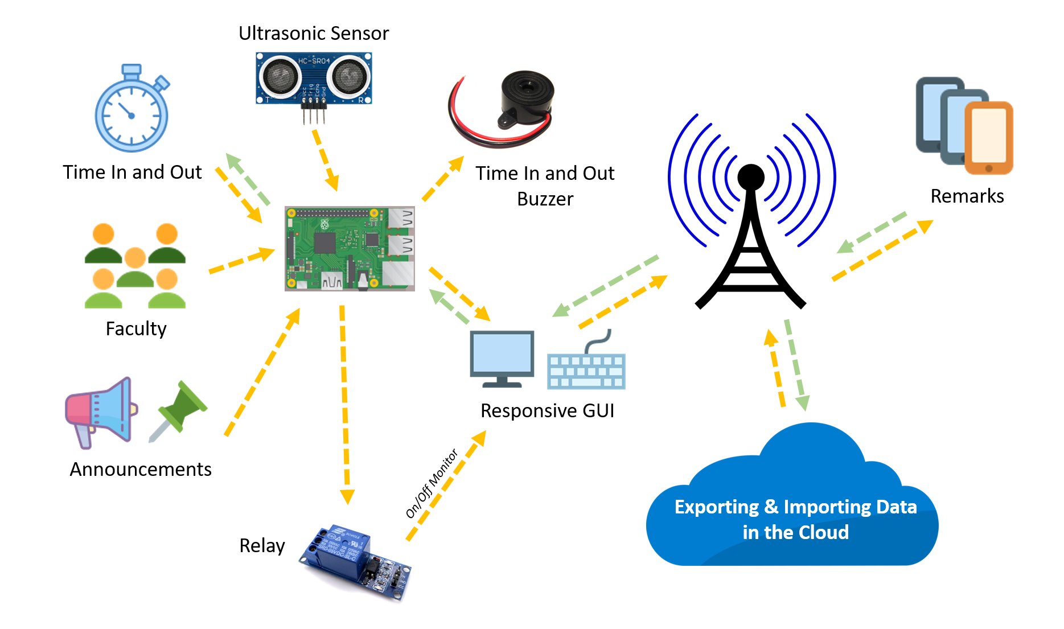
PROPOSED DESIGN

Slide 11
RANGE DETECTION ACCURACY
Location of the user/object (from the Sensor) | Detection Time Delay of Ultrasonic Sensor | Has the Monitor Turned On/Off? (On or Off)
0.2 ft | 120 s | On
0.4 ft | 120 s | On
0.6 ft | 120 s | On
1 ft | 120 s | On
1.5 ft | 120 s | On
1.8 ft | 120 s | On
2 ft | 120 s | On
2.2 ft | 10 us | Off
2.5 ft | 10 us | Off
2.8 ft | 10 us | Off

Slide 12
Transimitting Data from Android Application to the Software in RPi (via IoT)
Trials | Sent Data (Remark) | Time Sent | Received Data (Received string by the RPi) | Time Received | Was the data transmitted accurately? (Yes or No)
1 | TEST1 | 1:05 AM | TEST1 | 1:08 AM | Yes
2 | TeSTtest2 | 7:07 PM | TeSTtest2 | 7:10 PM | Yes
3 | Test 3 | 9:15 PM | Test 3 | 9:16 PM | Yes
4 | test 4 | 8:01 AM | test 4 | 8:05 AM | Yes
5 | TEST 555 | 11:31 AM | TEST 555 | 11:33 AM | Yes

Slide 13
CONCLUSION
The RPi, a microcomputer was used as a core component of the system.
We were able to make a database in the cloud, in which it can import and export data through the GUI.
Were able to make an Android mobile application.
Our system has a power saving capability in which we made use of an ultrasonic sensor.

Slide 14
CONCLUSION
The researchers tested the range detection accuracy of the ultrasonic sensor.
The obtained result shows that it agrees with the expected outcome.
The researchers tested the reliability of the data transmission of the Android mobile application to the GUI
Based on the obtained result, we can say that the data was transmitted accurately

Slide 15
RECOMMENDATION
An application that can be used by IOS users.
Use of touch screen monitor, to lessen the hardware used.

