Slide 1
SM MEGAMALL TOPOLOGY
PRESENTED BY:
PAMBID, Luis Daniel A.
PASCUAL, Lance Vincent V.

Slide 2
TOPOLOGY
34 END DEVICES
8 ROUTERS
17 SWITCHES

Slide 3
ADDRESSING TABLE
All PCs are using IPv4 DHCPs
All IOTs are using IPv4 DHCPS
DEFAULT GATEWAYS are all using 1st usable address
SWITCHES are all using 2nd and 3rd usable address
All the DNS of the end devices are 10.10.10.10

Slide 4
ADDRESSING TABLE
REGISTRATION SERVERS:
TIMEZONE-SECURITY
CONTROL-SERVER
SPORTS-CENTRAL-SECURITY
PARKING-SECURITY
USERNAME: admin
PASSWORD: admin

Slide 5
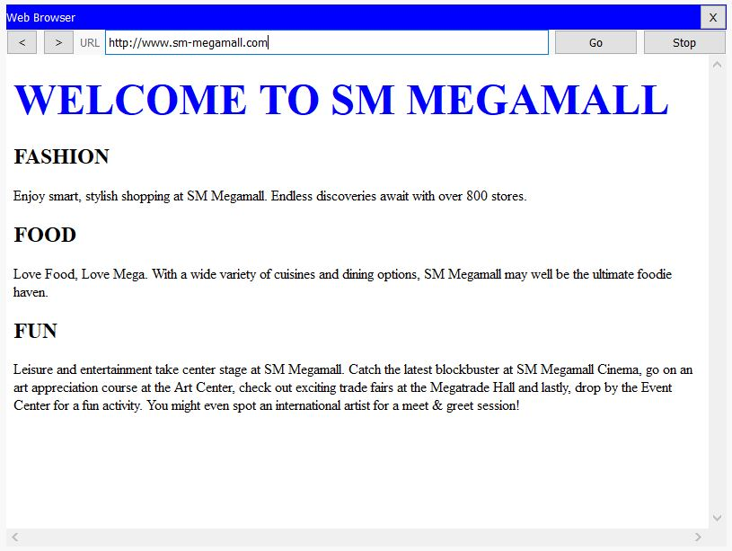
ADDRESSING TABLE
WEB SERVERS:
www.sm-megamall.com

Slide 6
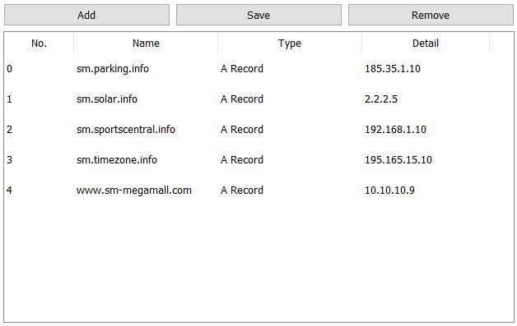
Addressing table
DNS-SERVER: 10.10.10.10

Slide 7
ROUTERS
TELNET PASSWORD: admin
CONSOLE PASSWORD: admin
GLOBAL CONFIGURATION PASSWORD: admin
All the SERIALS of the router has a network address of 190.12.0.0/24
RIPv2 is implemented to all routers except the PARKING-LOT router
DHCP configuration is implemented to all routers
Static Routing is implemented at:
3RD-FLOOR (IPv4)
MAINTENANCE (IPv4 and IPv6)
PARKING-LOT (IPv4 and IPv6)
LOWER-GROUND-FLOOR (IPv6)

Slide 8
Access list
Networks that has IOT DEVICES only permits network address 10.10.10.0/24 (NETWORK-ROOM) and 172.38.20.0/24 (SAFETY-ROOM)

Slide 9
SWITCHES
TELNET PASSWORD: admin
CONSOLE PASSWORD: admin
GLOBAL CONFIGURATION PASSWORD: admin
All unused ports are shutdown

Slide 10
SWITCHES
Switch Port Security is implemented at:
NETWORK-ROOM
ADMIN
SAFETY-ROOM
FOOD-COURT
CYBER-ZONE
JOLLIBEE
MCDONALDS
KFC

Slide 11
SWITCHES
InterVLANS are implemented at:
LOWER-GROUND-FLOOR
FOOD-COURT (IPv4 and IPv6)
CYBER-ZONE (IPv4 and IPv6)
1st –FLOOR
MCDONALDS (IPv4)
KFC (IPv4)
JOLLIBEE (IPv4)
3RD-FLOOR
TIMEZONE (IPv4)
GQ-BARBER-SHOP (IPv4)

Slide 12
Emergency POWER SYSTEM
Located at SOLAR-PANELS-ROOM
The SOLAR-PANELS charges the generator and the power generated can be monitored through the POWER-METER
The EMERGENCY-LIGHTS-BUTTON turns ON the EMERGENCY-LIGHTS when activated
The EMERGENCY-LIGHTS turns ON only if the available power is above 25% else it turns OFF automatically

Slide 13
Emergency power system
The EMERGENCY-LIGHTS-BUTTON-MONITOR tells if the EMEREGENCY-LIGHTS-BUTTON is activated
Button not activated: “LIGHTS OFF”
Button activated: “LIGHTS ON”
The GENERATOR-PERCENT-MONITOR tells the available power in the generator
GENERATOR(Available Power), POWER-METER, and SOLAR-PANELS can be monitored through the registration server

Slide 14
FIRE DETECTOR
Located at the SPORTS-CENTRAL
Turns ON the FIRE-SPRINKLER and ALARM when there is fire detected
The SPORTS-CENTRAL-MONITOR tells if there is fire detected
No fire detected: “COOL”
Fire detected: “FIRE!”
ALARM and FIRE-DETECTOR can be monitored through the registration server

Slide 15
BURGLAR SENSOR
Located at the TIMEZONE
Turns ON the CCTV and ALARM when the BURGLAR-SENSOR is activated
The TIMEZONE-MONITOR tells us that if there is a burglar detected
No burglar detected: “DETECTING MODE”
Burglar detected: “BURGLAR!”
CCTV and ALARM can be monitored through the registration server

Slide 16
CAR DETECTOR
Located at the PARKING-LOT
The CCTV turns ON when there is smoke detected which comes from the car else it turns OFF
The PARKING-MONITOR tells if there is a car detected
Car detected: “CAR DETECTED”
No car incoming: “MONITORING MODE”
CCTV can be monitored through the registration server

