Slide 1
OCR Options for Vietnamese Banking Documents
Technology comparison for batch OCR (~176k pages/month workload)

Slide 2
Context
Use case:
- Banking documents in Vietnamese
- Batch upload: ~20 PDFs × 40 pages
- Up to 10 batches in the morning
- OCR converts scanned PDFs into structured Excel data
Goal:
- One OCR pipeline supporting multiple document layouts
- Always-on batch processing

Slide 3
OCR Options Evaluated
1. Tesseract (baseline open-source OCR)
2. Claude Haiku 4.5 API (Vision LLM)
3. Hunyuan OCR (Tencent OCR VLM self-host)
4. Qwen3‑VL 4B / 8B self-host
5. Databricks AI Parse (document parsing service)

Slide 4
Side-by-Side Comparison
Option | Deployment | Cost Model | Speed | Notes
Tesseract | Self-host | Infra only | Low-Medium | Baseline OCR
Claude Haiku | API | Token-based | High | Fastest implementation
Hunyuan OCR | Self-host | GPU infra | High | Strong OCR specialization
Qwen3-VL 4B/8B | Self-host | GPU infra | Medium-High | Flexible multimodal
Databricks Parse | Managed | Per-page pricing | High | Good if using Databricks

Slide 5
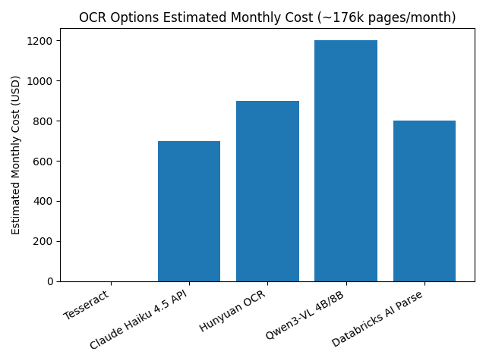
Estimated Monthly Cost Comparison

Slide 6
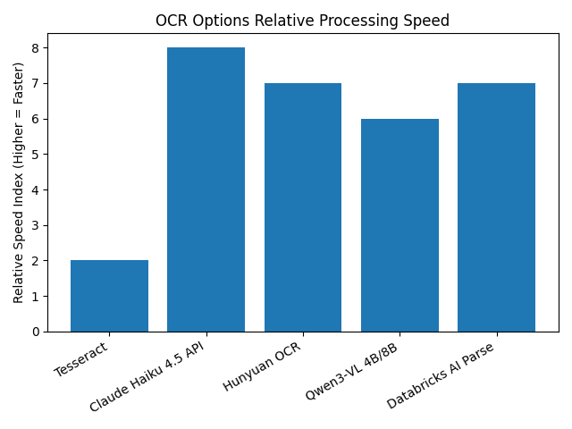
Relative OCR Processing Speed

Slide 7
Recommendation
Recommended approach:
1. Start with Claude Haiku 4.5 API for fastest production deployment
2. Run parallel POC with Hunyuan OCR for self-host cost control
3. Consider Databricks AI Parse if pipeline already runs inside Databricks
Tesseract remains baseline for comparison.

