Slide 1
PROJECT TITLE
CAPSTONE PROJECT
Presented By: Manjunatha M
Student Name : Manjunatha M
College Name & Department : New Horizon college (BCA)

Slide 2
OUTLINE
Problem Statement
Technology used
Wow factor
End users
Result
Conclusion
Git-hub Link
Future scope

Slide 3
Problem Statement
In today’s digital age, secure communication is crucial. Traditional methods of encrypting messages can be detected, making them vulnerable to interception. This project addresses the need for a more discreet way of transmitting sensitive information by hiding messages within images using steganography.

Slide 4
Technology used
The project is built using Python, leveraging the following libraries:
OpenCV for image processing.
Tkinter for the graphical user interface (GUI).
Pillow (PIL) for image display and manipulation.
OS module for file handling. The program runs on any system with Python installed and supports common image formats like PNG and JPEG.

Slide 5
Wow factors
The project combines steganography with a user-friendly GUI, making it accessible even to non-technical users. It allows users to securely embed and extract messages from images without visible alterations, ensuring complete secrecy. Additionally, the use of a passcode adds an extra layer of security, ensuring only authorized users can decrypt the hidden message.

Slide 6
End users
This project is designed for:
Individuals who want to send confidential messages discreetly.
Organizations requiring secure communication channels.
Students and researchers exploring steganography and image processing.
Developers looking for a simple implementation of steganography.

Slide 7
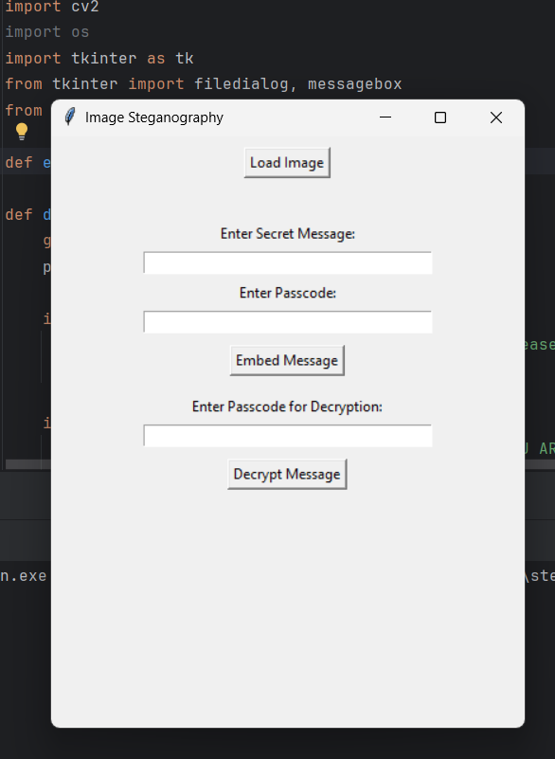
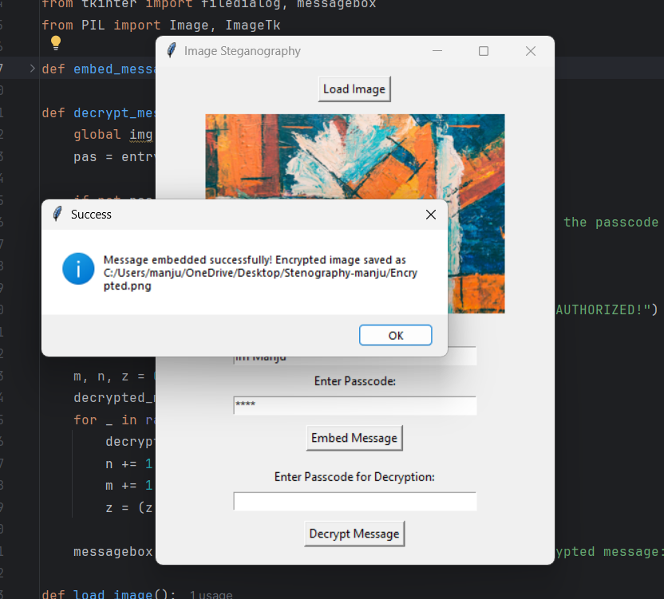
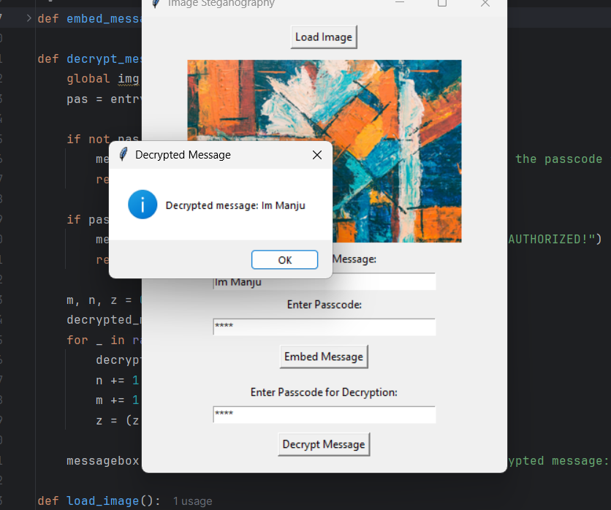
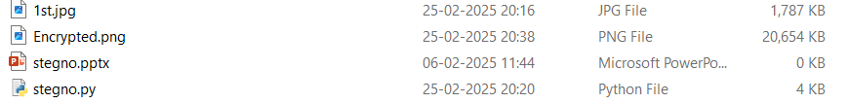
Results

Slide 8
Conclusion
This project demonstrates the practical application of steganography for secure communication. By hiding messages within images, it provides a discreet and effective way to transmit sensitive information. The integration of a GUI makes the tool accessible to a wide range of users, while the passcode feature ensures security. This project highlights the potential of steganography in modern digital communication.

Slide 9
GitHub Link
The complete source code and documentation for this project can be found on GitHub: https://github.com/frostftw01-1/Steganography_manju.git

Slide 10
Future scope(optional)
Future enhancements for this project could include:
Adding support for more image formats.
Implementing encryption algorithms (e.g., AES) to further secure the hidden message.
Developing a web or mobile version for broader accessibility.
Adding batch processing to handle multiple images at once.
Exploring advanced steganography techniques, such as frequency domain embedding.

Slide 11
THANK YOU

