Slide 1

Meta-Learning
许睿
2019 07 11

Slide 2
CONTENTS
1
2
3
Why
What
how

Slide 3
1
PART 01
Why

Slide 4
Why Meta-Learning?
Deep learning is data hungry
How to solve problems
without an expensive dataset
The advantages of meta-learning:
Machine Learning
Deep Learning
Deep Reinforcement Learning
Faster
More flexible
More autonomous
Less dependence of data
Use previous knowledge
Deep Meta Learning

Slide 5
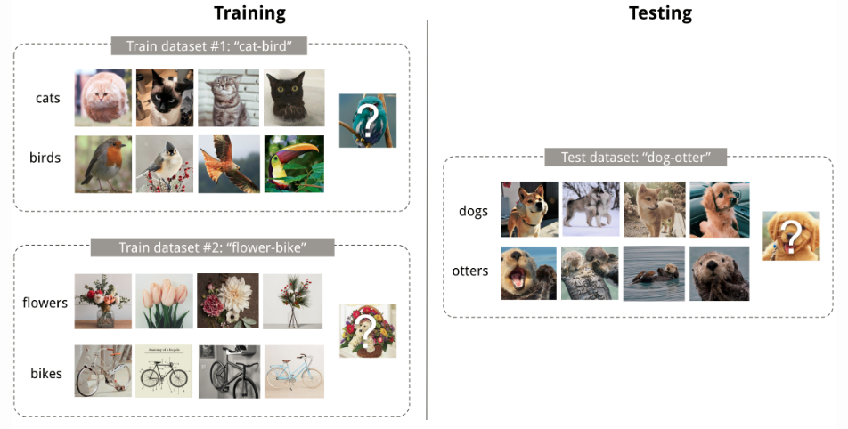
Why Meta-Learning?
Fig. 1. An example of 4-shot 2-class image classification. (Image thumbnails are from Pinterest)

Slide 6
2
PART 02
What

Slide 7
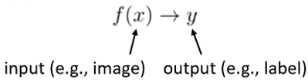
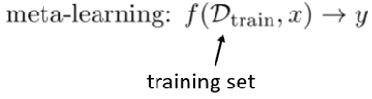
What is Meta-Learning?
Meta-Learning , also known as “Learning to learn” , intends to design models that can learn new skills or adapt to new environments rapidly with a few training examples.
The meta-learning problem treats entire tasks as training examples
Notes:
机器学习对分类问题效果不好，从而提出深度学习。深度强化学习可以将当前状态映射到相应动作，基于预期回报评判动作价值。但是依赖于大量数据集，而且需要精准的反馈。深度元学习可以让人工智能具备快速学习的能力。

Slide 8

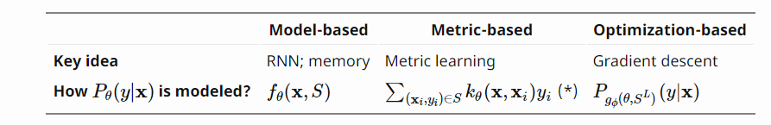
What is Meta-Learning?
There are three common approaches:
metric-based (learn an efficient distance metric)
Convolutional Siamese Neural Network[5]
Matching Network[6]
Relation Network
Prototypical Network[3]
model-based(use (recurrent) network with external or internal memory)
Memory-Augmented Neural Networks
Meta Networks
optimization-based(optimize the model parameters explicitly for fast learning)
LSTM Meta-Learner
MAML[1][2]
Reptile

Slide 9
3
PART 03
how

Slide 10
How to implement
Two examples:
metric-based
Prototypical Network
optimization-based
MAML

Slide 11
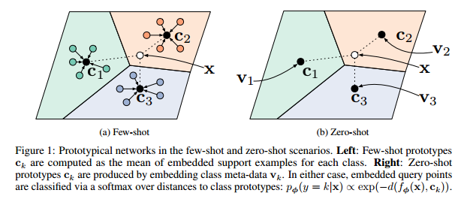
How to implement
Prototypical Network[3]
Fig. 2. Prototypical Network in few-shot
Notes:
原形网络要为每个类别计算出一个原形表示Ck,通过一个非线性函数 ,将维度D的样例数据映射到M维的空间上。Ck是对样例数据取均值得到的。在测试时，针对一个新样本x，计算x到Ck的距离,划分为距离最近的类。
训练过程是通过随机梯度下降法最小化目标函数：其中k为训练样本的真实标签。训练的episode为随机从训练集中选择的一个类子集，从这些类子集中选择一些样例数据作为支持（support set）集，其剩余的作为查询（query set）集。完整的loss计算过程我们参考伪码：

Slide 12

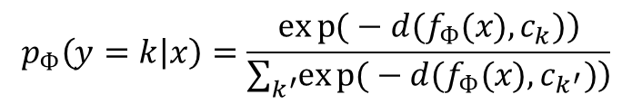
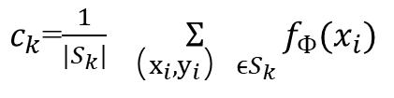
How to implement
Prototypical Network
Each prototype is the mean vector of the embedded support points belonging to its class:
$c_{k}$=$\frac{1}{|S_{k}|}\underset{（x_{i},y_{i}）ϵS_{k}}{Ʃ}{f_{Ф}{(x}_{i})}$
Prototypical networks produce a distribution over classes for a query point x based on a softmax over distances to the prototypes in the embedding space:
$$p_{Ф}\left(y=k | x\right)=\frac{\left.exp{(}−d(f_{Ф}(x),c_{k})\right)}{\sum_{k^{′}}{\left.exp{(}−d(f_{Ф}(x),c_{k^{′}})\right)}}$$
The loss :
$J\left(Ф\right)=−logp_{Ф}$(y=k|x)
Notes:
原形网络要为每个类别计算出一个原形表示Ck,通过一个非线性函数 ,将维度D的样例数据映射到M维的空间上。Ck是对样例数据取均值得到的。在测试时，针对一个新样本x，计算x到Ck的距离,划分为距离最近的类。
这是针对新样本的基于softmax函数的输出概率。把数据归到0-1.
训练过程是通过随机梯度下降法最小化目标函数：其中k为训练样本的真实标签。训练的episode为随机从训练集中选择的一个类子集，从这些类子集中选择一些样例数据作为支持（support set）集，其剩余的作为查询（query set）集。完整的loss计算过程我们参考伪码：

Slide 13
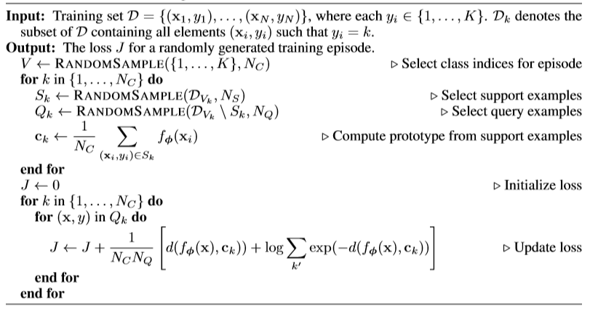
How to implement
Prototypical Network

Slide 14
How to implement
Mode Agnostic Meta Learning[1][2]
Intuition
internal representations
transferable among tasks
Transfer Learning
good parameters trained on lots of data
Meta Learning
Parameters which are sensitive to small changes
Large improvement on loss function for any task
Notes:
中心思想是后面两句。

Slide 15
Motivation • Model-agnostic • any model trained with gradient descent • a variety of different learning problems, • classification, regression, reinforcement learning.
• If the internal representation is suitable to many tasks, simply fine-tuning the parameters slightly can produce good results.
• Learning process can be viewed as maximizing the sensitivity of the loss functions of new tasks with respect to the parameters: when the sensitivity is high, small local changes to the parameters can lead to large improvements in the task loss.

Slide 16
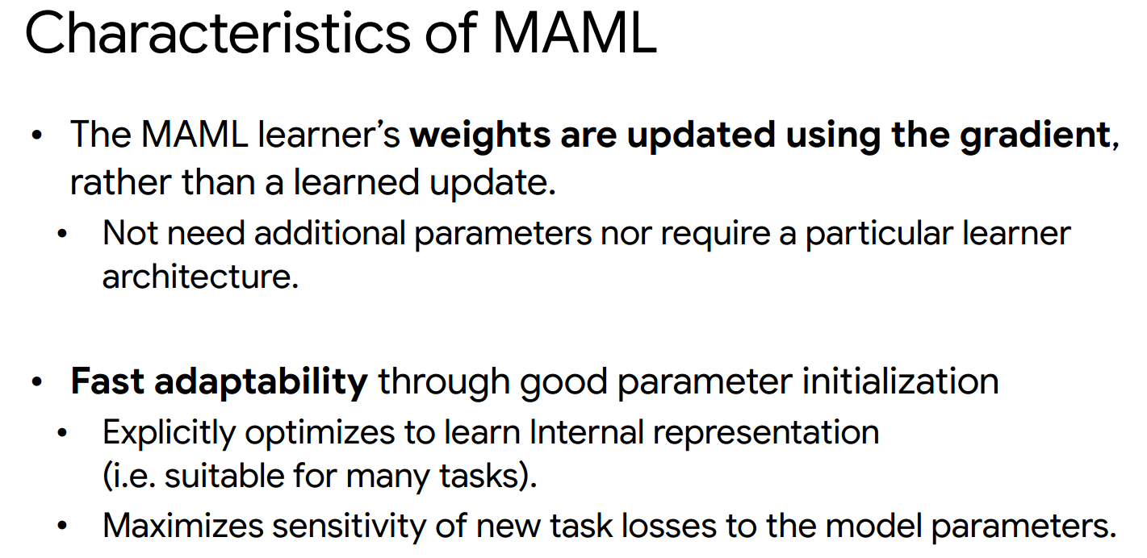

Slide 17
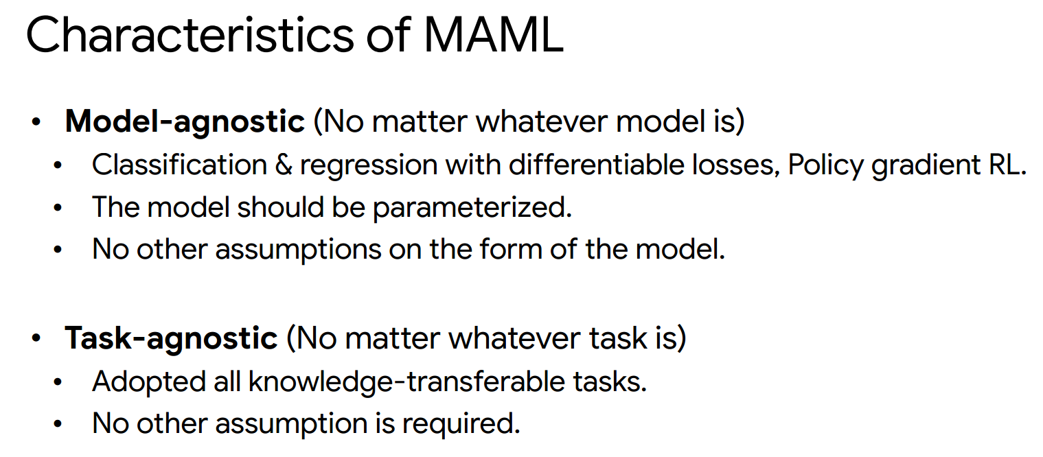

Slide 18
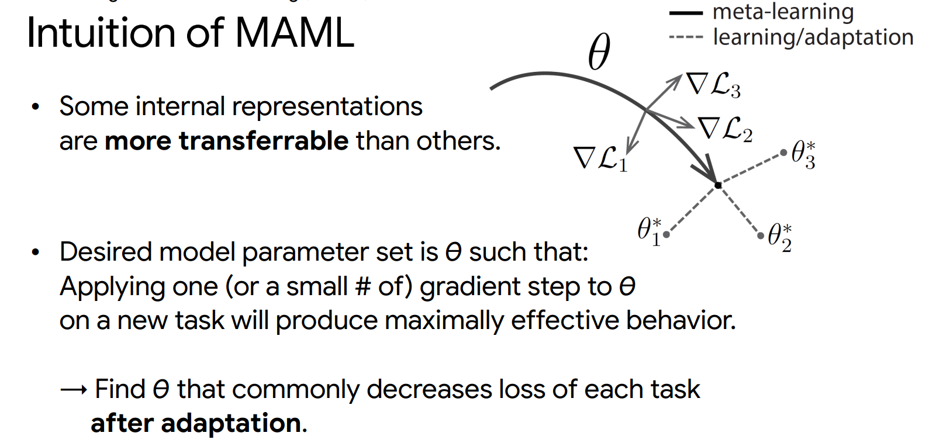

Slide 19
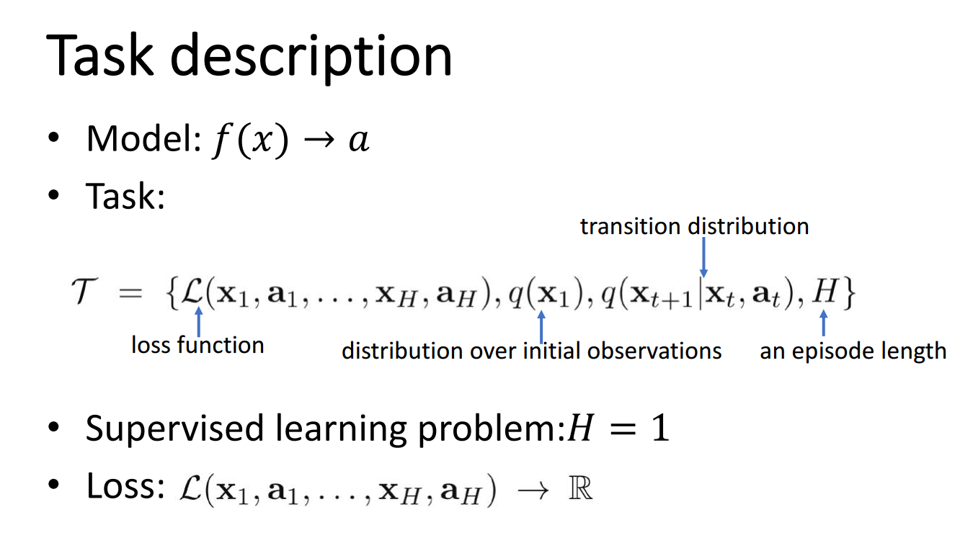

Slide 20
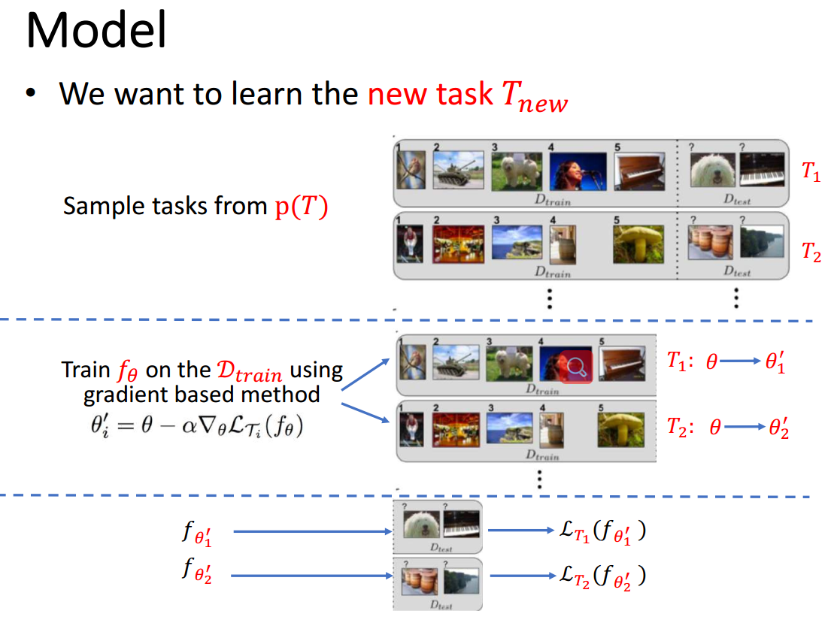

Slide 21
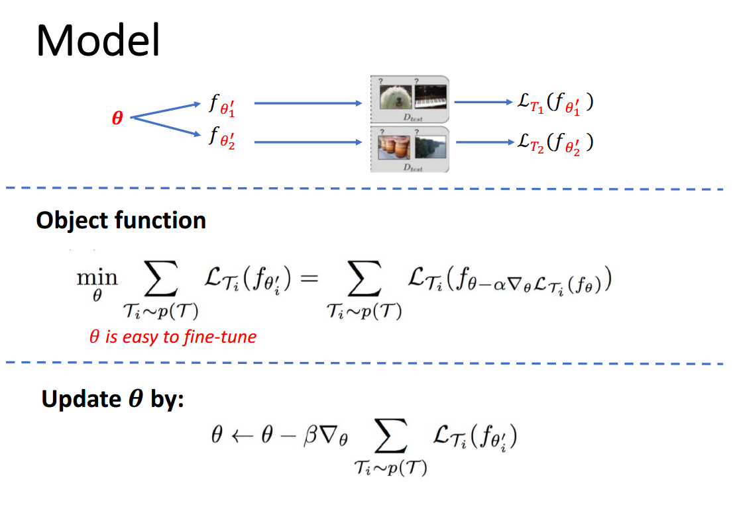

Slide 22
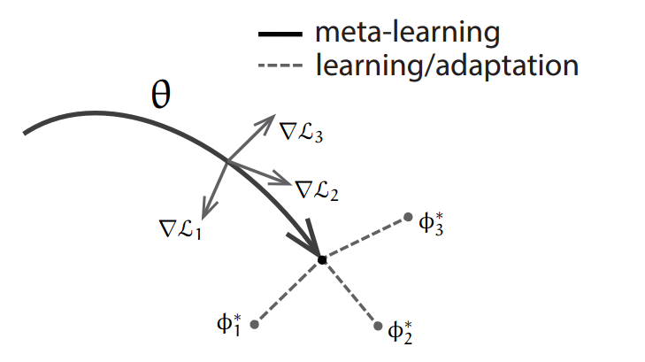
How to implement
Mode Agnostic Meta Learning
Problem Definition
Model f parameterized by θ
Maps x → a
p(T):tasks distribution
■Supervised learning : H=1
K-shot learning :K samples drawn from q_{i}
$$T=\{L\left(x_{1},a_{1},…,x_{H},a_{H},\right),q\left(x_{1}\right),q\left(x_{t+1} | x_{t},a_{t},\right),H\}$$

Slide 23
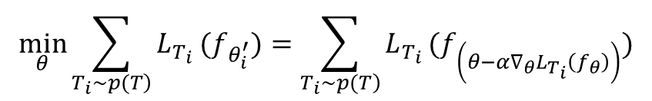

How to implement
Mode Agnostic Meta Learning
Method
For task T_{i} model’s parameter θ become
$$θ_{i}^{′}=θ−\text{α}∇_{θ}L_{Ti}(f_{θ})$$
Multiple gradient update also is extendable
Objective
$$\min_{θ}\sum_{\left.T_{i}∼p(T\right)}{L_{T_{i}}}(f_{θ_{i}^{′}})=\sum_{\left.T_{i}∼p(T\right)}{L_{T_{i}}}(f_{\left(θ−α∇_{θ}L_{T_{i}}\left(f_{θ}\right)\right)})$$

Slide 24
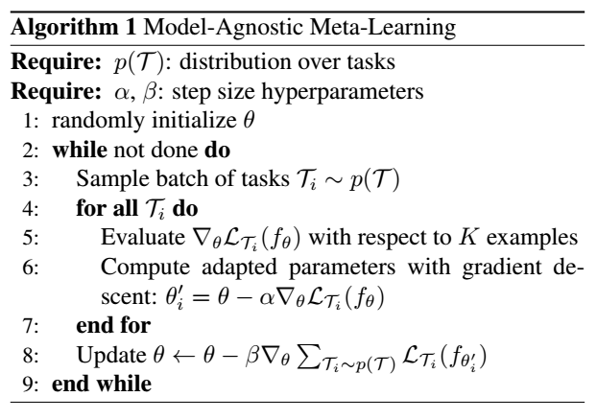
How to implement
Mode Agnostic Meta Learning

Slide 25
Reference:
[1] Chelsea Finn, Pieter Abbeel , and Sergey Levine. “Model-Agnostic Meta-Learning for Fast Adaptation of Deep Networks”. In: (2017).
[2] Chelsea Finn . “Learning to Learn with Gradients ,” UC Berkeley .
[3] Jake Snell, Kevin Swersky ,.Richard S. Zemel . “ Prototypical Networks for Few-shot Learning ” arXiv:1703.05175v2 [cs.LG] 19 Jun 2017
[4] Joaquin Vanschoren. “ Meta-Learning: A Survey ” Eindhoven University of Technology, arXiv:1810.03548v1 [cs.LG] 8 Oct 2018
[5] Gregory Koch, Richard Zemel, and Ruslan Salakhutdinov. “Siamese neural networks for one-shot image recognition.” ICML Deep Learning Workshop. 2015.
[6] Oriol Vinyals, et al. “Matching networks for one shot learning.” NIPS. 2016.
[7] Chelsea Finn, Pieter Abbeel, and Sergey Levine. “Model-agnostic meta-learning for fast adaptation of deep networks.” ICML 2017.

Slide 26
THANK YOU

