Slide 1
Within Class Representation for Image Annotation
Speaker : Shao Qianqian
2019

Slide 2
CONTENTS
Background introduction
Experimental method
Experimental results
01
02
03

Slide 3

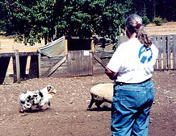
01
Background introduction
What is automatic image annotation?
adding semantic keywords to the image that reflect its content by computer
dog woman
tree
Application
image retrieval

Slide 4
01
Background introduction
1、The models without graph structure
learning the joint distribution over image features and labels
learning classifiers
nearest neighbor based models
Algorithm classification
2、The graph based model
locally linear embedding（LLE）
Laplacian eigenmaps (LE)
Hypergraph

Slide 5
02
Experimental method
1、Establishing local training set
selecting K-nearest neighbors to form a local training set for each test sample
2、Low-rank matrix factorization for coefficient matrix
3、 Preserving sample similarities and tag correlation

Slide 6
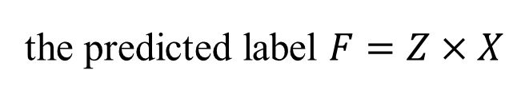



02
Low-rank matrix factorization for coefficient matrix
the predicted label $F=Z×X$
$$Z$$
$$W×H$$
$$F=W×H×X$$
W
:new coefficient matrix
HX
:new feature matrix

Slide 7


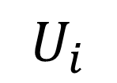





02
Preserving sample similarities and tag correlation
1、Preserving sample similarities（1）:
a sample $k_{1}$
Label d
cluster center
$$\overline{k}$$
a sample $k_{N^{d}}$
a sample i
cluster center
$$\overline{i}$$
$$U_{i}$$
a sample $j_{1}$
Label c
cluster center
$$\overline{j}$$
a sample $j_{N^{c}}$

Slide 8
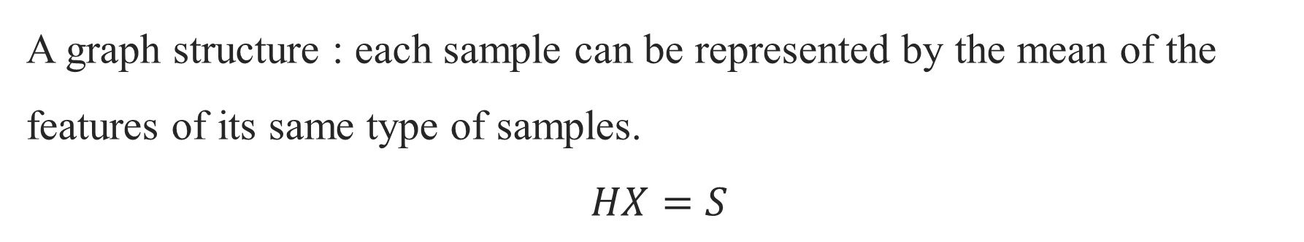
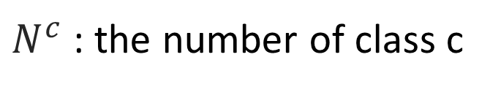
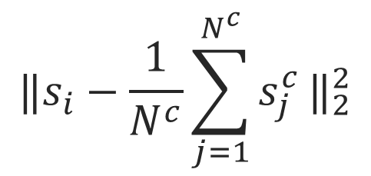
02
Preserving sample similarities and tag correlation
A graph structure : each sample can be represented by the mean of the features of its same type of samples.
$$HX=S$$
$${‖s_{i}−\frac{1}{N^{c}}\sum_{j=1}^{N^{c}}{s_{j}^{c}}‖}_{2}^{2}$$
$N^{c}$ : the number of class c

Slide 9
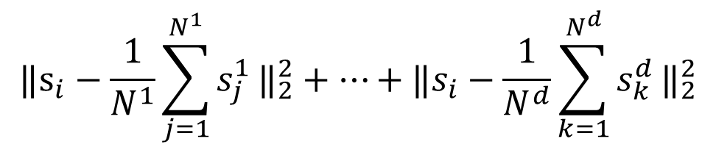

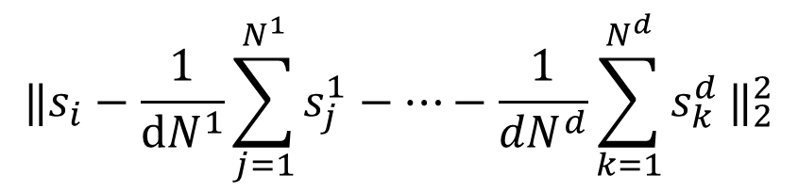
02
Preserving sample similarities and tag correlation
$${‖s_{i}−\frac{1}{N^{1}}\sum_{j=1}^{N^{1}}{s_{j}^{1}}‖}_{2}^{2}+…+{‖s_{i}−\frac{1}{N^{d}}\sum_{k=1}^{N^{d}}{s_{k}^{d}}‖}_{2}^{2}$$
$${‖s_{i}−\frac{1}{{dN}^{1}}\sum_{j=1}^{N^{1}}{s_{j}^{1}−…−\frac{1}{{dN}^{d}}\sum_{k=1}^{N^{d}}{s_{k}^{d}}}‖}_{2}^{2}$$
$$U_{i}$$
$${‖S−SU‖}_{F}^{2}=trace\left(S\left(I−U\right){\left(I−U\right)}^{T}S^{T}\right)$$

Slide 10








02
Preserving sample similarities and tag correlation
1、Preserving sample similarities（2）:
a sample $j_{1}$
Label c
cluster center
$$\overline{j}$$
$$G^{c}$$
a sample $j_{N^{c}}$
a sample $k_{1}$
Label d
cluster center
$$\overline{k}$$
$$G^{d}$$
a sample $k_{N^{d}}$

Slide 11
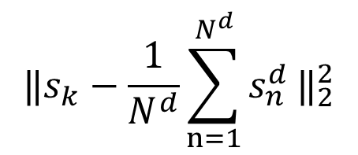



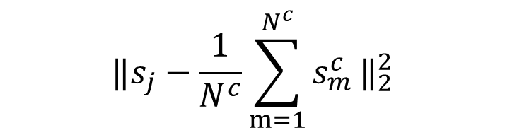
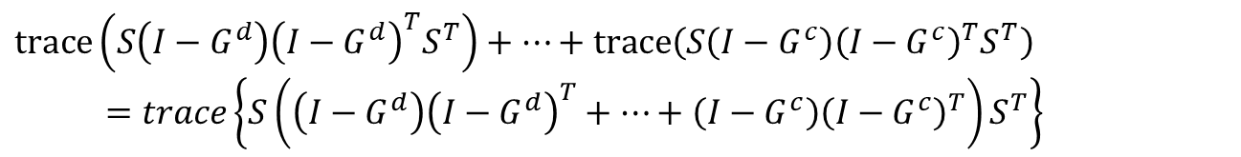
02
Preserving sample similarities and tag correlation
Label d
Label c
$${‖s_{k}−\frac{1}{N^{d}}\sum_{n=1}^{N^{d}}{s_{n}^{d}}‖}_{2}^{2}$$
$${‖s_{j}−\frac{1}{N^{c}}\sum_{m=1}^{N^{c}}{s_{m}^{c}}‖}_{2}^{2}$$
$$G^{d}$$
$$G^{c}$$
$${‖S−SG^{d}‖}_{F}^{2}=trace\left(S\left(I−G^{d}\right){\left(I−G^{d}\right)}^{T}S^{T}\right)$$
$${‖S−SG^{c}‖}_{F}^{2}=trace\left(S\left(I−G^{c}\right){\left(I−G^{c}\right)}^{T}S^{T}\right)$$
$trace\left(S\left(I−G^{d}\right){\left(I−G^{d}\right)}^{T}S^{T}\right)+⋯+$ $trace\left(S\left(I−G^{c}\right){\left(I−G^{c}\right)}^{T}S^{T}\right)$
$=trace\left\{S\left(\left(I−G^{d}\right){\left(I−G^{d}\right)}^{T}+⋯+\left(I−G^{c}\right){\left(I−G^{c}\right)}^{T}\right)S^{T}\right\}$

Slide 12

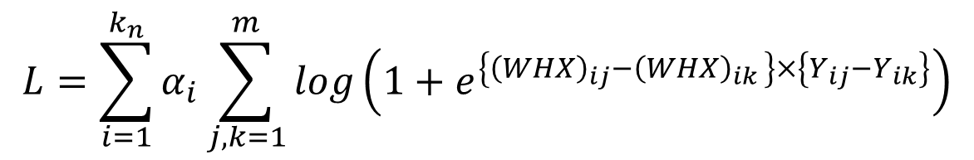

02
Preserving sample similarities and tag correlation
2、 Tag correlation :
$$T^{∗}=arg\min_{T}\left\{{‖Y−TY‖}_{F}^{2}+μ{‖T‖}_{1}\right\}$$
$${Ω\left(W\right)=‖W−TW‖}_{F}^{2}$$
3、 Objective function:
$$L+λR\left(H\right)+γΩ\left(W\right)+η\left({‖W‖}_{F}^{2}+{‖H‖}_{F}^{2}\right)$$
$$L=\sum_{i=1}^{k_{n}}{α_{i}}\sum_{j,k=1}^{m}{log\left(1+e^{\left\{{\left(WHX\right)}_{ij}−{\left(WHX\right)}_{ik }\right\}×\left\{Y_{ij}−Y_{ik}\right\}}\right)}$$

Slide 13
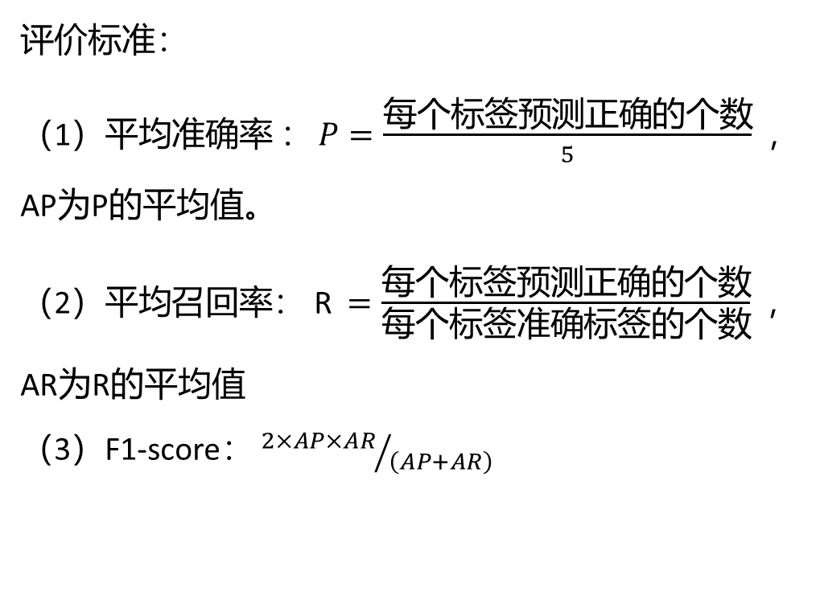
03
Experimental results
1、Datasets : NUS-WIDE Corel5k ESPGame IAPRTC12
评价标准：
（1）平均准确率 ：$P=\frac{每个标签预测正确的个数}{5}$ ， AP为P的平均值。
（2）平均召回率： R$=\frac{每个标签预测正确的个数}{每个标签准确标签的个数}$， AR为R的平均值
（3）F1-score： ${2×AP×AR}/{\left(AP+AR\right)}$

Slide 14
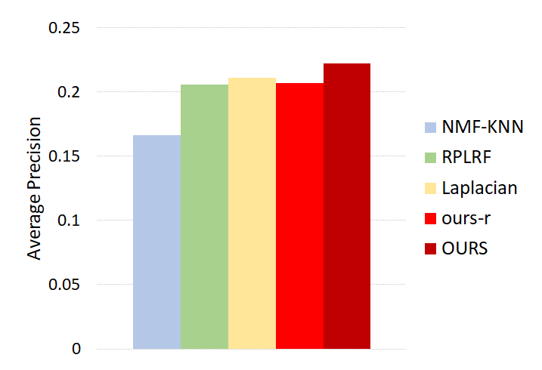
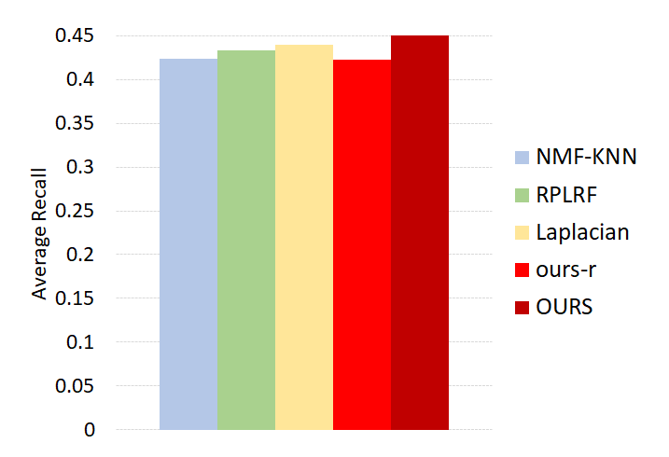
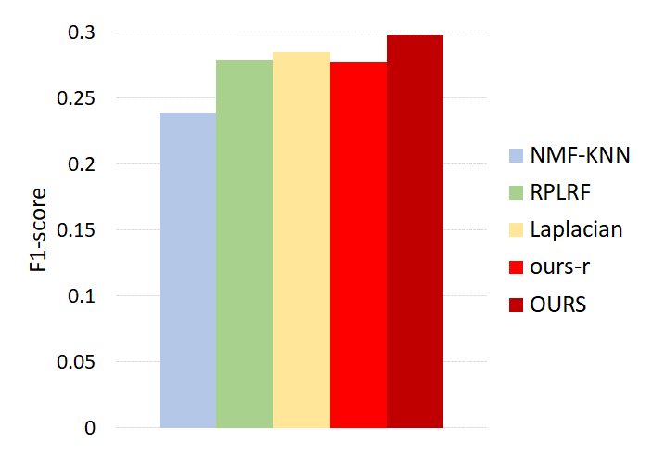
03
Experimental results(1)
NUS-WIDE

Slide 15
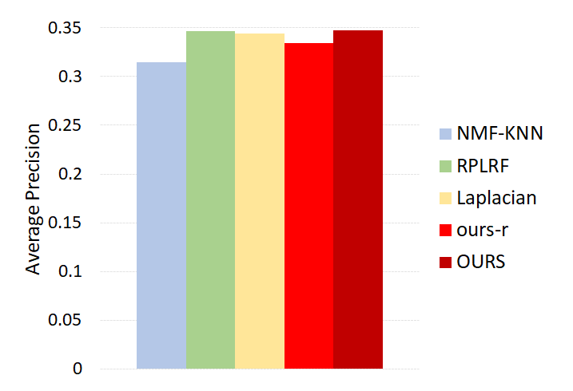
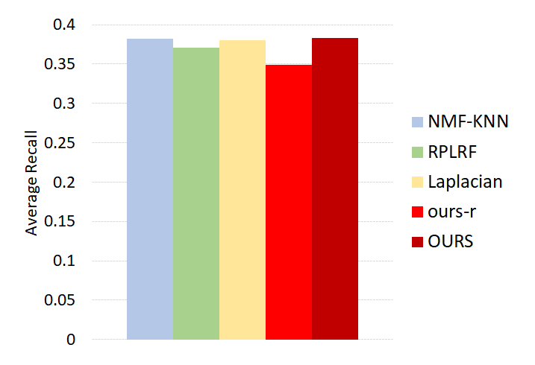
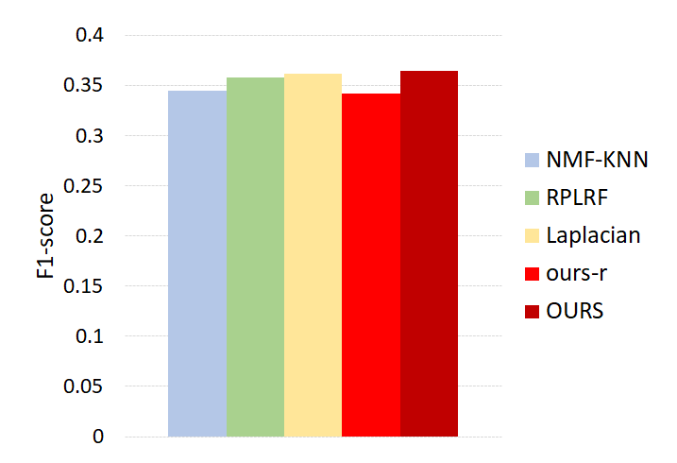
03
Experimental results(1)
Corel5k

Slide 16
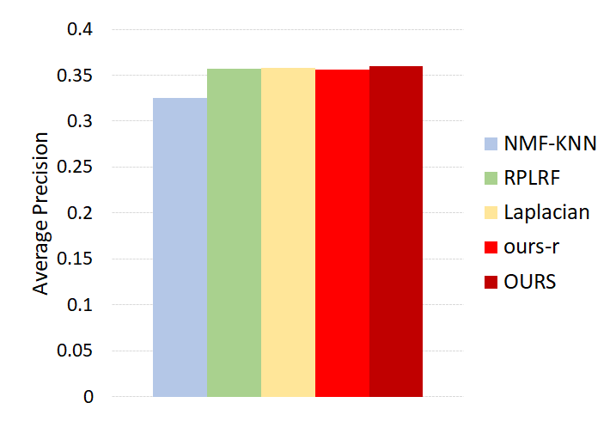


03
Experimental results(1)
ESPGame

Slide 17
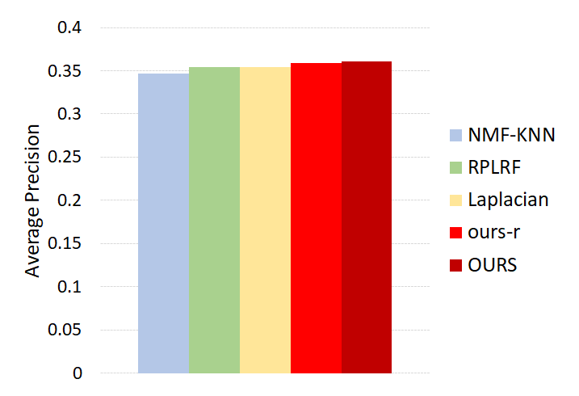
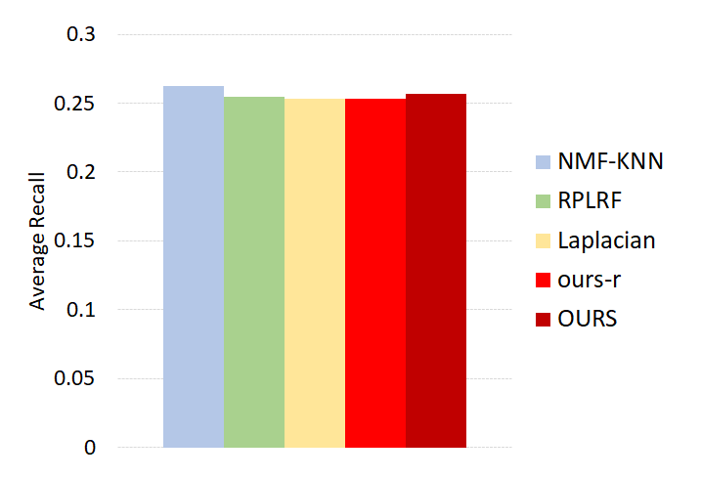
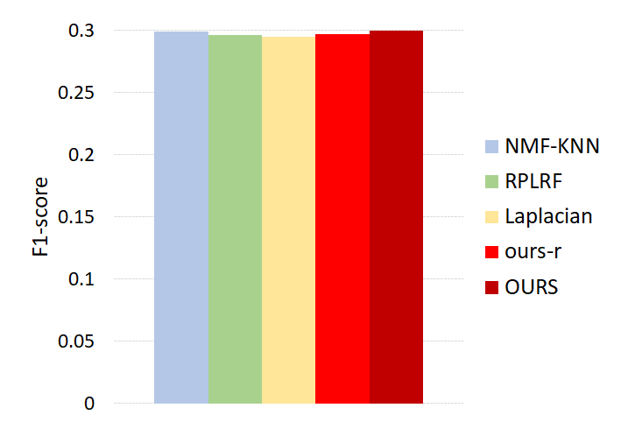
03
Experimental results(1)
IAPRTC12

Slide 18

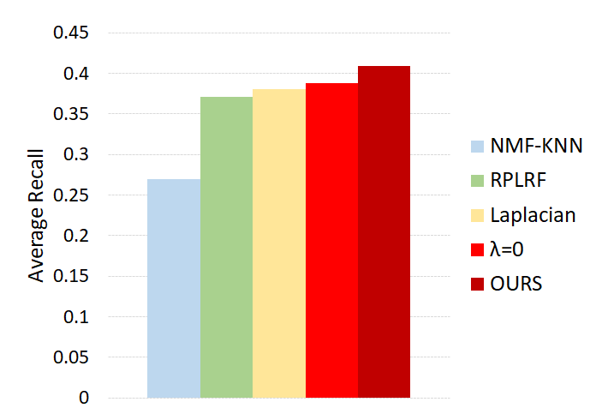
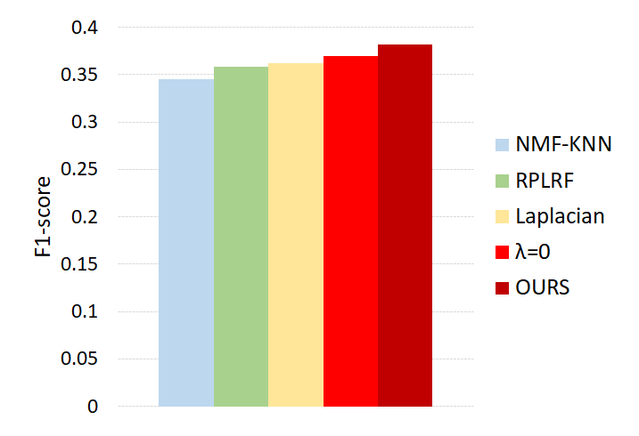
03
Experimental results(2)
Corel5k

Slide 19
THANK YOU
2019

