Slide 1
Extrapolated full waveform inversion with deep learning

Slide 2
Background
The lack of low frequency information and a good initial model can seriously affect the success of full waveform inversion (FWI)
Because of the acquisition limitation in seismic processing, the input data for seismic inversion are typically limited to a band above 3Hz.
This paper propose an architecture of convolutional neural network (CNN) to automatically extrapolate the missing low frequencies without preprocessing and post-processing steps.

Slide 3
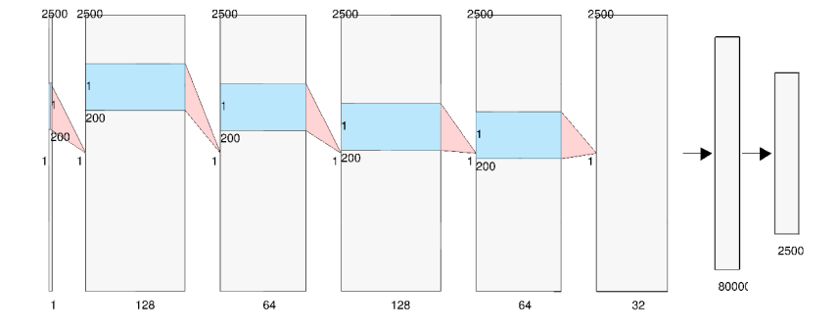
CNN
The architecture is a feed-forward stack of five sequential combinations of the convolution, PReLU and batch normalization layers, followed by one fully connected layer that outputs continuous-valued amplitude of the time-domain signal in the low frequency band.

Slide 4
Image Super-Resolution via Sparse Representation

Slide 5
This paper presents a approach to single-image superresolution, based on sparse signal representation.
Image patches can be well represented as a sparse linear combination of elements from an appropriately chosen over-complete dictionary.
we seek a sparse representation for each patch of the low-resolution input, and then use the coefficients of this representation to generate the high-resolution output .

Slide 6




Dictionary training
our goal is to learn dictionaries for high resolution and low resolution image patches, so that the sparse representation of the high resolution patch is the same as the sparse representation of the corresponding low resolution patch.

Slide 7

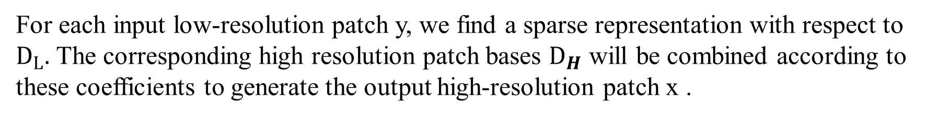
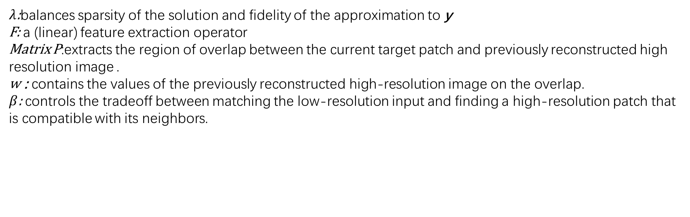
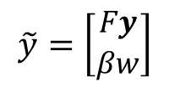
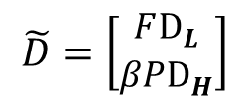
Sparse representation
For each input low-resolution patch y, we find a sparse representation with respect to $D_{L}.$ The corresponding high resolution patch bases $D_{H}$ will be combined according to these coefficients to generate the output high-resolution patch x .
$$\min_{α}{\text{||}\tilde{D}α−\tilde{y}{||}_{2}^{2}\text{+}λ|{\left|α\right||}_{1}}$$
$$\tilde{D}=\left[\begin{aligned}FD_{L} \\ βPD_{H}\end{aligned}\right]$$
$$\tilde{y}=\left[\begin{aligned}Fy \\ βw\end{aligned}\right]$$
$λ$:balances sparsity of the solution and fidelity of the approximation to y
F: a (linear) feature extraction operator
Matrix P:extracts the region of overlap between the current target patch and previously reconstructed high resolution image .
w : contains the values of the previously reconstructed high-resolution image on the overlap. $β$: controls the tradeoff between matching the low-resolution input and finding a high-resolution patch that is compatible with its neighbors.

Slide 8
谢谢！

