Slide 1
Parameters-GAN
Peng Xuyang

Slide 2
1. DAWSON
DAWSON means ”a Domain Adaptive Few Shot Generation Framework For GANs”, a Domain Adaptive Few Shot Generation Framework For GANs based on meta-learning and naturally combines the two-step training procedure of GANs and the two-step training procedure of meta-learning algorithms(MAML). DAWSON is a plug-and-play framework that supports a broad family of meta-learning algorithms and various GANs with architectural-variants.

Slide 3
1. DAWSON
If GANs are combined with Meta-Learning, the problem of gradient transfer should be solved. DAWSON combines GANs with MAML. The MAML algorithm includes two loops. The inner loop provides gradients for the outer loop to update parameters. DAWSON constructs a two-layer loop of the MAML algorithm by cloning generators and discriminators. If the clone method is not used, the generator and discriminator parameters will be updated during the inner loop.

Slide 4
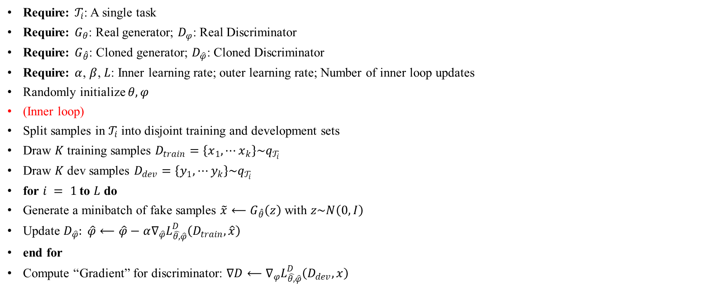
1.1 Algorithm of DAWSON
Require: $𝒯_{i}$: A single task
Require: $G_{θ}$: Real generator; $D_{φ}$: Real Discriminator
Require: $G_{\hat{θ}}$: Cloned generator; $D_{\hat{φ}}$: Cloned Discriminator
Require: $α$, $β$, $L$: Inner learning rate; outer learning rate; Number of inner loop updates
Randomly initialize $θ,φ$
(Inner loop)
Split samples in $𝒯_{i}$ into disjoint training and development sets
Draw $K$training samples $D_{train}=\left\{x_{1},⋯x_{k}\right\}\sim q_{𝒯_{i}}$
Draw $K$dev samples $D_{dev}=\left\{y_{1},⋯y_{k}\right\}\sim q_{𝒯_{i}}$
for $i = 1$ to $L$ do
Generate a minibatch of fake samples $\tilde{x}⟵G_{\hat{θ}}\left(z\right)$ with $z\sim N\left(0,I\right)$
Update $D_{\hat{φ}}: \hat{φ}⟵\hat{φ}−α∇_{\hat{φ}}L_{\hat{θ,}\hat{φ}}^{D}\left(D_{train},\hat{x}\right)$
end for
Compute “Gradient” for discriminator: $∇D⟵∇_{φ}L_{\hat{θ,}\hat{φ}}^{D}\left(D_{dev},x\right)$

Slide 5
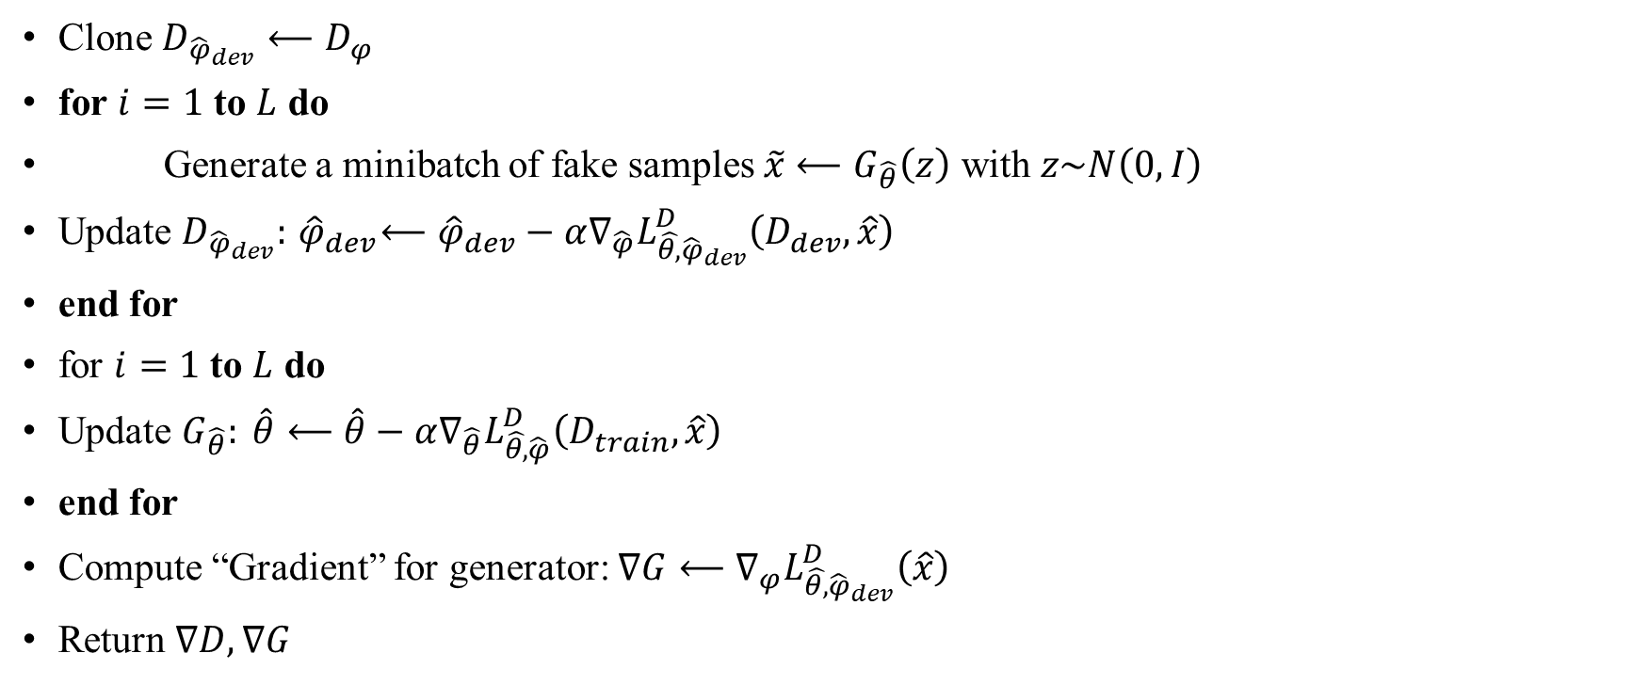
1.2 Algorithm of DAWSON
Clone $D_{{\hat{φ}}_{dev}}⟵D_{φ}$
for $i=1$ to $L$ do
Generate a minibatch of fake samples $\tilde{x}⟵G_{\hat{θ}}\left(z\right)$ with $z\sim N\left(0,I\right)$
Update $D_{{\hat{φ}}_{dev}}:{ \hat{φ}}_{dev}⟵{\hat{φ}}_{dev}−α∇_{\hat{φ}}L_{\hat{θ,}{\hat{φ}}_{dev}}^{D}\left(D_{dev},\hat{x}\right)$
end for
for $i=1$ to $L$ do
Update $G_{\hat{θ}}: \hat{θ}⟵\hat{θ}−α∇_{\hat{θ}}L_{\hat{θ,}\hat{φ}}^{D}\left(D_{train},\hat{x}\right)$
end for
Compute “Gradient” for generator: $∇G⟵∇_{φ}L_{\hat{θ,}{\hat{φ}}_{dev}}^{D}\left(\hat{x}\right)$
Return $∇D,∇G$

Slide 6
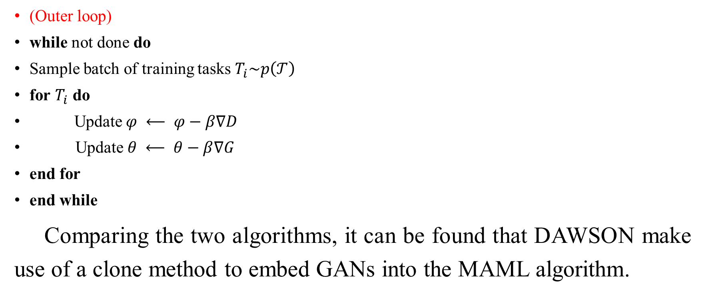
1.2 Algorithm of DAWSON
(Outer loop)
while not done do
Sample batch of training tasks $T_{i}\sim p\left(𝒯\right)$
for $T_{i}$ do
Update$φ ⟵ φ−β∇D$
Update $θ ⟵ θ−β∇G$
end for
end while
Comparing the two algorithms, it can be found that DAWSON make use of a clone method to embed GANs into the MAML algorithm.

Slide 7
2. Task2Vec
Achille et al. propose a method to generate vectorial representations of visual classiﬁcation tasks which can be used to reason about the nature of those tasks and their relations. Task2Vec can find the best match between the classifier and the task.
Task2Vec processes images through a “probe network” and computes an embedding based on estimates of the Fisher information matrix associated with the probe network parameters.

Slide 8
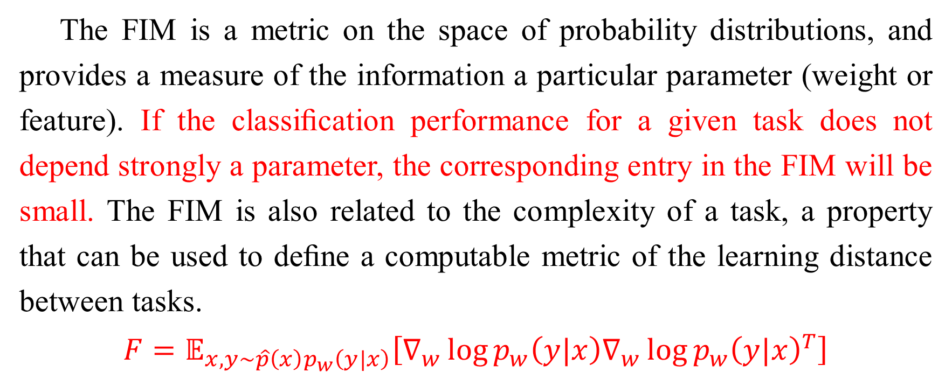
2. Task2Vec
The FIM is a metric on the space of probability distributions, and provides a measure of the information a particular parameter (weight or feature). If the classiﬁcation performance for a given task does not depend strongly a parameter, the corresponding entry in the FIM will be small. The FIM is also related to the complexity of a task, a property that can be used to deﬁne a computable metric of the learning distance between tasks.
$$F=𝔼_{x,y\sim \hat{p}\left(x\right)p_{w}\left(y|x\right)}\left[∇_{w}\log{p_{w}\left(y|x\right)∇_{w}\log{p_{w}{\left(y|x\right)}^{T}}}\right]$$
Notes:
$\hat{p}$: empirical distribution F represents a combine distribution

Slide 9
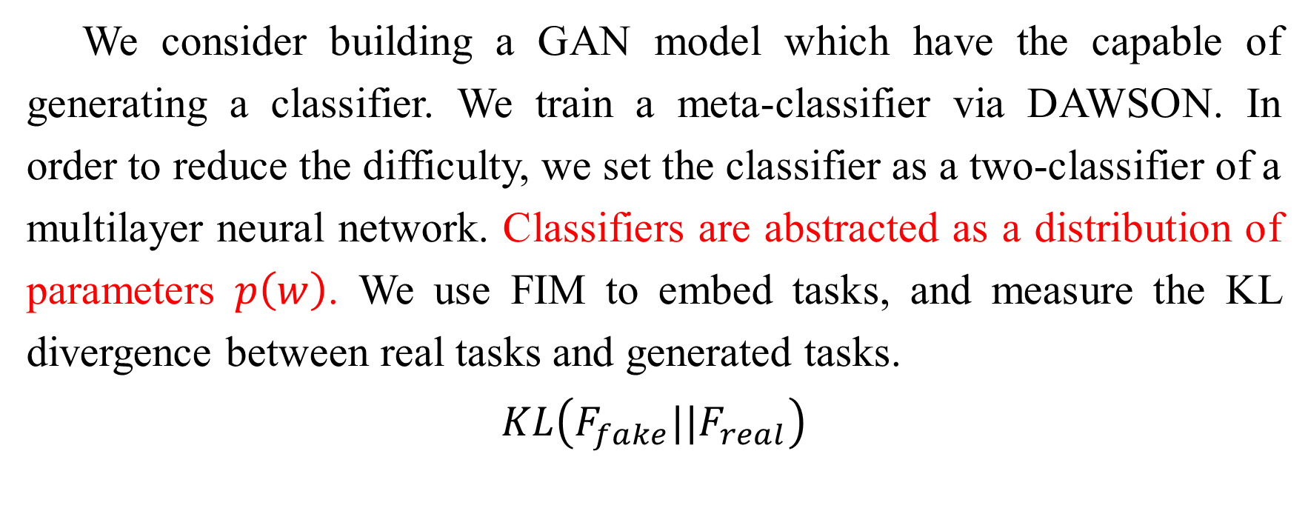
3. Our work
We consider building a GAN model which have the capable of generating a classifier. We train a meta-classifier via DAWSON. In order to reduce the difficulty, we set the classifier as a two-classifier of a multilayer neural network. Classifiers are abstracted as a distribution of parameters $p\left(w\right)$. We use FIM to embed tasks, and measure the KL divergence between real tasks and generated tasks.
$$KL\left(F_{fake}||F_{real}\right)$$
Notes:
If the classiﬁcation performance for a given task does not depend strongly on a parameter, the corresponding entries in the FIM will be small.

Slide 10
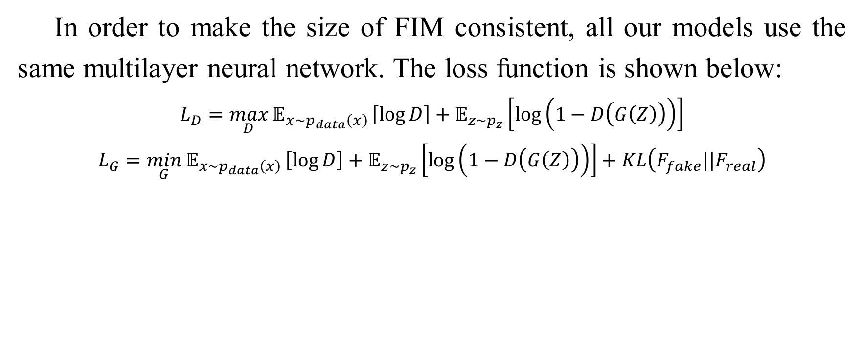
3. Our work
In order to make the size of FIM consistent, all our models use the same multilayer neural network. The loss function is shown below:
$$L_{D}=\max_{D}{𝔼_{x\sim p_{data}\left(x\right)}}\left[\log{D}\right]+𝔼_{z\sim p_{z}}\left[\log\left(1−D\left(G\left(Z\right)\right)\right)\right]$$
$$L_{G}=\min_{G}{𝔼_{x\sim p_{data}\left(x\right)}}\left[\log{D}\right]+𝔼_{z\sim p_{z}}\left[\log\left(1−D\left(G\left(Z\right)\right)\right)\right]+KL\left(F_{fake}||F_{real}\right)$$

Slide 11
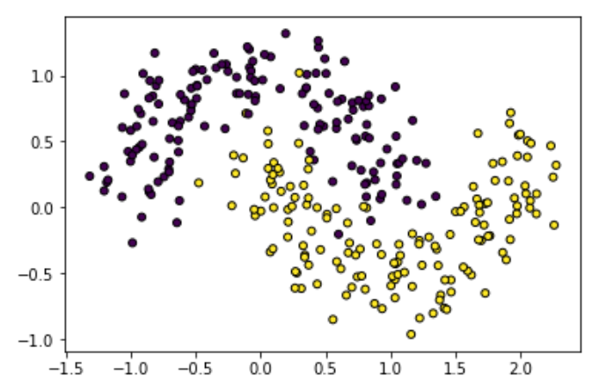
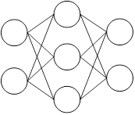
4. Experiment
Currently only experiments on generating parameters. Tasks are defined as simple binary classification tasks.

Slide 12
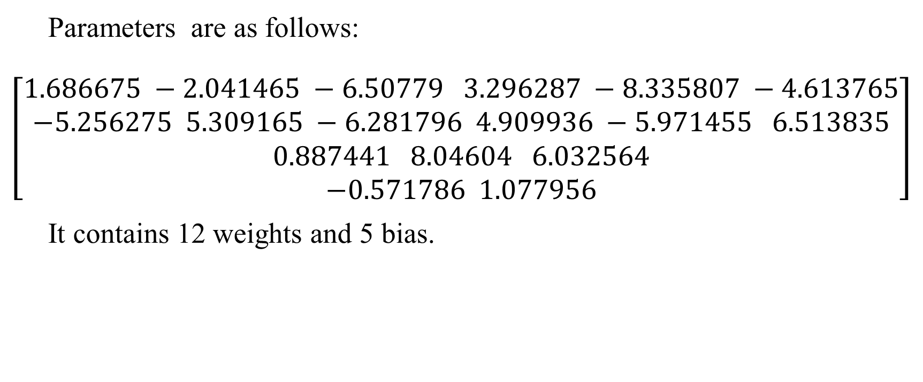
4. Experiment
Parameters are as follows:
$$\left[\begin{aligned}1.686675 −2.041465 −6.50779 3.296287 −8.335807 −4.613765 \\ −5.256275 5.309165 −6.281796 4.909936 −5.971455 6.513835 \\ 0.887441 8.04604 6.032564 \\ −0.571786 1.077956\end{aligned}\right]$$
It contains 12 weights and 5 bias.

Slide 13
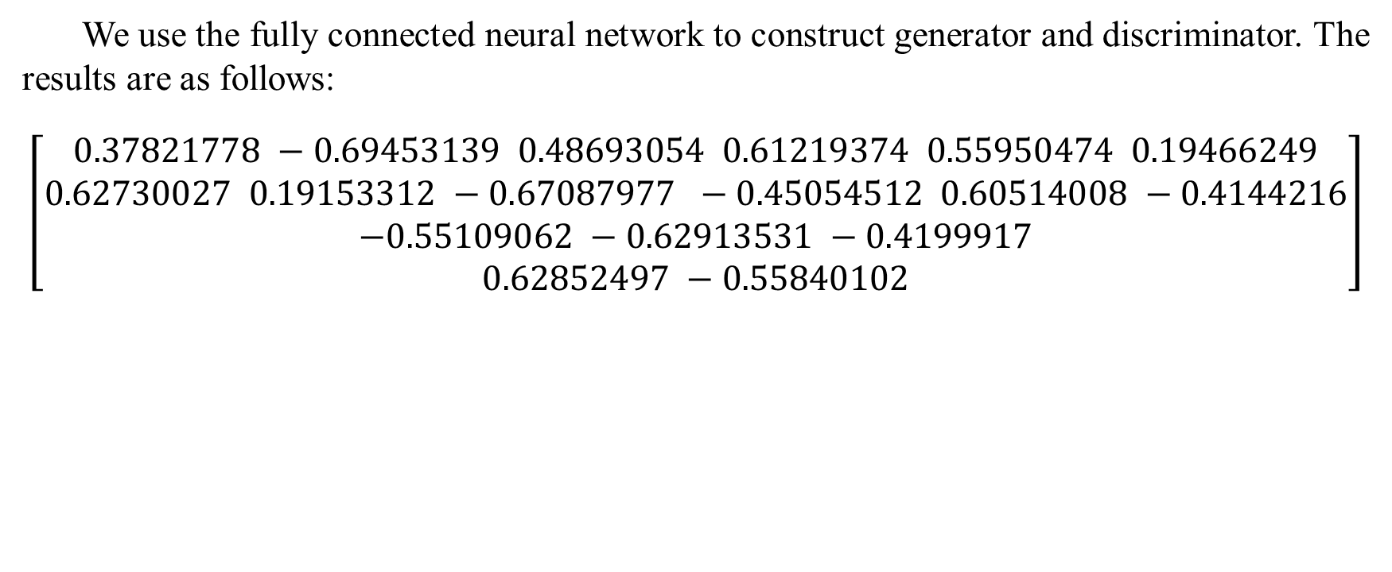
4. Experiment
We use the fully connected neural network to construct generator and discriminator. The results are as follows:
$$\left[\begin{aligned}0.37821778 −0.69453139 0.48693054 0.61219374 0.55950474 0.19466249 \\ 0.62730027 0.19153312 −0.67087977 −0.45054512 0.60514008 −0.4144216 \\ −0.55109062 −0.62913531 −0.4199917 \\ 0.62852497 −0.55840102\end{aligned}\right]$$

Slide 14
5. Existing problems
1. Ways to conduct the two models;
2. The distribution of parameters;
3. Training problems with different types of parameters
4. The size of the data set

Slide 15
Thanks for listening!

