Slide 1
Low frequency recovery in full waveform inversion
with deep learning
Yaoliu
20200507

Slide 2
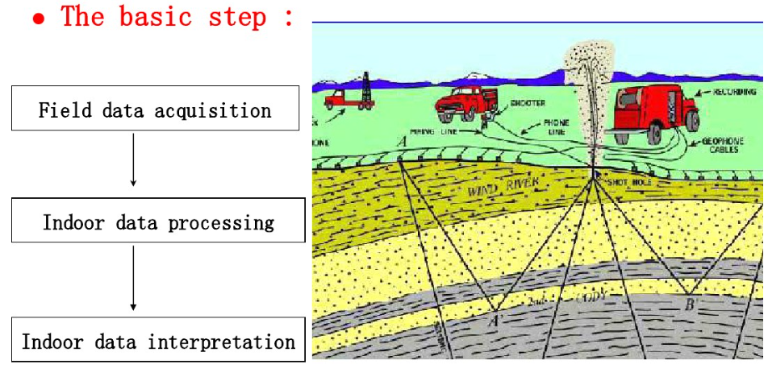
Seismic exploration
Objective：
Explore the unknown structures of underground
Earthquake excitation by artificial means
Receivers receive the reflected signal
Seismic records processing
forward
inversion FWI
underground structure

Slide 3
Background
Because of the acquisition limitation in seismic processing, the input data for seismic inversion are typically limited to a band above 3Hz.
The lack of low frequency information and a good initial model can seriously affect the success of full waveform inversion (FWI)

Slide 4
Task
The task is to restore the low frequency data from the limited frequency data.
Methods：Using the convolutional neural network (CNN) to automatically extrapolate the missing low frequencies without preprocessing and post-processing steps.
Hongyu Sun ,Laurent Demanet. Extrapolated full waveform inversion with deep learning. arXiv:1909.11536v2 [physics.geo-ph],2019

Slide 5
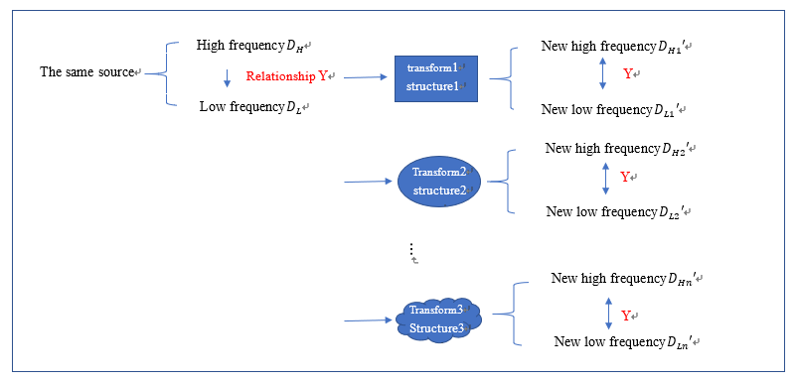
Feasibility Analysis
The idea behind CNN is to mine the hidden correlations among different frequency components.
Correlation：HF and FF > HF and LF
The input of CNN：
limited limited frequency data
The output of CNN：
full frequency data

Slide 6
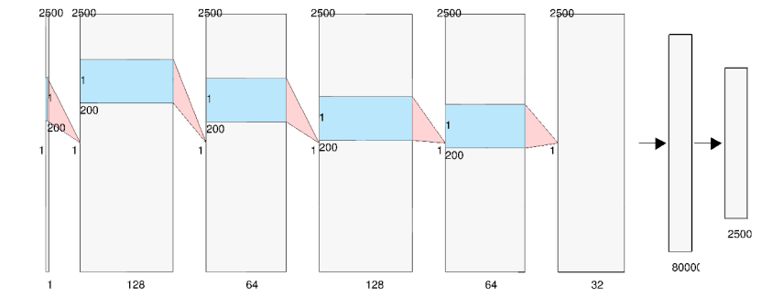
CNN
The architecture is a feed-forward stack of five sequential combinations of the convolution, PReLU and batch normalization layers, followed by one fully connected layer that outputs continuous-valued amplitude of the time-domain signal in the low frequency band.

Slide 7
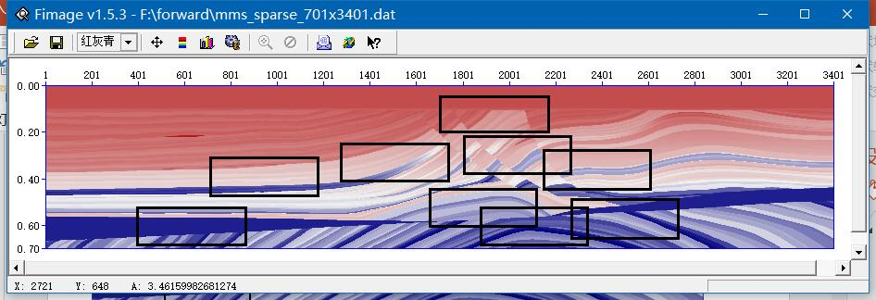
Data set -Physical model
Acquisition the seismic records by forward modeling.
Training models : nine parts of the Marmousi model with different structure but the same number of grid points 166 × 461 with a grid interval of 4m.
Test model: downsample the original model to 166×461. downsample the BP 2004 benchmark model to 80 × 450 grid points with a grid interval of 150m.

Slide 8
Data set – Forward modeling
Source: Ricker wavelet with dominant frequency 7Hz.
Acquisition geometry: Each model consists of 30 sources and 461 receivers evenly spaced at the surface.
Use a tenth order in space and second order in time finite-difference modeling method with PML to solve the 2D acoustic wave equation in the time domain. The sampling interval and the total recording time are 1ms and 2.5s, respectively. The grid interval of forward(DH) is 10m,which is not introduced in the paper.
We consider each time series or trace as one sample in the data set, so have 124470 training samples and 13830 test samples for each test model in total.

Slide 9
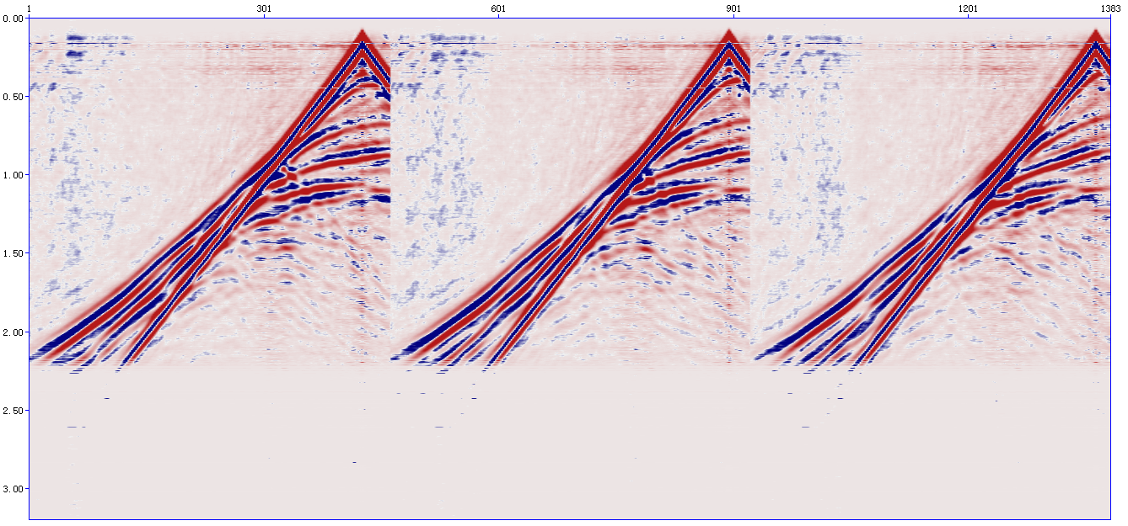
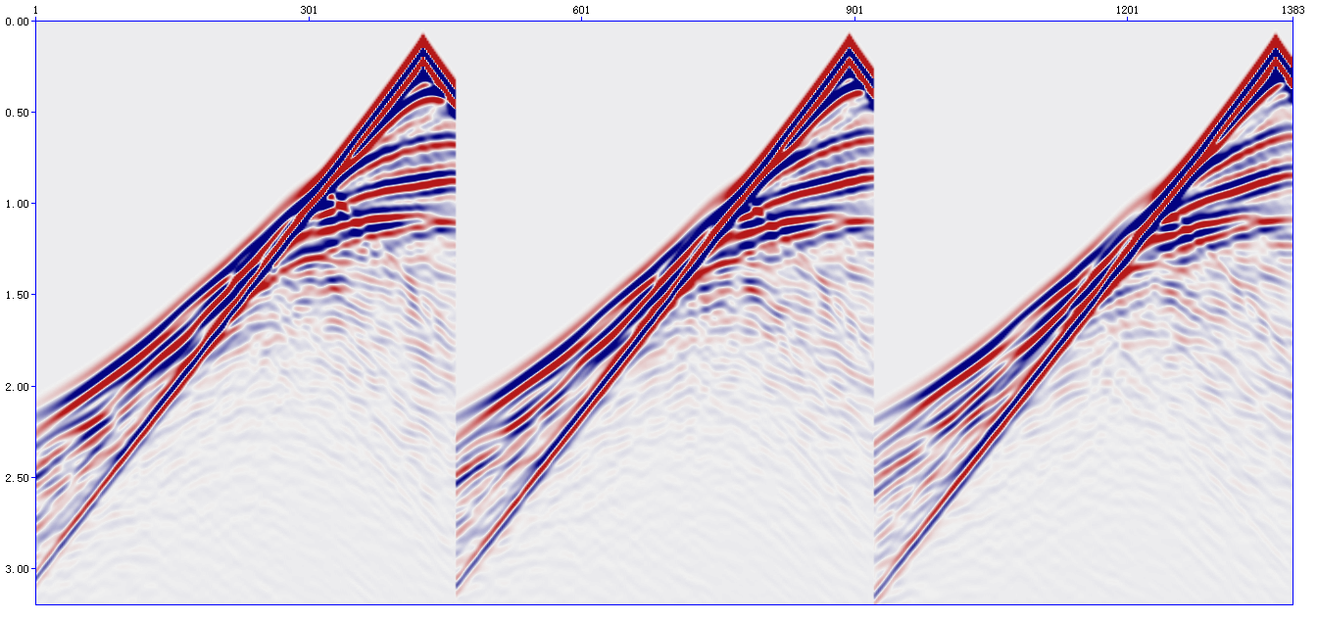
Experiment results
the picture above ：
predicted full frequency data
the images below：
True full frequency data
Test_loss: MSE=0.8511361
(25816 training samples)
Next week plans：
Continue training with new data set

Slide 10
谢谢！

