Slide 1
Introduce Graph to GANs
Peng Xuyang

Slide 2
Catalogue
BiGAN & SAGAN
Our work
Some problems

Slide 3
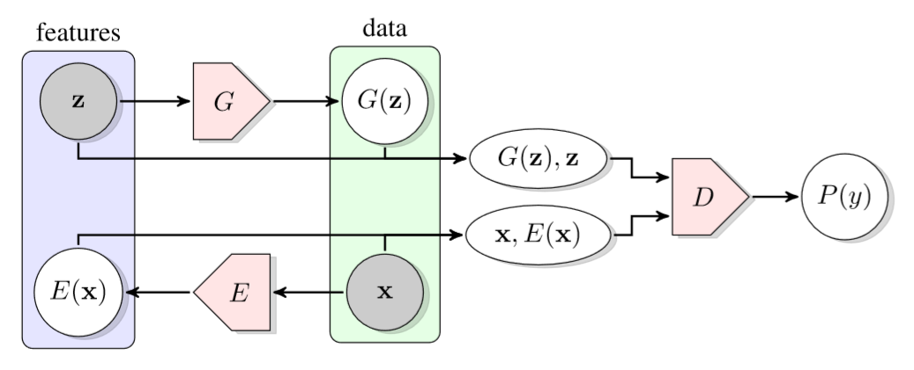
1. BiGAN & SAGAN
BiGAN means Bidirectional Generative Adversarial Networks. Compared with standard GAN, BiGAN introduces a encoder to GANs model whose function is mapping the real data to the noise z.

Slide 4
1. BiGAN & SAGAN
This inverse mapping demonstrates that the resulting learned feature representation is useful for auxiliary supervised discrimination tasks, competitive with contemporary approaches to unsupervised and self-supervised feature learning. BiGAN shows that GAN can perform representation learning

Slide 5
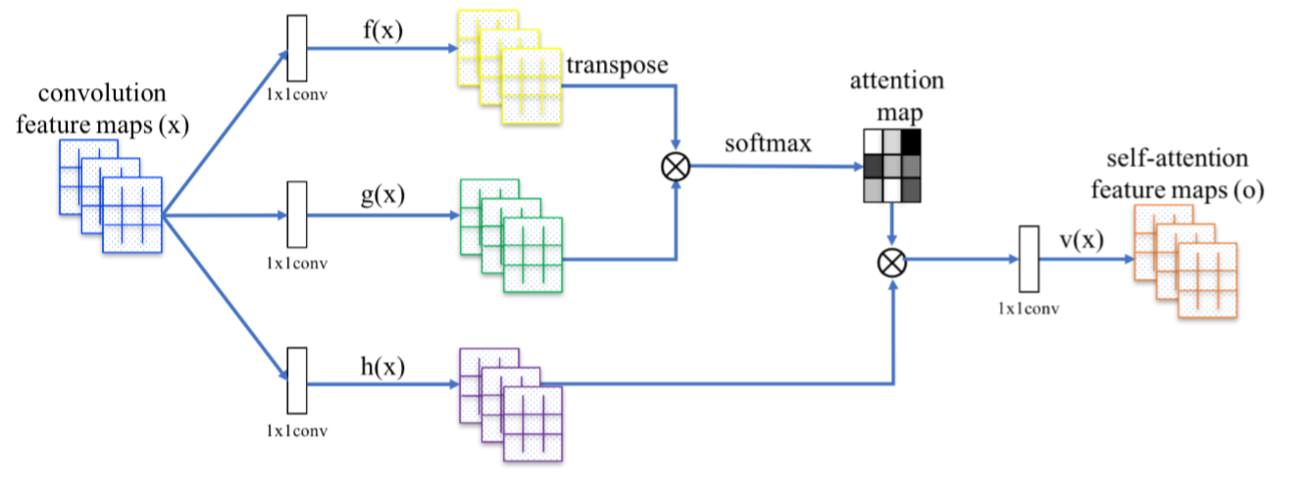
1. BiGAN & SAGAN
SAGAN means Self-Attention Generative Adversarial Networks. It introduce a self-attention mechanism into convolutional GANs.

Slide 6
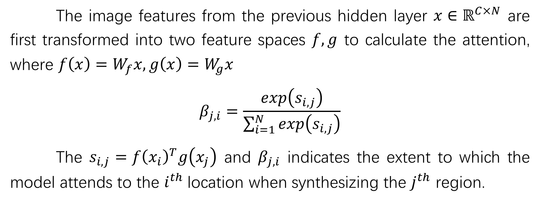
1. BiGAN & SAGAN
The image features from the previous hidden layer $x∈ℝ^{C×N}$ are first transformed into two feature spaces $f,g$ to calculate the attention, where $f\left(x\right)=W_{f}x, g\left(x\right)=W_{g}x$
$$β_{j,i}=\frac{exp\left(s_{i,j}\right)}{\sum_{i=1}^{N}{exp\left(s_{i,j}\right)}}$$
The $s_{i,j}={f\left(x_{i}\right)}^{T}g\left(x_{j}\right)$ and $β_{j,i}$ indicates the extent to which the model attends to the $i^{th}$location when synthesizing the $j^{th}$ region.

Slide 7
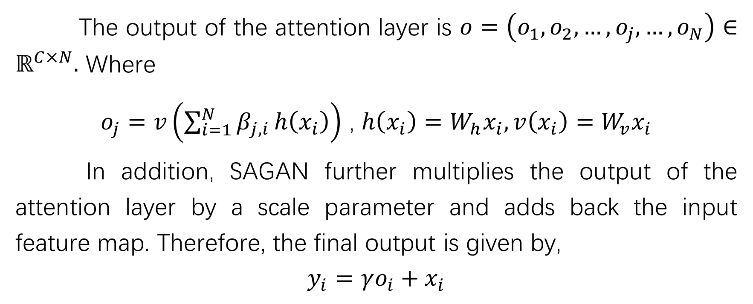
1. BiGAN & SAGAN
The output of the attention layer is $o=\left(o_{1},o_{2},…,o_{j},…,o_{N}\right)∈ℝ^{C×N}.$ Where
$o_{j}=v\left(\sum_{i=1}^{N}{β_{j,i}}h\left(x_{i}\right)\right)$ , $h\left(x_{i}\right)=W_{h}x_{i},v\left(x_{i}\right)=W_{v}x_{i}$
In addition, SAGAN further multiplies the output of the attention layer by a scale parameter and adds back the input feature map. Therefore, the final output is given by,
$$y_{i}=γo_{i}+x_{i}$$

Slide 8
2. Our work
Combining the represent learning of BiGAN and the self-attention mechanism of SAGAN, we introduce Graph to GANs model. We use the GCN model to extract the relationship feature of the convolutional feature maps. The main idea is to construct an adjacency matrix by the attention mechanism.

Slide 9

2. Our work
GCN：
$Z=D^{−\frac{1}{2}}A$ $D^{−\frac{1}{2}}XΘ$

Slide 10
2. Our work

Slide 11
2. Our work

Slide 12
3. Some problems
1. Since each adjacency matrix needs to calculate each channel separately during normalization, the time loss of the algorithm will be larger.
2. When GCN is used in the generator, the graph convolution should be an inverse process.

Slide 13
Thanks!

