Slide 1
Table to Text
汇报人：fei wang

Slide 2
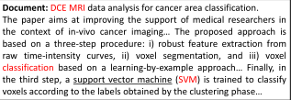
Neural Keyphrase Generation via Reinforcement Learning
with Adaptive Rewards
task
generate
Using the attentional encoder-decoder model (Rui Meng, etc. 2017. Deep keyphrase generation ) with copy mechanism generating predicted keyphrase which includes an Attentional encoder-decoder mode, Pointer-generator network and using Maximum likelihood function as loss function to generate predicted keyphrase .
Reinforcement learning was used for TOP-N ranking of selected keywords, and an innovative adaptive reward function was used.
techniques
then
Compared four baseline generative models using maximum-likelihood loss or adaptive reward function (Proposed). These models include catSeq, catSeqD, catSeqCorr and
catSeqTG .
F1@5 and F1@M evaluation criteria were used.
measure

Slide 3
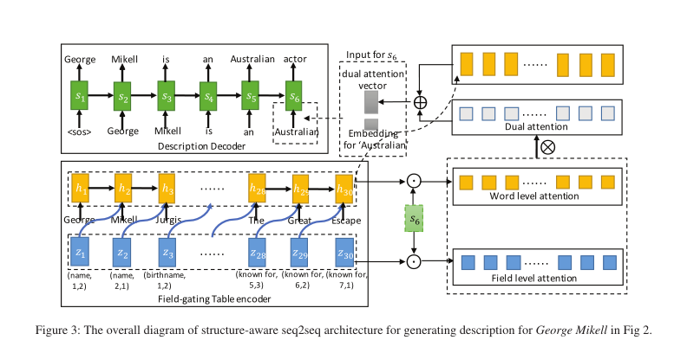
Table-to-Text Generation by Structure-Aware Seq2seq Learning
structure

Slide 4
Result
leonard john **randle** -lrb- born february 12 , 1949 -rrb- is a former major league baseball second baseman and third baseman .
leonard shenoff randle -lrb- born february 12 , 1949 -rrb- is a former major league baseball player .
philippe **adnot** -lrb- born 25 august 1945 -rrb- is a french politician and member of the european parliament for **aube** canton .
philippe adnot -lrb- born 25 august 1945 in rhèges -rrb- is a member of the senate of france .
miroslav popov -lrb- born 14 june 1995 -rrb- is a grand prix motorcycle racer from the czech republic .
miroslav popov -lrb- born 14 june 1995 in dvůr králové nad labem -rrb- is a czech grand prix motorcycle racer .

Slide 5
Result
设置了10个epoch
最好运行的结果是
Rouge-4(with copy F-measure)=0.39218 (epoch 11)；
BLEU-4(with copy F-measure)=0.4262 (epoch 12)；
Rouge-4(without copy F-measure)=0.31326 (epoch 11)；
BLEU-4(without copy F-measure)=0.3960 (epoch 12)。

Slide 6
Thanks for you

