Slide 1
Low frequency extrapolation in full waveform inversion
with deep learning
Yaoliu
20200528

Slide 2
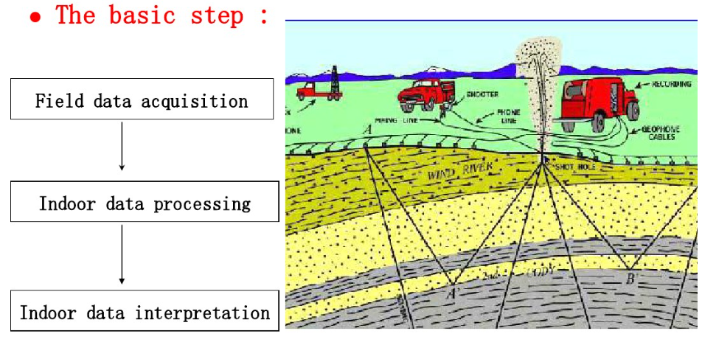
Seismic exploration
Objective：
Explore the unknown structures of underground
Earthquake excitation by artificial means
Receivers receive the reflected signal
Seismic records processing
forward
inversion FWI
underground structure

Slide 3
Background
Because of the acquisition limitation in seismic processing, the input data for seismic inversion are typically limited to a band above 3Hz.
The lack of low frequency information and a good initial model can seriously affect the success of full waveform inversion (FWI)

Slide 4
Task
The task is to restore the low frequency data from the limited frequency data.
Methods：Using the convolutional neural network (CNN) to automatically extrapolate the missing low frequencies without preprocessing and post-processing steps.
[1] Hongyu Sun ,Laurent Demanet. Extrapolated full waveform inversion with deep learning. arXiv:1909.11536v2 [physics.geo-ph],2019
[2] Hongyu Sun and Laurent Demanet, (2020), "Extrapolated full-waveform inversion with deep learning," GEOPHYSICS 85: R275-R288.

Slide 5
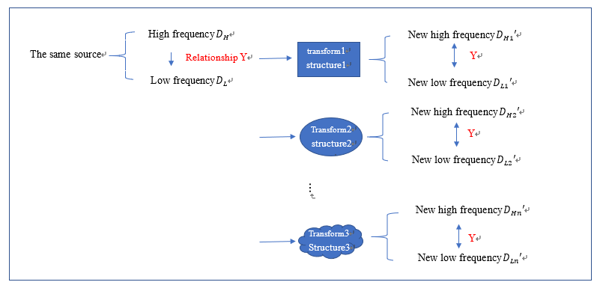
Feasibility Analysis
The idea behind CNN is to mine the hidden correlations among different frequency components.
Correlation：HF and FF > HF and LF
（see waveform ）
The input of CNN：
limited limited frequency data
The output of CNN：
full frequency data

Slide 6
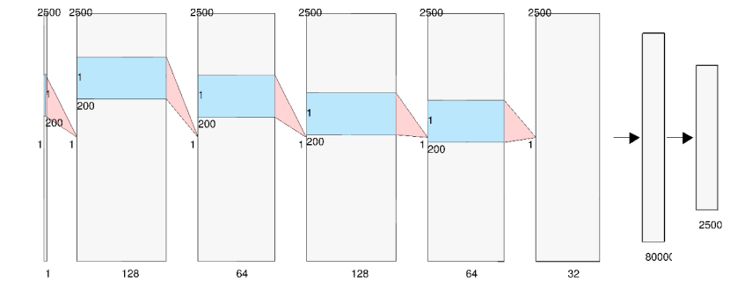
CNN
The architecture is a feed-forward stack of five sequential combinations of the convolution, PReLU and batch normalization layers, followed by one fully connected layer that outputs continuous-valued amplitude of the time-domain signal in the low frequency band.

Slide 7
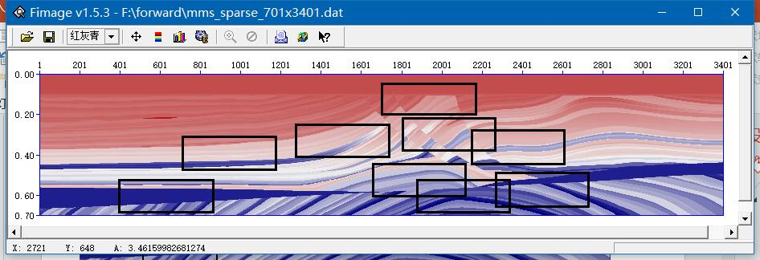
Data set -Physical model
Acquisition the seismic records by forward modeling.
Training models : nine parts of the Marmousi model with different structure but the same number of grid points 166 × 461 with a grid interval of 4m.
Test model: downsample the original model to 166×461. downsample the BP 2004 benchmark model to 80 × 450 grid points with a grid interval of 150m.

Slide 8
Training models
4
3
5
2
6
7
1
9
8
coordinates ：
1（400,520） -（860,685） 6（2145,272）-（2605,437）
2（701,310） -（1161,475） 461 7（1653,440）-（2113,605）
3（1276,244）-（1736,409） 166 8（1873,520）-（2333,685）
4（1701,35） -（2161,200） 9（2261,480）-（2721,645）
5（1801,208）-（2261-373）

Slide 9
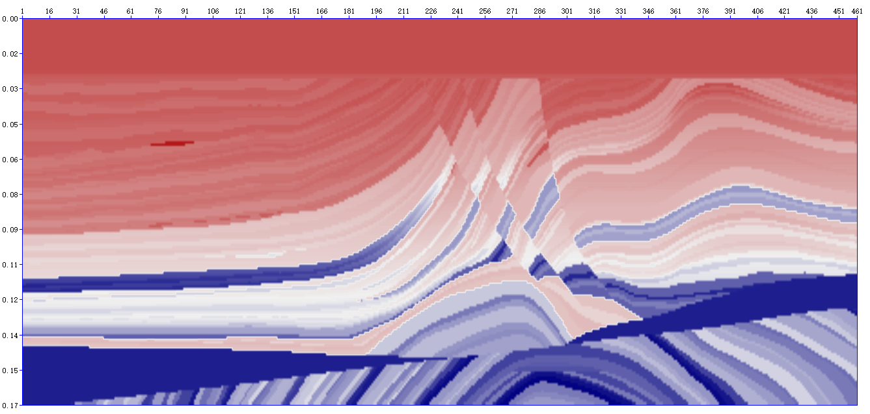
Test models
source
226
30
absorbing Boundary
30
521

Slide 10
Data set – Forward modeling
Source: Ricker wavelet with dominant frequency 7Hz.
Acquisition geometry: Each model consists of 30 sources and 461 receivers evenly spaced at the surface.
Use a tenth order in space and second order in time finite-difference modeling method with PML to solve the 2D acoustic wave equation in the time domain. The sampling interval and the total recording time are 1ms and 2.5s, respectively. The grid interval of forward(DH) is 10,which is not introduced in the paper.
We consider each time series or trace as one sample in the data set, so have 124470 training samples and 13830 test samples for each test model in total.

Slide 11
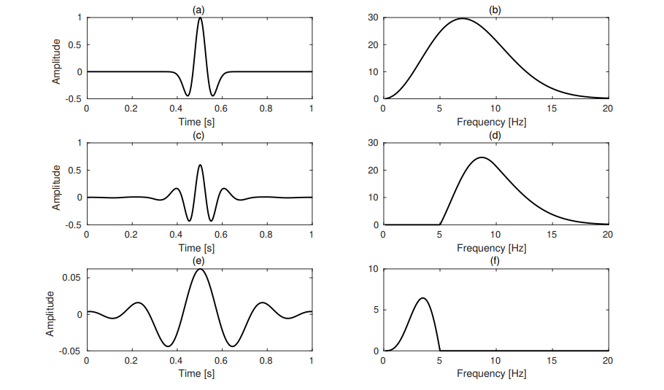
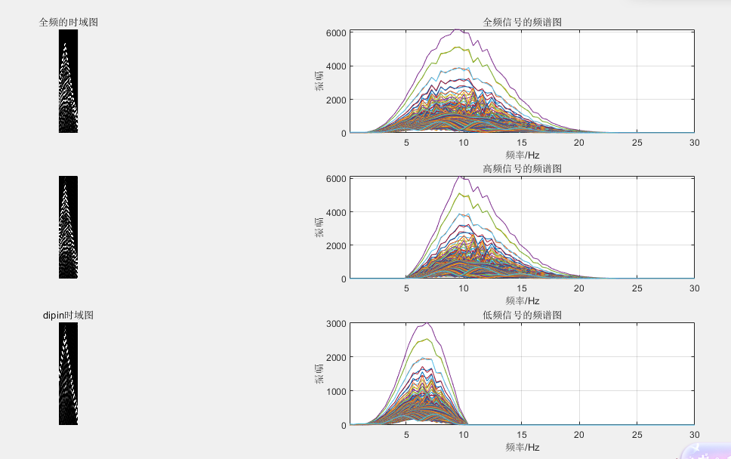
Filter –above 5hz and below 5hz

Slide 12
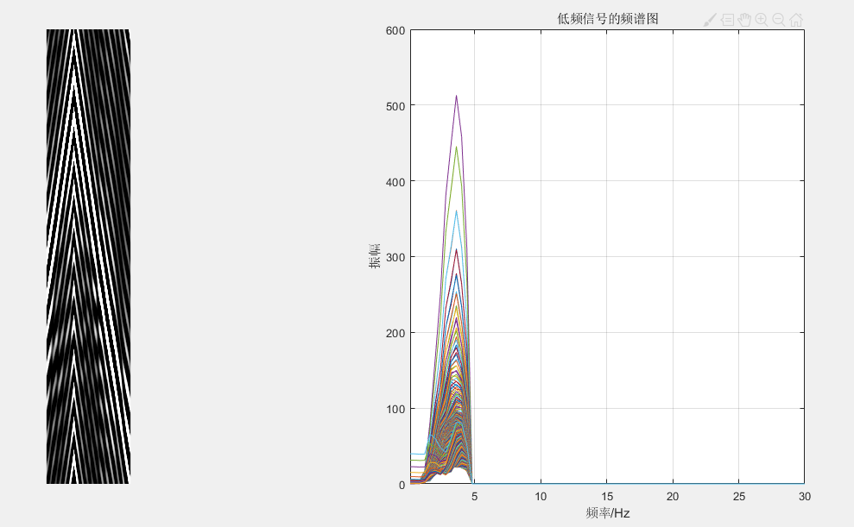

Slide 14
Q&A
1.使用高通滤波器获得5hz以上的地震记录时，要从哪个频率开始衰减？
-论文中应该是从10Hz开始衰减。为什么是10不清楚。
2.低频信号是由全频减去高频还是也使用低通滤波器？
-我选择的方式是第一种，这样低频跟高频加起来还是完整的信号；而论文中的低频也同高频一般使用了滤波器，得到的0-5HZ的低频并不完整，那么学出来的低频也不是完整的，这个操作我不明白。
-请教了王珺老师，王老师也倾向于第一种方法。
3.使用的是主频为7hz的雷克子波，按照雷克子波频谱图应该得到的是0-20hz的地震记录，为什么显示的地震记录频谱图有偏移现象？
-地球物理的师兄说是正常现象，具体原因没说；
-王老师暂时不清楚这个问题。

Slide 15
谢谢！

Slide 16
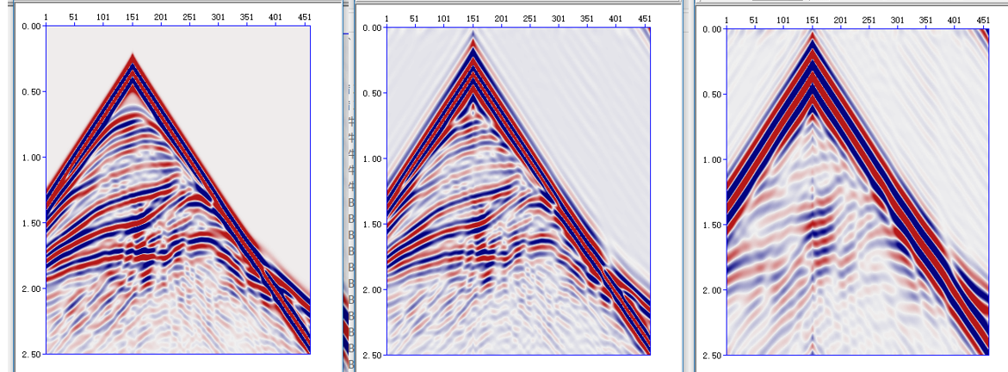
True ff, hf, lf

