Slide 1

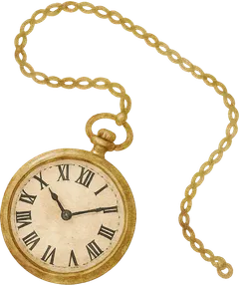
SHIRU
I
II
III
IV
CHAPTER ? · MISSING
This page fell down the wrong hole
Whatever was here has been torn out. It happens to old books.
CLIMB BACK TO THE STORY

