Slide 1


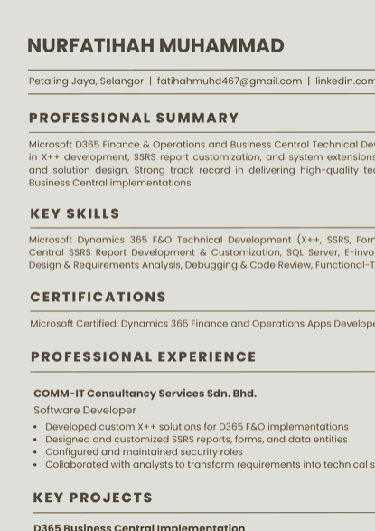
CASE NO. II · RÉSUMÉ
on the record
A Microsoft Dynamics 365 Finance & Operations and Business Central technical developer with over four years of experience. X++, SSRS reports and extensions; requirements in, working solutions out.
NOW
D365 F&O Associate Developer, LOGISTEED Solutions Asia-Pacific Sdn. Bhd. (Feb 2026 – present)
BEFORE
COMM-iT Group: Software Developer (Feb 2023 – Apr 2026), Junior Consultant (Feb 2022 – Feb 2023)
CERTIFIED
Microsoft Certified: Dynamics 365 Finance and Operations Apps Developer Associate (June 2023)
STUDIED
Bachelor of Electronic Engineering (Computer) with Honours, Universiti Malaysia Sabah (2016 – 2020)
BASED IN
Selangor, Malaysia
SKILLS
X++
SSRS reports
Forms & data entities
Extensions
Business Central
AL
SQL Server
E-invoicing
Security roles
Solution design
Debugging & code review
DOWNLOAD THE RÉSUMÉ
PDF, 1 page, 2.7 MB
Or read it in the browser
·
The long version is in the grimoire ↓

