Slide 1


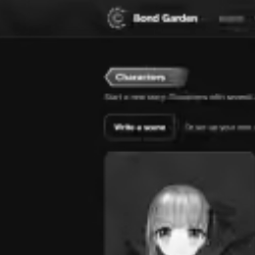
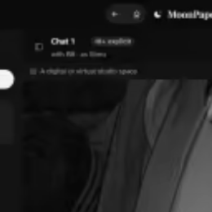
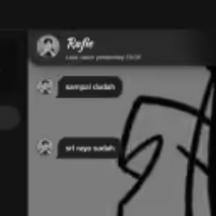
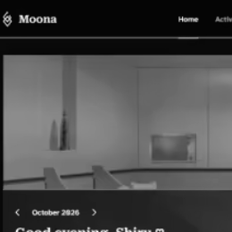
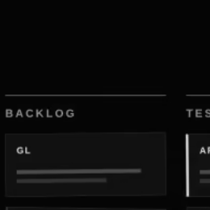
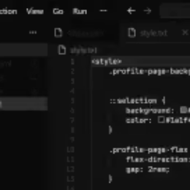
CASE NO. III · WORK
The archives
What I build after hours. Six open investigations; none of them are closed.
Pick a file. They don’t bite. Mostly.
NO. 1
NO. 2
NO. 3
Bond Garden
MoonPaper
Napyru
NO. 4
NO. 5
NO. 6
Moona
F&O Task Board
The colour themes

