Slide 1
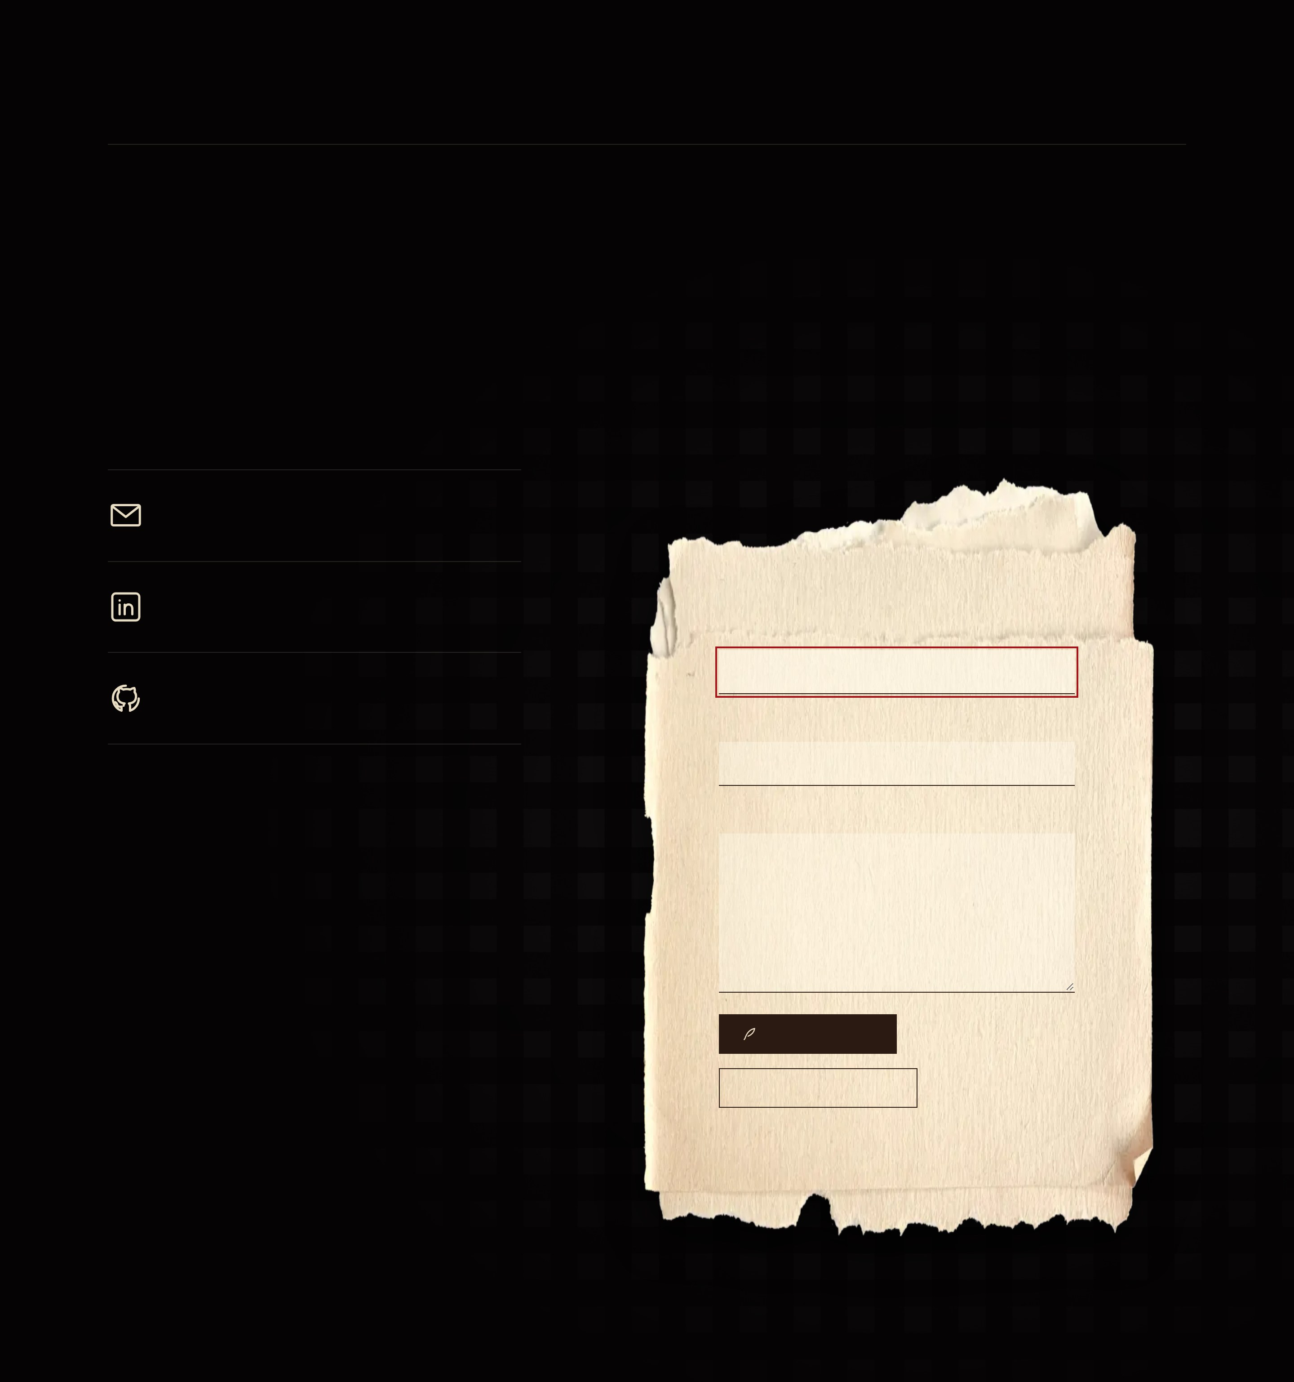
CASE NO. V · CONTACT
Tea at midnight
There’s a seat at the table. The tea is still warm, probably.
EMAIL
shirubawing@gmail.com
LINKEDIN
Write to me
The professional record
YOUR NAME
GITHUB
Code, experiments, unfinished things
YOUR EMAIL
YOUR LETTER
SEND THE RAVEN
FOLD THE LETTER AWAY
Opens your mail app with the letter ready.

