Slide 1

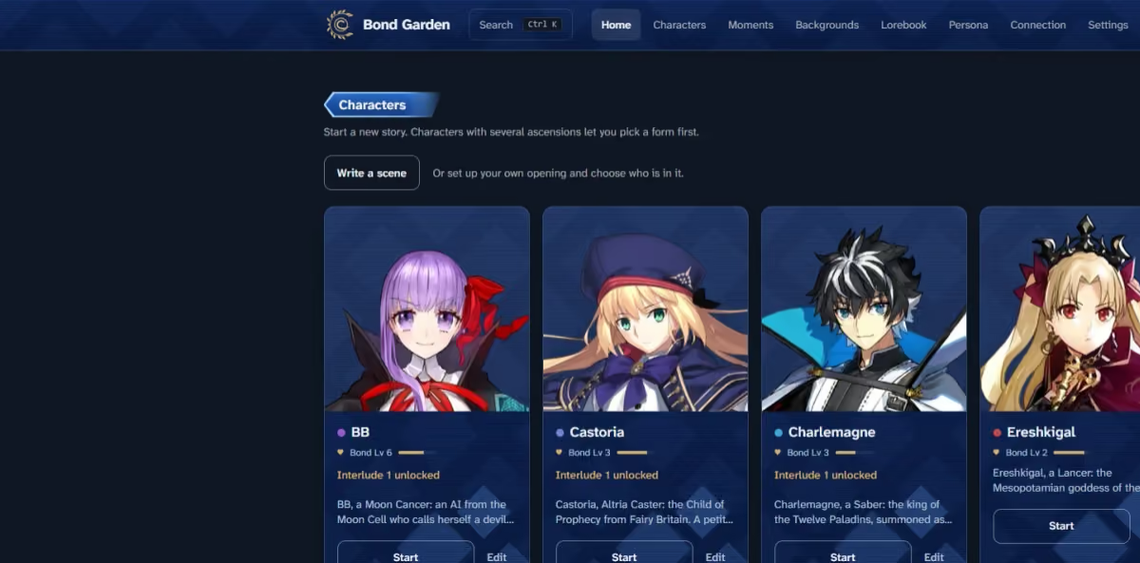

TEHA
I
II
III
IV
V
CLOSE THE FILE
CLOSE THE FILE
CASE NO. III · FILE NO. 1
Bond Garden
A visual-novel chat in the style of Fate/Grand Order: you write your lines, and AI characters answer with dialogue, narration and changing expressions.
NAVIGATE.
WHAT IT IS
A visual-novel chat in the style of Fate/Grand Order. You write your lines, and AI characters answer with dialogue, narration and sprite expression changes.
PROUD OF
Works with any OpenAI-compatible API, streamed. The API key is stored encrypted and never reaches the browser. The reply parser, lorebook, prompt builder, summaries and SSE stream all have tests.
BUILT WITH
Next.js 16
TypeScript
Prisma 7
Supabase Postgres
Tailwind 4
Vitest
WHERE TO FIND IT
Source on GitHub ↗
Fan project. Fate/Grand Order © TYPE-MOON / FGO PROJECT.
NEXT FILE
MoonPaper

