Slide 1
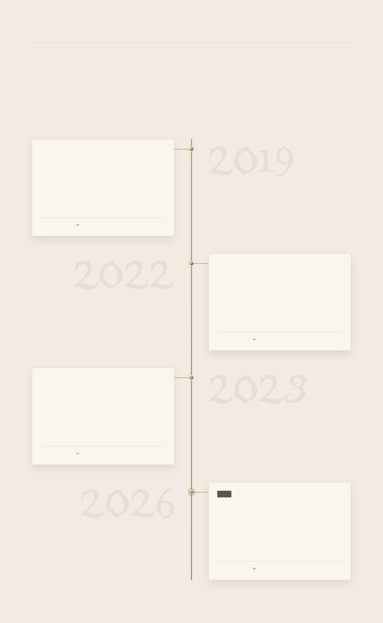
CASE NO. III · EMPLOYMENT
The paper trail
Every job, in the order it happened. Follow the thread; open any file for the details.
OCT 2019
·
1 MO
Maintenance Engineer
Advanced Air Traffic Systems (M) Sdn. Bhd.
Apprenticeship · Kota Kinabalu, Sabah · On-site
A Network Attached Storage (NAS) system, built from the ground up.
OPEN THE FILE
FEB 2022 – FEB 2023
·
1 YR 1 MO
Junior Consultant
COMM-iT Group
Full-time · Petaling Jaya, Selangor · On-site
Led the redesign of the company website, with X++ alongside.
OPEN THE FILE
FEB 2023 – APR 2026
·
3 YRS 3 MOS
Software Developer
COMM-iT Group
Full-time · Petaling Jaya, Selangor · On-site
Custom X++ for Dynamics 365 Finance & Operations implementations, and AL for Business Central.
OPEN THE FILE
NOW
FEB 2026 – PRESENT
·
10 MOS
D365 F&O Associate Developer
LOGISTEED Solutions Asia-Pacific Sdn. Bhd.
Full-time · Bandar Baru Bangi, Selangor · Hybrid
X++ and SQL Server Reporting Services on Dynamics 365 Finance & Operations.
OPEN THE FILE

