Slide 1
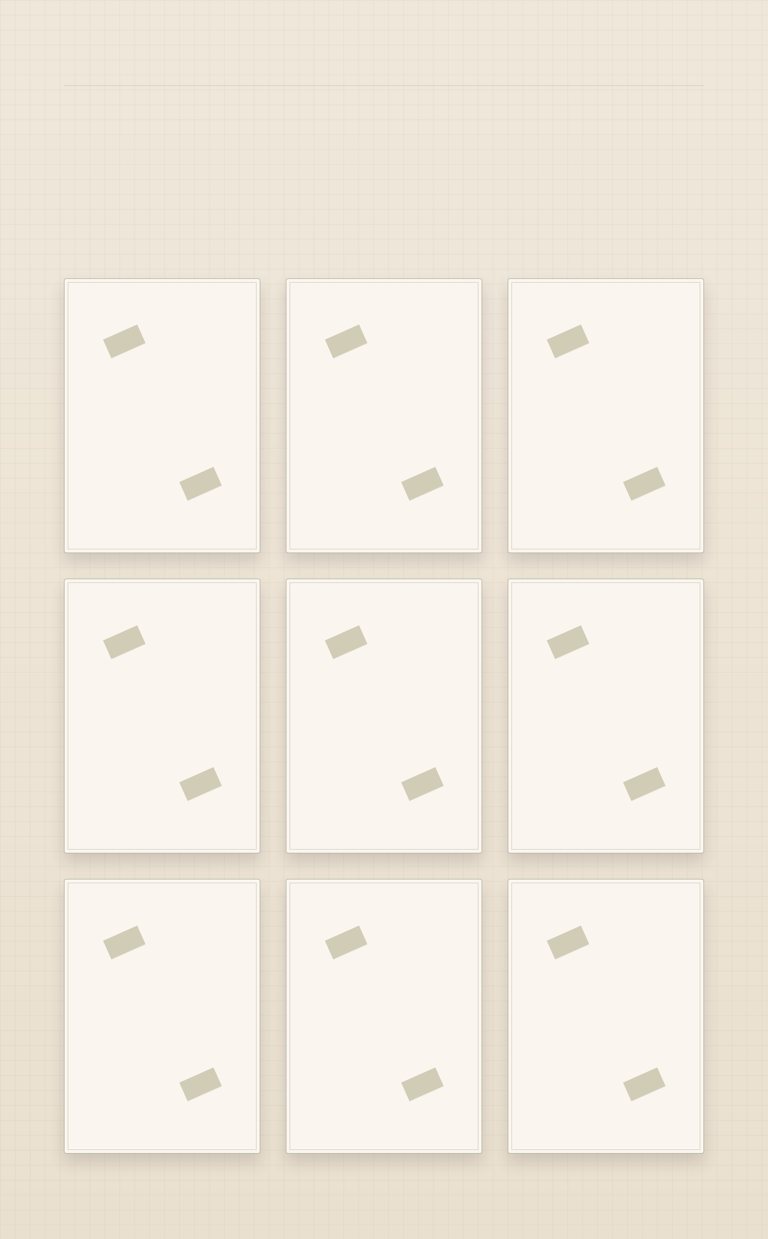
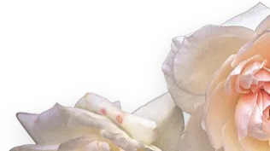
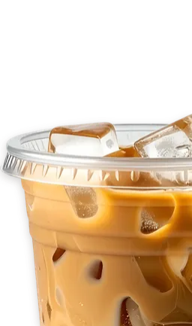

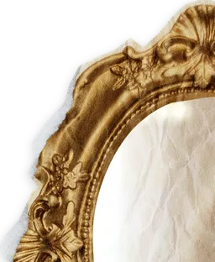


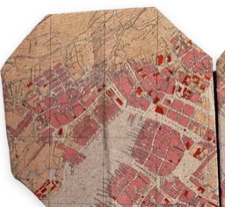
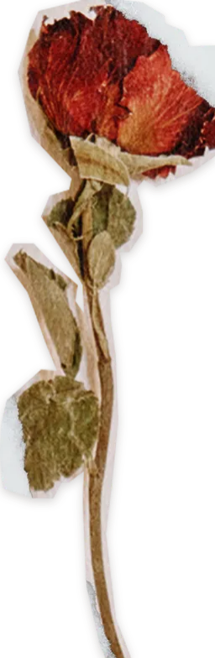
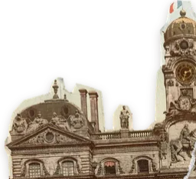
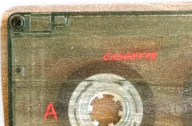
CASE NO. II · HOBBIES
Small, living things
What I keep when nobody is paying me to: pressed, labelled, only slightly dusty. Turn one over.
SPECIMEN NO. I
SPECIMEN NO. II
SPECIMEN NO. III
NO. I · CATS
NO. II · ICED COFFEE
NO. III · WORLDS I PLAY IN
Cats, always. The best colleagues: quiet, warm, and they never ask for a status update.
The official fuel. Always iced, at any hour, in any weather.
Where my evenings go, and where half my characters come from.
Genshin Impact
Fate/Grand Order
Wuthering Waves
Honkai: Star Rail
Cats
TURN IT BACK ↺
Iced coffee
TURN IT BACK ↺
TURN IT BACK ↺
Worlds I play in
SPECIMEN NO. IV
SPECIMEN NO. V
SPECIMEN NO. VI
NO. IV · CHARACTERS & AUS
NO. V · COSPLAY
NO. VI · BETWEEN TWO TONGUES
Taking someone I love and asking who they’d be somewhere else. Half my side projects exist so they have somewhere to talk.
I buy my cosplays rather than sew them. The craft I care about is choosing who to be for a day.
I translate between English and Malay. Some words have no twin on the other side; you learn to walk around them politely.
TURN IT BACK ↺
TURN IT BACK ↺
TURN IT BACK ↺
Characters & AUs
Cosplay
Between two tongues
SPECIMEN NO. VII
SPECIMEN NO. VIII
SPECIMEN NO. IX
NO. VII · THINGS I BUILD FOR FUN
NO. VIII · DARK LULLABIES
NO. IX · THE AESTHETIC
Chat apps where my characters can answer back, a messenger for two, a tracker that judges my spending, and over a hundred VS Code colour themes.
Music boxes, ticking clocks and things that sound slightly wrong. The tea party playing on this site is my own, made with Suno.
American Horror Story, Alice in Wonderland and a little Violet Harmon. You may have noticed.
All of it on GitHub ↗
PLAY THE TEA PARTY
TURN IT BACK ↺
TURN IT BACK ↺
TURN IT BACK ↺
Things I build for fun
Dark lullabies
The aesthetic

