Slide 1


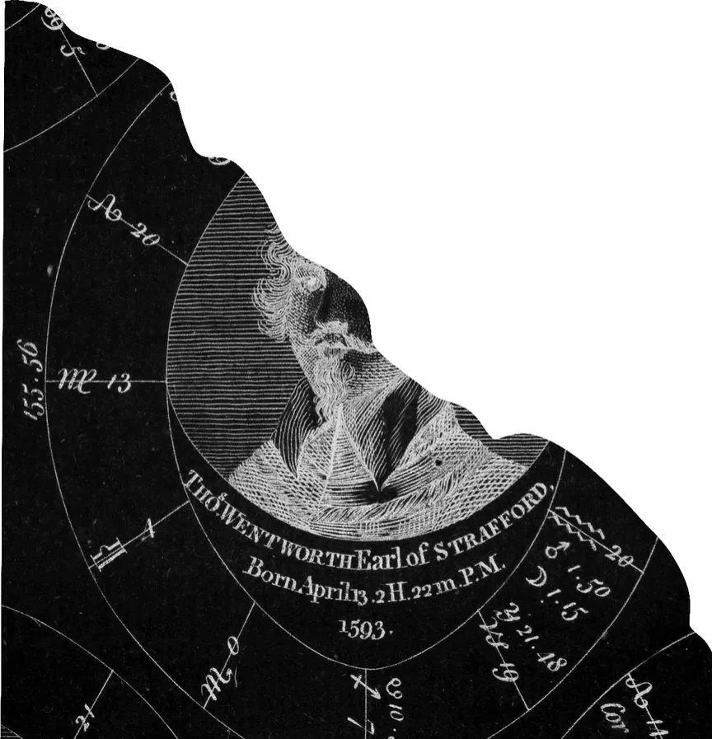
CASE NO. III · ASTROLOGY
Written in the stars
Seen from the glasshouse after dark: three signs the sky chose before I had a say.
SUN · WHO I AM
MOON · WHAT I FEEL
RISING · HOW I ARRIVE
♊︎
♌︎
♉︎
Gemini
Leo
Taurus
Air · 21 May – 20 Jun
Fire · 23 Jul – 22 Aug
Earth · 20 Apr – 20 May

