Slide 1

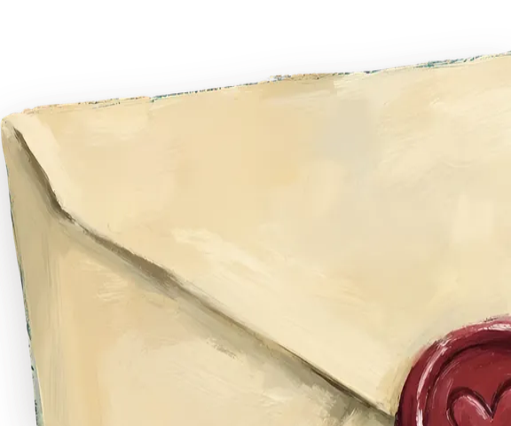
CASE NO. IV · CONTACT
Tea at midnight
There’s a seat at the table. The tea is still warm, probably.
EMAIL
shirubawing@gmail.com
GITHUB
Code, experiments, unfinished things
LINKEDIN
The professional record
INSTAGRAM
@teha.muhd
↑ CLICK THE SEAL

