Slide 1
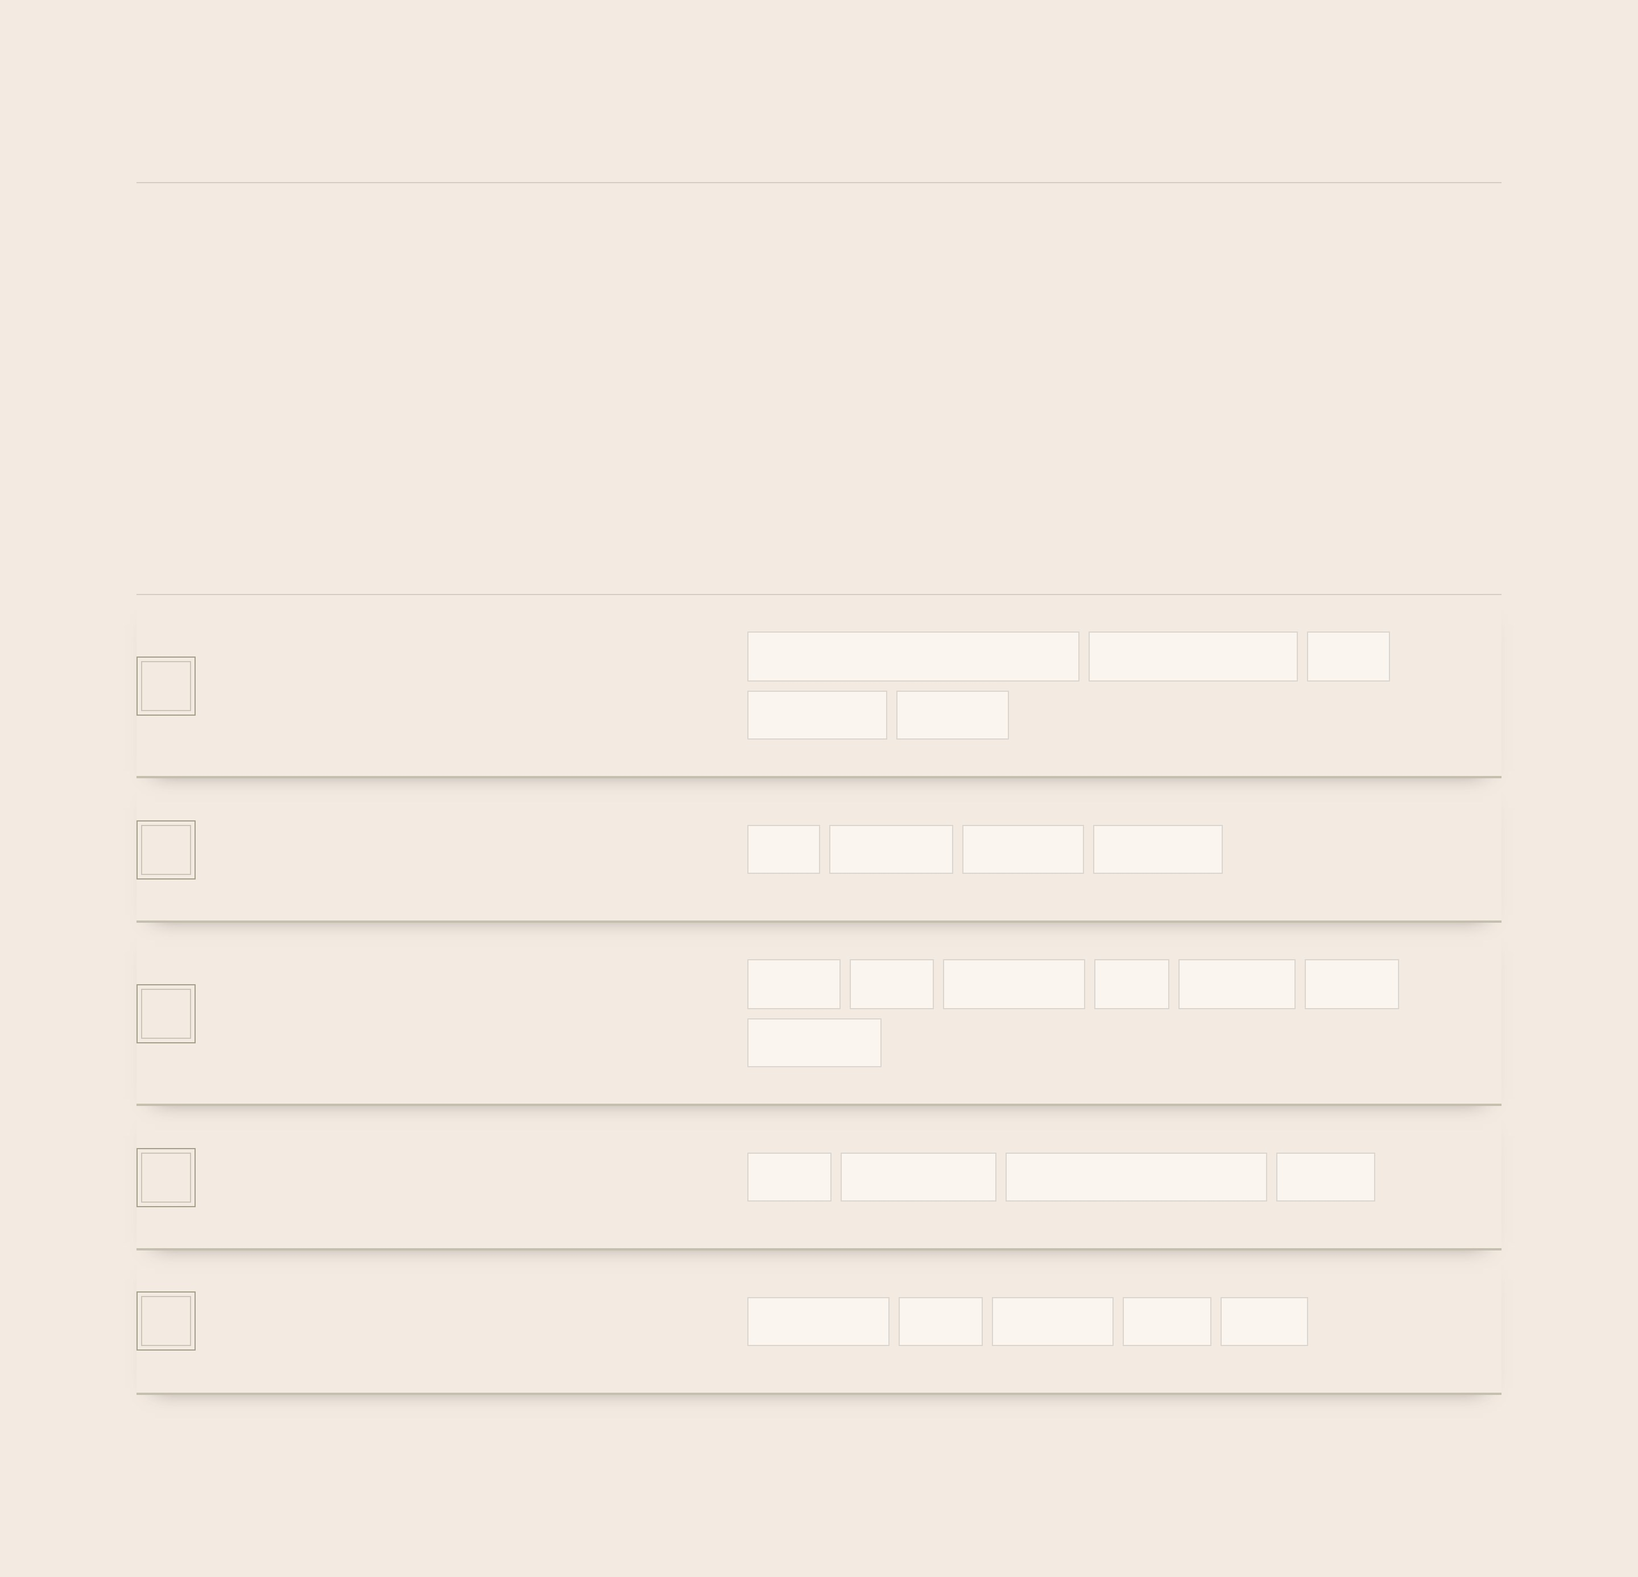
CASE NO. II · TECH STACK
The tool cabinet
What I reach for, shelf by shelf. The top two pay the bills; the rest is how I build everything else.
A
Enterprise applications
Dynamics 365 Finance & Operations
Business Central (AL)
SSRS
Where the day job lives.
Data entities
Workflow
B
Core development
X++
TypeScript
JavaScript
SQL Server
The languages I think in.
C
Frontend
Next.js
React
Tailwind CSS
PWA
Supabase
Prisma
Web apps, built properly.
PostgreSQL
D
Motion & interface
GSAP
Framer Motion
Three.js / React Three Fiber
UI / UX
Motion, colour and rooms like this one.
E
Tools & workflow
Git & GitHub
Vitest
Playwright
Figma
Canva
What keeps the work honest.

