Slide 1
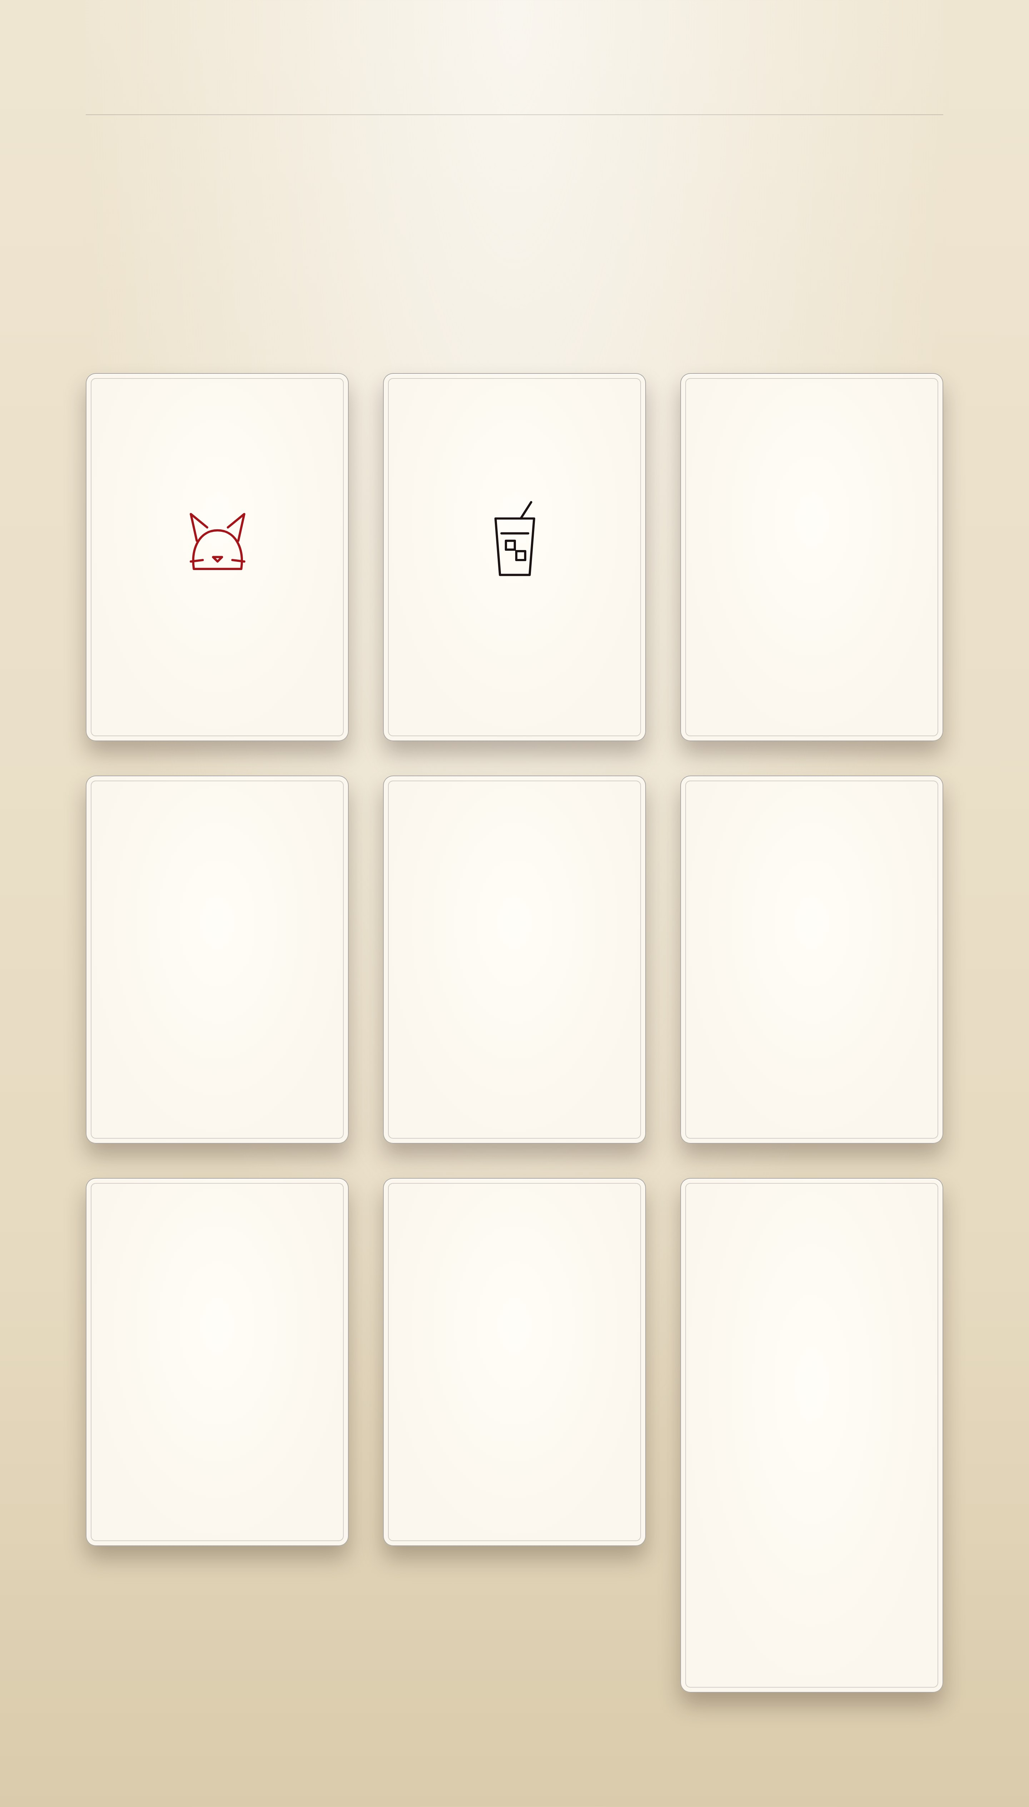
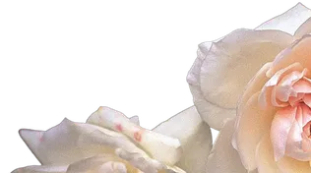
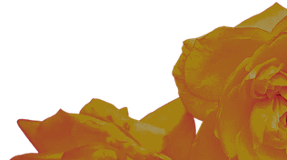
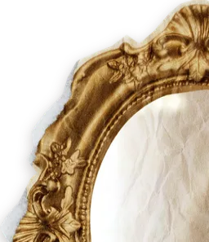


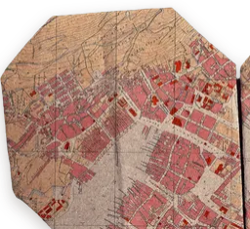
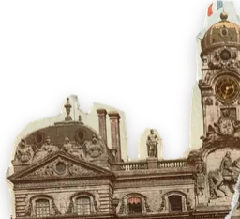
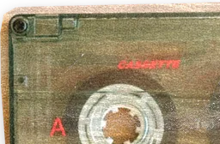
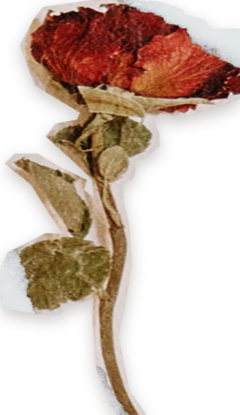
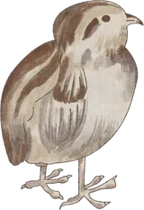
CASE NO. II · HOBBIES
A deck of curiosities
What I do when nobody is paying me to. The Queen dealt them; turn one over.
I
II
III
♥
I ♥ · CATS
♠
II ♠ · ICED COFFEE
♦
III ♦ · WORLDS I PLAY IN
Cats, always. The best colleagues: quiet, warm, and they never ask for a status update.
The official fuel. Always iced, at any hour, in any weather.
Where my evenings go, and where half my characters come from.
Genshin Impact
Fate/Grand Order
Wuthering Waves
Honkai: Star Rail
Cats
Iced coffee
Worlds I play in
TURN IT BACK ↺
♥
TURN IT BACK ↺
♠
TURN IT BACK ↺
♦
I
II
III
IV
V
VI
♣
IV ♣ · CHARACTERS & AUS
♥
V ♥ · COSPLAY
♠
VI ♠ · BETWEEN TWO TONGUES
Taking someone I love and asking who they’d be somewhere else. Half my side projects exist so they have somewhere to talk.
I buy my cosplays rather than sew them. The craft I care about is choosing who to be for a day.
I translate between English and Malay. Some words have no twin on the other side; you learn to walk around them politely.
Characters & AUs
Cosplay
Between two tongues
TURN IT BACK ↺
♣
TURN IT BACK ↺
♥
TURN IT BACK ↺
♠
IV
V
VI
VII
VIII
IX
♦
VII ♦ · THINGS I BUILD FOR FUN
♣
VIII ♣ · DARK LULLABIES
♥
IX ♥ · THE AESTHETIC
Chat apps where my characters can answer back, a messenger for two, a tracker that judges my spending, and over a hundred VS Code colour themes.
Music boxes, ticking clocks and things that sound slightly wrong. The tea party playing on this site is my own, made with Suno.
American Horror Story, Alice in Wonderland and a little Violet Harmon. You may have noticed.
All of it on GitHub ↗
PLAY THE TEA PARTY
Things I build for fun
Dark lullabies
TURN IT BACK ↺
♦
TURN IT BACK ↺
♣
VII
VIII
The aesthetic
TURN IT BACK ↺
♥
IX

