Slide 1
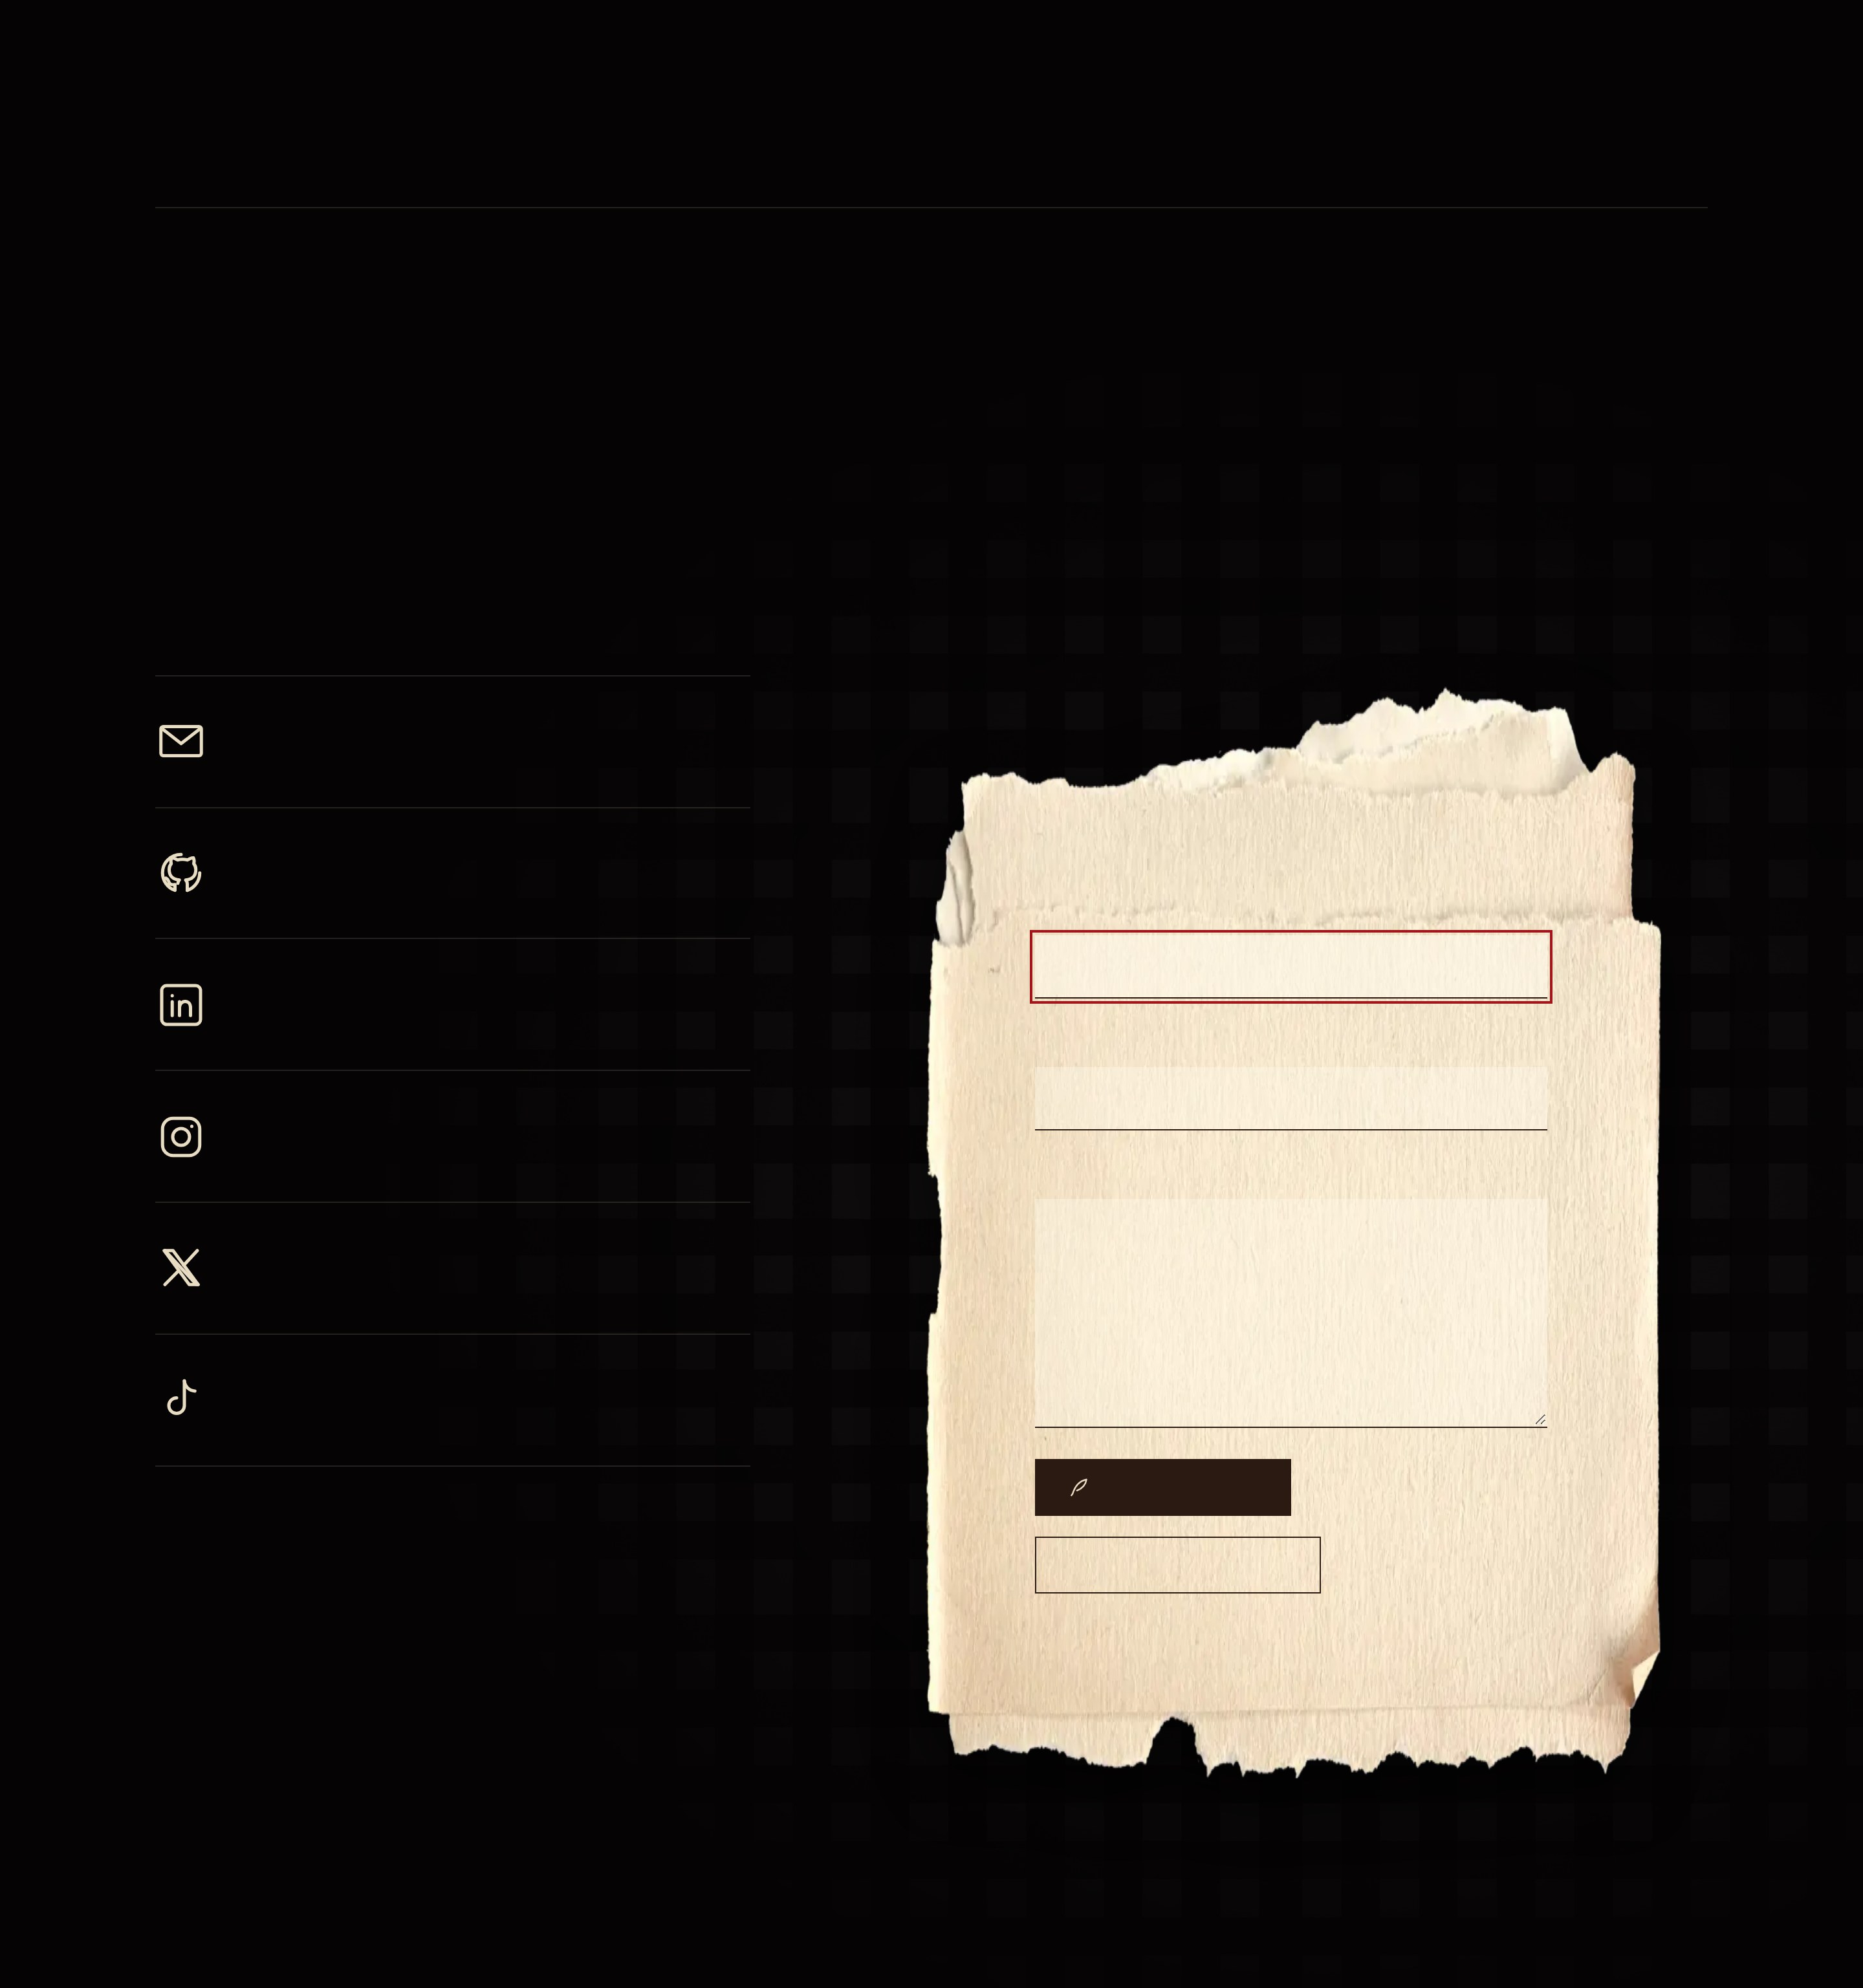
CASE NO. IV · CONTACT
Tea at midnight
There’s a seat at the table. The tea is still warm, probably.
EMAIL
shirubawing@gmail.com
GITHUB
Write to me
Code, experiments, unfinished things
YOUR NAME
LINKEDIN
The professional record
YOUR EMAIL
INSTAGRAM
@teha.muhd
YOUR LETTER
X
@shirubawing
TIKTOK
@shirubawing
SEND THE RAVEN
FOLD THE LETTER AWAY
Opens your mail app with the letter ready.

