Slide 1
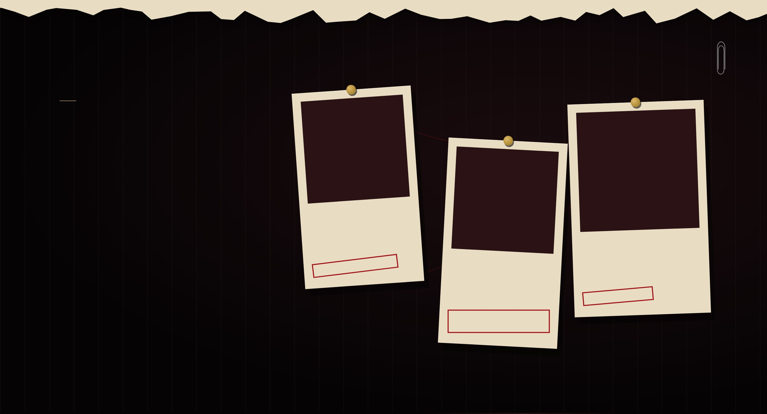
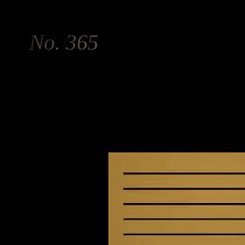
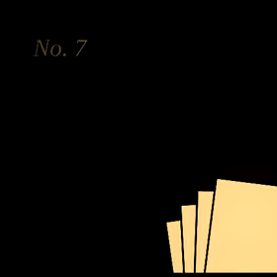
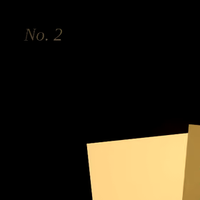
CHAPTER II · WORK
The case files
Three open investigations. None of them are closed.
NO. 365
Pick a file. They don’t bite. Mostly.
The ledger that balanced itself
NO. 7
The archive under the stairs
ERP DEVELOPMENT
NO. 2
Words that changed sides
FGO LORE SITE
TRANSLATION · EDITING

