Slide 1
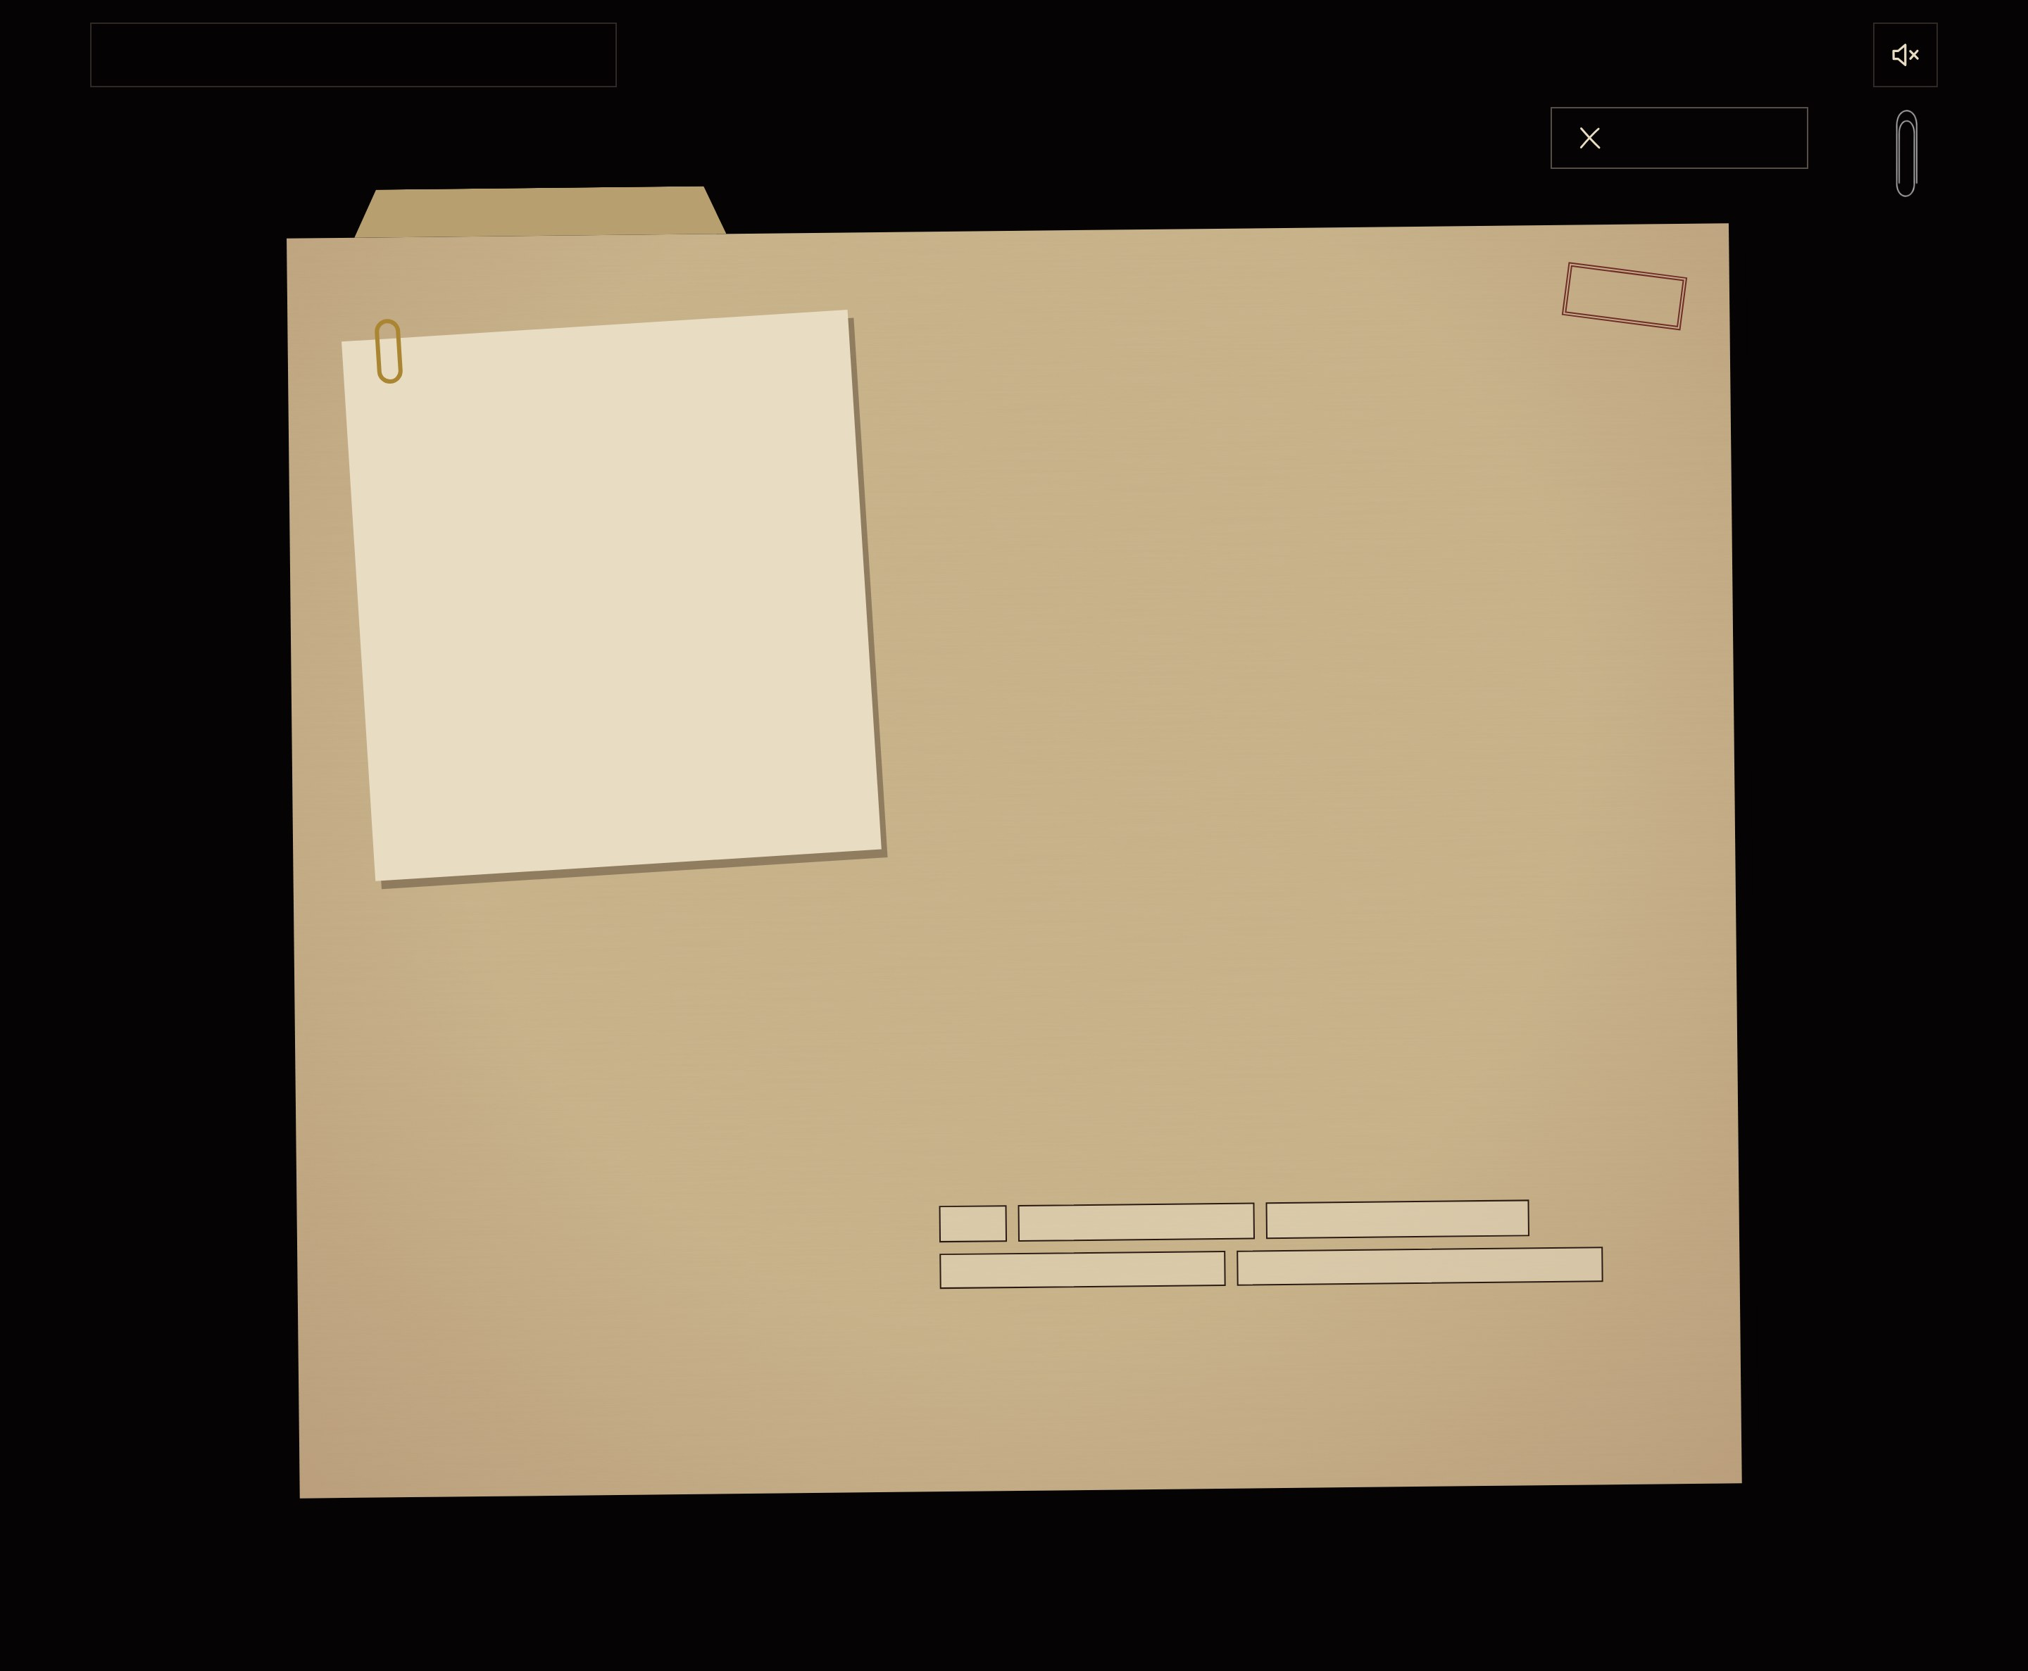
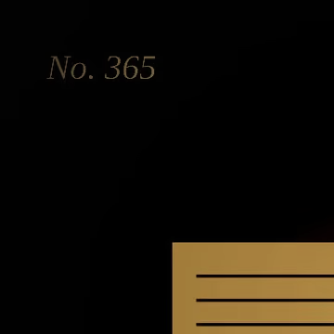
SHIRU
I
II
III
IV
CLOSE THE FILE
CLOSE THE FILE
NO. 365 · ERP DEVELOPMENT
OPEN
CASE FILE NO. 365
The ledger that balanced itself
Dynamics 365 Finance & Operations. X++, extensions, integrations, batch jobs that run while everyone sleeps.
WHAT I DO
I build and maintain customisations for D365 F&O. Extensions only: Chain of Command, event handlers, data entities. Nothing that breaks on the next update.
WHAT I LIKE
Upgrade-safe code, clean data migrations, and reports that finance actually trusts. TODO: replace with real projects you can talk about.
EVIDENCE
X++
DYNAMICS 365 F&O
SYSOPERATION BATCH
DATA ENTITIES & ODATA
SSRS / ELECTRONIC REPORTING
Next file: Words that changed sides

