Slide 1
WISE
Assets adoption
How well customers are adopting it, and what the next 12 months look like
Andrii Morozov | Portfolio project | October 2026
2.25%
3.83%
+66%
£413m
convert to Assets
convert to Assets
more Assets customers
total holdings
of all signups
of customers who fund a balance
same cohort, 12 months on
forecast Jun-2024, all customers
Based on 10,000 sampled profiles created Jan-Jun 2023 · 225 of them invested · Built with MySQL, Excel and Power BI
Notes:
Headline: conversion is 2.25% of all signups but 3.83% of customers who can actually invest. Adoption is accelerating despite what the raw monthly trend looks like.

Slide 2
THE FUNNEL
Conversion is 2.25%, but 3.83% is the number to manage
Funnel across all 10,000 sampled profiles
All 225 investors funded a balance first
10,000
Profile created
100%
Not most of them: every single one. Holding and funding a balance is a hard gate with zero exceptions in 225 cases. Everything else in the product is optional.
10,000
Completed a first action
100%
So measure conversion on the funded base, not on signups.
5,879
Held a balance
58.8%
What the 225 investors had already done
5,879
Funded the balance
58.8%
Held + funded a balance
100%
Local account details
59%
225
Invested in Assets
2.25%
Card transaction
51%
Sent money abroad
12%
41% never fund a balance and are structurally unable to invest
Sending money abroad is almost irrelevant to Assets adoption.
Notes:
The ordering check is the important bit: I compared FIRST_ASSETS against every other FIRST_* timestamp. All 225 had funded a balance beforehand.

Slide 3
WHAT DRIVES CONVERSION
Assets is for money that stays, not money that moves
The signals that hold up
8.1%
Direct debit users
vs 3.8% funded average, the strongest single behavioural marker
7.5%
Customers holding £10k+ cash
vs 3.4% for customers who keep nothing at Wise
4.2%
Business customers
but only 1.2x once you control for funding, so mostly a funding effect
0.7%
Customers who send money abroad
0.3% at one product → 12.0% at five. A 46x spread.
the only product NEGATIVELY associated with investing
These are associations, not causal effects. The common thread: conversion tracks how far Wise is the customer's primary account.
Notes:
Direct debit does not cause investing. Both reflect a customer treating Wise as a primary account.

Slide 4
CUSTOMER FORECAST
Adoption is accelerating: the raw monthly trend hides it
The trap
Monthly sign-ups peak in Jun-2023 then fall. But nobody joins this sample after Jun-2023, so the group is simply ageing. A falling line is what a fixed, ageing pool always looks like.
The fix: compare cohorts at equal age
At 7 months old
1.33%
→
2.80%
2.1x
Jan-23 cohort
Jun-23 cohort
Method: chain-ladder on a cohort development triangle. Age-to-age growth factors taken from the observed data, tail decayed beyond month 12. Cross-check: the model implies 8-15 new investors a month through 2024 against 8-14 actually observed.
Jan-2024
Jan-2025
Sampled cohort (10,000 profiles)
225
373
+66%
Whole customer base, 2023 vintages on
17.7k
52.7k
3.0x
Notes:
Range on the sampled cohort is 306 conservative to 463 optimistic, driven by how fast the tail growth fades.

Slide 5
HOLDINGS FORECAST
Assets is an interest business, and a concentrated one
Scaled to the whole customer base
Jun-2023
Jun-2024
Interest
£47.7m
£154m
3.2x
Equity
£0.7m
£2.2m
3.1x
Cash
£209m
£257m
1.2x
Total holdings
£258m
£413m
1.6x
The risk worth naming
Cash £5.50m → £6.76m Interest £1.25m → £4.05m Equity £19k → £57k
The five largest holders are ~61% of all interest balances. One of them leaving moves the total more than a month of new adopters does.
Assets move from 19% to 38% of everything customers hold.
Method: holdings driven off the customer forecast (holders x balance per holder), not extrapolated directly. Growth on existing balances is damped from the 54%/42%/16% launch ramp, and new joiners are added at their observed smaller size (median first deposit fell from ~£1,000 to ~£400).
Notes:
Interest grew 177x in six months while equity grew 4.9x. Without damping, a naive extrapolation would be wildly inflated.

Slide 6
Four things I would change
01
Report Assets conversion on the funded base
02
Trigger the Assets prompt on balance behaviour
Signups are the wrong denominator: 41% of them can never convert. Funding a balance is a separate growth problem that owns the larger loss.
The moment a customer tops up, sets a direct debit, or crosses £1k in cash is the highest-probability moment. Direct debit users convert at 2.1x.
03
Stop marketing Assets on the send-money journey
04
Treat interest concentration as a retention priority
It is the one product negatively associated with investing, and it is the largest share of traffic. That spend is better placed elsewhere.
Five customers hold 61% of the interest book. Protecting them is worth more than a month of new adopters.
What this analysis cannot see
Only profiles created Jan-Jun 2023 are in the data, so every population figure understates the true total, as pre-2023 customers are absent entirely. · 225 converters is a small base; cuts below ~50 customers are directional only. · The three data tables end in different months, so each question is forecast 12 months from its own latest month.
Notes:
The two judgement calls worth defending: the tail-decay assumption in the customer forecast and the damping assumption in the holdings forecast.

Slide 7
METHOD AND TOOLS
One analysis, three tools, the same numbers
1
MySQL
2
Excel
3
Power BI
Clean, check and model
Forecast model
Interactive dashboard
Loaded the raw data and ran 13 import checks before any analysis
Rebuilt the funnel, drivers and cohort triangle in SQL
CTEs (incl. recursive), window functions and views feed Power BI
Chain-ladder on the cohort triangle, with three scenarios for the tail
Holdings = holders x balance per holder, scaled x38 to the full base
Tidy forecast tables exposed for Power BI
Three pages: adoption, who invests, 12-month forecast
27 DAX measures, a gradient-formatted cohort heatmap and a custom theme
What-if slider on new-investor growth updates every forecast
Reconciled across all three: 10,000 / 5,879 / 225 · 2.25% and 3.83% · direct debit 8.09% · Jan vs Jun cohort at month 7: 1.33% vs 2.80%
Code, workbook and dashboard: github.com/frostovandrey/wise-assets-analysis

Slide 8
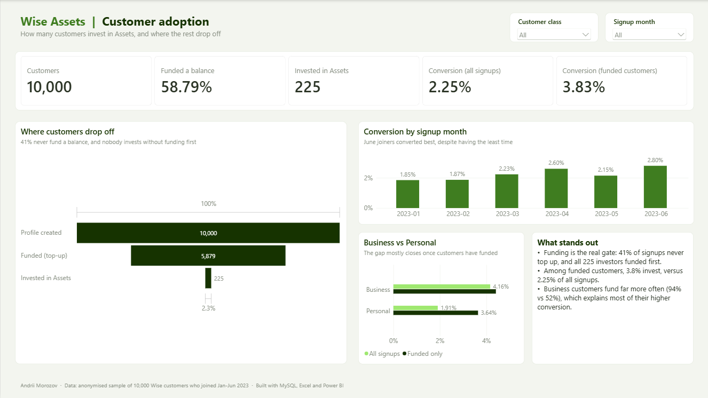
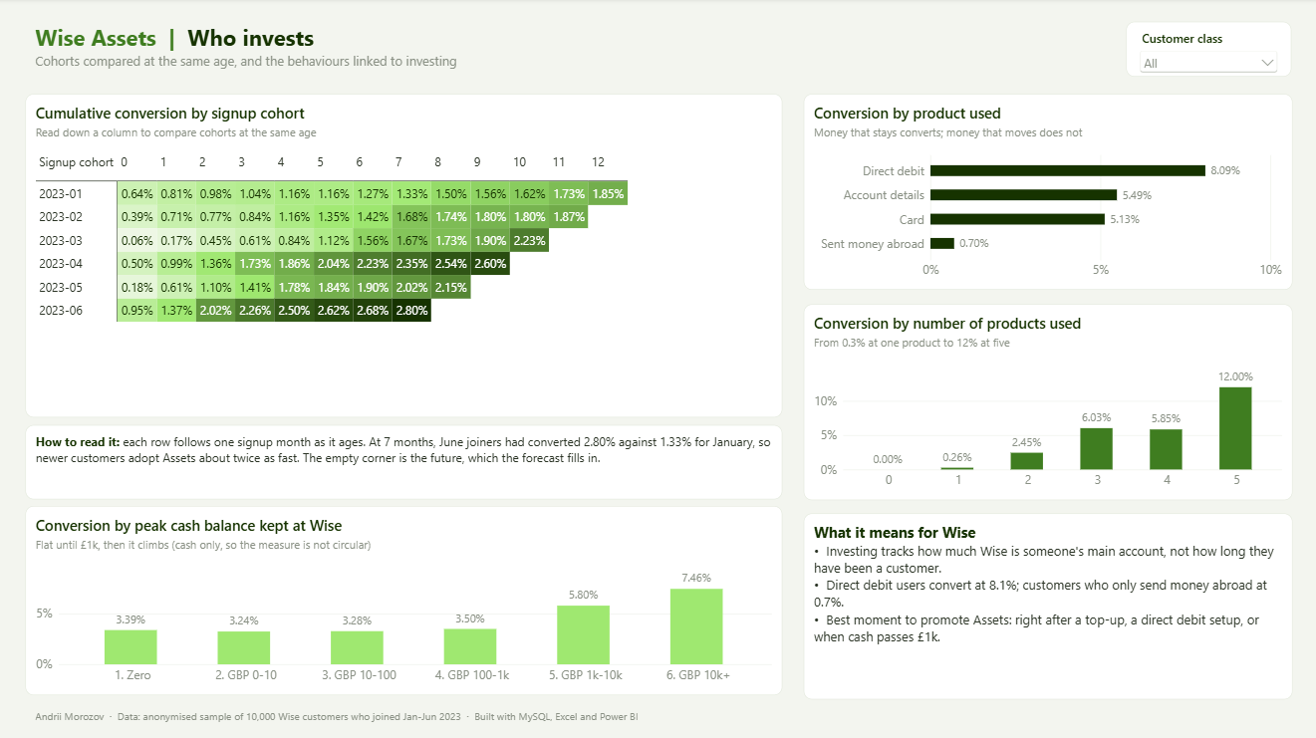
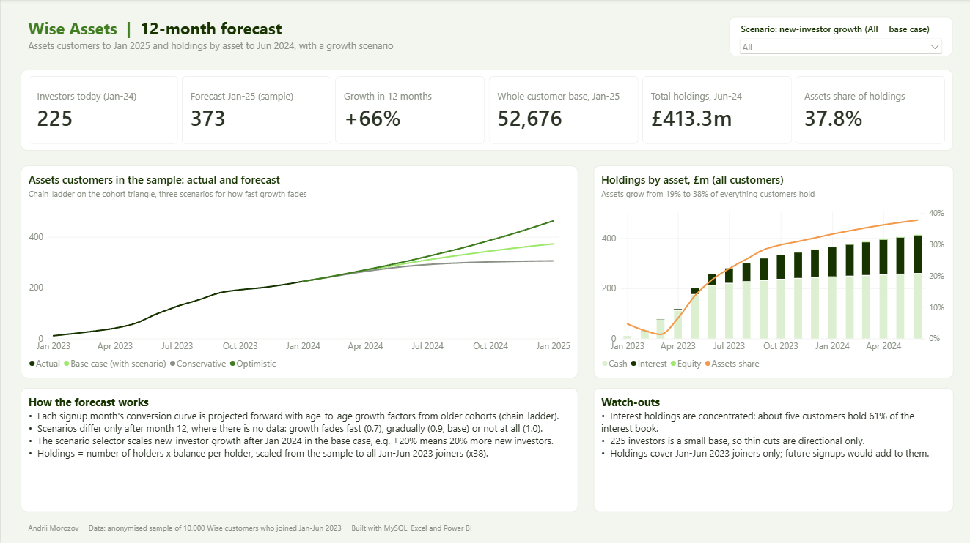
POWER BI DASHBOARD
The analysis as a three-page dashboard
Customer adoption: funnel, conversion by signup month, Business vs Personal
Who invests (top) and 12-month forecast (bottom)

