Slide 1
Wait,
Are you phishing me?!
On the evasive malware faking official report portal
I mean, miniapps

Slide 2
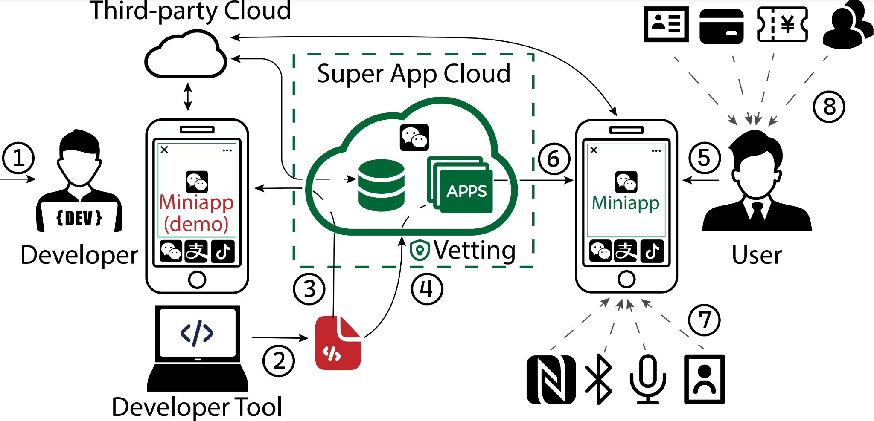
Miniapps and Super Apps

Slide 3
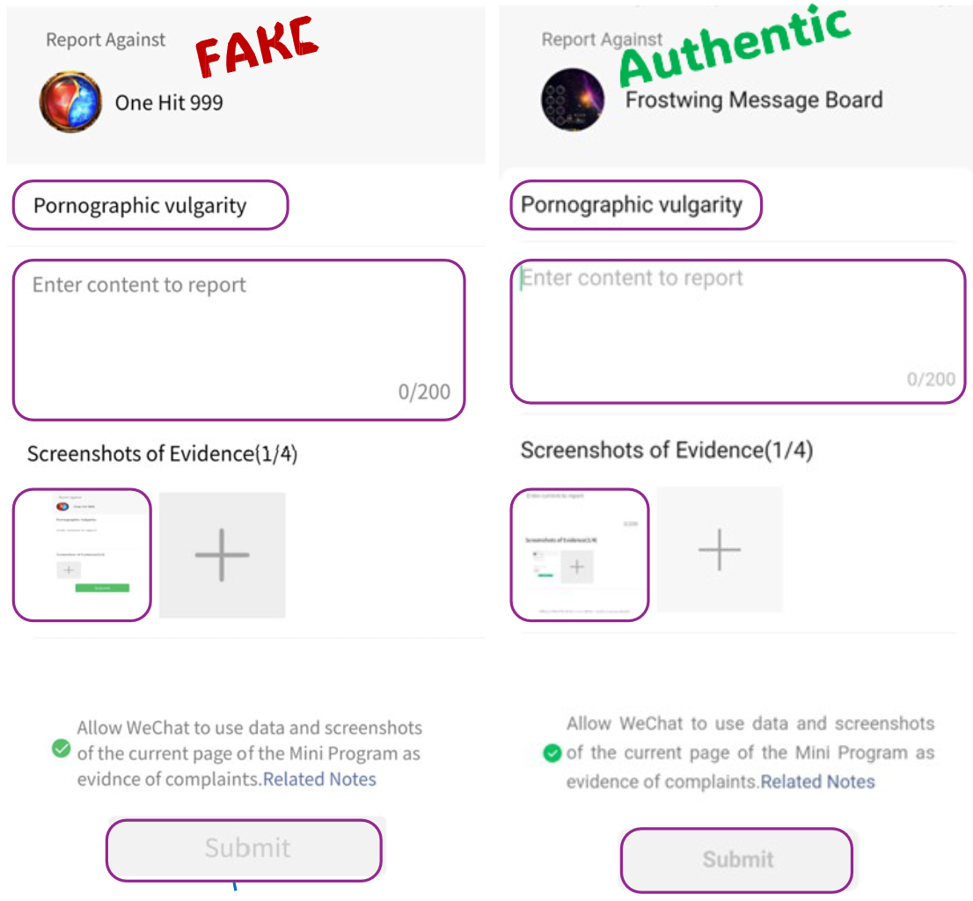
The new “phishing” malware

Slide 4
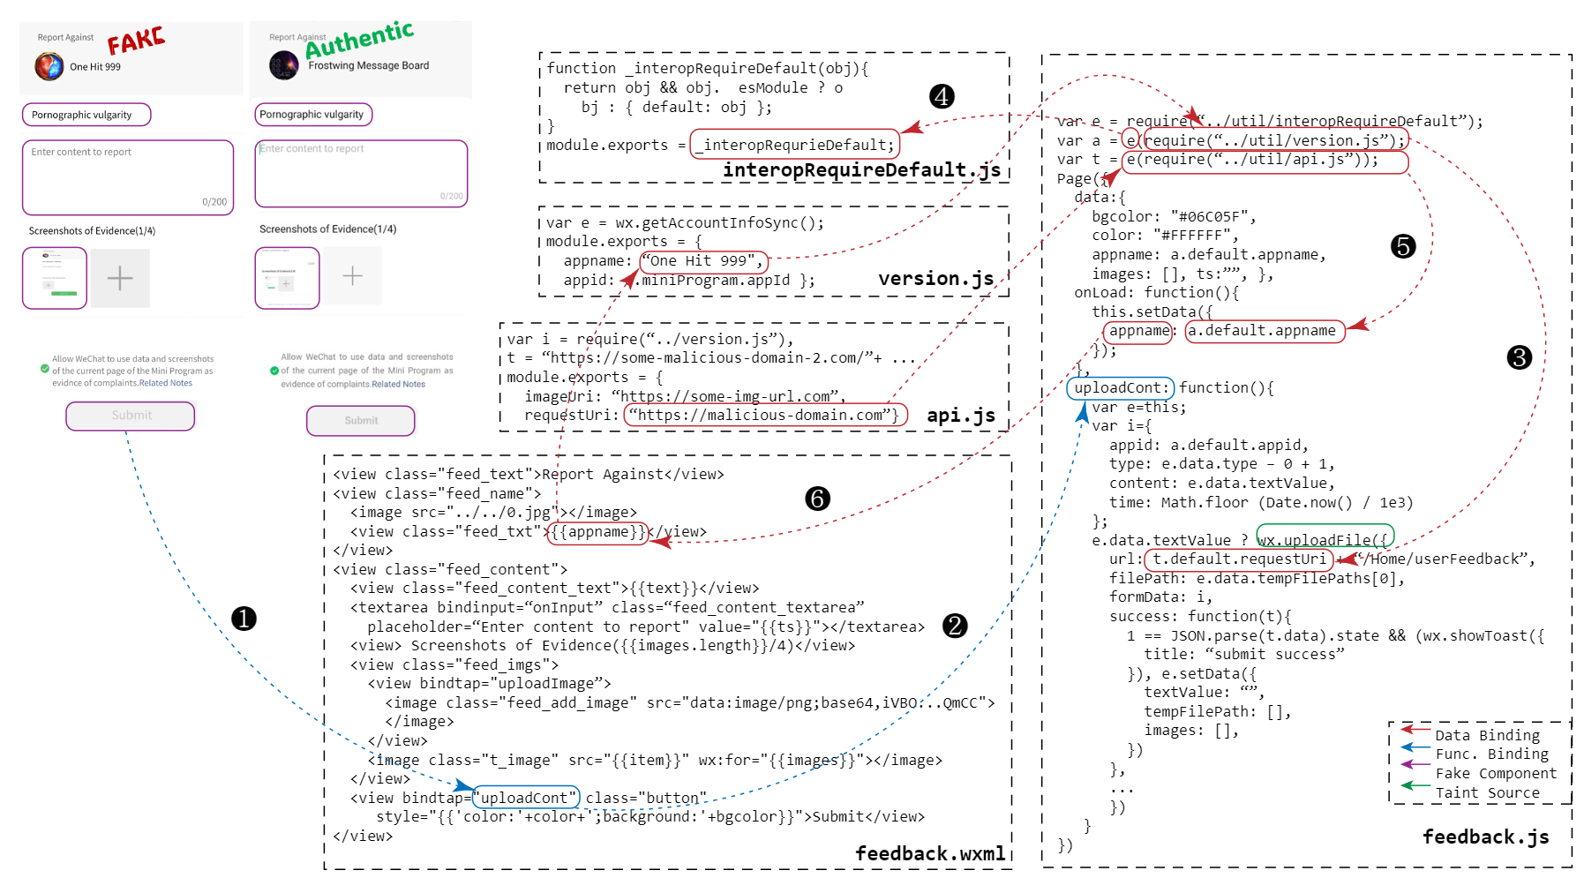

Slide 5
Contribution
A static analysis framework to extract code signatures for malware detection
A detection model that can be applied to detect the malware
A dataset of 4000 real-world miniapps for analysis
Marked 300, that is

Slide 6
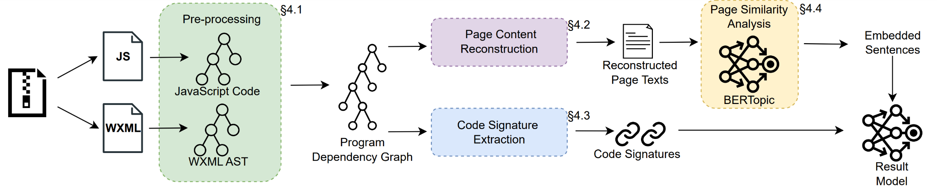
Extracting the signatures from the miniapps

Slide 8
In the beginning…
Dataflow analysis!
Static API control flow
+ Data flow value resolving
Resolves:
User interaction page methods
API call trace
URL domain

Slide 9
Experiment setup
A server with 16 core
16 Threads, paralleling processing

Slide 10
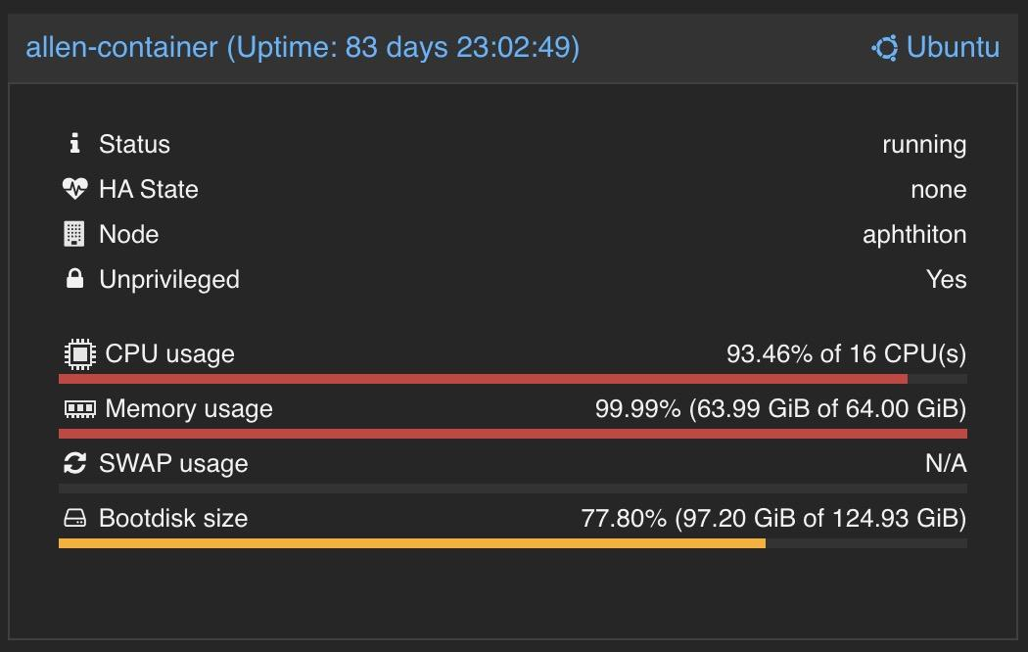
😰

Slide 11
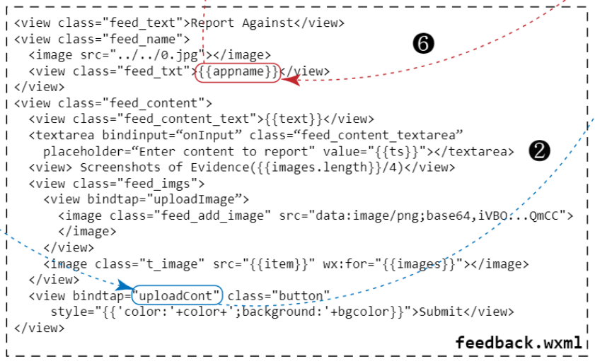
Malware features: WXML signatures (4)
Component usage
Tags:
<view>
<form>
<button>
Structure:
Max indent

Slide 12
Malware features: APIs invoked (6)
Network
wx.request
wx.uploadFile
Navigate
redirectTo
navigateTo
Media
chooseImage
chooseMedia

Slide 13
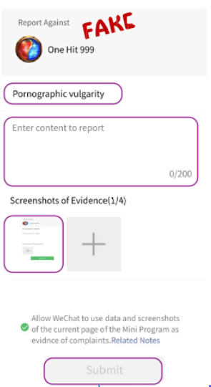
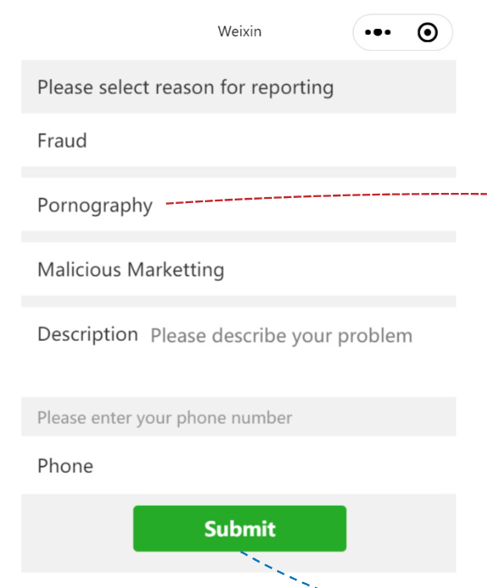
Keyword hit (18)
Two official pages
One report page (5)
One select reason page (13)

Slide 14
Displayed texts (768)
The texts are free-formed
We use sentence bert to embed these texts
Converted into 768-dimension vector

Slide 15
How to determine?
Merge 768+18+6+4 dimension = 796!
The code signatures may be undermined!
Embedded vectors have their own meanings in the represented space
Better to let each model do their job, and aggregate the result

Slide 16
Ensemble learning

Slide 17
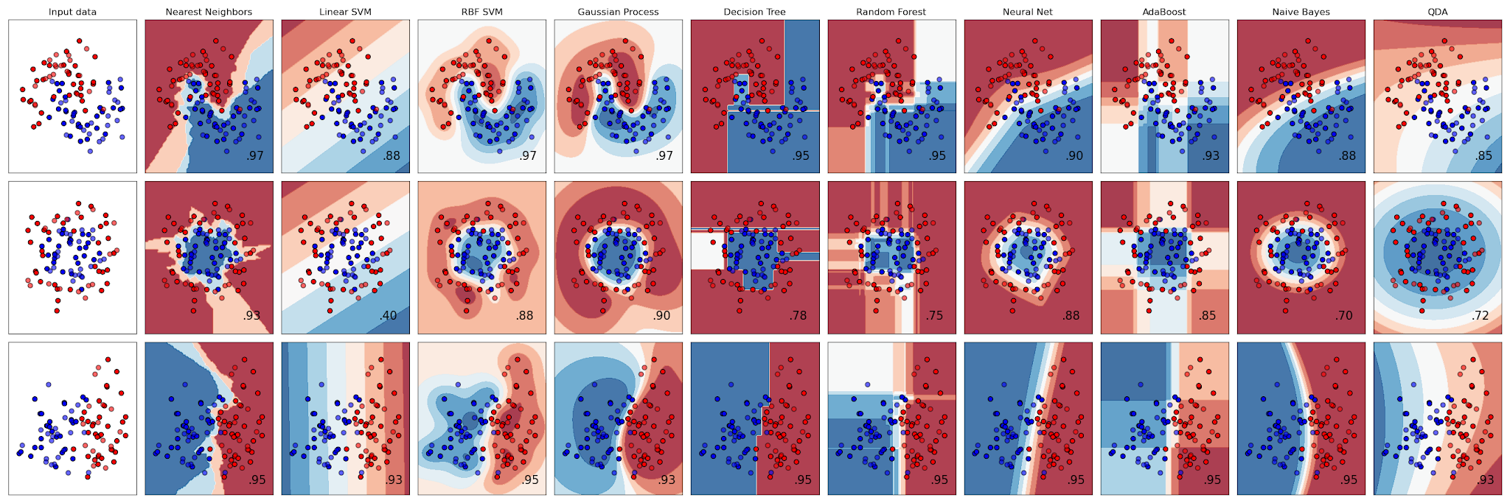
What models to choose?
A 2-class classification
Only the text embeddings have meaning geometrical wise
Others are more like decision making

Slide 18
Models
Sentence: Multi-layer perception classifier
Code signatures (WXML+API): DecisionTree
Keyword hit: DecisionTree
Final model: DecisionTree
Texts
M_sent
API/WXML
M_code
M_final
Keyword
Hit
M_key

Slide 19
RQ: What are best signatures?
Code signatures
WXML signatures (4)
API signatures (6)
Keyword hit (18)
Displayed texts

Slide 20
Data Sampling
Scanned 4000 miniapps (with “report” keyword)
Sampled 300 miniapps
41,561 pages
85 malicious pages
:( Too small for training
But we can try

Slide 21
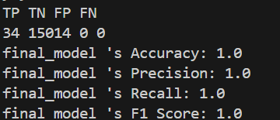
🤣
When the sentence model is added it overfitted
Precision, Accuracy, Recall… 100%
MLP/SVC are similar
We used Gaussian Naive Bayes, and it is getting better

Slide 22
Potential reason
The training set has too few positive cases
85/41561
The feature dimensions are overwhelming
768-d array of embedding
=>:

Slide 23
Results
 | TP | TN | FP | FN
sentence_model | 29 | 14994 | 26 | 5
code_model | 19 | 15017 | 3 | 15
keyword_model | 34 | 67 | 14953 | 0
final_model | 19 | 15020 | 0 | 15

Slide 24
Results
 | Accuracy | Precision | Recall | F1 Score | ROC Score
sentence_model | 0.9979 | 0.5273 | 0.8529 | 0.6517 | 0.9804
code_model | 0.9988 | 0.8636 | 0.5588 | 0.6786 | 0.9894
keyword_model | 0.0067 | 0.0023 | 1.0 | 0.0045 | 0.5022
final_model | 0.9990 | 1 | 0.5588 | 0.7170 | 0.9264

Slide 25
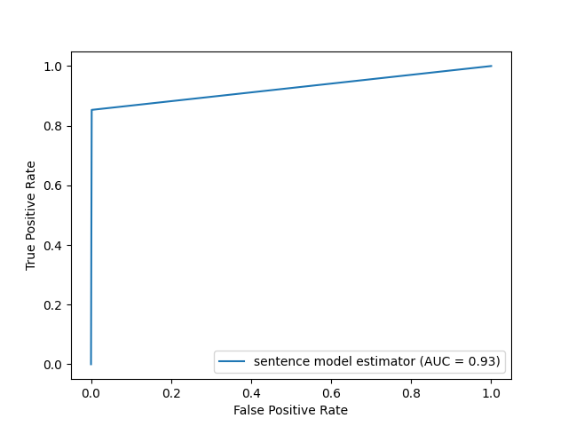
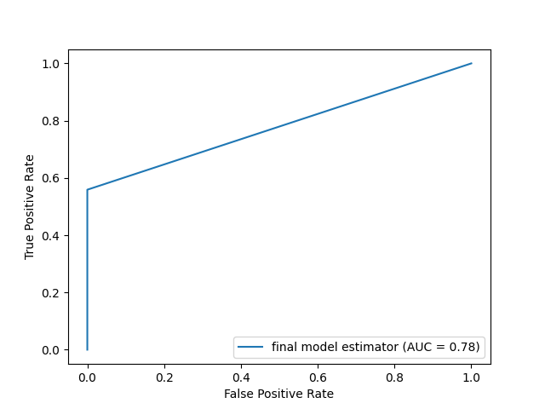

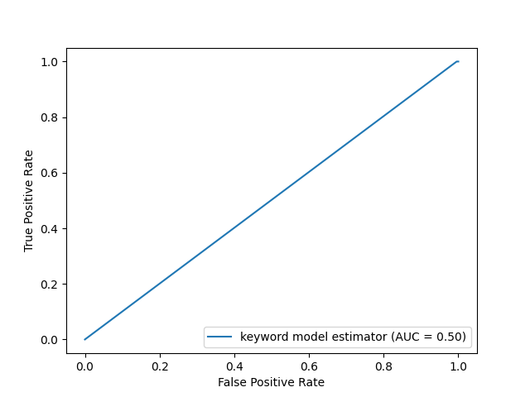

Slide 26
Limitations and future work
Scalability
URL resolution
Event handling
Model tuning
Current is not ideal
Need to work out the embedding
Dataset
More ground truths, especially positive cases

