Slide 1
Semantica
Ontology-Governed Knowledge Graphs · MCP · Multi-Agent Analytics
Deterministic semantics vs. LLM hallucination

Slide 2
Agenda
1. Semantica concept: ontology + knowledge graph
2. Architecture: MCP servers & multi-agent pipeline
3. Configuration: graph JSON, business rules, R2RML mapping
4. Worked example: OTP from business meaning → SQL
5. Decision Store: audit trail without graph bloat
6. Deterministic layer vs. stochastic LLM behavior

Slide 3
Part 1 — Concepts

Slide 4
What is Semantica?
A semantic layer between natural language and enterprise data
Semantica is an open-source platform for building context graphs: ontology + mappings + business rules + optional decision audit.
Agents and humans ask questions in business language; Semantica resolves meaning to validated SQL against Hive/Iceberg, PostgreSQL, etc.
Core modules: ingest, ontology, context graph, MCP server, Knowledge Explorer, decision store.
Design goal: separate what things mean (ontology) from where they live (tables/columns) and how KPIs are computed (rules).

Slide 5
Ontology vs. Knowledge Graph
Ontology (T-box)
Knowledge Graph (A-box + schema)
Formal vocabulary: classes, properties, hierarchies
Examples: Flight, Airline, OTP, SevereDelay
Object properties: operatedBy, originAirport
Datatype properties: arrDelay, crsDepTime
Stored as OWL/Turtle; compiled into graph nodes
Answers: What concepts exist? How do they relate?
Runtime ContextGraph JSON: nodes + edges
OntologyClass, ObjectProperty, BusinessRule nodes
DatabaseTable mappings (when Hive introspection enabled)
192+ nodes for airline demo (87 classes, 26 rules)
Loaded via SEMANTICA_KG_PATH in MCP
Answers: What is wired to the warehouse today?

Slide 6
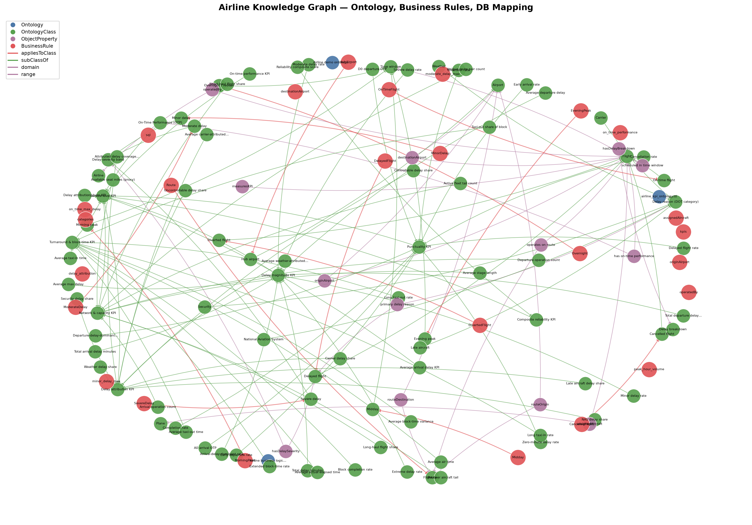
Airline Knowledge Graph Overview
Ontology classes, object properties, and business rules (force-directed layout)
Generated by scripts/export_kg_business_rules_image.py · 129 nodes in ontology/rules view

Slide 7
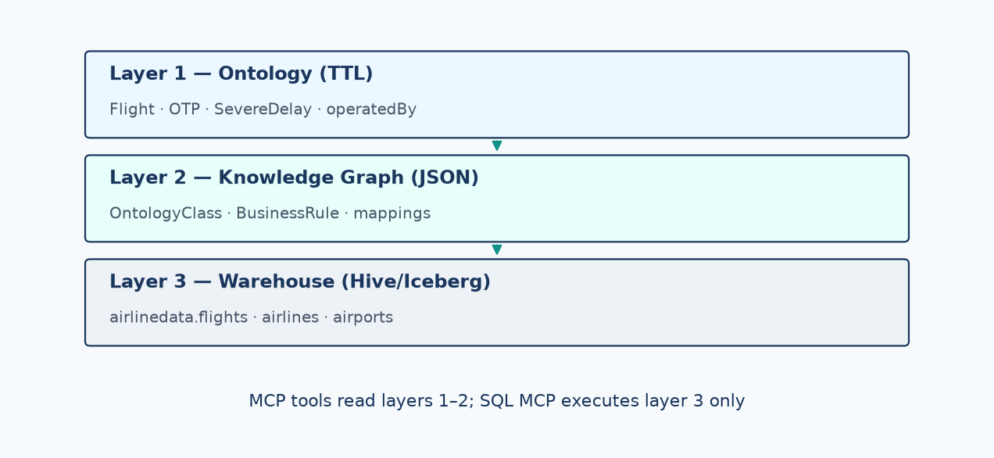
Three-Layer Semantic Stack
Ontology → ContextGraph JSON → physical warehouse

Slide 8
Three-Layer Semantic Stack (detail)
Layer 1 — Ontology: domain meaning (US DOT airline, KPI catalog, delay severities)
Layer 2 — Knowledge Graph: materialized ontology + rules + DB bindings as traversable JSON
Layer 3 — Physical warehouse: airlinedata.flights, airlines, airports, planes (Iceberg/Hive)
Agents never guess layer 3 from memory; they read layers 1–2 via MCP tools, then execute layer 3 via warehouse MCP.
Invalid columns (e.g. airports.name) are blocked in mapping YAML — a common LLM hallucination vector.
User: "OTP for AA in 2008"
→ Ontology: OTP ≡ OnTimePerformance, Airline, Flight
→ Rules: otp.sql.expr, threshold 15 min
→ Mapping: flights.uniquecarrier → Airline.code
→ SQL: SELECT … FROM airlinedata.flights JOIN airlines …

Slide 9
Part 2 — Architecture

Slide 10
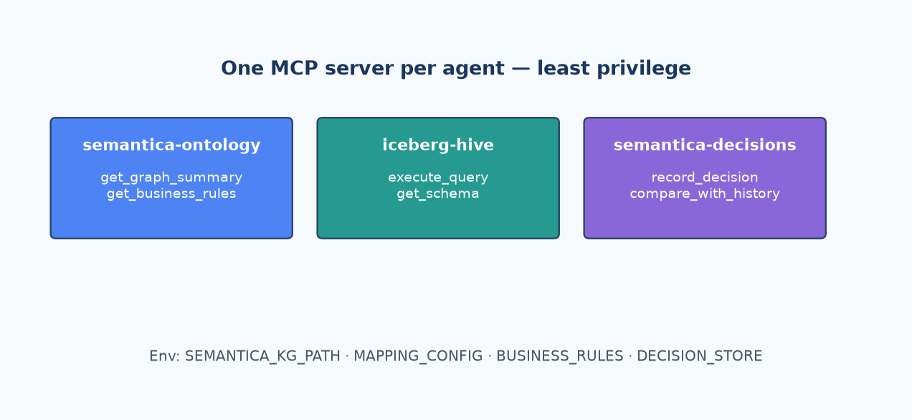
MCP Server Topology
Separate credentials and toolsets per agent role

Slide 11
MCP (Model Context Protocol) Architecture
One specialized MCP server per agent — least privilege, no credential sprawl
semantica-ontology MCP: get_graph_summary, get_business_rules (read-only semantics)
iceberg-hive MCP: execute_query, get_schema (warehouse access only)
semantica-decisions MCP: record_decision, compare_with_history, find_precedents (audit log)
Each MCP subprocess loads only its toolset (SEMANTICA_MCP_TOOLSET) — faster cold start, smaller attack surface.
Configuration via env: SEMANTICA_KG_PATH, SEMANTICA_MAPPING_CONFIG, SEMANTICA_BUSINESS_RULES, SEMANTICA_DECISION_STORE.
Agent Studio mounts /workflow_data read-only; writable decisions go to /workspace/decisions.

Slide 12
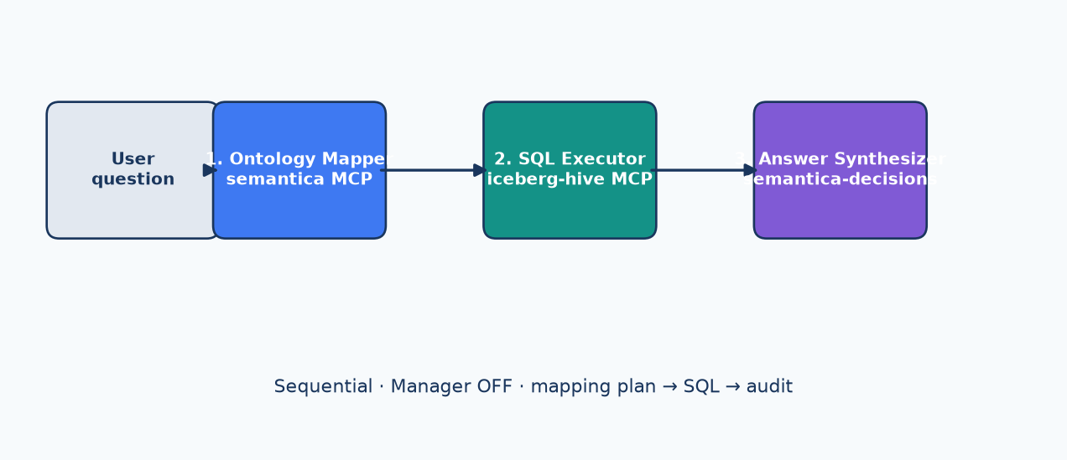
Multi-Agent Conversational Pipeline
Sequential process · Manager OFF · Conversational ON
Handoff: mapping plan JSON → SQL rows → narrative + Decision Store record

Slide 13
Multi-Agent Pipeline (detail)
Why Manager OFF and Sequential routing
Step 1 — ontology_mapper: NL question → mapping plan JSON (ready_for_sql, tables, joins, metrics, display_columns)
Step 2 — sql_executor: executes SQL from plan only; aborts if ready_for_sql ≠ true
Step 3 — answer_synthesizer: business-language answer + optional record_decision to Decision Store
Why Manager OFF? Crew managers delegate without tools and hallucinate schema/joins from backstory.
Why Sequential? User message flows agent 1 → 2 → 3 with structured handoffs, not parallel guesswork.

Slide 14
Agent Responsibilities
Ontology Mapper
SQL Executor + Synthesizer
MCP: semantica-ontology
Tools: get_graph_summary, get_business_rules
Output: mapping plan JSON
Must include display_columns
Must list invalid_columns_avoided
Never executes SQL
Never calls NER when graph pre-loaded
SQL: iceberg-hive execute_query
Uses plan tables/joins/metrics only
Efficient patterns: filter early, no OR joins
Synthesizer: semantica-decisions MCP
record_decision with sql_text, metrics
compare_with_history for deltas
No SQL, no ontology rebuild

Slide 15
Part 3 — Configuration

Slide 16
Configuration Trilogy
① airline_graph.json (SEMANTICA_KG_PATH) — ContextGraph: ontology classes, properties, business rule nodes, optional DatabaseTable nodes
② airline_business_rules.yaml — KPI definitions, thresholds, SQL expressions, object_property_joins, sql_agent_hints (do_not_use columns)
③ airline_r2rml_db_mapping.yaml — class→table, column→property, invalid_columns, preferred_tables
Built by: scripts/build_airline_graph.py (imports TTL ontologies + ingests rules + optional Hive introspection)
Deployed to Agent Studio: /workflow_data/data/ + /workflow_data/config/

Slide 17
Business Rules YAML (excerpt)
Joins & guardrails
OTP rule block
operatedBy: flights.uniquecarrier = airlines.code
originAirport: flights.origin = airports.iata
do_not_use: airports.name (use airport)
do_not_use: airlines.name (use description)
do_not_use: flights.carrier (use uniquecarrier)
ontology_class: OTP
equivalent: OnTimePerformance
threshold_minutes: 15 (FAA/DOT)
on_time_predicate: arrdelay & depdelay ≤ 15
denominator: cancelled = 0 only
sql.expr: ROUND(100 * on_time / completed, 2)

Slide 18
Mapping Plan Template (Agent Output)
Structured contract between ontology_mapper and sql_executor
ready_for_sql: boolean gate — sql_executor aborts if false
ontology_terms, business_rules_applied, tables, joins
display_columns: {Airport.airportName: airports.airport}
invalid_columns_avoided: [airports.name]
metrics: [{name: otp_pct, expr: <from business rules>}])
sql_patterns: aggregate_fact_first | single_edge_join — prevents OR-join anti-patterns
{
"ready_for_sql": true,
"ontology_terms": ["OTP", "Airline", "Flight"],
"tables": ["flights", "airlines"],
"joins": [{"edge": "operatedBy", "on": "f.uniquecarrier = a.code"}],
"metrics": [{"name": "otp_pct", "expr": "<otp.sql.expr>"}],
"display_columns": {"Airline.description": "a.description"}
}

Slide 19
Part 4 — OTP Example

Slide 20
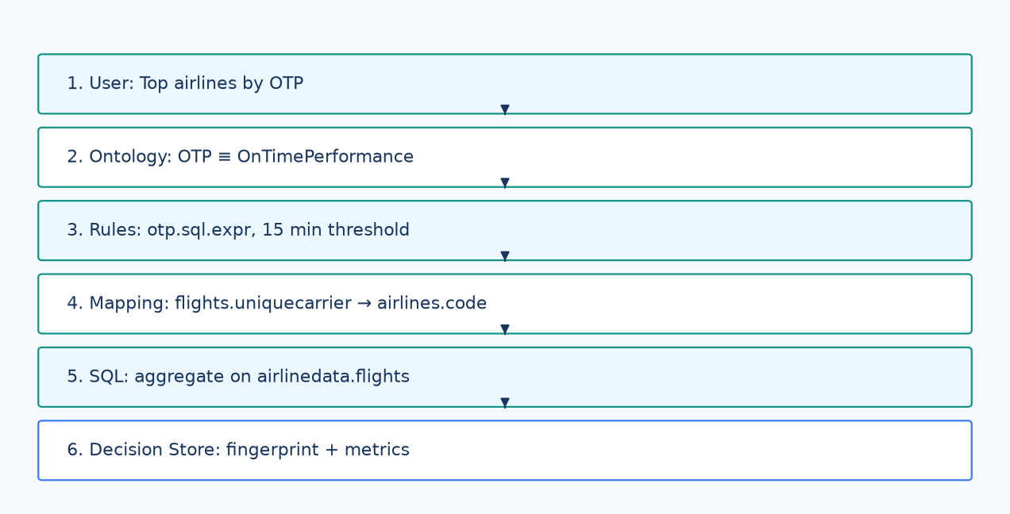
OTP: From Meaning to SQL
Deterministic resolution chain — config-driven, not invented by the LLM

Slide 21
OTP Resolution (detail)
End-to-end resolution chain (deterministic config, not LLM invention)
① User asks: "Top 5 airlines by OTP in 2003"
② ontology_mapper calls get_graph_summary → confirms OTP, Airline, Flight classes in graph
③ get_business_rules → resolves OTP → otp.sql.expr, threshold 15 min, alt_labels
④ Mapping YAML → Flight→flights, uniqueCarrier→uniquecarrier, operatedBy→airlines.code
⑤ Mapping plan includes metric expr verbatim from rules; display_columns for airline names
⑥ sql_executor runs qualified SQL on airlinedata; answer_synthesizer records decision with fingerprint

Slide 22
OTP SQL (Generated from Rules)
Numerator: completed flights where arrDelay ≤ 15 AND depDelay ≤ 15
Denominator: completed flights only (cancelled = 0)
Join: flights.uniquecarrier = airlines.code (operatedBy)
Partition filter: year = 2003 applied early on fact table
Result: otp_percentage per airline — reproducible from config hashes in decision record
SELECT a.description AS airline_name,
COUNT(*) AS total_flights,
SUM(CASE WHEN f.arrdelay <= 15 THEN 1 ELSE 0 END) AS on_time_flights,
ROUND(100.0 * SUM(CASE WHEN f.arrdelay <= 15 AND f.depdelay <= 15
THEN 1 ELSE 0 END) / NULLIF(SUM(CASE WHEN f.cancelled = 0
THEN 1 ELSE 0 END), 0), 2) AS otp_percentage
FROM airlinedata.flights f
JOIN airlinedata.airlines a ON f.uniquecarrier = a.code
WHERE f.year = 2003 AND f.cancelled = 0
GROUP BY a.description ORDER BY otp_percentage DESC LIMIT 5

Slide 23
Part 5 — Decision Store

Slide 24
Decision Store
Append-only audit log — separate from the knowledge graph
Path: SEMANTICA_DECISION_STORE (Agent Studio: /workspace/decisions/decisions.jsonl)
record_decision appends one JSON line per analysis — does NOT mutate SEMANTICA_KG_PATH
Slim records: category, scenario, reasoning, outcome, confidence, query_fingerprint, sql_hash, result_metrics
Optional SQLite index for fast fingerprint / time-range lookup; JSONL remains source of truth
Tools: compare_with_history, explain_decision_delta, find_precedents, get_causal_chain
Merged graph variant (airline_graph_with_decisions.json) adds decision nodes for Explorer UI only

Slide 25
Decision Record Example
decision_id + recorded_at + schema_version for audit
query_intent: top_airlines_by_otp · query_fingerprint for dedup/compare
business_rules_hash + ontology_mapping_hash — prove which config version was used
sql_text + result_metrics — reproducibility without storing full result sets in the graph
Enables: "Did we change the severe-delay definition between runs?" via explain_decision_delta
{
"decision_id": "ef7fa934-...",
"category": "airline_analytics",
"query_intent": "top_airlines_by_otp",
"query_params": {"year": 2003, "otp_rule": "arrdelay <= 15"},
"result_metrics": {"Hawaiian Airlines Inc.": {"otp_percentage": 91.28}},
"sql_text": "SELECT a.description ...",
"business_rules_hash": "sha256:d4d406fa..."
}

Slide 26
Part 6 — Deterministic vs. LLM

Slide 27
Deterministic Semantics vs. LLM Hallucination
Deterministic (Semantica config)
Stochastic LLM (unguarded)
Ontology classes & properties from TTL/YAML
Join keys from object_property_joins
KPI formulas from business_rules / kpi_catalog
Invalid columns explicitly blocked
Same question + same config → same SQL shape
Auditable via config hashes in decisions
get_graph_summary forces tool-grounded plans
Invents columns: airports.name, flights.carrier
OR-joins on fact×dimension (slow, wrong)
Confuses delay minutes with carrier IDs
Parallel record_decision calls with bad types
Manager agent answers without MCP tools
Markdown "decision records" instead of store
Different SQL every run — no fingerprint

Slide 28
Guardrails That Reduce Hallucination
ready_for_sql gate: sql_executor refuses incomplete plans
Mandatory tool order: get_graph_summary before any mapping
do_not_use column list in business rules (airports.name documented as invalid)
display_columns required — forces explicit label→column binding
One MCP per agent — sql_executor has no ontology write access
Decision Store stores sql_hash + rules_hash — detect config drift vs. ad-hoc answers
Falsification demos: same question with Manager ON vs. OFF shows hallucination rate drop

Slide 29
Knowledge Explorer & SPARQL
semantica-explorer --graph airline_graph_with_decisions.json
Interactive graph canvas, ontology hub, decision workspace, SPARQL editor
SPARQL projects ContextGraph to ent:/prop: namespaces (read-only SELECT/ASK/CONSTRUCT)
Example: ?rule a ent:BusinessRule ; rdfs:label ?label . FILTER(CONTAINS(?label,"otp"))
Static overview PNG: scripts/export_kg_business_rules_image.py

Slide 30
Deployment Checklist (Agent Studio)
Build graph: uv run python scripts/build_airline_graph.py [--skip-hive]
Copy to workflow_data: airline_graph.json, airline_r2rml_db_mapping.yaml, airline_business_rules.yaml, airline_kpi_catalog.yaml
Register MCPs: semantica-mcp-ontology.json, iceberg-hive-mcp.json, semantica-mcp-decisions.json
Three agents sequential: ontology_mapper → sql_executor → answer_synthesizer
Env: SEMANTICA_DECISION_STORE=/workspace/decisions (writable)
Verify: get_graph_summary graph_ready_for_sql true; get_decision_store_status writable true

Slide 31
Summary
Semantica = ontology-governed context graph + MCP tools + multi-agent pipeline
Meaning (ontology) · structure (KG) · physics (warehouse) are explicitly separated
OTP exemplifies: business term → rule SQL expr → mapping → qualified Hive query
Decision Store provides append-only audit without bloating the graph
LLMs interpret language; Semantica config makes analytics deterministic and reproducible
Repository: github.com/semantica-agi/semantica · Docs: docs/guides/decision-store.md

Slide 32
Questions?
Semantica — ontology-first analytics with accountable AI

