Slide 1
y
y’
θ₀₊θ
Dy’
ω₀
ω
Dy
P
θ₀
A
θ
x’
x
Dx
Dx’

Slide 3
Hypocycloide : R=A+P, r=P (Antispin)
rat= -3 deltoide
rat= -3 && A=3P triangle équilatéral ?
rat= -4 && A=3P astroide
rat= -4 && A=5P Pentagone
Épicycloïde : R=A-P,r=P (Spin)
rat= 1
rat= 2 && A=3P nephroide

Slide 4
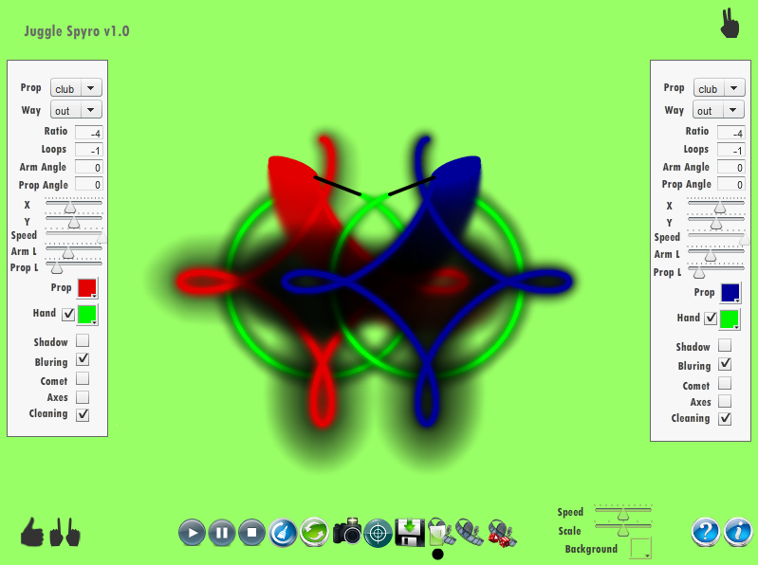

Slide 5
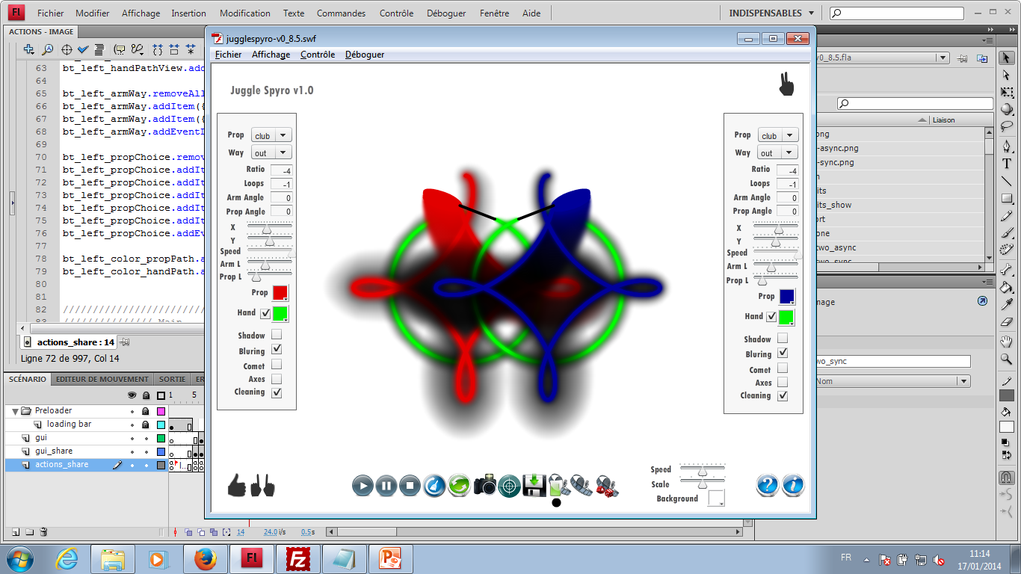
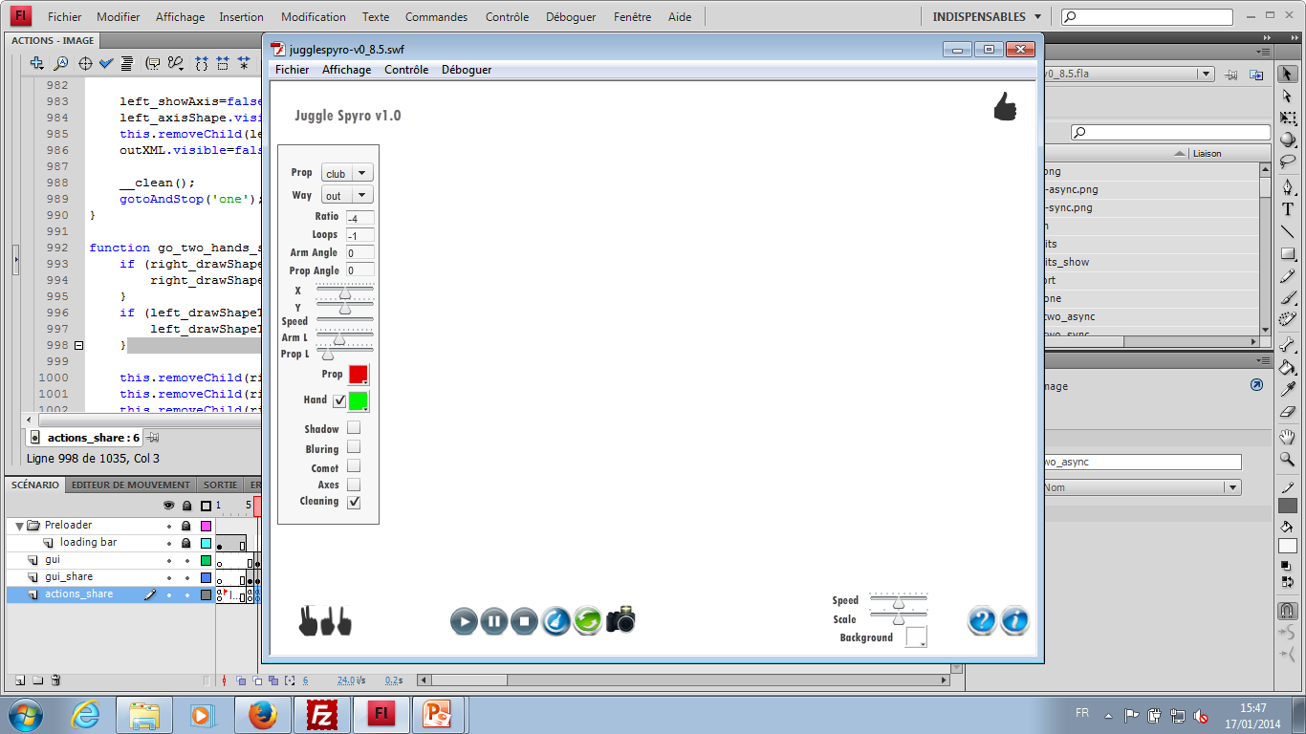
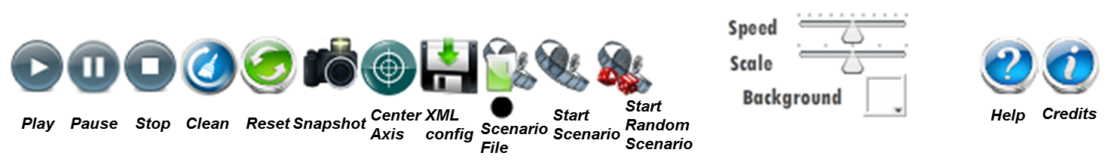
Center
Axis
XML
config
Start
Scenario
Start
Random
Scenario
Help
Credits
Play
Pause
Stop
Clean
Reset
Snapshot
Scenario
File
1 Clock
2 Clocks
1 hand
2 hands

Slide 6
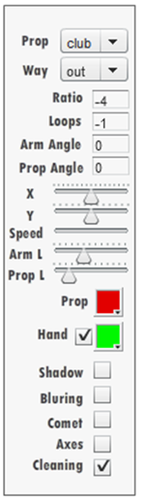
Prop : None, Stick, Staff, Poi
Prop Way : Out, In
Ratio : Prop Speed / Arm Speed
Number of Loops (-1 : infinity)
Initial Arm Angle in degrees
Initial Prop Angle in degrees
Arm Length
Prop Length
Prop Color
Hand Path Color
Show Axis
Clean Path after each Loop

Slide 7
<?xml version="1.0" encoding="UTF-8"?>
<scenario name="exemple.xml">
<scene name="XXX">
<right nbloops=«INT» PARAMETERS>
<left nbloops=«INT» PARAMETERS>
</scene>
<scene name="YYY">
<right nbloops=«INT» PARAMETERS>
<left nbloops=«INT» PARAMETERS>
<scene>
</scenario>

