Slide 1



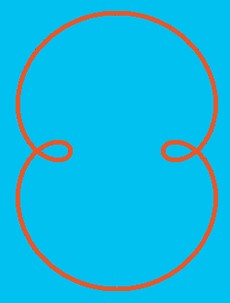









SPINs
0
1
2
4
3
5
Cardioid
Circle
ANTISPINs
-1
-2
-3
-4
-5
Circle
Deltoid
Ellipse

Slide 2


2
-4
Nephroid
Astroid

Slide 3
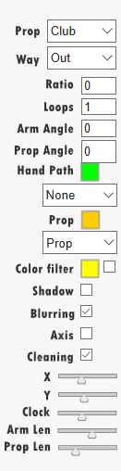
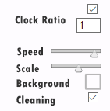
Prop choice: None, Stick, Staff, Poï, Club, Hoop
Arm Way: in or out
Ratio between the Arm Speed Rotation and the Prop Speed Rotation
Number of loops (-1 : infinity)
Initial Rotation Angle in degrees for the Arm
Initial Rotation Angle in degrees for the Prop
Hand Path Color
Hand View Mode: None, Comet, Path
Prop Color
Prop View Mode: None, Comet, Path, Path+CometProp, Path+Prop
Color Filter. Set it and choose the color if needed. This may take a lot of resources
Shadow Mode
Blurring Mode
Show Axis or not
Clean after each loop
X coordinate (abscissa) value for Axis. Slider handles values between 0 and Panel Width
Y coordinate (ordinate) value for Axis. Slider handles values between 0 and Panel Height
Hand Clock Speed. Slider handles values between 0.5 and 10.5
Arm length. Slider handle values between 0 and Panel Height/4
Prop length. Slider handle values between 0 and Panel Height/4
Set Clock Speed Ratio between both hands
Set a fixed ratio between both Hand Clock Speeds. You however have to fix the reference Hand Clock Speed with the left panel
Speed Percentage for the Main Clock Usage. Slider handle values between 0 and 100
Scale for the whole Animation. Slider handles values between 0 and 2
Background Color
Animation Cleaning. Different from cleaning in right/left panel that cleans after every loops. This one permit to clean after every Scene

Slide 4
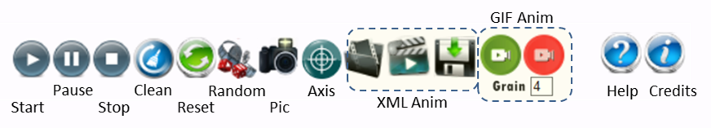


GIF Anim
Start
Pause
Stop
Clean
Reset
Random
Pic
Axis
XML Anim
Help
Credits
“One Hand”
“Both Hands”

Slide 5
<?xml version=“1.0” encoding=“UTF-8”?>
<animation name=”Anim1”>
<scenario name=“Scenario1”>
<scene name=“Scene1.1”>
< right nbloops=“INT” PARAMETERS />
< left nbloops=“INT” PARAMETERS />
<both PARAMETERS />
</scene>
<scene name=“Scene1.2”>
< right nbloops=“INT” PARAMETERS />
< left nbloops=“INT” PARAMETERS />
<both PARAMETERS />
</scene>
</scenario>
<scenario name=“Scenario2”>
<scene name=“Scene2.1”>
< right nbloops=“INT” PARAMETERS />
< left nbloops=“INT” PARAMETERS />
<both PARAMETERS />
</scene>
<scene name=“Scene2.2”>
< right nbloops=“INT” PARAMETERS />
< left nbloops=“INT” PARAMETERS />
<both PARAMETERS />
</scene>
</scenario>
</animation>
<?xml version=“1.0” encoding=“UTF-8”?>
<animation name=”Anim1” nbloops=“INT”>
<scenario name=“Scenario1” nbloops=“INT”>
<scene name=“Scene1.1” nbloops=“INT”>
…
</scene>
<scene name=“Scene1.2” nbloops =“INT”>
…
</scene>
…
</scenario>
</animation>
<?xml version=“1.0” encoding=“UTF-8”?>
<animation name=”Anim1” nbloops=“INT”>
<scenario name=“Scenario1” nbloops=“INT”>
…
</scenario>
<scenario name=“Scenario1” nbloops=“INT”>
…
</scenario>
</animation>

Slide 6
