Slide 1

Linear Algebra Libraries for High-Performance Computing: Scientific Computing with Multicore and Accelerators
Sunday, June 15, 2012 9:00 AM - 1:00 PM
Presenters Prof. Jack Dongarra (9:00 – 10:00)
University of Tennessee & Oak Ridge National Lab Dr. Jakub Kurzak (10:00 – 12:00)
University of Tennessee
Dr. Hatem Ltaief (12:00 – 1:00)
Computational Scientist, KAUST Supercomputing Laboratory
Break at 11:00-11:30 and Lunch at 1:00

Slide 2
ISC 2012 Tutorial Instructions
Tutorial feedback:
https://www.surveymonkey.com/s/isc12_tutorial02
Slides available at:
http://www.isc12.org/proceedings_tutorials
Username:
Password:

Slide 3
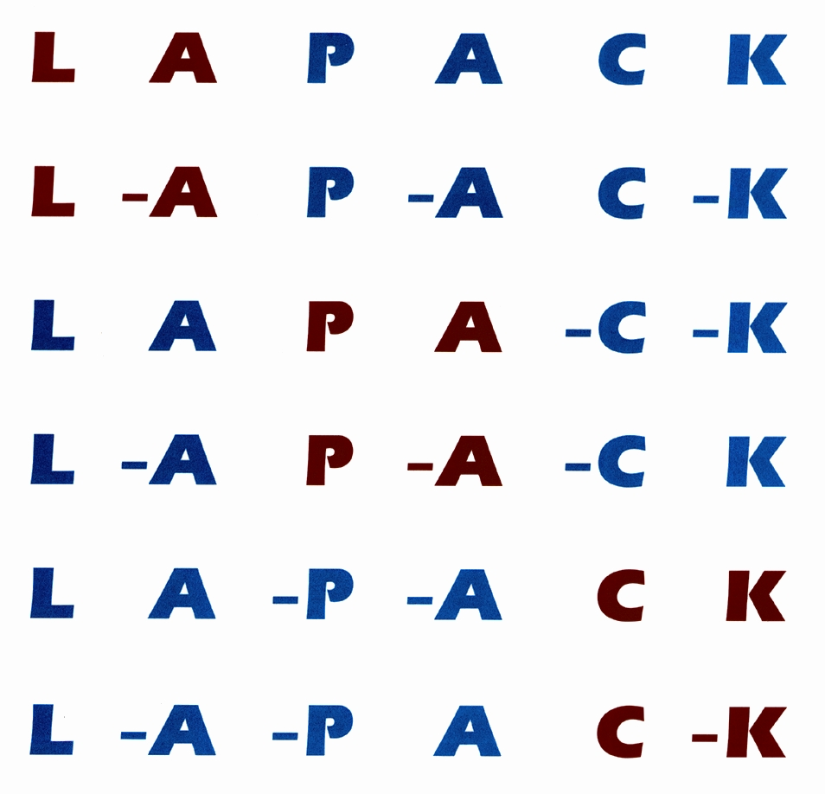
Overview of Dense Numerical Linear Algebra Libraries
BLAS: kernel for dense linear algebra
LAPACK: sequential dense linear algebra
ScaLAPACK: parallel distributed dense linear algebra
Linear Algebra PACKage

Slide 4
What do you mean by performance?
What is a xflop/s?
xflop/s is a rate of execution, some number of floating point operations per second.
Whenever this term is used it will refer to 64 bit floating point operations and the operations will be either addition or multiplication.
Tflop/s refers to trillions (10¹²) of floating point operations per second and
Pflop/s refers to 10¹⁵ floating point operations per second.
What is the theoretical peak performance?
The theoretical peak is based not on an actual performance from a benchmark run, but on a paper computation to determine the theoretical peak rate of execution of floating point operations for the machine.
The theoretical peak performance is determined by counting the number of floating-point additions and multiplications (in full precision) that can be completed during a period of time, usually the cycle time of the machine.
For example, an Intel Xeon 5570 quad core at 2.93 GHz can complete 4 floating point operations per cycle or a theoretical peak performance of 11.72 GFlop/s per core or 46.88 Gflop/s for the socket.

Slide 5
What Is LINPACK?
LINPACK is a package of mathematical software for solving problems in linear algebra, mainly dense linear systems of linear equations.
LINPACK: “LINear algebra PACKage”
Written in Fortran 66
The project had its origins in 1974
The project had four primary contributors: myself when I was at Argonne National Lab, Jim Bunch from the University of California-San Diego, Cleve Moler who was at New Mexico at that time, and Pete Stewart from the University of Maryland.
LINPACK as a software package has been largely superseded by LAPACK, which has been designed to run efficiently on shared-memory, vector supercomputers.

Slide 6
Computing in 1974
High Performance Computers:
IBM 370/195, CDC 7600, Univac 1110, DEC PDP-10, Honeywell 6030
Fortran 66
Trying to achieve software portability
Run efficiently
BLAS (Level 1)
Vector operations
Software released in 1979
About the time of the Cray 1

Slide 7
LINPACK Benchmark?
The Linpack Benchmark is a measure of a computer’s floating-point rate of execution.
It is determined by running a computer program that solves a dense system of linear equations.
Over the years the characteristics of the benchmark has changed a bit.
In fact, there are three benchmarks included in the Linpack Benchmark report.
LINPACK Benchmark
Dense linear system solve with LU factorization using partial pivoting
Operation count is: 2/3 n³ + O(n²)
Benchmark Measure: MFlop/s
Original benchmark measures the execution rate for a Fortran program on a matrix of size 100x100.

Slide 8
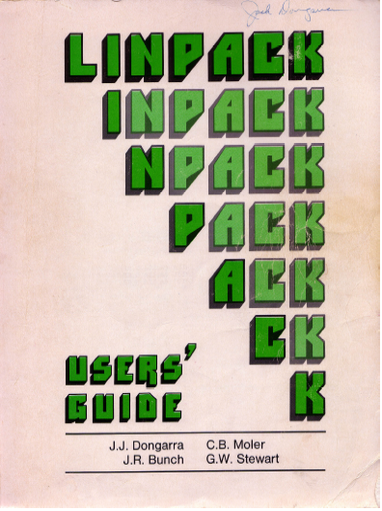
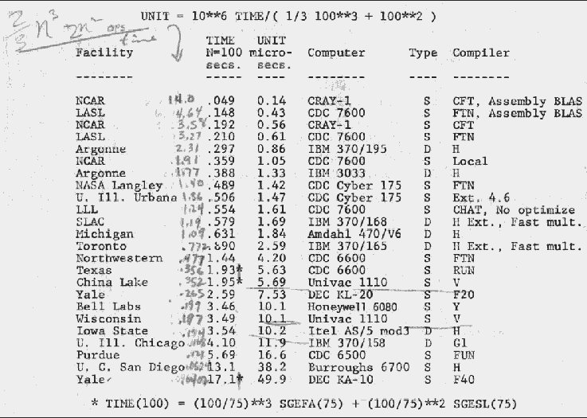
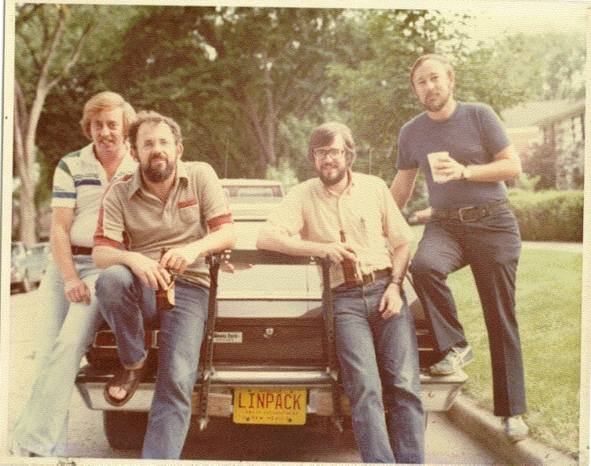
Accidental Benchmarker
Appendix B of the Linpack Users’ Guide
Designed to help users extrapolate execution time for Linpack software package
First benchmark report from 1977;
Cray 1 to DEC PDP-10

Slide 9
High Performance Linpack (HPL)
Benchmark | Matrix | Optimizations | Parallel
Name | dimension | allowed | Processing
Linpack 100 | 100 | compiler | –ª
Linpack 1000^{b} | 1000 | hand, code replacement | –^{c}
Linpack Parallel | 1000 | hand, code replacement | Yes
HPLinpack^{d} | arbitrary | hand, code replacement | Yes
ª Compiler parallelization possible. ^{b} Also known as TPP (Toward Peak Performance) or Best Effort
^{c} Multiprocessor implementations allowed.
^{d} Highly-Parallel LINPACK Benchmark is also known as NxN Linpack Benchmark or High Parallel Computing (HPC).

Slide 10
A brief history of (Dense) Linear Algebra software
But the BLAS-1 weren’t enough
Consider AXPY ( y = α·x + y ): 2n flops on 3n read/writes
Computational intensity = (2n)/(3n) = 2/3
Too low to run near peak speed (read/write dominates)
So the BLAS-2 were developed (1984-1986)
Standard library of 25 operations (mostly) on matrix/vector pairs
“GEMV”: y = α·A·x + β·x, “GER”: A = A + α·x·y^{T}, x = T⁻¹·x
Up to 4 versions of each (S/D/C/Z), 66 routines, 18K LOC
Why BLAS 2 ? They do O(n²) ops on O(n²) data
So computational intensity still just ~(2n²)/(n²) = 2
OK for vector machines, but not for machine with caches

Slide 11
A brief history of (Dense) Linear Algebra software
The next step: BLAS-3 (1987-1988)
Standard library of 9 operations (mostly) on matrix/matrix pairs
“GEMM”: C = α·A·B + β·C, C = α·A·A^{T} + β·C, B = T⁻¹·B
Up to 4 versions of each (S/D/C/Z), 30 routines, 10K LOC
Why BLAS 3 ? They do O(n³) ops on O(n²) data
So computational intensity (2n³)/(4n²) = n/2 – big at last!
Good for machines with caches, other mem. hierarchy levels
How much BLAS1/2/3 code so far (all at www.netlib.org/blas)
Source: 142 routines, 31K LOC, Testing: 28K LOC
Reference (unoptimized) implementation only
Ex: 3 nested loops for GEMM

Slide 12
Memory Hierarchy
By taking advantage of the principle of locality:
Present the user with as much memory as is available in the cheapest technology.
Provide access at the speed offered by the fastest technology.
Processor
Tertiary
Storage
(Disk/Tape)
Secondary
Storage
(Disk)
Control
Level
2 and 3
Cache
(SRAM)
Main
Memory
(DRAM)
Distributed
Memory
Remote
Cluster
Memory
Datapath
On-Chip
Cache
Registers
Speed (ns):
1s
10s
100s
10,000,000s
(10s ms)
100,000 s
(.1s ms)
10,000,000,000s
(10s sec)
10,000,000 s
(10s ms)
Size (bytes):
100s
Ks
Ms
Gs
Ts
Notes:
The design goal is to present the user with as much memory as is available in the cheapest technology (points to the disk).
While by taking advantage of the principle of locality, we like to provide the user an average access speed that is very close to the speed that is offered by the fastest technology.
(We will go over this slide in details in the next lecture on caches).
+1 = 16 min. (X:56)

Slide 13
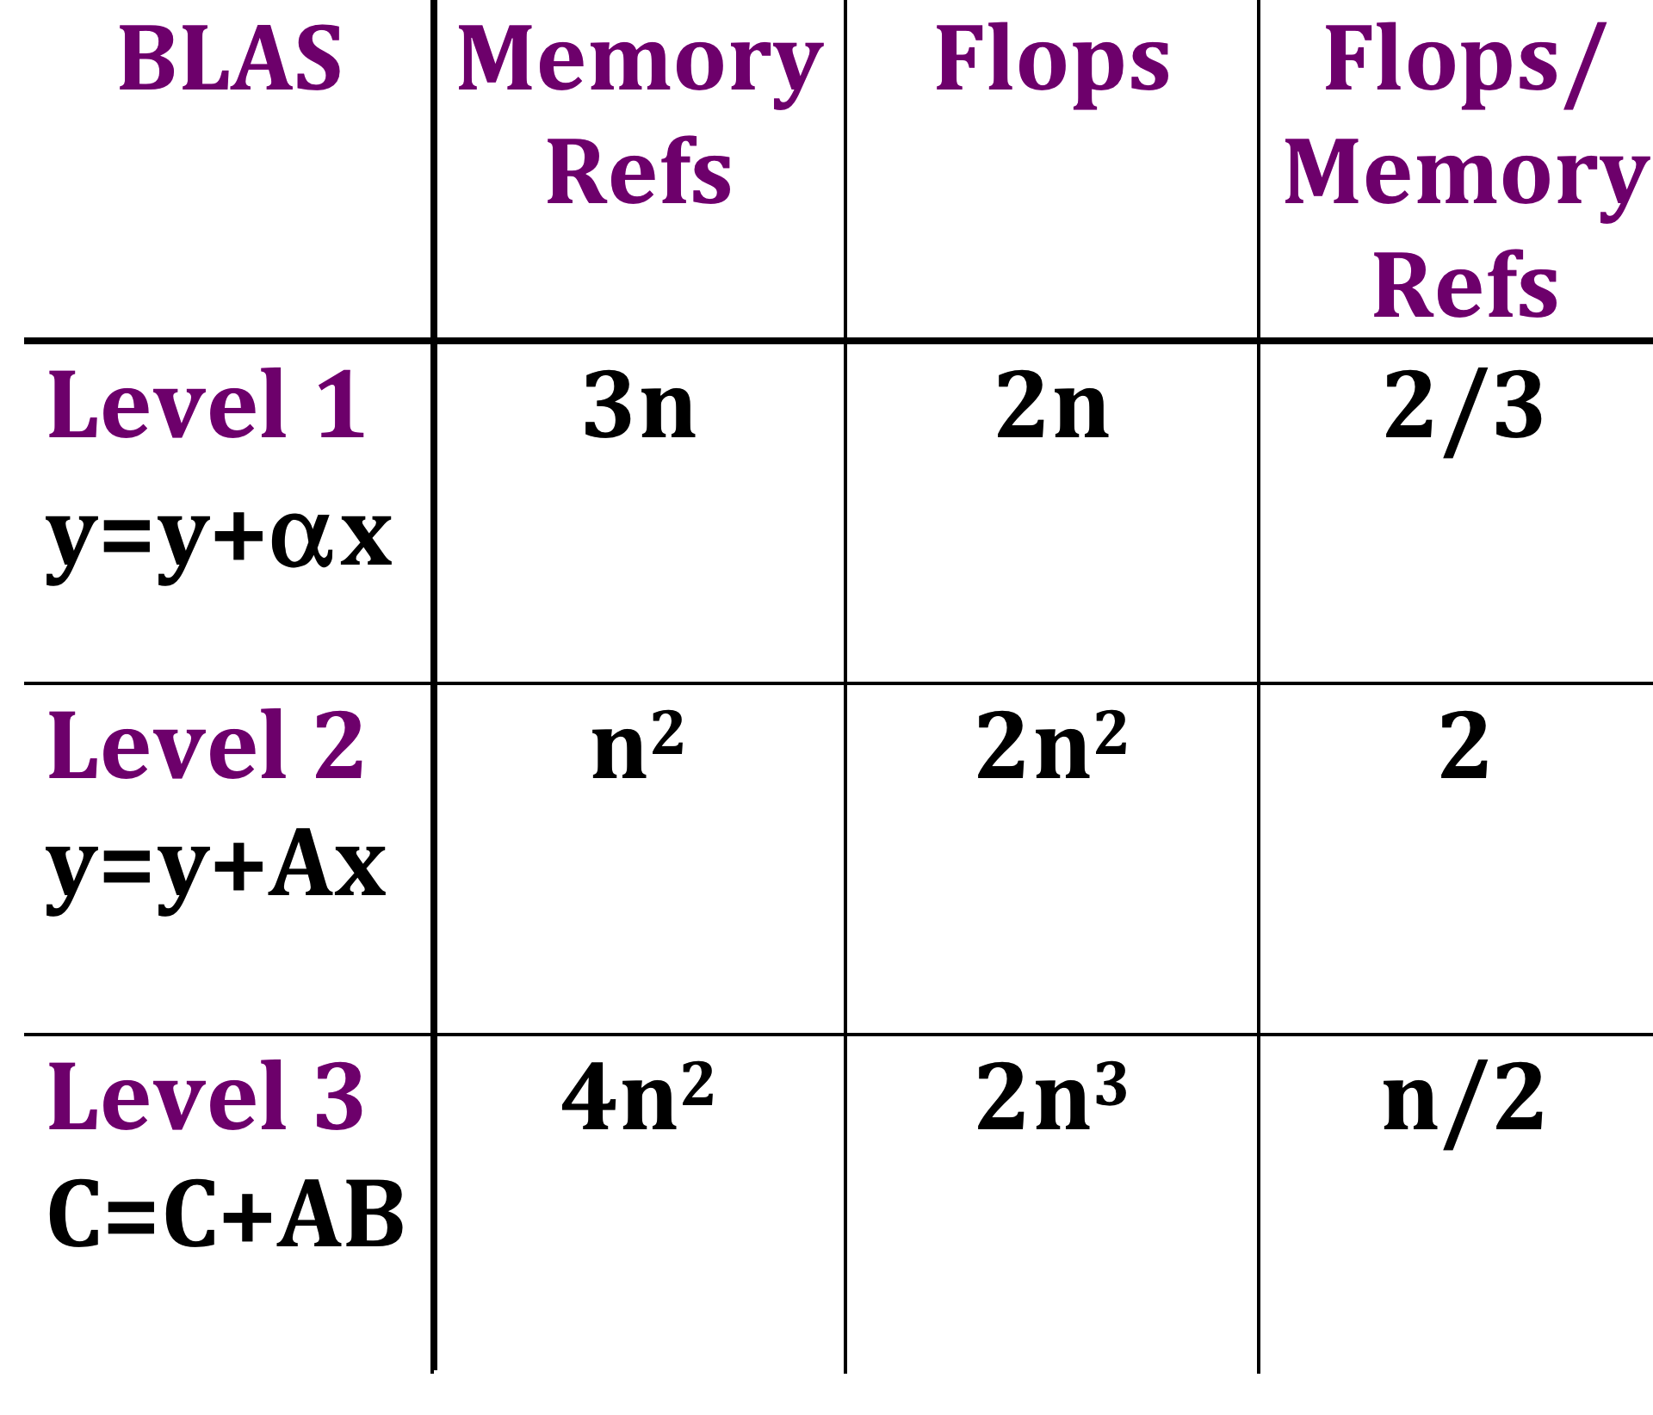
Why Higher Level BLAS?
Can only do arithmetic on data at the top of the hierarchy
Higher level BLAS lets us do this
Registers
L 1 Cache
L 2 Cache
Local Memory
Remote Memory
Secondary Memory

Slide 14
Level 1, 2 and 3 BLAS
Level 1 BLAS Vector-Vector operations
Level 2 BLAS Matrix-Vector operations
Level 3 BLAS Matrix-Matrix operations
+
*
*
+
*

Slide 15
Level 1, 2 and 3 BLAS Before (2007)

Slide 16
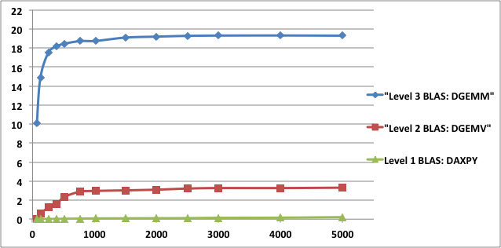
Level 1, 2 and 3 BLAS
1 core Intel Xeon E5-2670 (Sandy Bridge), 2.6 GHz.
24 MB shared L3 cache, and each core has a private 256 KB L2 and 64 KB L1.
The theoretical peak for this architecture in double precision is 20.8 Gflop/s per core.
Compiled with gcc 4.4.6 and using MKL_composer_xe_2013.3.163
19.3
Gflops
3.3
0.2
Matrix size

Slide 17
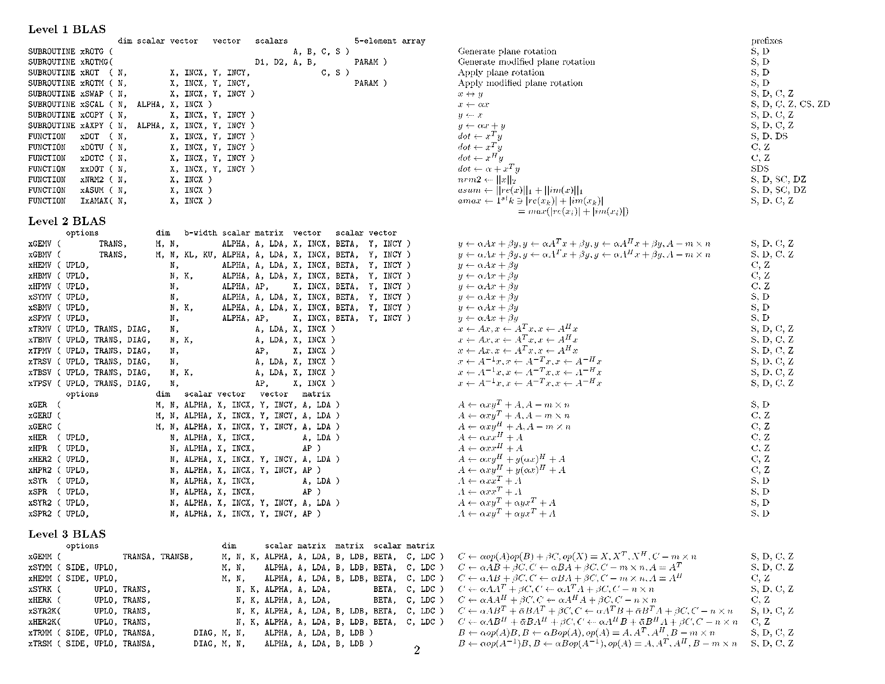

Slide 18
A brief history of (Dense) Linear Algebra software
LAPACK – “Linear Algebra PACKage” - uses BLAS-3 (1989 – now)
Ex: Obvious way to express Gaussian Elimination (GE) is adding multiples of one row to other rows – BLAS-1
How do we reorganize GE to use BLAS-3 ? (details later)
Contents of LAPACK (summary)
Algorithms we can turn into (nearly) 100% BLAS 3
Linear Systems: solve Ax=b for x
Least Squares: choose x to minimize ||Ax - b||₂
Algorithms that are only 50% BLAS 3 (so far)
“Eigenproblems”: Find λ and x where Ax = λ x
Singular Value Decomposition (SVD): (A^{T}A)x=σ²x
Generalized problems (eg Ax = λ Bx)
Error bounds for everything
Lots of variants depending on A’s structure (banded, A=A^{T}, etc)
How much code? (Release 3.4, Nov 2011) (www.netlib.org/lapack)
Source: 1674 routines, 490K LOC, Testing: 448K LOC

Slide 19
A brief history of (Dense) Linear Algebra software
Is LAPACK parallel?
Only if the BLAS are parallel (possible in shared memory)
ScaLAPACK – “Scalable LAPACK” (1995 – now)
For distributed memory – uses MPI
More complex data structures, algorithms than LAPACK
Only (small) subset of LAPACK’s functionality available
All at www.netlib.org/scalapack

Slide 20
LAPACK
LAPACK is in FORTRAN
Column Major
http://www.netlib.org/lapack/
LAPACK (Linear Algebra Package) provides routines for
solving systems of simultaneous linear equations,
least-squares solutions of linear systems of equations,
eigenvalue problems,
and singular value problems.
LAPACK relies on BLAS
The associated matrix factorizations (LU, Cholesky, QR, SVD, Schur, generalized Schur) are also provided, as are related computations such as reordering of the Schur factorizations and estimating condition numbers.
Dense and banded matrices are handled, but not general sparse matrices. In all areas, similar functionality is provided for real and complex matrices, in both single and double precision.
LAPACK is SEQUENTIAL
LAPACK is a REFERENCE implementation

Slide 21
A new generation of algorithms?
Algorithms follow hardware evolution along time.
LINPACK (80’s) (Vector operations) |  | Rely on - Level-1 BLAS operations
LAPACK (90’s) (Blocking, cache friendly) |  | Rely on - Level-3 BLAS operations

Slide 22
Example with GESV Solve a system of linear equations using a LU factorization
subroutine dgesv( n, nrhs, A, lda, ipiv, b, ldb, info )
input:
output:
n
nrhs
A
B
ip
i
v
n
n
info
n
Solution of Ax=b
n
nrhs
X
ip
i
v
U
n
n
info
n
L

Slide 23
Functionalities in LAPACK
Type of Problem | Acronyms
Linear system of equations | SV
Linear least squares problems | LLS
Linear equality-constrained least squares problem | LSE
General linear model problem | GLM
Symmetric eigenproblems | SEP
Nonsymmetric eigenproblems | NEP
Singular value decomposition | SVD
Generalized symmetric definite eigenproblems | GSEP
Generalized nonsymmetric eigenproblems | GNEP
Generalized (or quotient) singular value decomposition | GSVD (QSVD)

Slide 24
LAPACK Software
First release in February 1992
Version 3.4.0 released in November 2011
LICENSE: Mod-BSD, freely-available software package - Thus, it can be included in commercial software packages (and has been). We only ask that proper credit be given to the authors.
Open SVN repository
Multi-OS
*nix, Mac OS/X, Windows
Multi-build support (cmake)
make, xcode, nmake, VS studio, Eclipse, etc..
LAPACKE: Standard C language APIs for LAPACK (In collaboration with INTEL)
2 layers of interface
High-Level Interface : Workspace allocation and NAN Check
Low-Level Interface
Prebuilt Libraries for Windows
Extensive test suite
Forum and User support: http://icl.cs.utk.edu/lapack-forum/

Slide 25
Latest Algorithms
Since release 3.0 of LAPACK
Hessenberg QR algorithm with the small bulge multi-shift QR algorithm together with aggressive early deflation. [2003 SIAM SIAG LA Prize winning algorithm of Braman, Byers and Mathias]
Improvements of the Hessenberg reduction subroutines. [G. Quintana-Ortí and van de Geijn]
New MRRR eigenvalue algorithms [2006 SIAM SIAG LA Prize winning algorithm of Dhillon and Parlett]
New partial column norm updating strategy for QR factorization with column pivoting. [Drmač and Bujanovic]
Mixed Precision Iterative Refinement for exploiting fast single precision hardware for GE, PO [Langou’s]
Variants of various factorization (LU, QR, Chol) [Du]
RFP (Rectangular Full Packed) format [Gustavson, Langou]
XBLAS and Extra precise iterative refinement for GESV [Demmel et al.].
New fast and accurate Jacobi SVD [2009 SIAM SIAG LA Prize, Drmač and Veselić]
Pivoted Cholesky [Lucas]
Better multishift Hessenberg QR algorithm with early aggressive deflation [Byers]
Complete CS decomposition [Sutton]
Level-3 BLAS symmetric indefinite solve and symmetric indefinite inversion [Langou’s]
Since LAPACK 3.3, all routines in are now thread-safe
3.1
3.2
3.3

Slide 26
LAPACK 3.4.2
xGEQRT: QR factorization (improved interface). Contribution by Rodney James, UC Denver. xGEQRT is analogous to xGEQRF with a modified interface which enables better performance when the blocked reflectors need to be reused. The companion subroutines xGEMQRT apply the reflectors.
xGEQRT3: recursive QR factorization.
Contribution by Rodney James, UC Denver.
The recursive QR factorization enable cache-oblivious and enable high performance on tall and skinny matrices.
xTPQRT: Communication-Avoiding QR sequential kernels.
Contribution by Rodney James, UC Denver.
These subroutines are useful for updating a QR factorization and are used in sequential and parallel Communication Avoiding QR. These subroutines support the general case Triangle on top of Pentagone which includes as special cases the so-called triangle on top of triangle and triangle on top of square. This is the right-looking version of the subroutines and the routine is blocked.The T matrices and the block size are part of the interface. The companion subroutines xTPMQRT apply the reflectors.
xSYEVK: LDLT with rook pivoting and fast Bunch-Parlett pivoting.
Contribution by Craig Lucas.
These subroutines enables better stability than the Bunch-Kaufman pivoting scheme (xSYEV) currently used in LAPACK. The computational time is slightly higher.

Slide 27
Resources
Reference Code:
Reference code: (current version 3.4.2)
http://www.netlib.org/lapack/lapack.tgz
LAPACK build for windows (current version 3.4.2)
http://icl.cs.utk.edu/lapack-for-windows/lapack
LAPACKE: Standard C language APIs for LAPACK (in collaboration with INTEL):
http://www.netlib.org/lapack/#_standard_c_language_apis_for_lapack
Remi’s wrappers (wrapper for Matlab users):
http://icl.cs.utk.edu/~delmas/lapwrapmw.htm
Vendor Libraries:
more or less same as the BLAS: MKL, ACML, VECLIB, ESSL, etc… (WARNING: some implementations are just a subset of LAPACK)
Documentation:
LAPACK Users’ guide:
http://www.netlib.org/lapack/lug/
LAPACK Working notes (in particular LAWN 41)
http://www.netlib.org/lapack/lawns/downloads/
LAPACK release notes
http://www.netlib.org/lapack/lapack-3.4.2.html
LAPACK NAG example and auxiliary routines
http://www.nag.com/lapack-ex/lapack-ex.html
CRC Handbook of Linear Algebra, Leslie Hogben ed, Packages of Subroutines for Linear Algebra, Bai, Demmel, Dongarra, Langou, and Wang, Section 75: pages 75-1,75-24, CRC Press, 2006.
http://www.netlib.org/netlib/utk/people/JackDongarra/PAPERS/CRC-LAPACK-2005.pdf
Support:
LAPACK forum: (more than 1000 topics)
http://icl.cs.utk.edu/lapack-forum/
LAPACK mailing-list:
lapack@cs.utk.edu
LAPACK mailing-list archive:
http://icl.cs.utk.edu/lapack-forum/archives/

Slide 28
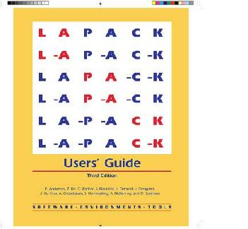
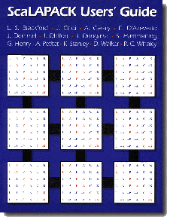
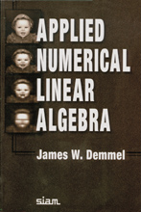
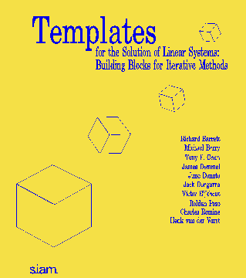
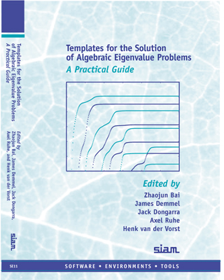
Organizing Linear Algebra – in books
www.netlib.org/lapack
www.netlib.org/scalapack
www.netlib.org/templates
www.cs.utk.edu/~dongarra/etemplates

Slide 29
Parallelization of LU and QR.
Parallelize the update: Easy and done in any reasonable software. This is the 2/3n³ term in the FLOPs count. Can be done efficiently with LAPACK+multithreaded BLAS
dgemm
-
U
L
A⁽¹⁾
dgetf2
lu(
)
dtrsm (+ dswp)
\
dgemm
-
U
L
A⁽²⁾

Slide 30

Overview of Dense Numerical Linear Algebra Libraries
BLAS: kernel for dense linear algebra
LAPACK: sequential dense linear algebra
ScaLAPACK: parallel distributed dense linear algebra
Scalable Linear Algebra PACKage

Slide 31
ScaLAPACK
Library of software dealing with dense & banded routines
Distributed Memory - Message Passing
MIMD Computers and Networks of Workstations
Clusters of SMPs

Slide 32
ScaLAPACK
http://www.netlib.org/scalapack/
ScaLAPACK (Scalable Linear Algebra Package) provides routines for
solving systems of simultaneous linear equations,
least-squares solutions of linear systems of equations,
eigenvalue problems,
and singular value problems.
Relies on LAPACK / BLAS and BLACS / MPI
Includes PBLAS ( Parallel BLAS )
ScaLAPACK is in FORTRAN and C
ScaLAPACK is for PARALLEL DISTRIBUTED
ScaLAPACK is a REFERENCE implementation

Slide 33
Programming Style
SPMD Fortran 77 with object based design
Built on various modules
PBLAS Interprocessor communication
BLACS
PVM, MPI, IBM SP, CRI T3, Intel, TMC
Provides right level of notation.
BLAS
LAPACK software expertise/quality
Software approach
Numerical methods

Slide 34
Overall Structure of Software
Object based - Array descriptor
Contains information required to establish mapping between a global array entry and its corresponding process and memory location.
Provides a flexible framework to easily specify additional data distributions or matrix types.
Currently dense, banded, & out-of-core
Using the concept of context

Slide 35
PBLAS
Similar to the BLAS in functionality and naming.
Built on the BLAS and BLACS
Provide global view of matrix
CALL DGEXXX ( M, N, A( IA, JA ), LDA,... )
CALL PDGEXXX( M, N, A, IA, JA, DESCA,... )

Slide 36
ScaLAPACK Structure
ScaLAPACK
PBLAS
Global
Local
LAPACK
BLACS
BLAS
PVM/MPI/...

Slide 37
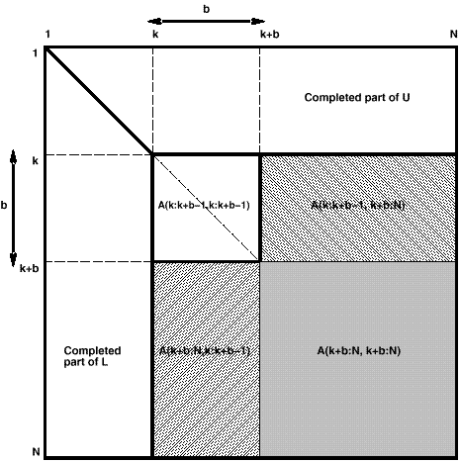
Choosing a Data Distribution
Main issues are:
Load balancing
Use of the Level 3 BLAS

Slide 38
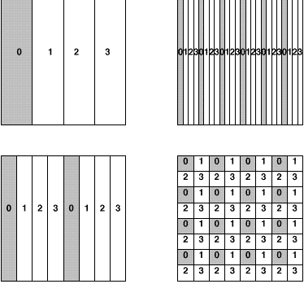
Possible Data Layouts
1D block and cyclic column distributions
1D block-cycle column and 2D block-cyclic distribution
2D block-cyclic used in ScaLAPACK for dense matrices

Slide 39
From LAPACK to ScaLAPACK
[LAPACK] subroutine dgesv( n, nrhs, a(ia,ja), lda, ipiv, b(ib,jb), ldb, info )
input:
output:
n
nrhs
LAPACK Data layout
A
B
i
p
i
v
n
n
info
n
n
nrhs
LAPACK Data layout
X
i
p
i
v
U
n
n
info
n
L

Slide 40
From LAPACK to ScaLAPACK
[LAPACK] subroutine dgesv( n, nrhs, a(ia,ja), lda, ipiv, b(ib,jb), ldb, info )
input:
output:
n
nrhs
ScaLAPACK Data layout
A₁₁
A₁₂
A₁₃
B₁₁
ip₁
n
A₂₁
A₂₂
A₂₃
n
B₂₁
ip₂
info
A₃₁
A₃₂
A₃₃
B₃₁
ip₃
n
nrhs
U₁₁
U₁₂
U₁₃
X₁₁
ip₁
ScaLAPACK Data layout
L₁₁
n
L₂₁
U₂₂
U₂₃
n
X₂₁
ip₂
info
L₂₂
L₃₁
L₃₂
U₃₃
X₃₁
ip₃
L₃₃

Slide 41
From LAPACK to ScaLAPACK
[LAPACK] subroutine dgesv( n, nrhs, a(ia,ja), lda, ipiv, b(ib,jb), ldb, info ) [ScaLAPACK] subroutine pdgesv( n, nrhs, a, ia, ja, desca, ipiv, b, ib, jb, descb, info )
input:
output:
n
nrhs
ScaLAPACK Data layout
A₁₁
A₁₂
A₁₃
B₁₁
ip₁
n
A₂₁
A₂₂
A₂₃
n
B₂₁
ip₂
info
A₃₁
A₃₂
A₃₃
B₃₁
ip₃
n
nrhs
U₁₁
U₁₂
U₁₃
X₁₁
ip₁
ScaLAPACK Data layout
L₁₁
n
L₂₁
U₂₂
U₂₃
n
X₂₁
ip₂
info
L₂₂
L₃₁
L₃₂
U₃₃
X₃₁
ip₃
L₃₃

Slide 42
Distribution and Storage
Matrix is block-partitioned & maps blocks
Distributed 2-D block-cyclic scheme
5x5 matrix partitioned in 2x2 blocks 2x2 process grid point of view
Routines available to distribute/redistribute data.
A
A
A
A
A
A
A
A
A
A
11
12
13
14
15
11
12
15
13
14
A
A
A
A
A
A
A
A
A
A
21
22
23
24
25
21
22
25
23
24
A
A
A
A
A
A
A
A
A
A
31
32
33
34
35
51
52
55
53
54
A
A
A
A
A
41
42
43
44
45
A
A
A
A
A
31
32
35
33
34
A
A
A
A
A
51
52
53
54
55
A
A
A
A
A
41
42
45
43
44

Slide 43
2D Block Cyclic Layout
Matrix point of view
Processor point of view
N
Q
0
0
0
2
2
2
4
4
4
0
0
0
2
2
2
4
4
4
0
0
0
2
2
2
4
4
4
0
0
0
2
2
2
4
4
4
M
P
0
0
0
2
2
2
4
4
4
1
1
1
3
3
3
5
5
5
1
1
1
3
3
3
5
5
5
1
1
1
3
3
3
5
5
5
1
1
1
3
3
3
5
5
5
NB
Matrix is MxN
Process grid is PxQ, P=2, Q=3
Blocks are MBxNB
MB
Notes:
43

Slide 44
2D Block Cyclic Layout
Matrix point of view
Processor point of view
0
0
0
2
2
2
4
4
4
0
0
0
2
2
2
4
4
4
0
0
0
2
2
2
4
4
4
0
0
0
2
2
2
4
4
4
0
0
0
2
2
2
4
4
4
1
1
1
3
3
3
5
5
5
1
1
1
3
3
3
5
5
5
1
1
1
3
3
3
5
5
5
1
1
1
3
3
3
5
5
5
Notes:
44

Slide 45
2D Block Cyclic Layout
Matrix point of view
Processor point of view
0
2
4
0
0
0
2
2
2
4
4
4
1
3
5
0
0
0
2
2
2
4
4
4
0
0
0
2
2
2
4
4
4
0
0
0
2
2
2
4
4
4
0
0
0
2
2
2
4
4
4
1
1
1
3
3
3
5
5
5
1
1
1
3
3
3
5
5
5
1
1
1
3
3
3
5
5
5
1
1
1
3
3
3
5
5
5
Notes:
45

Slide 46
2D Block Cyclic Layout
Matrix point of view
Processor point of view
0
2
4
0
2
4
0
0
0
2
2
2
4
4
4
1
3
5
1
3
5
0
0
0
2
2
2
4
4
4
0
0
0
2
2
2
4
4
4
0
0
0
2
2
2
4
4
4
0
0
0
2
2
2
4
4
4
1
1
1
3
3
3
5
5
5
1
1
1
3
3
3
5
5
5
1
1
1
3
3
3
5
5
5
1
1
1
3
3
3
5
5
5
Notes:
46

Slide 47
2D Block Cyclic Layout
Matrix point of view
Processor point of view
0
2
4
0
2
4
0
2
4
0
0
0
2
2
2
4
4
4
1
3
5
1
3
5
1
3
5
0
0
0
2
2
2
4
4
4
0
2
4
0
2
4
0
2
4
0
0
0
2
2
2
4
4
4
0
0
0
2
2
2
4
4
4
1
3
5
1
3
5
1
3
5
0
0
0
2
2
2
4
4
4
0
2
4
0
2
4
0
2
4
1
3
5
1
3
5
1
3
5
1
1
1
3
3
3
5
5
5
0
2
4
0
2
4
0
2
4
1
1
1
3
3
3
5
5
5
1
3
5
1
3
5
1
3
5
1
1
1
3
3
3
5
5
5
1
1
1
3
3
3
5
5
5
0
2
4
0
2
4
0
2
4
Notes:
47

Slide 48
2D Block Cyclic Layout
Matrix point of view
Processor point of view
0
2
4
0
2
4
0
2
4
0
0
0
2
2
2
4
4
4
1
3
5
1
3
5
1
3
5
0
0
0
2
2
2
4
4
4
0
2
4
0
2
4
0
2
4
0
0
0
2
2
2
4
4
4
0
0
0
2
2
2
4
4
4
1
3
5
1
3
5
1
3
5
0
0
0
2
2
2
4
4
4
0
2
4
0
2
4
0
2
4
1
3
5
1
3
5
1
3
5
1
1
1
3
3
3
5
5
5
0
2
4
0
2
4
0
2
4
1
1
1
3
3
3
5
5
5
1
3
5
1
3
5
1
3
5
1
1
1
3
3
3
5
5
5
1
1
1
3
3
3
5
5
5
0
2
4
0
2
4
0
2
4
Notes:
48

Slide 49
2D Block Cyclic Layout
Matrix point of view
Processor point of view
0
2
4
0
2
4
0
2
4
0
0
0
2
2
2
4
4
4
1
3
5
1
3
5
1
3
5
0
0
0
2
2
2
4
4
4
0
2
4
0
2
4
0
2
4
0
0
0
2
2
2
4
4
4
0
0
0
2
2
2
4
4
4
1
3
5
1
3
5
1
3
5
0
0
0
2
2
2
4
4
4
0
2
4
0
2
4
0
2
4
1
3
5
1
3
5
1
3
5
1
1
1
3
3
3
5
5
5
0
2
4
0
2
4
0
2
4
1
1
1
3
3
3
5
5
5
1
3
5
1
3
5
1
3
5
1
1
1
3
3
3
5
5
5
1
1
1
3
3
3
5
5
5
0
2
4
0
2
4
0
2
4
Notes:
49

Slide 50
2D Block Cyclic Layout
Matrix point of view
Processor point of view
3
5
1
3
5
1
3
5
0
0
2
2
2
4
4
4
2
4
0
2
4
0
2
4
0
0
2
2
2
4
4
4
0
0
2
2
2
4
4
4
3
5
1
3
5
1
3
5
0
0
2
2
2
4
4
4
2
4
0
2
4
0
2
4
3
5
1
3
5
1
3
5
1
1
3
3
3
5
5
5
2
4
0
2
4
0
2
4
1
1
3
3
3
5
5
5
3
5
1
3
5
1
3
5
1
1
3
3
3
5
5
5
1
1
3
3
3
5
5
5
2
4
0
2
4
0
2
4
Notes:
50

Slide 51
2D Block Cyclic Layout
Matrix point of view
Processor point of view
0
0
2
2
4
4
4
4
0
2
4
0
2
4
0
0
2
2
4
4
4
0
0
2
2
4
4
4
5
1
3
5
1
3
5
0
0
2
2
4
4
4
4
0
2
4
0
2
4
5
1
3
5
1
3
5
4
0
2
4
0
2
4
1
1
3
3
5
5
5
5
1
3
5
1
3
5
1
1
3
3
5
5
5
1
1
3
3
5
5
5
4
0
2
4
0
2
4
Notes:
51

Slide 52
2D Block Cyclic Layout
Matrix point of view
Processor point of view
0
0
2
2
4
4
0
0
2
2
4
4
1
3
5
1
3
5
0
0
2
2
4
4
0
2
4
0
2
4
1
3
5
1
3
5
0
2
4
0
2
4
1
1
3
3
5
5
1
3
5
1
3
5
1
1
3
3
5
5
1
1
3
3
5
5
0
2
4
0
2
4
Notes:
52

Slide 53
2D Block Cyclic Layout
Matrix point of view
Processor point of view
Notes:
53

Slide 54
Parallelism in ScaLAPACK
Level 3 BLAS block operations
All the reduction routines
Pipelining
QR Algorithm, Triangular Solvers, classic factorizations
Redundant computations
Condition estimators
Static work assignment
Bisection
Task parallelism
Sign function eigenvalue computations
Divide and Conquer
Tridiagonal and band solvers, symmetric eigenvalue problem and Sign function
Cyclic reduction
Reduced system in the band solver
Data parallelism
Sign function

Slide 55
Functionalities in LAPACK
Type of Problem | Acronyms
Linear system of equations | SV
Linear least squares problems | LLS
Linear equality-constrained least squares problem | LSE
General linear model problem | GLM
Symmetric eigenproblems | SEP
Nonsymmetric eigenproblems | NEP
Singular value decomposition | SVD
Generalized symmetric definite eigenproblems | GSEP
Generalized nonsymmetric eigenproblems | GNEP
Generalized (or quotient) singular value decomposition | GSVD (QSVD)

Slide 56
Functionnalities in ScaLAPACK
Type of Problem | Acronyms
Linear system of equations | SV
Linear least squares problems | LLS
Linear equality-constrained least squares problem | LSE
General linear model problem | GLM
Symmetric eigenproblems | SEP
Nonsymmetric eigenproblems | NEP
Singular value decomposition | SVD
Generalized symmetric definite eigenproblems | GSEP
Generalized nonsymmetric eigenproblems | GNEP
Generalized (or quotient) singular value decomposition | GSVD (QSVD)

Slide 57
Major Changes to Software
Must rethink the design of our software
Another disruptive technology
Similar to what happened with cluster computing and message passing
Rethink and rewrite the applications, algorithms, and software
Numerical libraries for example will change
For example, both LAPACK and ScaLAPACK will undergo major changes to accommodate this

Slide 58

A New Generation of Software: Parallel Linear Algebra Software for Multicore Architectures (PLASMA)
Software/Algorithms follow hardware evolution in time
LINPACK (70’s) (Vector operations) |  | Rely on - Level-1 BLAS operations
LAPACK (80’s) (Blocking, cache friendly) |  | Rely on - Level-3 BLAS operations
ScaLAPACK (90’s) (Distributed Memory) |  | Rely on - PBLAS Mess Passing
PLASMA (00’s) New Algorithms (many-core friendly) |  | Rely on - a DAG/scheduler - block data layout - some extra kernels
Those new algorithms
- have a very low granularity, they scale very well (multicore, petascale computing, … )
- removes a lots of dependencies among the tasks, (multicore, distributed computing)
- avoid latency (distributed computing, out-of-core)
- rely on fast kernels
Those new algorithms need new kernels and rely on efficient scheduling algorithms.

Slide 59
A New Generation of Software: Parallel Linear Algebra Software for Multicore Architectures (PLASMA)
Software/Algorithms follow hardware evolution in time
LINPACK (70’s) (Vector operations) |  | Rely on - Level-1 BLAS operations
LAPACK (80’s) (Blocking, cache friendly) |  | Rely on - Level-3 BLAS operations
ScaLAPACK (90’s) (Distributed Memory) |  | Rely on - PBLAS Mess Passing
PLASMA (00’s) New Algorithms (many-core friendly) |  | Rely on - a DAG/scheduler - block data layout - some extra kernels
Those new algorithms
- have a very low granularity, they scale very well (multicore, petascale computing, … )
- removes a lots of dependencies among the tasks, (multicore, distributed computing)
- avoid latency (distributed computing, out-of-core)
- rely on fast kernels
Those new algorithms need new kernels and rely on efficient scheduling algorithms.

Slide 60
A New Generation of Software: Parallel Linear Algebra Software for Multicore Architectures (PLASMA)
Software/Algorithms follow hardware evolution in time
LINPACK (70’s) (Vector operations) |  | Rely on - Level-1 BLAS operations
LAPACK (80’s) (Blocking, cache friendly) |  | Rely on - Level-3 BLAS operations
ScaLAPACK (90’s) (Distributed Memory) |  | Rely on - PBLAS Mess Passing
PLASMA (00’s) New Algorithms (many-core friendly) |  | Rely on - a DAG/scheduler - block data layout - some extra kernels
Those new algorithms
- have a very low granularity, they scale very well (multicore, petascale computing, … )
- removes a lots of dependencies among the tasks, (multicore, distributed computing)
- avoid latency (distributed computing, out-of-core)
- rely on fast kernels
Those new algorithms need new kernels and rely on efficient scheduling algorithms.

Slide 61
A New Generation of Software: Parallel Linear Algebra Software for Multicore Architectures (PLASMA)
Software/Algorithms follow hardware evolution in time
LINPACK (70’s) (Vector operations) |  | Rely on - Level-1 BLAS operations
LAPACK (80’s) (Blocking, cache friendly) |  | Rely on - Level-3 BLAS operations
ScaLAPACK (90’s) (Distributed Memory) |  | Rely on - PBLAS Mess Passing
PLASMA (00’s) New Algorithms (many-core friendly) |  | Rely on - a DAG/scheduler - block data layout - some extra kernels
Those new algorithms
- have a very low granularity, they scale very well (multicore, petascale computing, … )
- removes a lots of dependencies among the tasks, (multicore, distributed computing)
- avoid latency (distributed computing, out-of-core)
- rely on fast kernels
Those new algorithms need new kernels and rely on efficient scheduling algorithms.

Slide 62
Moore’s Law is Alive and Well
Data from Kunle Olukotun, Lance Hammond, Herb Sutter, Burton Smith, Chris Batten, and Krste Asanoviç

Slide 63
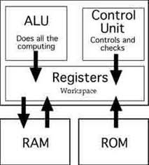
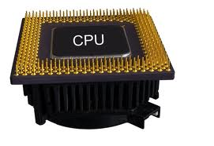
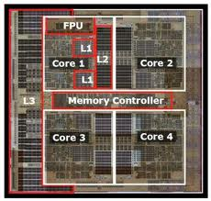
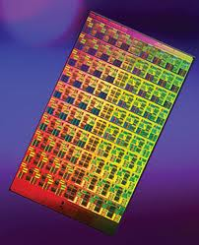
Transistors into Cores

Slide 64
But Clock Frequency Scaling Replaced by Scaling Cores / Chip
15 Years of exponential growth ~2x year has ended
Data from Kunle Olukotun, Lance Hammond, Herb Sutter, Burton Smith, Chris Batten, and Krste Asanoviç

Slide 65
Performance Has Also Slowed, Along with Power
Power is the root cause of all this
A hardware issue just became a
software problem
Data from Kunle Olukotun, Lance Hammond, Herb Sutter, Burton Smith, Chris Batten, and Krste Asanoviç

Slide 66
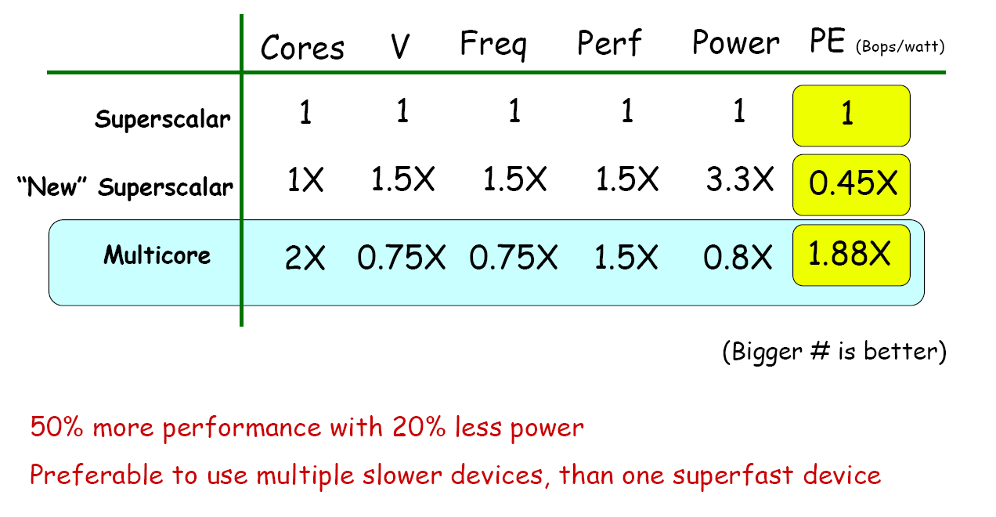
Power Cost of Frequency
Power ∝ Voltage² x Frequency (V²F)
Frequency ∝ Voltage
Power ∝Frequency³

Slide 67
Power Cost of Frequency
Power ∝ Voltage² x Frequency (V²F)
Frequency ∝ Voltage
Power ∝Frequency³

Slide 68
Moore’s Law Reinterpreted
Cores in the Top20 Systems
Number of cores per chip doubles every 2 year, while clock speed decreases (not increases).
Need to deal with systems with millions of concurrent threads
Future generation will have billions of threads!
Need to be able to easily replace inter-chip parallelism with intro-chip parallelism
Number of threads of execution doubles every 2 year

Slide 69
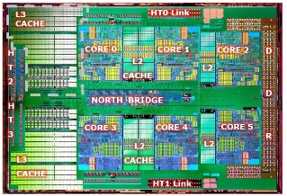
Example of typical parallel machine
Chip/Socket
Core
Core
Core
Core

Slide 70
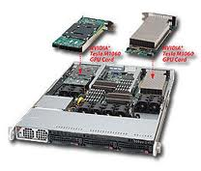

Example of typical parallel machine
Node/Board
Chip/Socket
GPU
…
Chip/Socket
GPU
Chip/Socket
GPU
Core
Core
Core
Core
Core

Slide 71
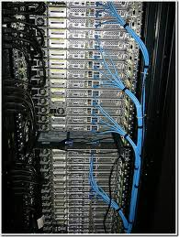
Example of typical parallel machine
Shared memory programming between processes on a board and
a combination of shared memory and distributed memory programming
between nodes and cabinets
Cabinet
Node/Board
…
Node/Board
Node/Board
Chip/Socket
GPU
…
Chip/Socket
GPU
Chip/Socket
GPU
Core
Core
Core
Core
Core

Slide 72
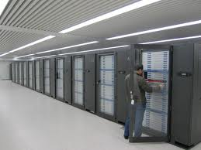
Example of typical parallel machine
Combination of shared memory and distributed memory programming
Switch
Cabinet
Cabinet
Cabinet
…
Node/Board
…
Node/Board
Node/Board
Chip/Socket
GPU
…
Chip/Socket
GPU
Chip/Socket
GPU
Core
Core
Core
Core
Core

Slide 73

November 2012: The TOP10
Rank | Site | Computer | Country | Cores | Rmax [Pflops] | % of Peak | Power [MW] | MFlops/Watt
1 | DOE / OS Oak Ridge Nat Lab | Titan, Cray XK7 (16C) + Nvidia Kepler GPU (14c) + custom | USA | 560,640 | 17.6 | 66 | 8.3 | 2120
2 | DOE / NNSA L Livermore Nat Lab | Sequoia, BlueGene/Q (16c) + custom | USA | 1,572,864 | 16.3 | 81 | 7.9 | 2063
3 | RIKEN Advanced Inst for Comp Sci | K computer Fujitsu SPARC64 VIIIfx (8c) + custom | Japan | 705,024 | 10.5 | 93 | 12.7 | 827
4 | DOE / OS Argonne Nat Lab | Mira, BlueGene/Q (16c) + custom | USA | 786,432 | 8.16 | 81 | 3.95 | 2066
5 | Forschungszentrum Juelich | JuQUEEN, BlueGene/Q (16c) + custom | Germany | 393,216 | 4.14 | 82 | 1.97 | 2102
6 | Leibniz Rechenzentrum | SuperMUC, Intel (8c) + IB | Germany | 147,456 | 2.90 | 90* | 3.42 | 848
7 | Texas Advanced Computing Center | Stampede, Dell Intel (8) + Intel Xeon Phi (61) + IB | USA | 204,900 | 2.66 | 67 | 3.3 | 806
8 | Nat. SuperComputer Center in Tianjin | Tianhe-1A, NUDT Intel (6c) + Nvidia Fermi GPU (14c) + custom | China | 186,368 | 2.57 | 55 | 4.04 | 636
9 | CINECA | Fermi, BlueGene/Q (16c) + custom | Italy | 163,840 | 1.73 | 82 | .822 | 2105
10 | IBM | DARPA Trial System, Power7 (8C) + custom | USA | 63,360 | 1.51 | 78 | .358 | 422
500 Slovak Academy Sci IBM Power 7 Slovak Rep 3,074 .077 81
Notes:
So it's not that I want to beat China per se; it's that I want us to have parity with them. I don't want to rely on them for the chip technology embedded in the supercomputers we use for national security. I don't want to rely on them for the low level software that runs my supercomputer because they figured out the parallelism before we did. I don't want to rely on them, or anyone else, for my own standard of living, for my safety and security, for the inventions that propel us forward, for open dialog and communications, all of which rely on supercomputing. I want the U.S. to be self reliant, capable and responsible for our own prosperity. »•« If we are to be partners in a world of global competition, I want us to come from a position of strength based on the best U.S. industry, academia and the national labs have to offer. That's what put us and has kept us in the leadership role we enjoy today in supercomputing. It's imperative we now begin to push forward on the necessary technology to ensure a continued leadership position. The stakes are very high

Slide 74
November 2012: The TOP10
`
Rank | Site | Computer | Country | Cores | Rmax [Pflops] | % of Peak | Power [MW] | MFlops/Watt
1 | DOE / OS Oak Ridge Nat Lab | Titan, Cray XK7 (16C) + Nvidia Kepler GPU (14c) + custom | USA | 560,640 | 17.6 | 66 | 8.3 | 2120
2 | DOE / NNSA L Livermore Nat Lab | Sequoia, BlueGene/Q (16c) + custom | USA | 1,572,864 | 16.3 | 81 | 7.9 | 2063
3 | RIKEN Advanced Inst for Comp Sci | K computer Fujitsu SPARC64 VIIIfx (8c) + custom | Japan | 705,024 | 10.5 | 93 | 12.7 | 827
4 | DOE / OS Argonne Nat Lab | Mira, BlueGene/Q (16c) + custom | USA | 786,432 | 8.16 | 81 | 3.95 | 2066
5 | Forschungszentrum Juelich | JuQUEEN, BlueGene/Q (16c) + custom | Germany | 393,216 | 4.14 | 82 | 1.97 | 2102
6 | Leibniz Rechenzentrum | SuperMUC, Intel (8c) + IB | Germany | 147,456 | 2.90 | 90* | 3.42 | 848
7 | Texas Advanced Computing Center | Stampede, Dell Intel (8) + Intel Xeon Phi (61) + IB | USA | 204,900 | 2.66 | 67 | 3.3 | 806
8 | Nat. SuperComputer Center in Tianjin | Tianhe-1A, NUDT Intel (6c) + Nvidia Fermi GPU (14c) + custom | China | 186,368 | 2.57 | 55 | 4.04 | 636
9 | CINECA | Fermi, BlueGene/Q (16c) + custom | Italy | 163,840 | 1.73 | 82 | .822 | 2105
10 | IBM | DARPA Trial System, Power7 (8C) + custom | USA | 63,360 | 1.51 | 78 | .358 | 422
500 Slovak Academy Sci IBM Power 7 Slovak Rep 3,074 .077 81
Notes:
So it's not that I want to beat China per se; it's that I want us to have parity with them. I don't want to rely on them for the chip technology embedded in the supercomputers we use for national security. I don't want to rely on them for the low level software that runs my supercomputer because they figured out the parallelism before we did. I don't want to rely on them, or anyone else, for my own standard of living, for my safety and security, for the inventions that propel us forward, for open dialog and communications, all of which rely on supercomputing. I want the U.S. to be self reliant, capable and responsible for our own prosperity. »•« If we are to be partners in a world of global competition, I want us to come from a position of strength based on the best U.S. industry, academia and the national labs have to offer. That's what put us and has kept us in the leadership role we enjoy today in supercomputing. It's imperative we now begin to push forward on the necessary technology to ensure a continued leadership position. The stakes are very high

Slide 75
Critical Issues for Peta and Exascale Algorithms
Synchronization-reducing algorithms
Break Fork-Join model
Communication-reducing algorithms
Use methods which have lower bound on communication
Mixed precision methods
2x speed of ops and 2x speed for data movement
Autotuning
Today’s machines are too complicated, build “smarts” into software have experiment to optimize.
Fault resilient algorithms
Implement algorithms that can recover from failures/bit flips
Reproducibility of results
Today we can’t guarantee this. We understand the issues, but some of our “colleagues” have a hard time with this.

Slide 76
Major Changes to Software
Must rethink the design of our software
Another disruptive technology
Similar to what happened with cluster computing and message passing
Rethink and rewrite the applications, algorithms, and software
Numerical libraries for example will change
For example, both LAPACK and ScaLAPACK will undergo major changes to accommodate this

Slide 77
LAPACK LU - Intel64 - 16 cores

Slide 78
Parallelization of QR Factorization
Parallelize the update: Easy and done in any reasonable software. This is the 2/3n³ term in the FLOPs count. Can be done efficiently with LAPACK+multithreaded BLAS
dgemm
-
R
V
A⁽¹⁾
dgeqf2 + dlarft
Panel factorization
qr(
)
Fork - Join parallelism
Bulk Sync Processing
Update of the remaining submatrix
dlarfb
-
R
V
A⁽²⁾

Slide 79
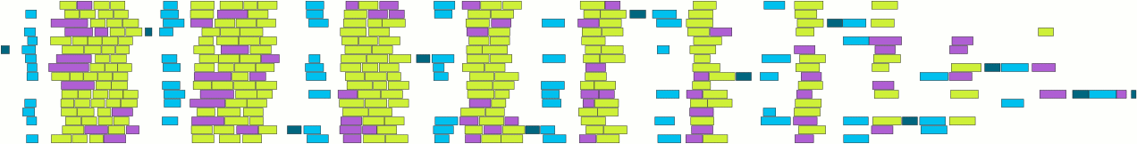
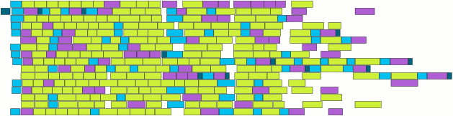
PLASMA: Parallel Linear Algebra s/w for Multicore Architectures
Objectives
High utilization of each core
Scaling to large number of cores
Shared or distributed memory
Methodology
Dynamic DAG scheduling
Split phases task generation and execution
Explicit parallelism/Implicit communication
Fine granularity / block data layout
Arbitrary DAG with dynamic scheduling
Cholesky
4 x 4
Fork-join
parallelism
DAG scheduled
parallelism
Time
79

