Slide 1

106213076 Wei-Cheng HUANG

Slide 2
Converts user's source program into object program.
Shows error when anything considered wrong occurs.

Slide 3
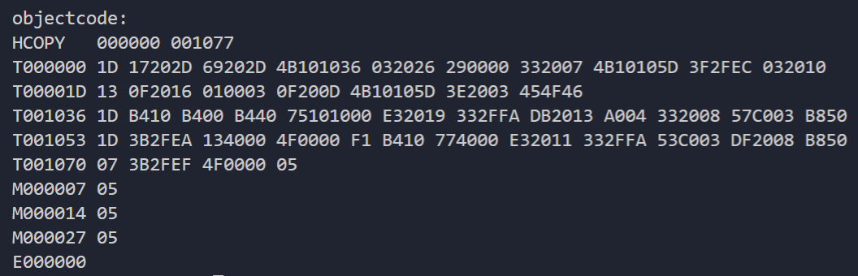
Result of (test)SICXE.asm

Slide 4
Change log 6/3/2020
RED error shown.
Errors for undefined symbol/mnemonic can now be shown.
wrong use of format X or C under BYTE will be shown.
Change log 6/2/2020
Everything above START and beneath END will be dumped.
PROG must starts with 'START'.
PROG must ends with 'END'.
START will only accept HEX value.
No operand for RSUB. Yes you can have label for RSUB.
WORD, RESW, and RESB only allow decimal input.
BYTE's restriction handled.
must be given with an operand.
strange format other then C or F or blank.
full-byte required for format X.
X or C must have content in BYTE.
No length limit for BYTE C format.
Undefined mnemonic.
For format 2 and indexed addressing, operand must be added with register only.
Undefined symbol reworked.
Redefined worked.
Unformatted error.
Change log 5/31/2020
First release

Slide 5
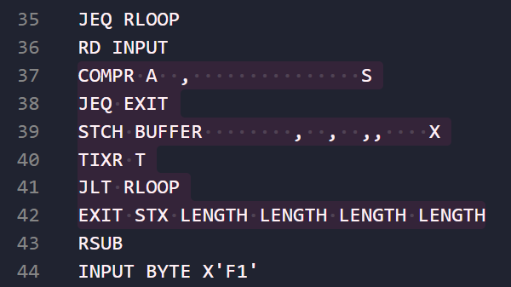
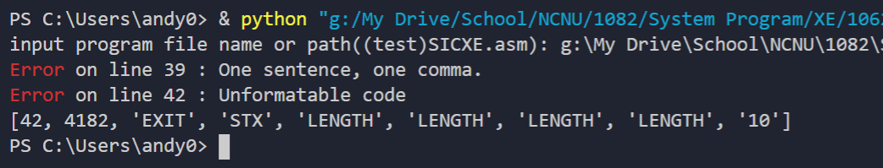
IF
ERROR HANDLED:
Strange-format tolerable.
RESULT

Slide 6
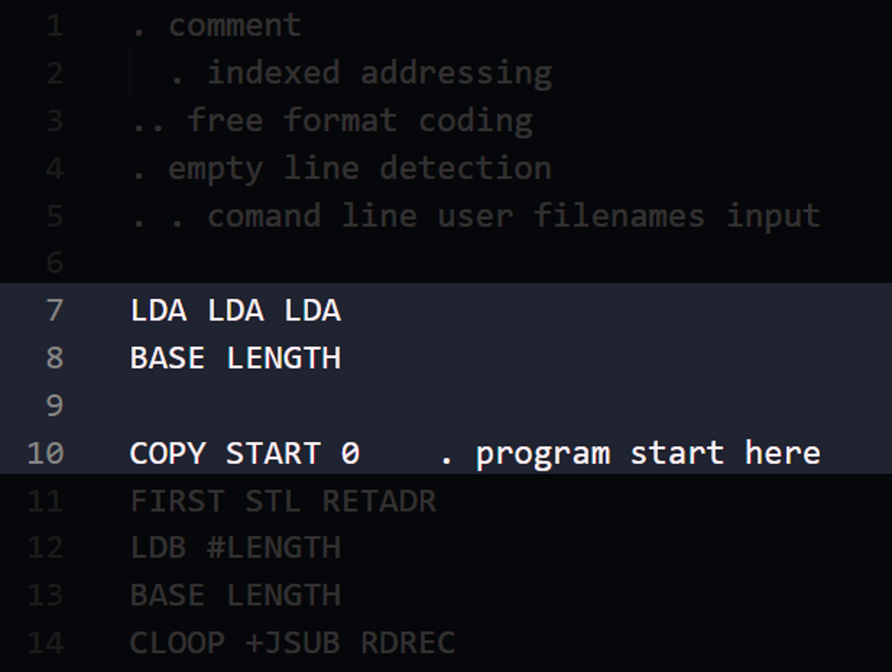
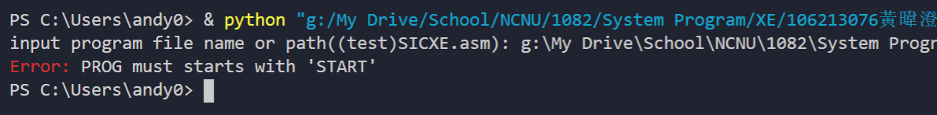
IF
ERROR HANDLED:
PROG must starts with 'START'
RESULT

Slide 7
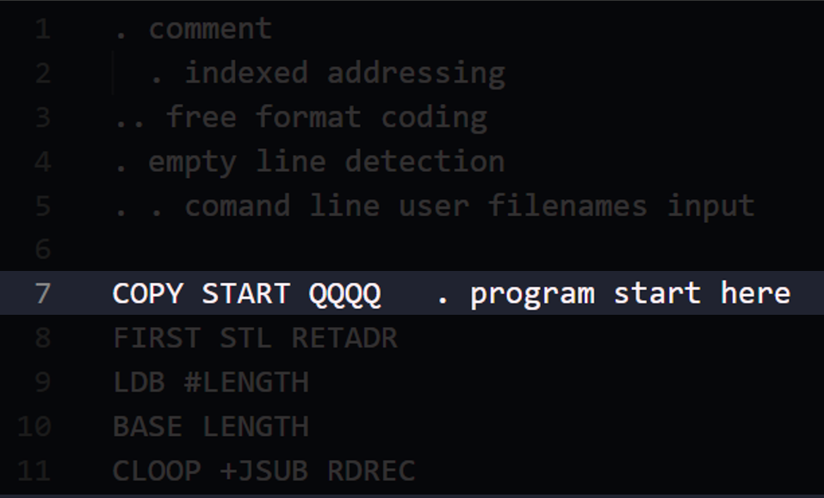
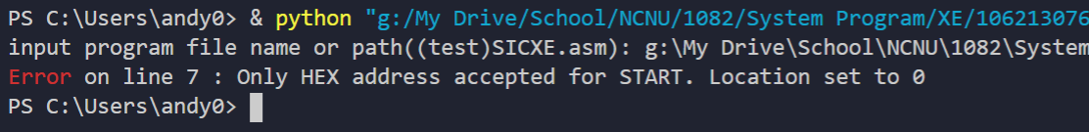
IF
ERROR HANDLED:
START will only accept HEX value
RESULT

Slide 8
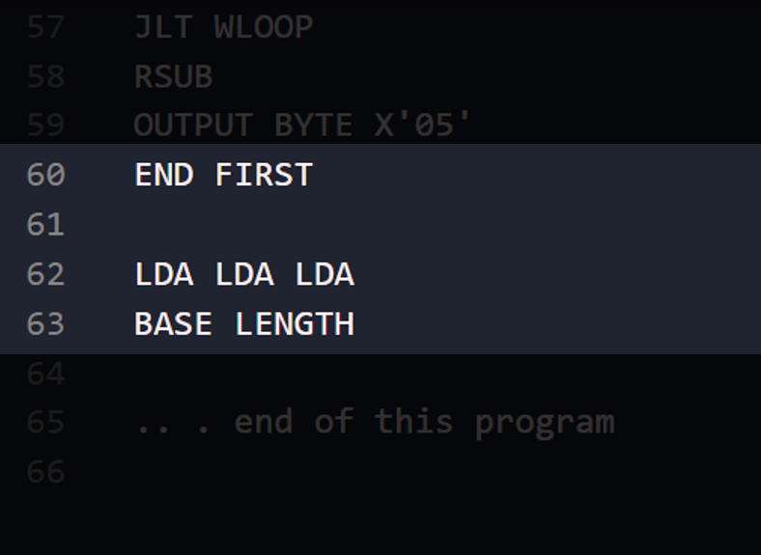
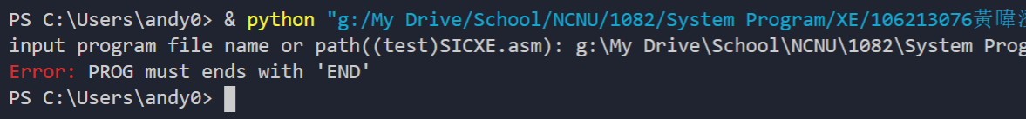
IF
ERROR HANDLED:
PROG must ends with 'END'
RESULT

Slide 9
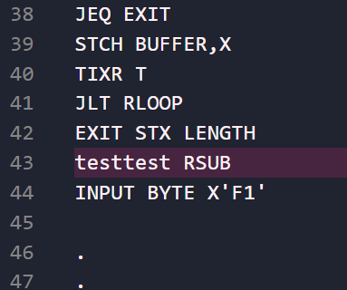
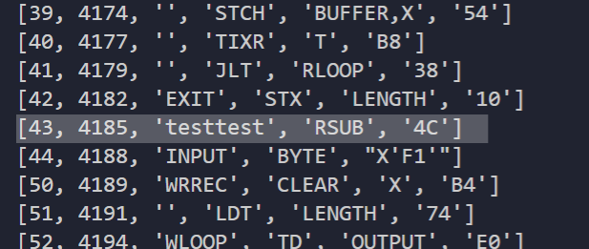
IF
ERROR HANDLED:
Yes you can have label for RSUB
RESULT

Slide 10
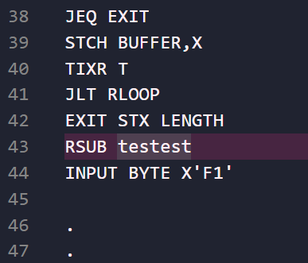
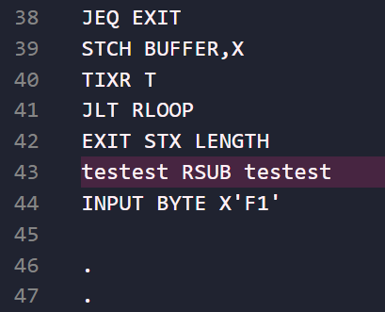
IF
ERROR HANDLED:
No you can't have operand for RSUB
RESULT

Slide 11
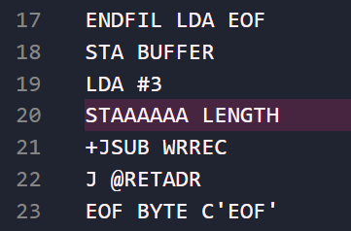
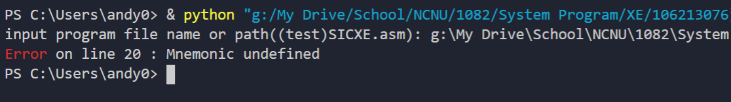
IF
ERROR HANDLED:
Undefined mnemonic
RESULT

Slide 12
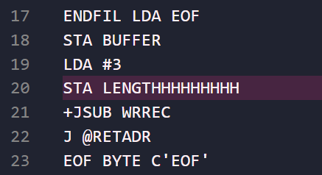
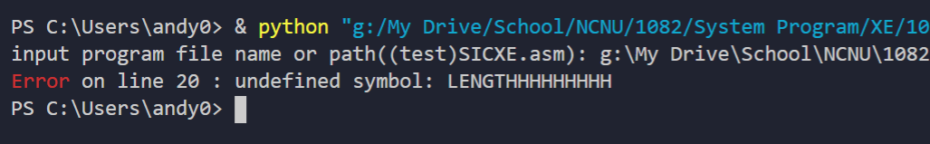
IF
ERROR HANDLED:
Undefined symbol
RESULT

Slide 13
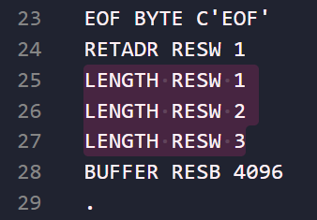
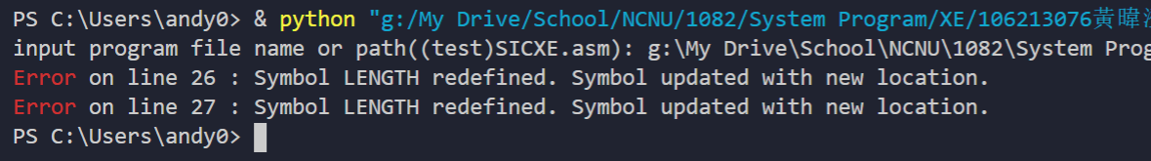
IF
ERROR HANDLED:
Redefined symbol
RESULT

Slide 14
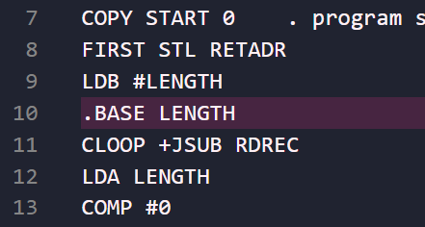
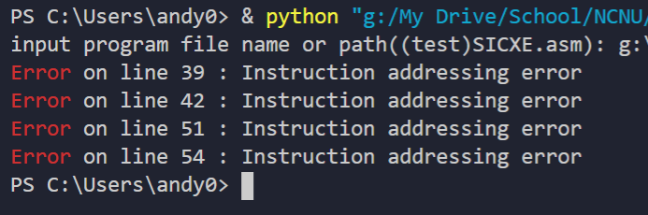
IF
ERROR HANDLED:
Instruction unaddressable
RESULT

Slide 15
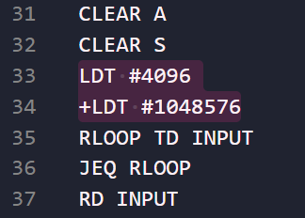
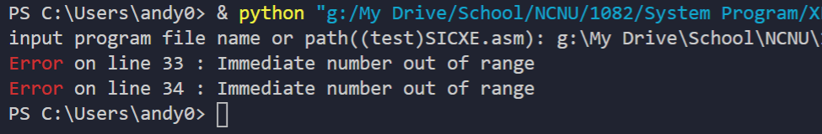
IF
ERROR HANDLED:
Instruction unaddressable
RESULT

Slide 16
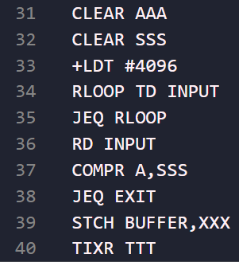
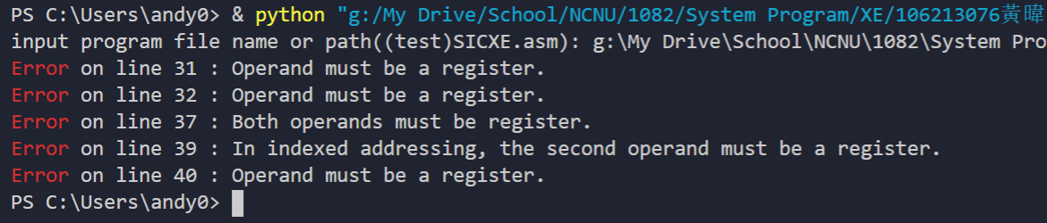
IF
ERROR HANDLED:
For format 2 and indexed addressing,
operand must be added with register only.
RESULT

Slide 17
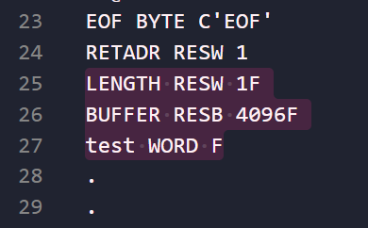
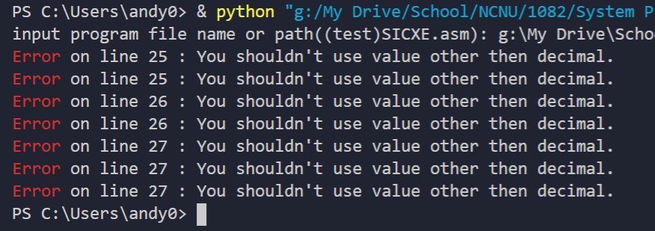
IF
ERROR HANDLED:
WORD, RESW, and RESB only allow decimal input
RESULT

Slide 18
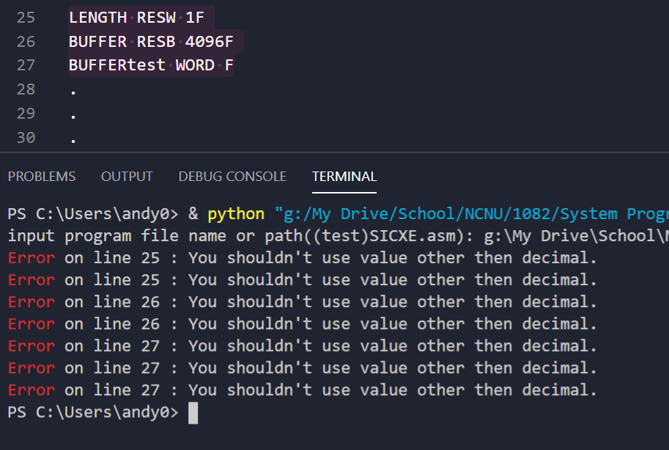
ERROR HANDLED:
WORD, RESW, and RESB only allow decimal input

Slide 19
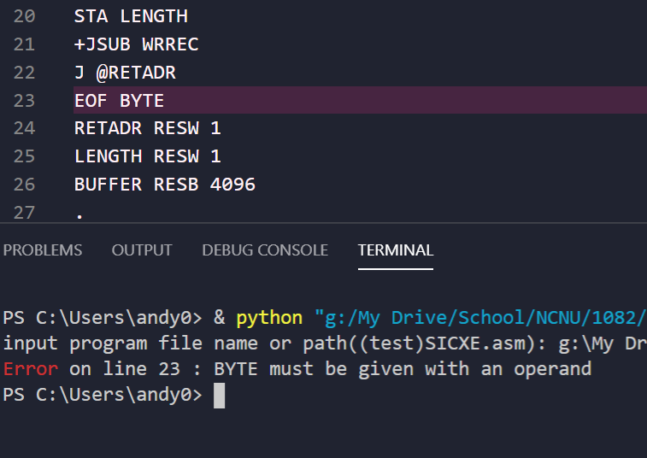
ERROR HANDLED:
BYTE must be given with an operand

Slide 20
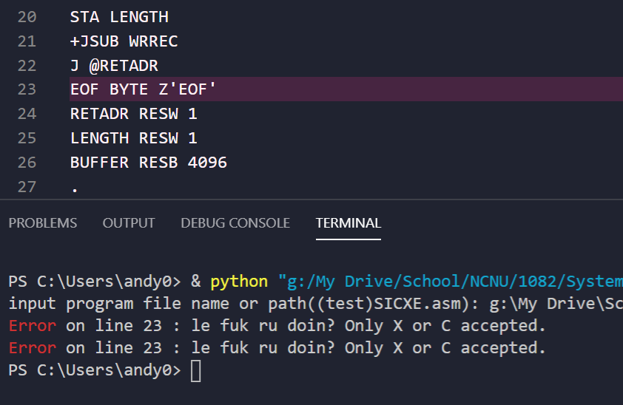
ERROR HANDLED:
BYTE wouldn't accept format other then X'' or C''

Slide 21
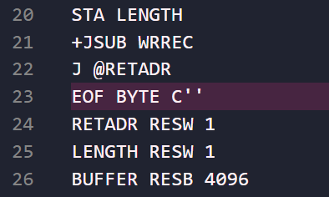
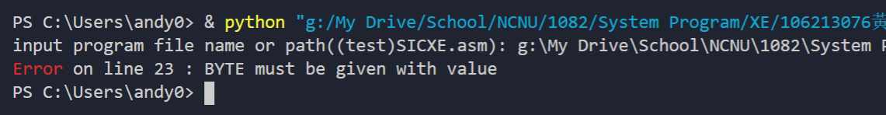
IF
ERROR HANDLED:
X or C must have content in it
RESULT

Slide 22
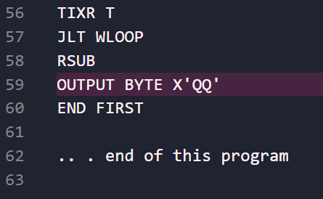
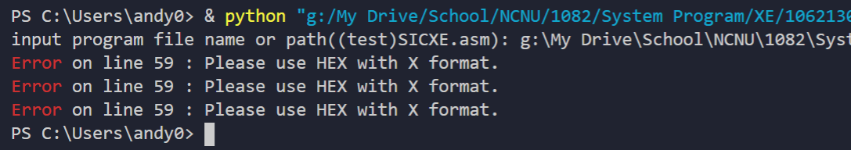
IF
ERROR HANDLED:
X format only allows HEX value
RESULT

Slide 23
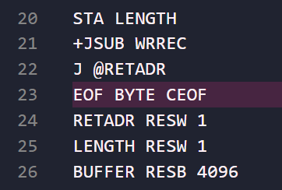
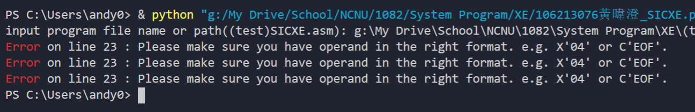
IF
ERROR HANDLED:
Wrong use of format X or C under BYTE
RESULT

Slide 24
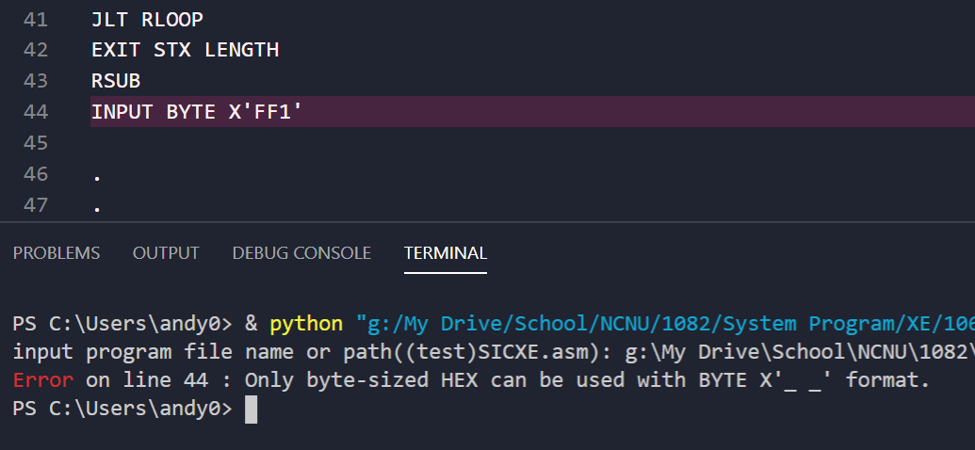
ERROR HANDLED:
Format X must be "byte-sized" when using BYTE

Slide 25
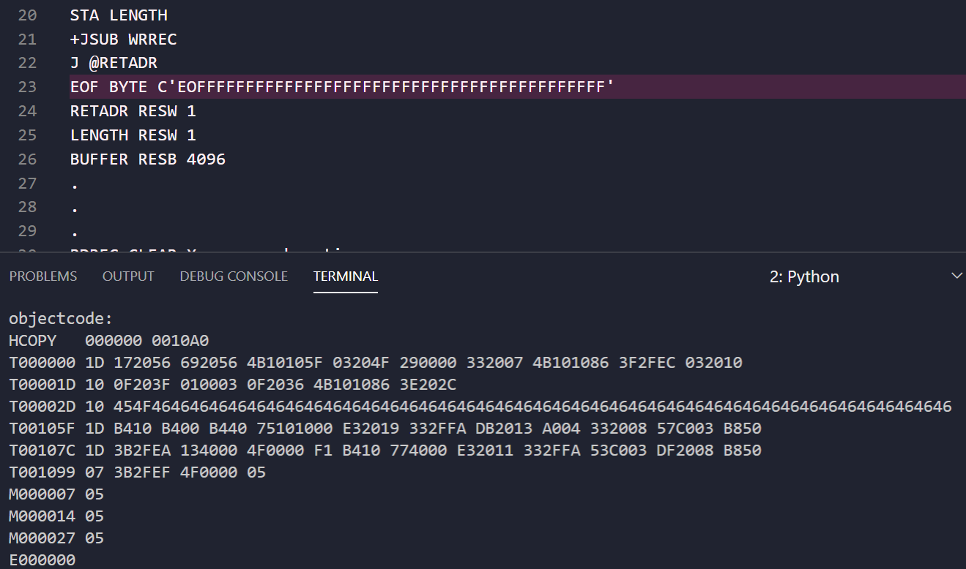
Extra
No length limit for BYTE C format

Slide 26
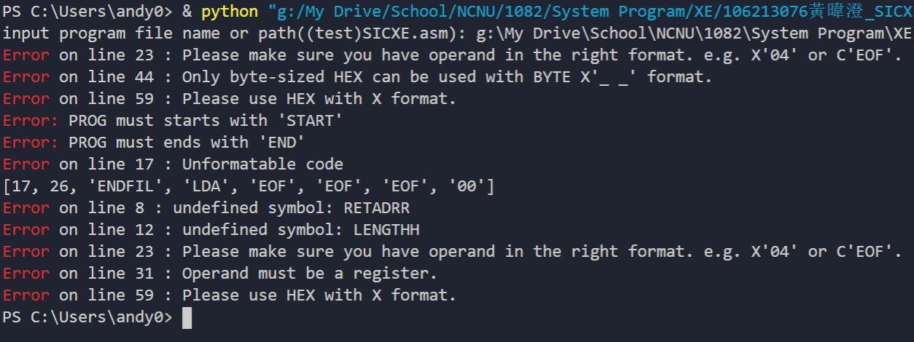
Extra
Multiple errors OK OK

Slide 27
THAT'S IT

Slide 28
THANK YOU

