Slide 1

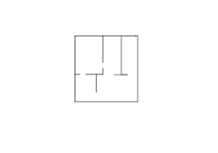

map0
UGM_chain
UGM_tree – blank

