Slide 1


CATCH UP 1
FINANCIAL ADVISOR PROJECT
BANCO PAN
JUNE, 2020
http://poupacerto.com/

Slide 2


GOAL
To conduct a PoC with a reduced number of Banco PAN's workers to test Poupa Certo's financial advisor functionality through the sending of behavioral insights via SMS generated by the app's algorithm.

Slide 3
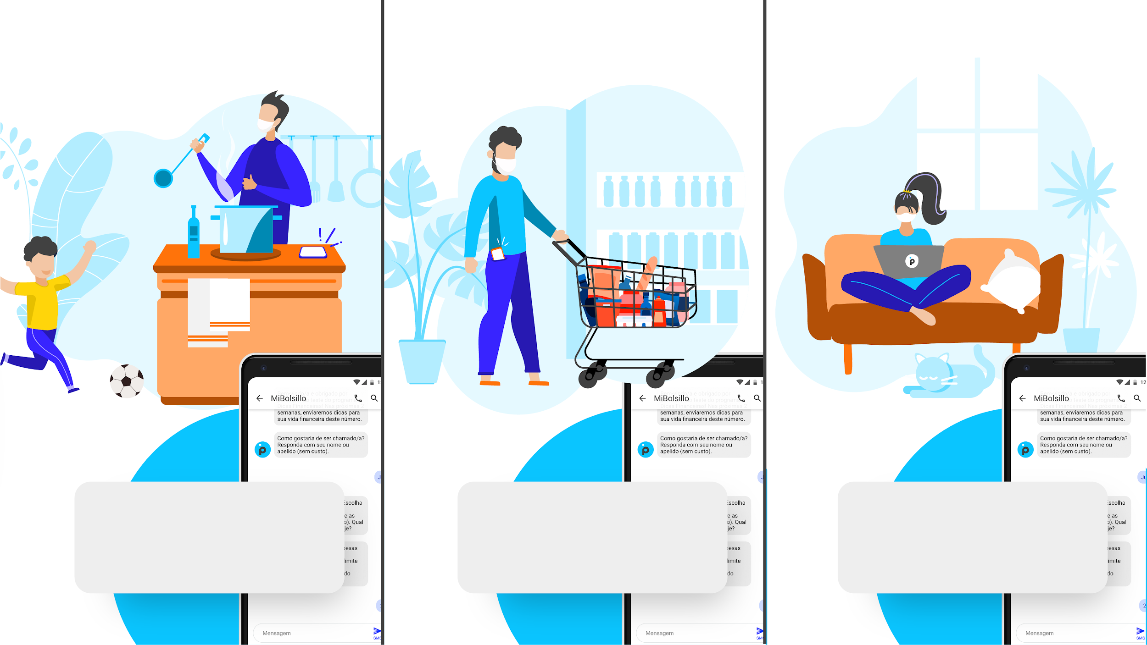

I saw that you usually enjoy eating out. What about leaving your kitchen for a bit while saving money? The PAN credit card has a R$50 iFood voucher.
During last year, you’ve increased your credit limit around 13 times. Planning your purchases can help keep your spending under control!
Are you clear about where your money goes? 7 out of 10 people who are aware of their spendings manage their budget and financial life better. You can count on me!

Slide 4
FRAMEWORK
HOW TO BETTER MANAGE YOUR CREDIT CARD EXPENSES
HOW TO AVOID GOING OVER YOUR CREDIT LIMIT
HOW TO RENEGOTIATE YOUR CREDIT CARD DEBT
DIAGNOSIS
TIME FRAMES
April 2019 on
Jan - March 18, 2020 (PRE-COVID)
March 18 - May 2020 (COVID)
Comparative Jan - March 18 to March 18 - May 2020
Control impulse purchases: categorize your expenses in essential and non-essential
Keep an eye on your credit card statement with frequency
Create your own monthly mit (independent of that of your credit card)
Do not mix your personal and company's expenses on one credit card
FINANCIAL EDUCATION
GENERAL + COVID19
Credit card as an ally
Control impulse purchases: categorize your expenses in essential and non-essential
Keep an eye on your credit card statement with frequency
60 day Brazilian policy to delay debt payments
Interest rate at 3% and expected to keep a downward trend for the rest of the year.
Pay credit card debt with a low interest rate personal loan
Compare interest rates and terms from different financial institutions
Avoid to the maximum to delay credit card payments (316% annual interest rate)
AVAILABLE INPUT DATA TO BE PROCESSED
USER'S HISTORICAL ANALYSIS
Frequency of use: Number of times
% of essential vs % non-essential expenses. and in Brazilian R$.
Top 3 essential and non-essential expenses
Number of times the user asked for a credit card limit expansion
Prediction of the limit spending based on the history
Frequency of use: Number of times compared to the rest of the users
% of essential vs % of non-essential expenses - compared to the rest of the users and in Brazilian R$
Number of times the user asked for a credit card limit expansion
% spendings/limit (generally and per category)
Number of people who DO NOT pay their credit card bills on time.
COMPARATIVE WITH THE UNIVERSE OF USERS
Trends in the 3 areas of most and least expense for that user only
TOP 3 of the most and least important expenses in the period of evaluation
Frequency of use
Trend in the 3 areas of most and least expense (% of increase or decrease) and where the user is compare to the trend
TOP 3 of the most and least important expenses in the period of evaluation
Frequency of use.
Number of people who DO NOT pay their credit card bills on time
People who have recurrent payments or pay in installments with frequency.
BEHAVIORAL BIASES
Reminder to pay the credit card bill on time and if it is as efficient as automatic payment | commitment devices
What is the effect of having the option to pay a minimum installment every month and the effects of rolling interests | âncora & default
Bring to light how having a credit card makes it easier to make other small unplanned payments such as Ubereats/rides tips that keep accumulating in the long run | present bias, time inconsistency & mental accounting lever
BANCO PAN'S BENEFITS PROGRAM
How Banco PAN's benefits program compares with other programs
By using Banco PAN's more frequently (based on your financial planning) you get more benefits
Benefits of Cuponeria, Platinum Card & Clube de Ofertas
Notes:
pedir complementos falando dos beneficios

Slide 5
POUPA CERTO
Charlotte Castelnau
Project Manager
charlotte@poupacerto.com
+55 11 963 172 096
http://poupacerto.com/

