Slide 1

Big Mountain Resort
How can BMR use its facilities to set the ticket prices and identify potential improvements in order to increase the profit during the next ski season?

Slide 2
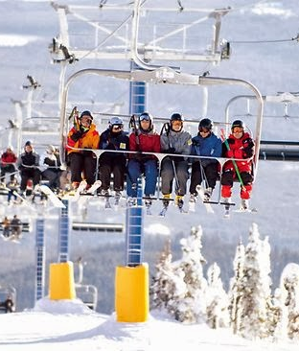
CONTEXT
BMR has recently installed an additional chair lift making this the twelfth and adding to their operating costs by $1540000. Currently their ticket sales price is solely based on adding a premium to the average price of the resorts in the same market segment. There is suspicion that BMR is not capitalizing on its facilities as much as it could. This hampers investment strategy. We need to get a good sense of the importance of the facilities compared to other resorts and how this can impact the ticket price as well as look into ways to cut costs.
.
This Photo by Unknown Author is licensed under CC BY

Slide 3
BMR’s proposals:
Features with most impact on ticket price
Recommendations
Permanently closing down up to 10 of the least used runs.
Increase the vertical drop by adding a run to a point 150 feet lower down but requiring the installation of an additional chair lift to bring skiers back up, without additional snow making coverage
Same as number 2, but adding 2 acres of snow making cover
Increase the longest run by 0.2 mile to boast 3.5 miles length, requiring an additional snow making coverage of 4 acres
BMR is at the top compared to other resorts in the features.
Increase ticket price to at least $96 and up to $97.5.
Close the least used run to decrease costs.
Proposal #2 would increase the price by and additional $1.99 with an expected revenue of $347,000.
Vertical drop
Area covered by snow making machines
Number of runs
Number of fast 4 person chairs
Other relevant features with less impact:
Total chairlifts
Length of the longest run
Total skiable area

Slide 4
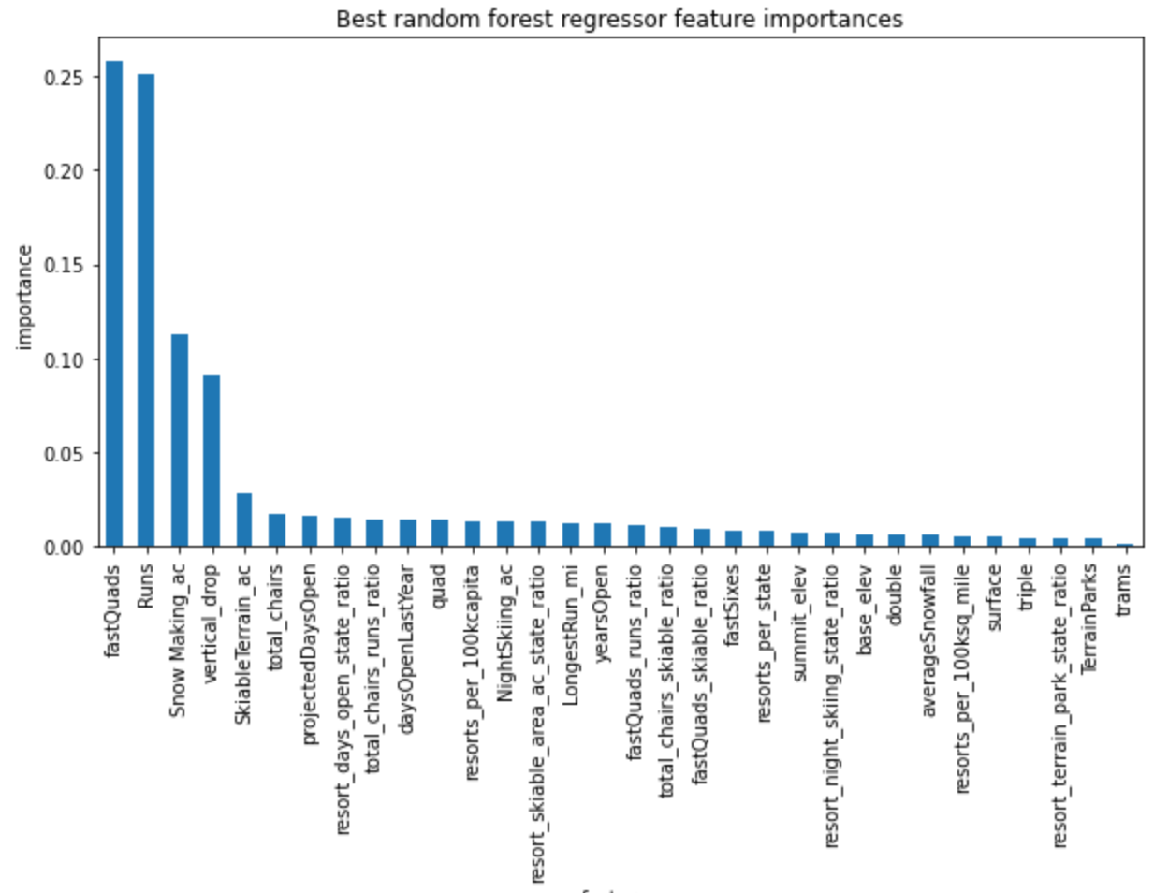
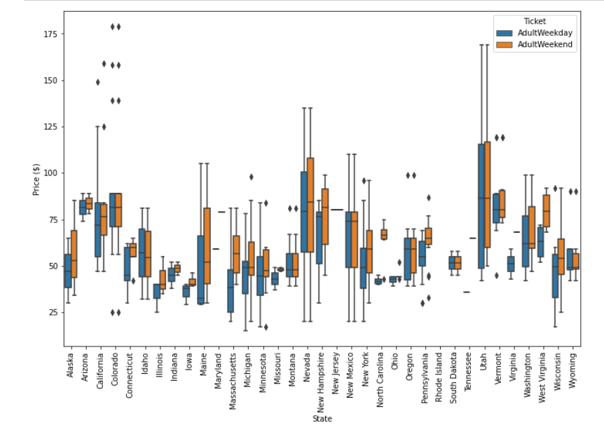
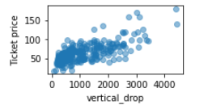
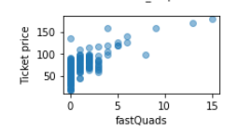
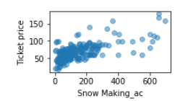
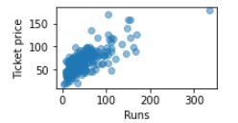
Analysis and Modeling
Ticket price distribution per state

Slide 5
Modeling metrics
We used 80% of the data to train the model and the rest to test. We considered a linear regression model and a random forest tree
Linear regression features |  | Random forest tree top features
vertical_drop Snow Making_ ac total_chairs fastQuads Runs LongestRun_mi trams SkiableTerrain_ac | 10.767857 6.290074 5.794156 5.745626 5.370555 0.181814 -4.142024 -5.249780 | fastQuads Runs Snow Macking_ac Vertical_drop
Cross validation n=5
Mean | 0.6976 | Mean | 0.71
Standard deviation | .071 | Standard deviation | .065
Linear regression mae |  | Random forest tree mae
mae | $11.8 | mae | $9.54
mae mean | $10.5 | mae mean | $9.64
mae std | $1.62 | mae std | $1.35
The standard deviation using cross-validation and mae metrics confirm that the random forest tree is a better model to predict ticket prices and it also has less features.
Mean absolute value = mae

Slide 6
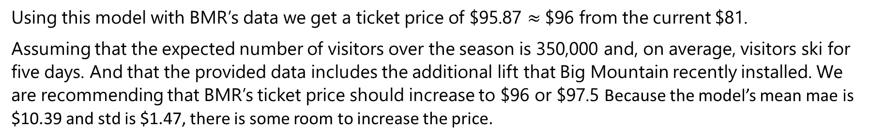
Modeling conclusion
We will use the random forest tree and retrain the model using all data except for BMR and here are the results:
Random forest tree mae
Mae mean | $10.39
Mae std | $1.47
Using this model with BMR’s data we get a ticket price of $95.87 $≈$$96 from the current $81.
Assuming that the expected number of visitors over the season is 350,000 and, on average, visitors ski for five days. And that the provided data includes the additional lift that Big Mountain recently installed. We are recommending that BMR’s ticket price should increase to $96 or $97.5 Because the model’s mean mae is $10.39 and std is $1.47, there is some room to increase the price.

