Slide 1

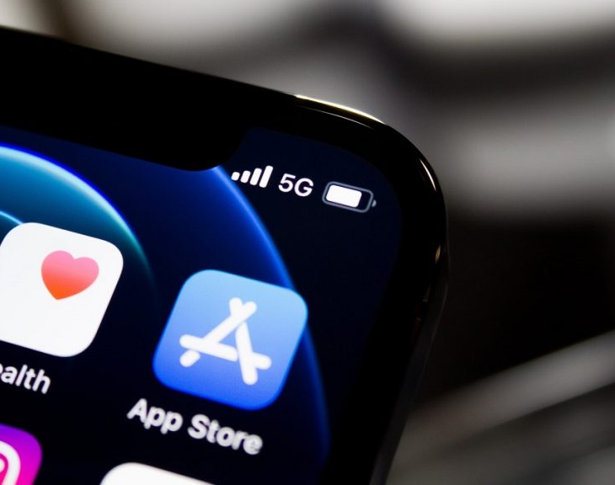
Elsa Yanez Gomez
This Photo by Unknown Author is licensed under CC BY-NC

Slide 2

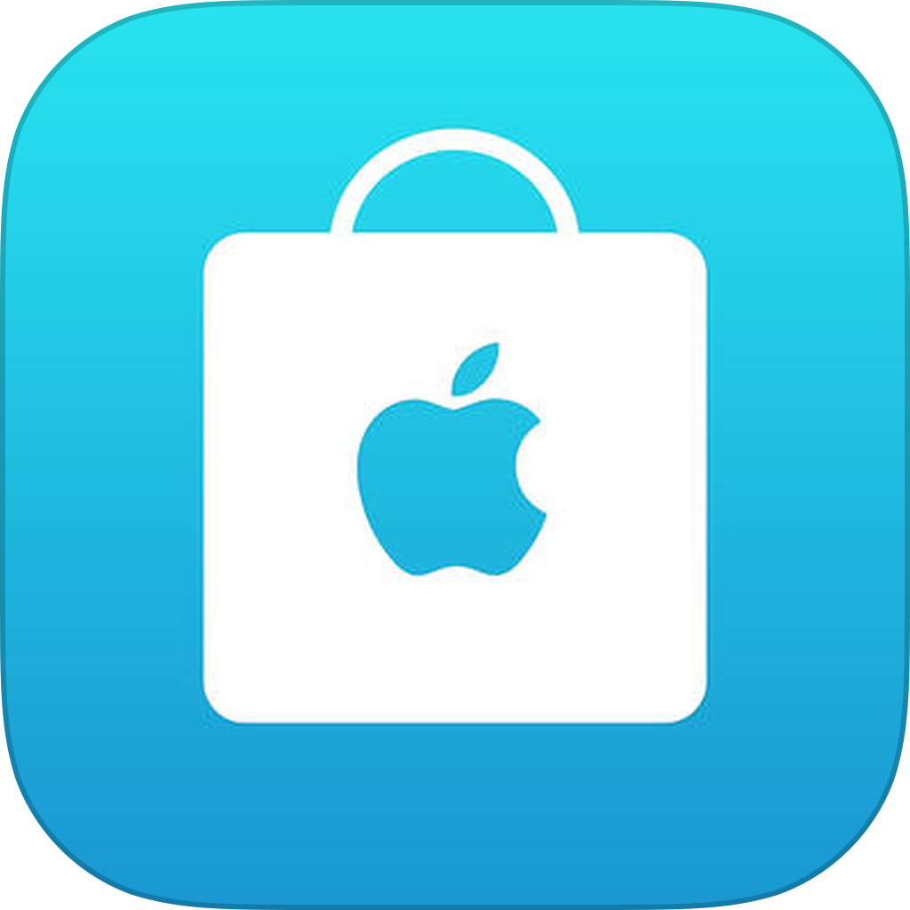
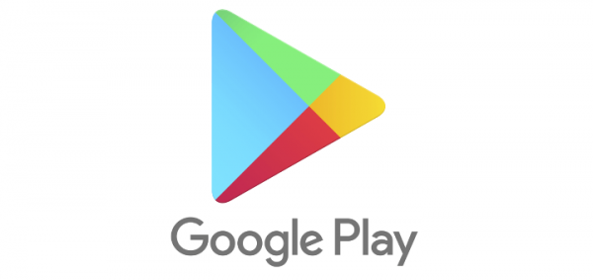
The mobile landscape is ever-changing and to get more people to download your app, you need to make sure they can easily find it. Mobile app analysis helps us understand the current strategy to drive growth and retention of future users.
“Using the rating (1-5) as the metric for user-satisfaction, data showed that the platform used to download mobile apps is important to the users.”
This Photo by Unknown Author is licensed under CC BY-NC
This Photo by Unknown Author is licensed under CC BY-NC-ND

Slide 3
Mobile app analysis of ratings
Data source: Kaggle
Apple Store: July 2017
7197 ratings from itunes search API at Apple inc. website
After cleaning data: 9366 ratings
Google Play store: No date reported
10841 ratings
After cleaning data: 6268 ratings
This Photo by Unknown Author is licensed under CC BY-NC
This Photo by Unknown Author is licensed under CC BY-NC-ND

Slide 4
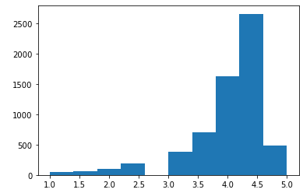
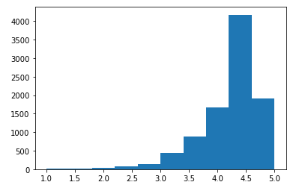
Does the platform make a difference in the ratings?
Mean rating: 4.05
Mean rating: 4.19
Difference: 0.14
This difference looks so small, could it be that this happened by chance? Or is this difference due to the platform?

Slide 5
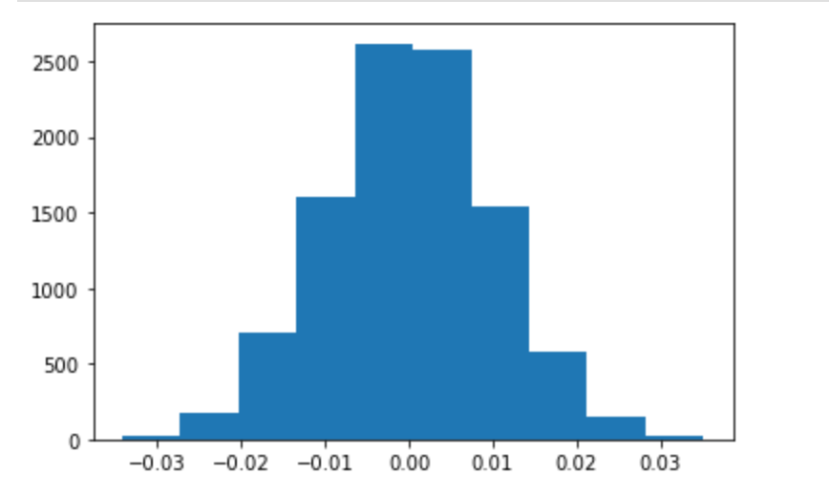
Distribution of the average difference in ratings
Conclusion:
The difference in average ratings between Apple store and Google Play store is due to the platform and couldn’t happen by chance alone.
Observed difference from our sample is 0.14. The p-value is 0

Slide 6
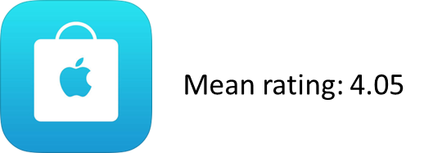
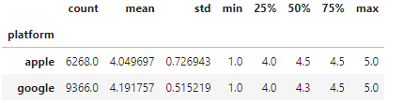
Other interesting statistics
Mean rating: 4.19

