Slide 1
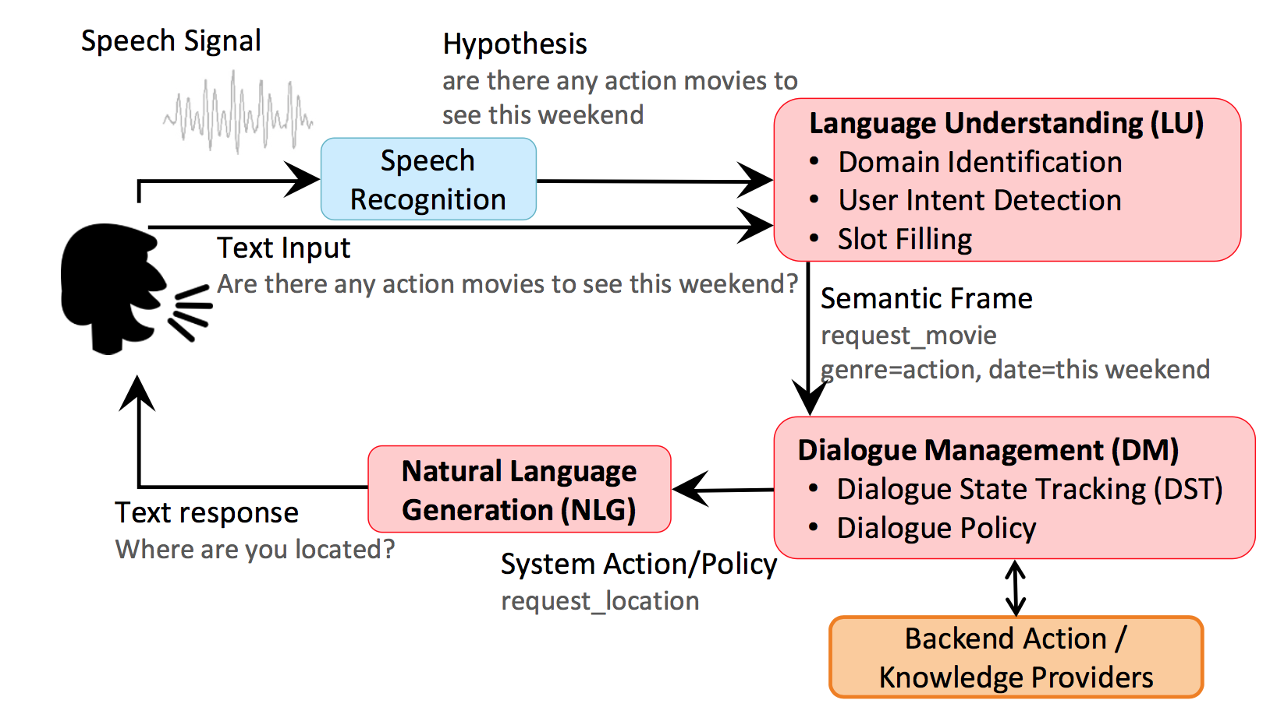
Task-oriented DS

Slide 2
Language Understanding
Three modules:
Domain classification
Intent classification
Slot filling

Slide 3
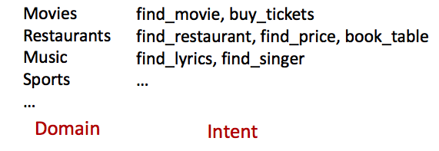
LU: Domain/Intent Classification
Find me a cheap Taiwanese restaurant in Oakland

Slide 4
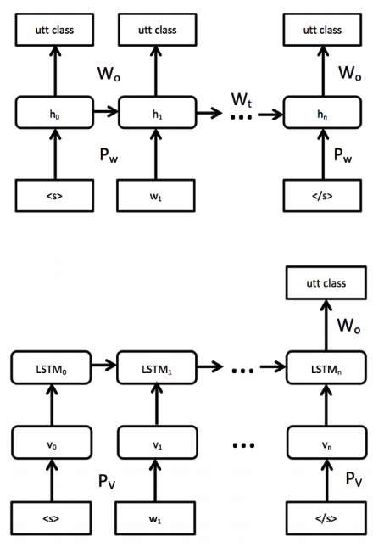
LU: Domain/Intent Classification
Challenges:
addressee detection
Sparseness of n-gram
Large number of singletons
Approaches:
RNN with LSTM to solve both domain/intent classification and addressee detection
Word-hashing to resolve singleton
Kat: #Ka, Kat, at#

Slide 5
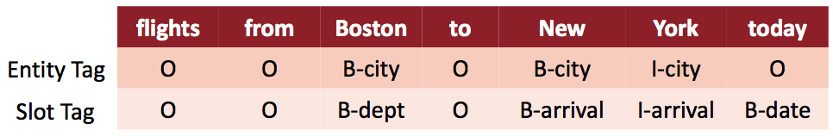
LU: Slot Filling
Flights from Boston to New York today

Slide 6
LU: Slot Filling
Challenges:
to model dependencies between labels
To capture contextual information
Approaches:
RNN with LSTM
LSTM-look around (the input is n-grams)
bLSTM
Encoder-decoder networks
Attention based encoder-decoder

Slide 7
LU: Joint-learning and Multi-domain
Motivation:
to prevent error propagation in the pipeline approach
to reduce the number of training data required for each domain
Challenges:
To use external information, e.g., dependency tree and parse tree
Unseen slot value

Slide 8
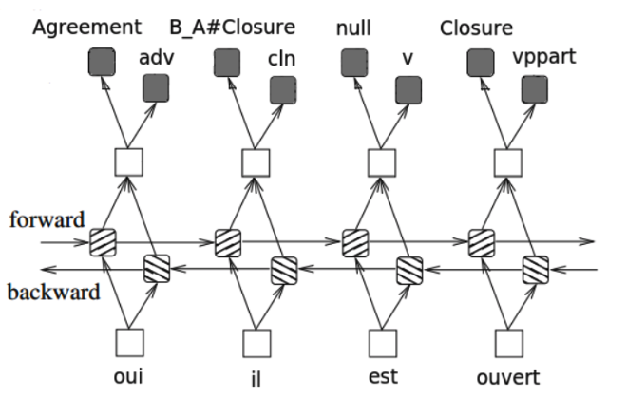
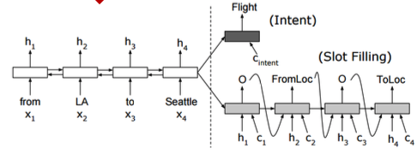
LU: Joint-learning and Multi-domain
Multi-task bLSTM (POS, disfluency, NER, frame label)
Slot filling and intent prediction at the same times

Slide 9
LU: Contextual
Motivation: many works exploit adjacency pair of utterances, not the history of dialogue
Approaches:
LSTM over the whole dialogue
Knowledge guided attention network (memory network)

Slide 10
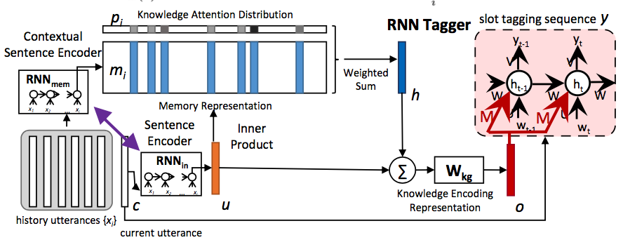
Knowledge guided attention network

Slide 11
Dialogue Management
Dialogue State Tracking
Dialogue Policy

Slide 12
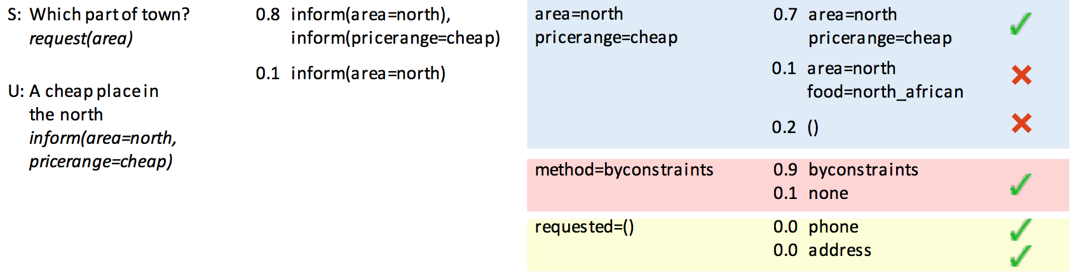
DM: Dialogue State Tracking

Slide 13
DM: Dialogue State Tracking
Challenges:
A DST that can work on many domains
Approaches:
To train one generalized RNN model and then specialized it for each slot name

Slide 14
DM: Dialogue Policy
Task: to guide what the system should say
Motivation:
To develop a generic RL algorithm to learn dialogue policy for all domains
Challenges:
Number of dialogues for training
Domain expertise
Approaches:
RL algorithms with different reward (e.g. #turns maximized or minimized)
User simulation (to generate enough data using dialogue history)

Slide 15
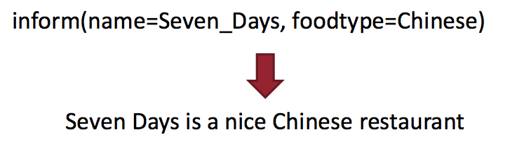
Language Generation
To map dialogue acts into natural language

Slide 16
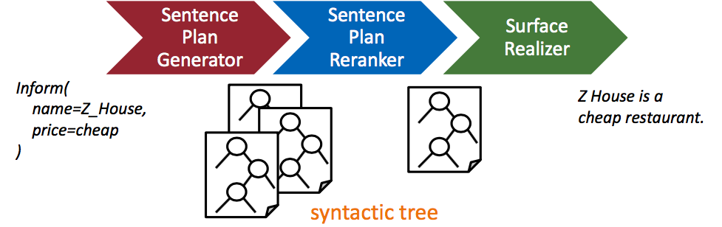
LG: Statistical NLG

Slide 17
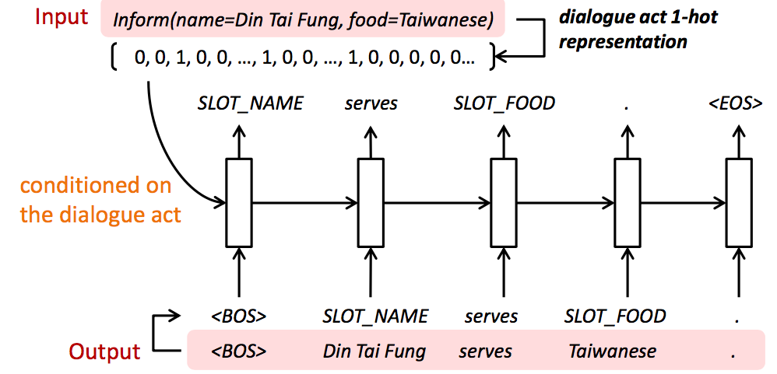
LG: NN

Slide 18
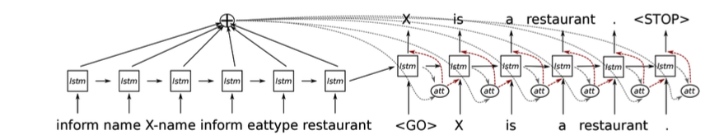
LG: NN

Slide 19
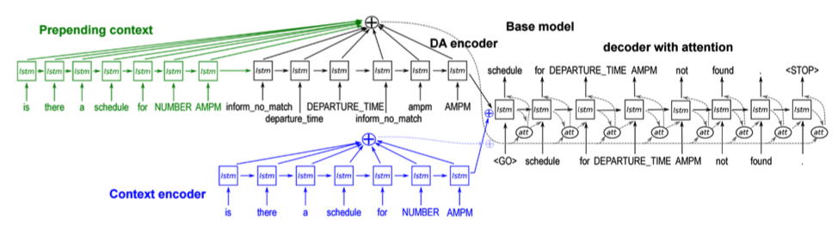
LG: Contextual

Slide 20
End-to-End
ChitChat
Task-oriented

Slide 21
ChitChat
Motivation:
To model dialogue without directly measurable goals
To train task-less DS using task-oriented data to obtain task-oriented DS
Challenges:
To model topic in the DS
Dull response
Approaches:
Seq2seq with MMI, deep RL, personalized DS (using user’s personal history),
IR-based technique (using twitter data)

Slide 22
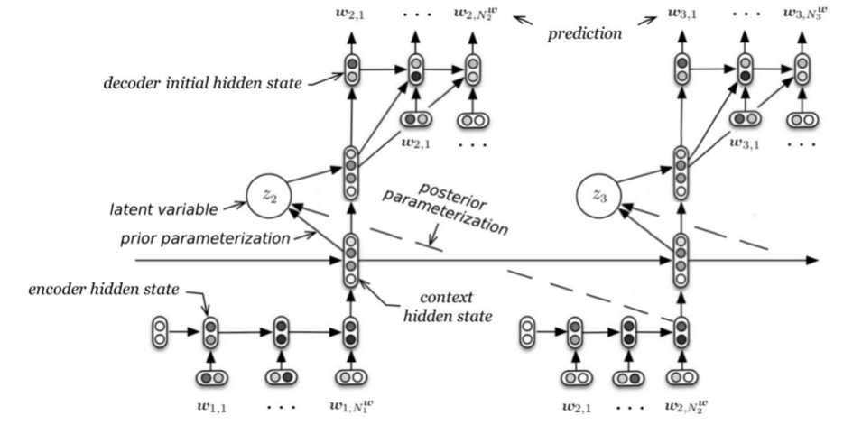

Slide 23
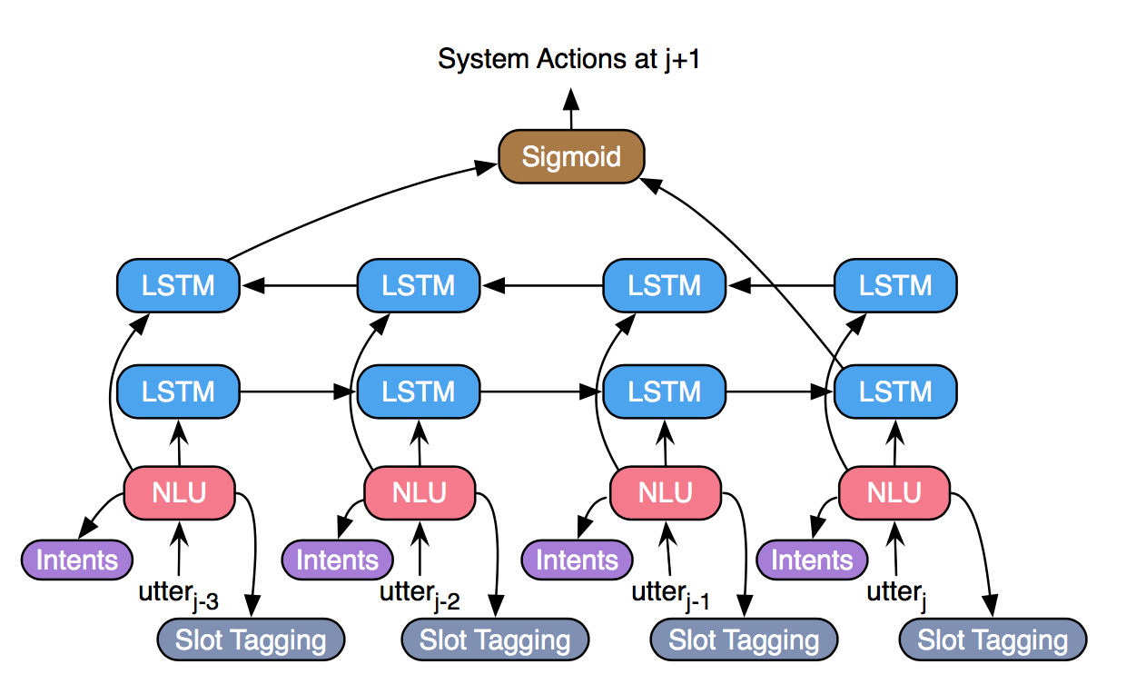
E2E: Task Oriented (Supervised Learning)
Notes:
No need to model dialogue policy

Slide 24
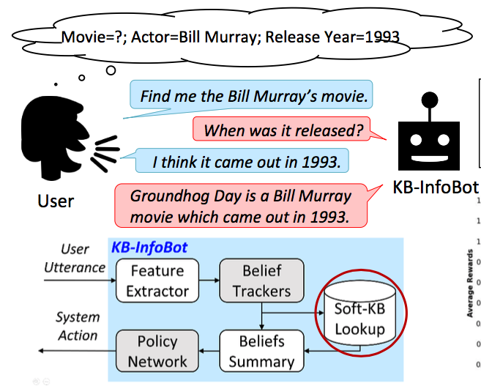
E2E: Task Oriented (Reinforcement Learning)
To traverse knowledge base

Slide 25
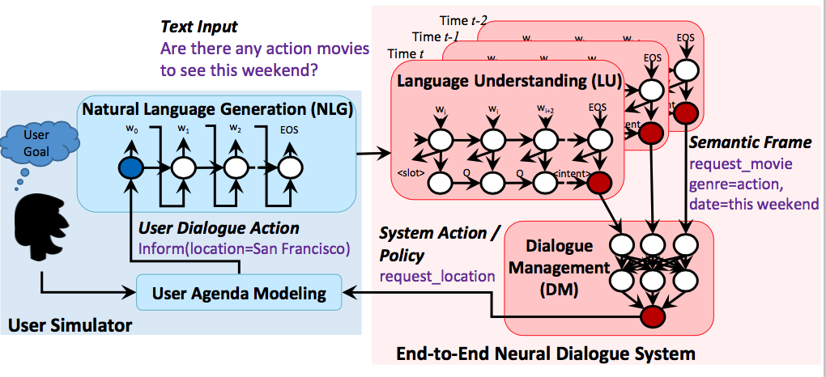
E2E Task-Oriented (RL)

Slide 26
Breakdown

Slide 27
Kyoto Institute of Technology
Poly kernel SVM
Features: word vector both in the system utterance and the previous user utterance (modified combinations of these utterances)
Shizuoka University
Handcrafted rules
I: if there is no shared keywords between system’s and user’s utterance, then it is a breakdown
II: system’s utterance after user’s question is a breakdown
III: system’s utterance which is a question is a breakdown

Slide 28
Tohoku University and PFI
Encode a pair of user’s and system’s utterance using NCM, LSTM encoder, BOW, or extended NCM
NAIST
LSTM-RNN
Features: word frequency vector (user and system), frequency vector of co-occurrence words, doc2vec (user, system, co-occurrence)

Slide 29
NTT Communication
6-layer perceptron
Features: word vector (user and system), word class vector (user and system), perplexity, cosine similarity (system and previous system), personality question, dialogue acts (SVM)
Hiroshima City University
LSTM-RNN
Features: word2vec of user’s and system’s utterances

