Slide 1
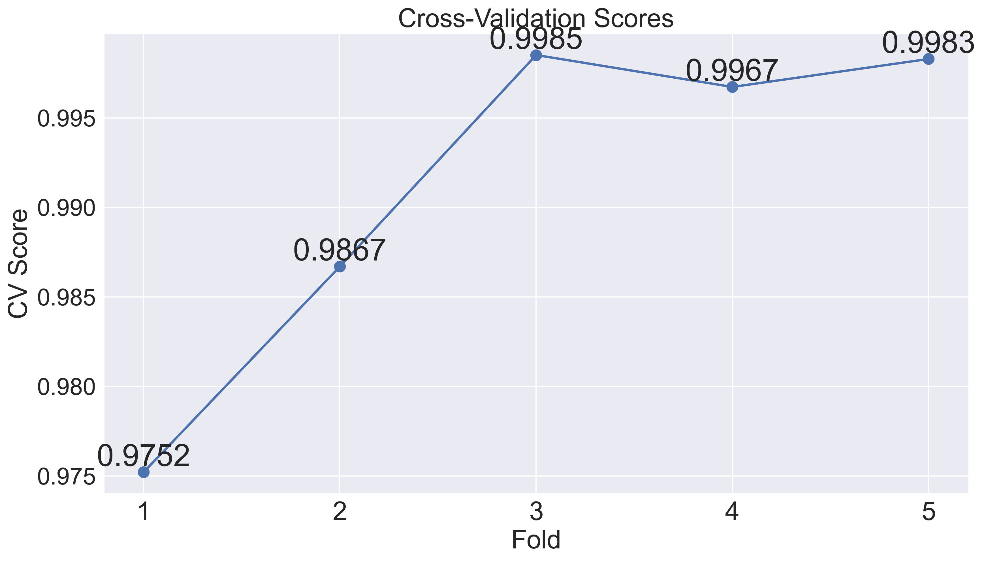
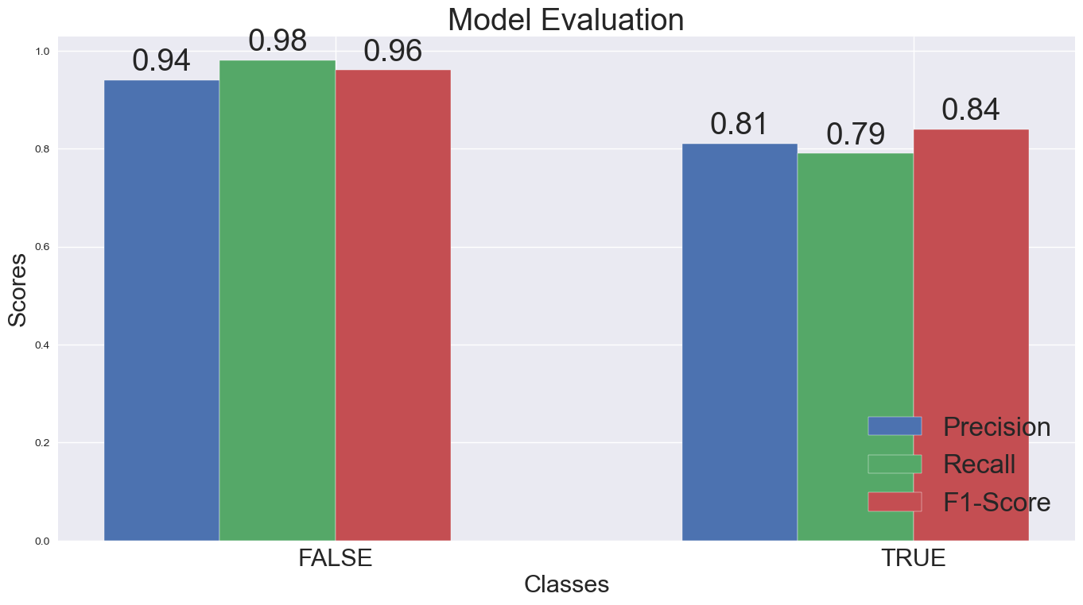
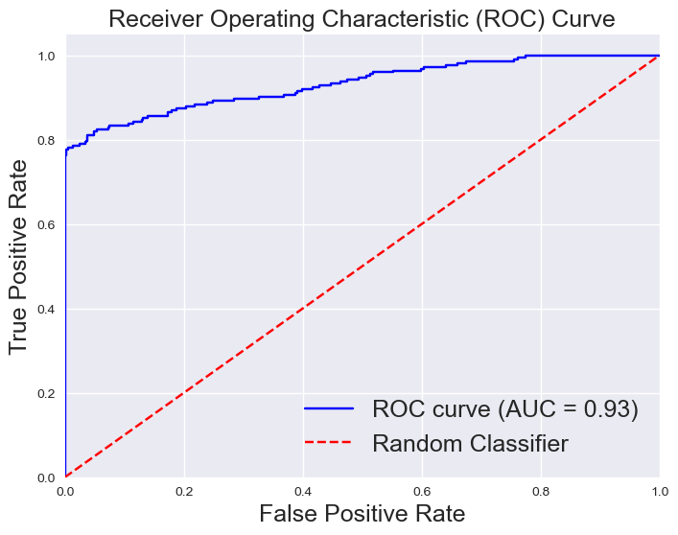
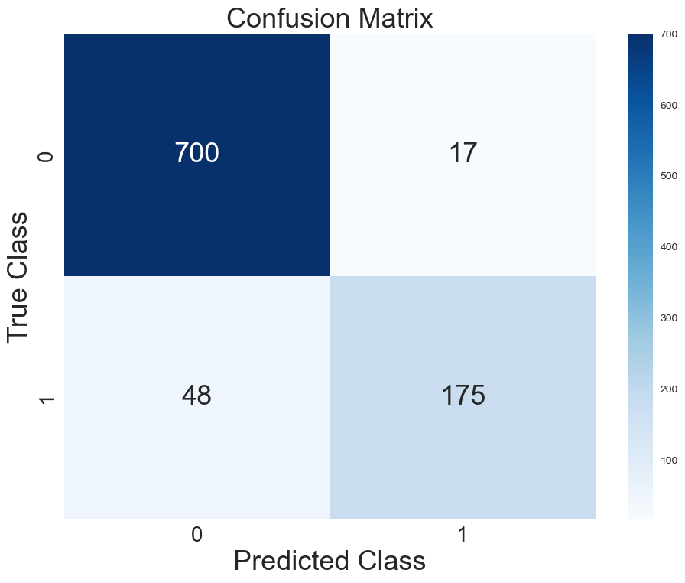

Slide 2
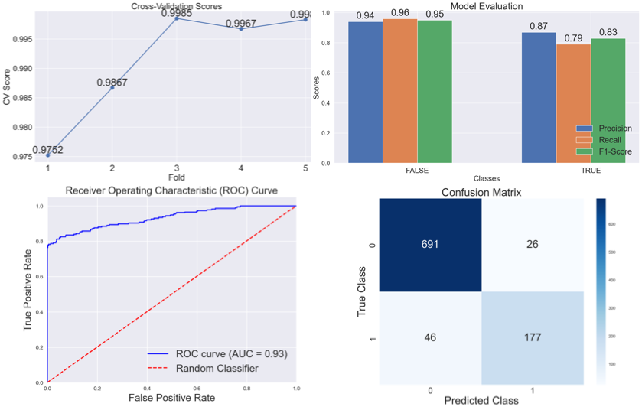

Slide 3
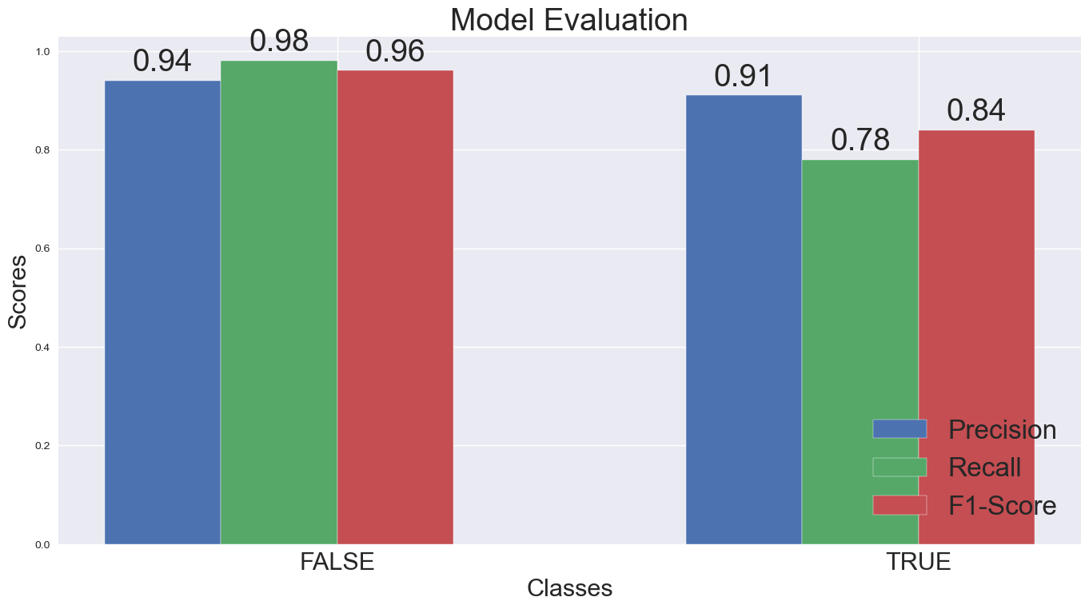
A
B
C
D

Slide 4
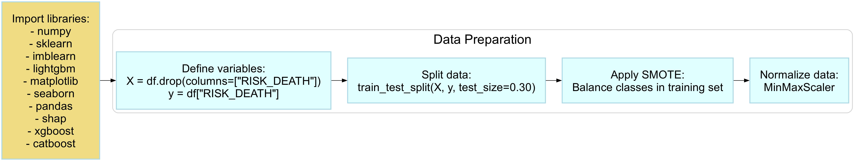
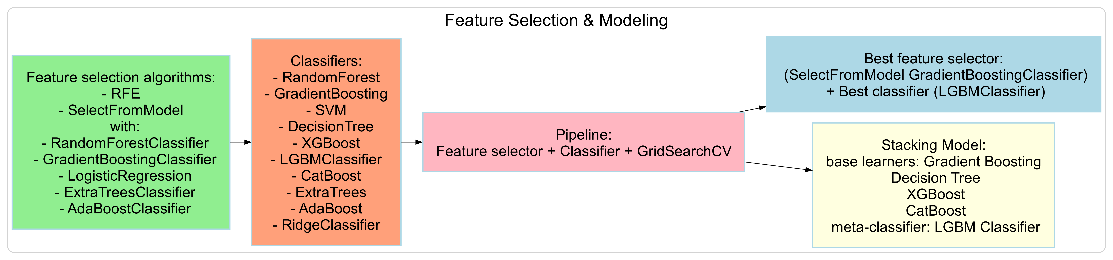

Slide 5
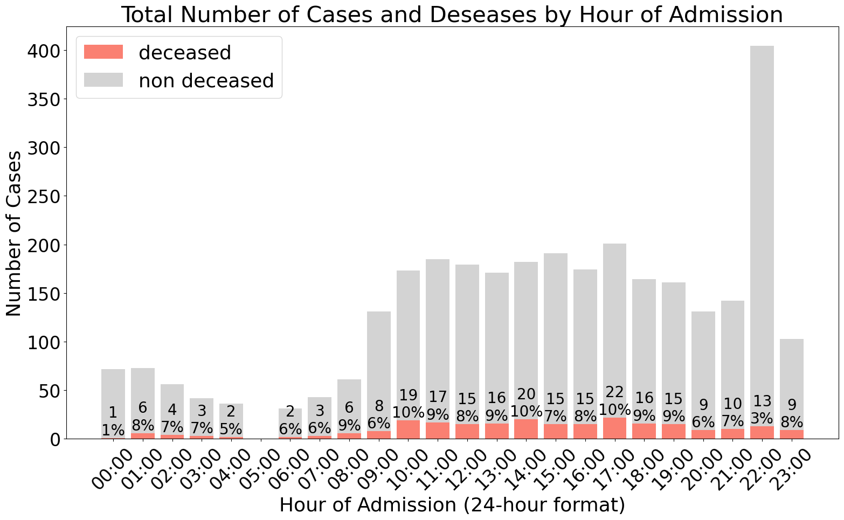
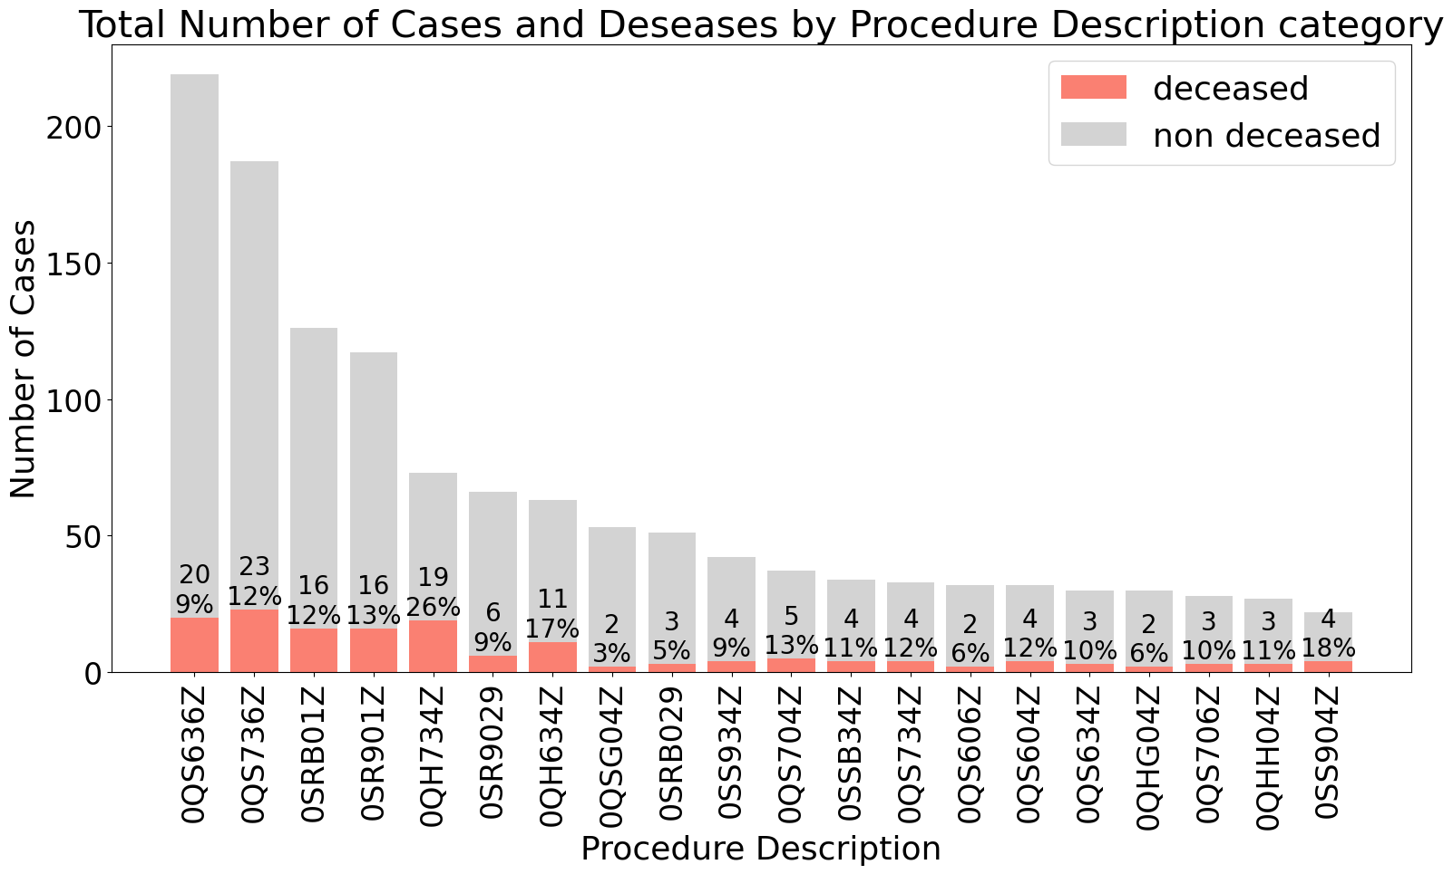
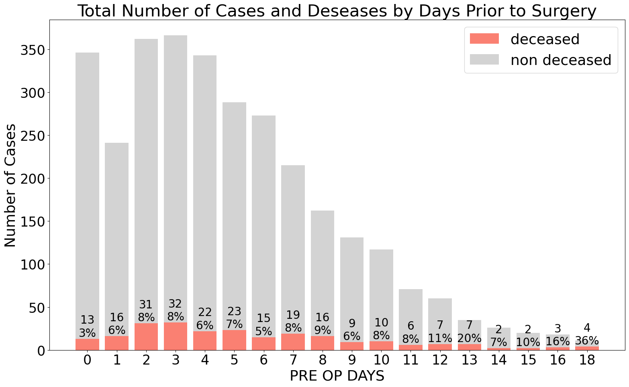
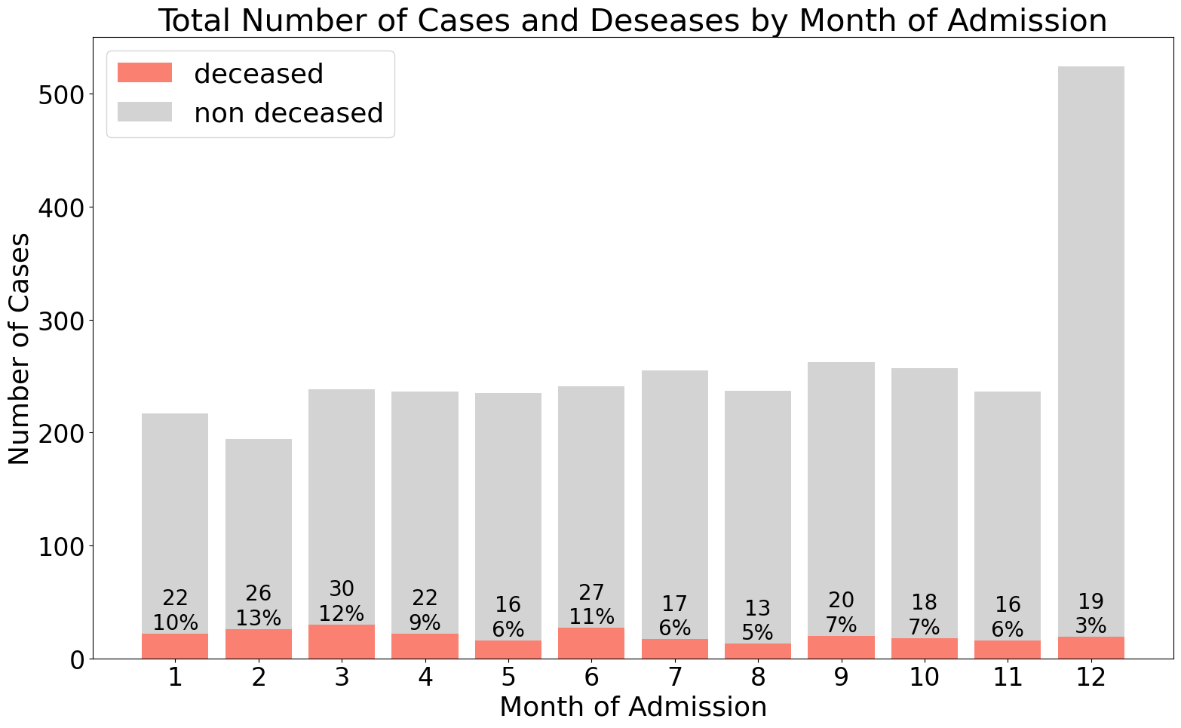
A
B
C
D

Slide 6
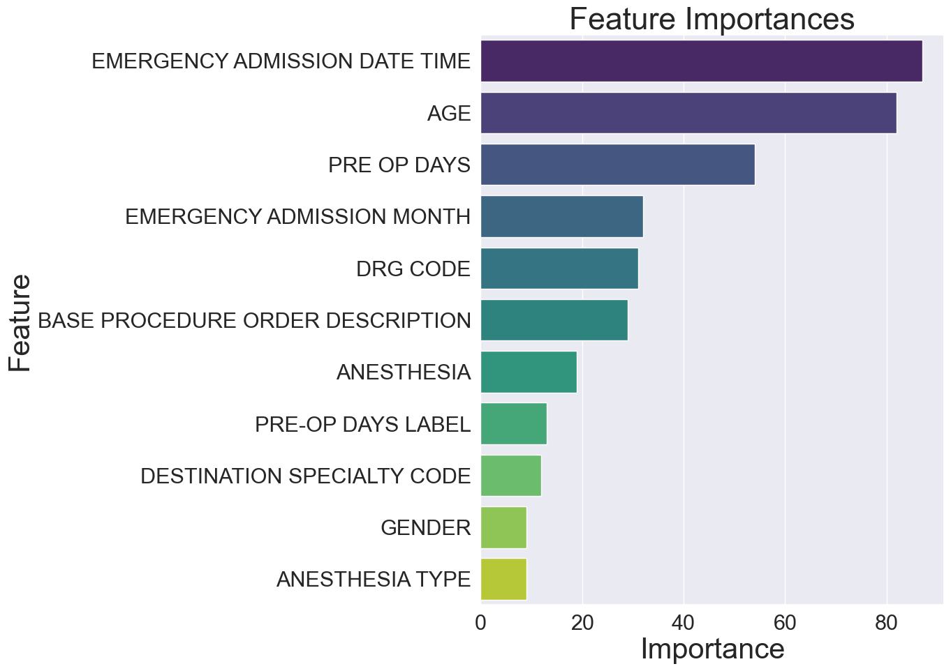
Feature | Importance
EMERGENCY ADMISSION DATE TIME | 87
AGE | 82
PRE-OPERATORY DAYS | 54
EMERGENCY ADMISSION MONTH | 32
DRG CODE | 31
BASE PROCEDURE ORDER DESCRIPTION | 29
ANESTHESIA | 19
PRE-OP DAYS LABEL | 13
DESTINATION SPECIALTY CODE | 12
GENDER | 9
ANESTHESIA TYPE | 9

Slide 7
FeatureImportance3EMERGENCY ADMISSION DATE TIME879AGE822PRE OP DAYS548EMERGENCY ADMISSION MONTH324DRG CODE317BASE PROCEDURE ORDER DESCRIPTION296ANESTHESIA1910PRE-OP DAYS LABEL131DESTINATION SPECIALTY CODE120GENDER95ANESTHESIA TYPE9

Slide 8
EMERGENCY ADMISSION DATE TIME | 2023-10-28 19:41:21 | -0,05
Feature | Value | SHAP Value
AGE | 105 | 9,61
PRE OP DAYS | 6 | -0,72
PROCEDURE DESCRIPTION | 0SR9029 | -0,68
ANESTHESIA | General | -0,40
DRG CODE | 342 | -0,39
EMERGENCY ADMISSION MONTH | 10 | -0,25
PRE-OP DAYS LABEL | 3 | -0,13
GENDER | Male | -0,10
BASE PROCEDURE ORDER DESCRIPTION | 3 | -0,05
EMERGENCY ADMISSION DATE TIME | 2023-10-28 19:41:21 | -0,05

Slide 9
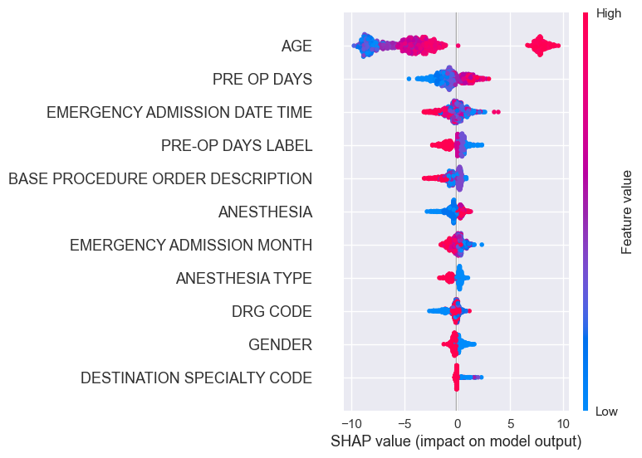
A
Feature | Value | SHAP Value
AGE | 105 | 9,61
PRE OP DAYS | 6 | -0,72
EMERGENCY ADMISSION DATE TIME | 2023-10-28 19:41:21 | -0,05
PRE-OP DAYS LABEL | 3 | -0,13
BASE PROCEDURE ORDER DESCRIPTION | 3 | -0,05
ANESTHESIA | General | -0,40
EMERGENCY ADMISSION MONTH | 10 | -0,25
DRG CODE | 342 | -0,39
GENDER | Male | -0,10
B

