Slide 1

Intrusion Detection Using Quantum Generative Adversarial Networks: A Federated Approach With Noisy Simulators
Franco Cirillo and Christian Esposito
University of Salerno
fracirillo@unisa.it
Quantum Engineering and Technologies conference

Slide 2

Introduction
Intrusion Detection Systems (IDS) play a critical role in ensuring security.
Anomaly detection has proven to be an effective approach for intrusion detection, establishing a baseline of normal system.
ML has emerged as a powerful tool, enabling systems to automatically classify network traffic as normal or malicious.
Intrusion Detection Using Quantum Generative Adversarial Networks: A Federated Approach With Noisy Simulators– Franco Cirillo– fracirillo@unisa.it
Notes:
Intrusion Detection Systems (IDS) play a critical role in ensuring the security and integrity of digital infrastructures by identifying malicious activities, unauthorized access, or policy violations.
Among the various detection techniques, anomaly detection has proven to be an effective approach for intrusion detection \cite{rafique2024machine}. anomaly detection methods establish a baseline of normal system or network behavior. Any deviation from this baseline is flagged as a potential intrusion.
In recent years, machine learning (ML) has emerged as a powerful tool for both intrusion and anomaly detection. ML techniques excel at learning complex patterns, enabling systems to automatically classify network traffic as normal or malicious.

Slide 3
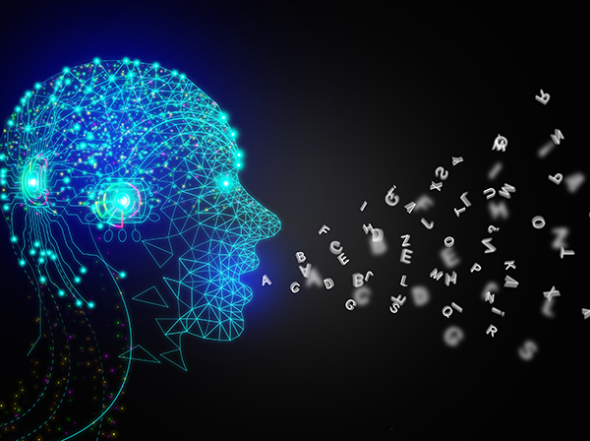
Introduction
ML’s reliance on quality datasets can limit its scalability and applicability.
A promising advancements in ML for intrusion detection is the application of Generative Adversarial Networks (GANs).
GANs can generate synthetic network traffic to augment training datasets and address class imbalance issues.
Intrusion Detection Using Quantum Generative Adversarial Networks: A Federated Approach With Noisy Simulators– Franco Cirillo– fracirillo@unisa.it
Notes:
However, ML’s reliance on quality datasets and extensive computational resources can limit its scalability and applicability in dynamic environments.
One of the most promising advancements in machine learning for intrusion detection is the application of Generative Adversarial Networks (GANs)
In the context of intrusion detection, GANs can generate synthetic network traffic to augment training datasets, address class imbalance issues, and improve the detection of subtle or rare anomalies.
%Adversarial training between a generator, which creates synthetic data, and a discriminator, which distinguishes between real and generated data.
%A promising advancements in ML for intrusion detection is the application of Generative Adversarial Networks (GANs)

Slide 4
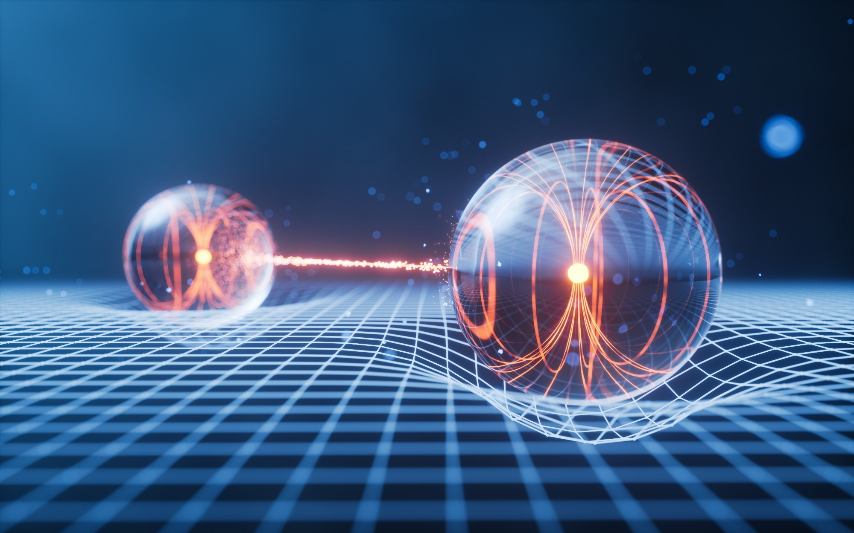
Introduction
Classical ML models suffer from limitations, such as managing high-dimensional spaces.
Quantum ML has the potential to overcome the scalability and performance limitations of classical ML techniques.
QML leverages entanglement and superposition to efficiently capture complex patterns.
Intrusion Detection Using Quantum Generative Adversarial Networks: A Federated Approach With Noisy Simulators– Franco Cirillo– fracirillo@unisa.it
Notes:
Classical ML models are constrained by the limitations of classical computing, which may struggle with the increasing complexity of data in high-dimensional spaces. To address these challenges, researchers have turned to Quantum Machine Learning (QML) as a promising alternative .
By harnessing the unique capabilities of quantum computers, QML has the potential to overcome the scalability and performance limitations of classical ML techniques.
Furthermore, their ability to operate effectively with limited data makes them highly suitable for cybersecurity applications, where datasets are often sparse or imbalanced.
QML leverages entanglement and superposition to efficiently capture complex patterns beyond classical ML capabilities.

Slide 5
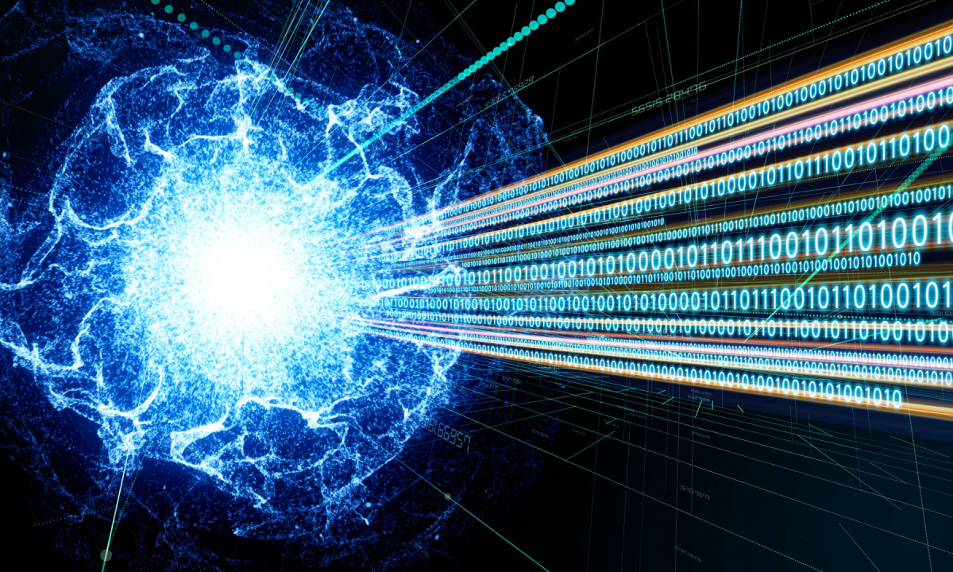
Quantum GAN
Full quantum and hybrid.
A typical hybrid QGAN consists of two components:
Quantum Generator (G): A parameterized quantum circuit (PQC) that generates quantum states representing data samples.
Classical Discriminator (D): A classical neural network that evaluates the similarity between generated samples and real data.
The generator aims to learn the underlying data distribution, while the discriminator attempts to distinguish between real and generated samples. The goal is to iteratively refine both components through adversarial training.
Intrusion Detection Using Quantum Generative Adversarial Networks: A Federated Approach With Noisy Simulators– Franco Cirillo– fracirillo@unisa.it
Notes:
QGAN structure
They can be implemented in two primary configurations: full quantum and hybrid. In a full quantum QGAN, both the generator and discriminator are quantum systems, leveraging parameterized quantum circuits for data generation and evaluation. In contrast, hybrid QGANs combine quantum and classical element
A typical hybrid QGAN consists of two components:
\begin{itemize}
\item Quantum Generator (G): A parameterized quantum circuit (PQC) that generates quantum states representing data samples.
\item Classical Discriminator (D): A classical neural network that evaluates the similarity between generated samples and real data.
\end{itemize}
The generator aims to learn the underlying data distribution by producing samples that minimize the difference from the real data distribution, while the discriminator attempts to distinguish between real and generated samples. %The goal is to iteratively refine both components through adversarial training: as the generator improves in producing realistic samples, the discriminator is forced to become more adept at identifying subtle discrepancies between real and generated samples. Over successive iterations, this adversarial dynamic pushes the generator to generate data that closely approximates the real distribution, while the discriminator enhances its ability to evaluate the authenticity of input samples. This process continues until the discriminator can no longer reliably differentiate between real and generated data, signifying that the generator has successfully modeled the underlying data distribution.

Slide 6
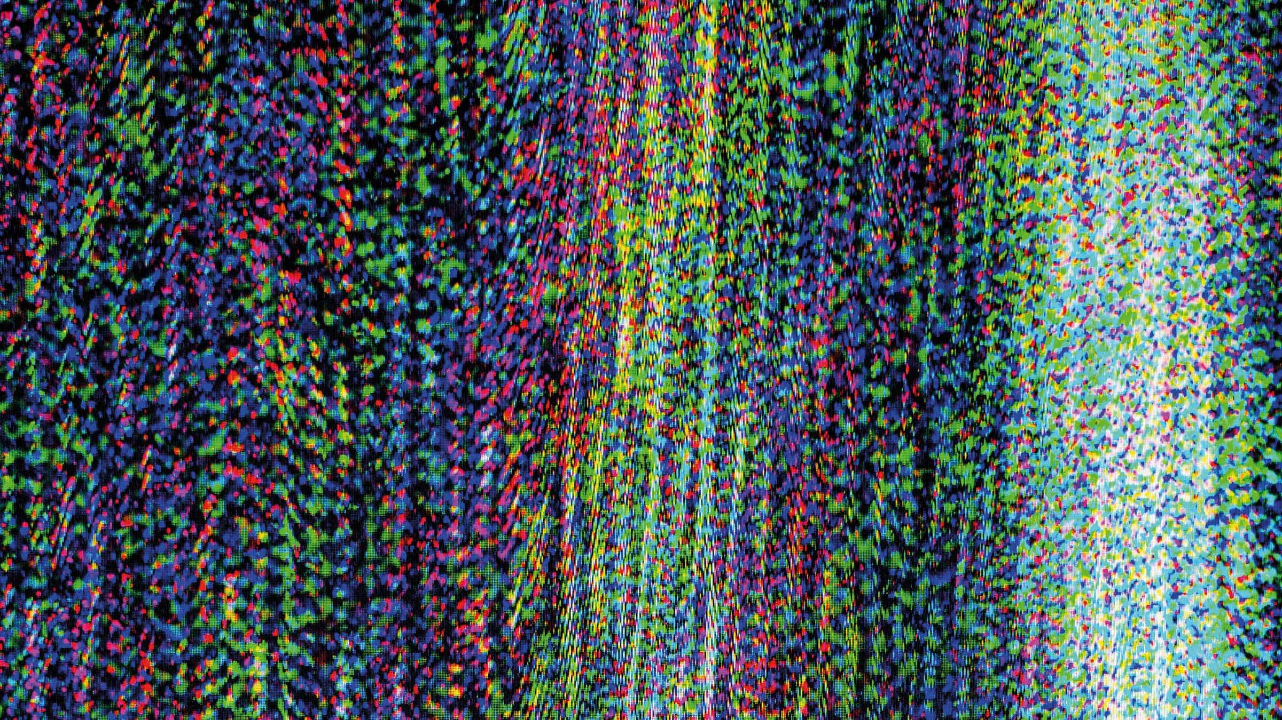
Quantum Noise
Decoherence, qubit errors, and gate imperfections in Noisy Intermediate-Scale Quantum (NISQ) era.
QML models tested under ideal conditions may not accurately reflect their real-world performance. Testing on actual quantum hardware is costly.
Noisy simulators can replicate the behavior of real quantum devices under noisy conditions.
Intrusion Detection Using Quantum Generative Adversarial Networks: A Federated Approach With Noisy Simulators– Franco Cirillo– fracirillo@unisa.it
Notes:
However, real-world quantum hardware in the Noisy Intermediate-Scale Quantum (NISQ) era presents significant challenges, including decoherence, qubit errors, and gate imperfections. As a result, QML models tested under ideal conditions may not accurately reflect their real-world performance. Additionally, testing on actual quantum hardware is costly.

Slide 7
State of the art
Existing studies have been limited to simplified datasets and challenges such as improving the fidelity of quantum generator outputs and achieving high accuracy and reliability in this domain remain unresolved.
Early studies implemented a federated QGAN in different contexts without reporting key performance metrics, also relying on quantum state transmission.
Intrusion Detection Using Quantum Generative Adversarial Networks: A Federated Approach With Noisy Simulators– Franco Cirillo– fracirillo@unisa.it
Notes:
Related
%This work is motivated by the need to thoroughly evaluate QGANs in the intrusion detection domain, focusing on their scalability, robustness, and performance.
Existing studies have been limited to simplified datasets and narrow feature sets, leaving their applicability to real-world intrusion detection systems underexplored. Additionally, challenges such as improving the fidelity of quantum generator outputs and achieving high accuracy and reliability in this domain remain unresolved. This study aims to optimize QGANs for intrusion detection by assessing their performance on high-dimensional datasets and providing a comprehensive analysis of their effectiveness through key metrics such as accuracy and F1-score

Slide 8
Key contributions
Development of a federated QGAN-based model specifically designed for intrusion detection.
Experimental validation across multiple configurations on the NSL-KDD dataset, while reducing time complexity compared to the non-federated version.
Evaluation on a noisy simulator and comparison with the ideal (noiseless) version.
Intrusion Detection Using Quantum Generative Adversarial Networks: A Federated Approach With Noisy Simulators– Franco Cirillo– fracirillo@unisa.it
Notes:
This work makes the following key contributions:
Development of a federated QGAN-based model specifically designed for intrusion detection.
Experimental validation across multiple configurations on the NSL-KDD dataset, achieving an accuracy of 0.9125 and an F1-score of 0.9034, while reducing time complexity compared to the non-federated version.
Evaluation on a noisy simulator and comparison with the ideal (noiseless) version.

Slide 9
Data Preprocessing
NSL-KDD dataset.
PCA with different numbers of principal components.
Min-Max scaling in range [0, 1] .
Intrusion Detection Using Quantum Generative Adversarial Networks: A Federated Approach With Noisy Simulators– Franco Cirillo– fracirillo@unisa.it
Notes:
Data preprocessing
The NSL-KDD dataset, a widely used benchmark in intrusion detection, is loaded as a structured dataset.
To achieve this, feature values are scaled to a [0, 1] range using Min-Max scaling.
To further optimize the dataset for QGAN processing, PCA is applied. PCA reduces the feature space to a lower-dimensional latent representation, retaining only the components that capture the majority of the data's variance. Different numbers of principal components have been tested to assess their impact on model performance, and the results of these evaluations will be presented in the next section.

Slide 10
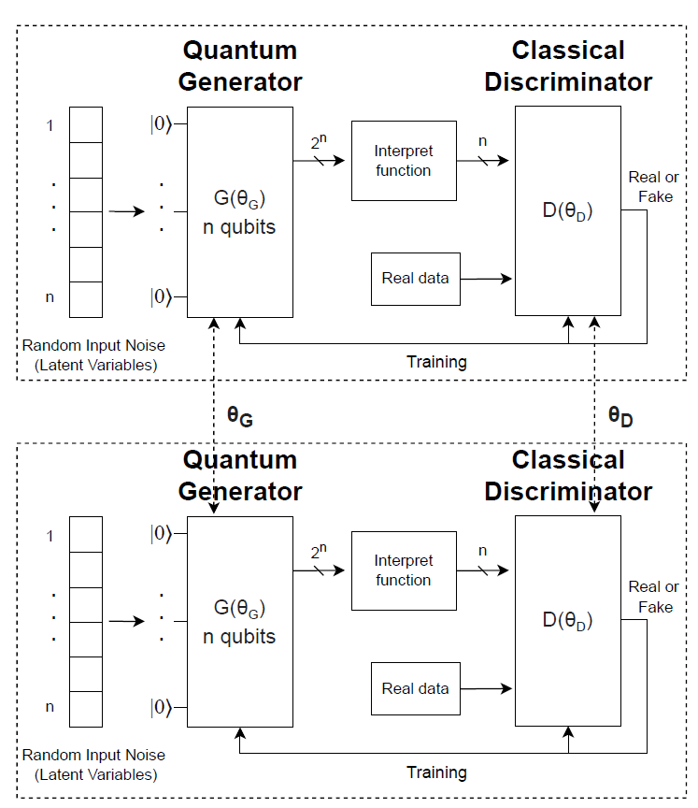
QGAN Configuration
Intrusion Detection Using Quantum Generative Adversarial Networks: A Federated Approach With Noisy Simulators– Franco Cirillo– fracirillo@unisa.it
Notes:
The proposed QGAN model is an adaptation for the intrusion detection problem, specifically a dedicated interpret function and a selection for quantum circuits has been done.
The structure is depicted in Figure and consists of two primary components: a quantum generator implemented as a Variational Quantum Circuit and a classical discriminator implemented as a neural network.
The process begins with a random noise vector that serves as input to the generator. This noise introduces variability to generate diverse samples.
The generator and discriminator are trained adversarially. While the discriminator \( D(\theta_D) \) learns to distinguish between real data (from the training set) and false data (from the generator), the generator \( G(\theta_G) \) learns to fool the discriminator by improving the quality of its generated data, minimizing the difference between real and false samples.

Slide 11
Federated Approach
Generator and discriminator weights are aggregated separately
Each quantum generator operates with a unique seed
FedAvg
Intrusion Detection Using Quantum Generative Adversarial Networks: A Federated Approach With Noisy Simulators– Franco Cirillo– fracirillo@unisa.it
Notes:
To enhance scalability and robustness, a federated training strategy is adopted. Multiple QGAN instances are deployed across distributed nodes, each independently training on a distinct subset of the dataset.
Given the sensitivity of quantum machine learning models to initialization, each quantum generator operates with a unique seed.
At the end of each training epoch, the generator and discriminator weights from all nodes are aggregated separately.
The next training iteration begins with the averaged weights, ensuring synchronization and collaborative learning across the distributed network.

Slide 12
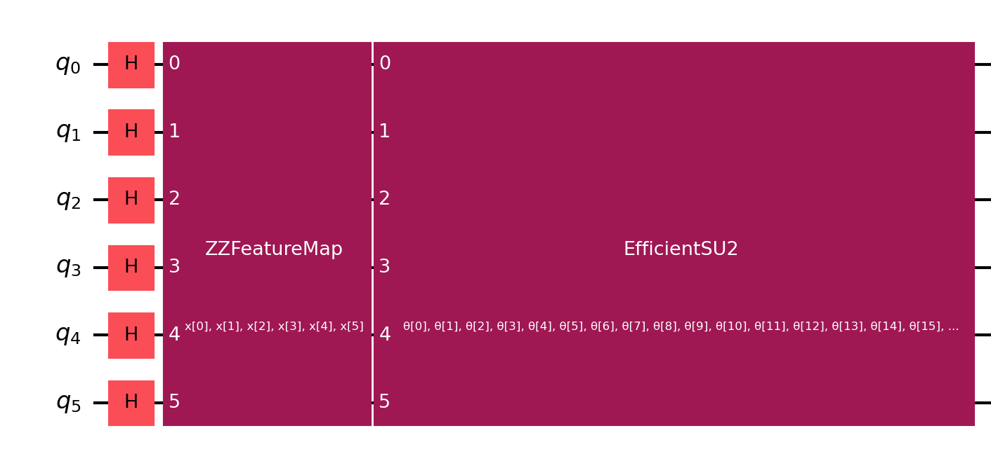
Generator
Each qubit in the circuit is mapped with a principal component of the pre-processed dataset.
Hadamard gates to all qubits
Feature map
Ansatz
Intrusion Detection Using Quantum Generative Adversarial Networks: A Federated Approach With Noisy Simulators– Franco Cirillo– fracirillo@unisa.it
Notes:
The generator is constructed as a variational quantum circuit designed to produce synthetic data from a noise vector. The Figure \ref{fig:qc} depicts an instance of the several tested configurations.
Each qubit in the circuit represents a feature of the dataset. The circuit begins by applying Hadamard gates to all qubits, bringing them into a superposition state. A feature map is applied to enhance the expressiveness of the circuit by encoding latent variables into the quantum state. In this circuit the ZZFeatureMap utilizes entanglement across qubits, introducing interdependence among qubits.
The ansatz defines the trainable portion of the quantum circuit. In the scheme of this specific configuration, EfficientSU2 architecture is used. By repeating these layers multiple times, the circuit gains expressive power, allowing it to approximate intricate probability distributions.
Additionally, noise is injected into the circuit via rotation gates, parameterized by a vector representing the noise input. The combination of noise input and trainable weights enables the generator to sample from a wide range of data distributions.

Slide 13
Interpret function
The interpret function transforms the generator's output, which corresponds to the probability of observing each combination of qubit states, with a cardinality of 2^{n}, into a lower-dimensional representation of cardinality n.
For each qubit i, the interpret function extracts its marginal probability by summing over all measurement outcomes where qubit i is in state 1.
Intrusion Detection Using Quantum Generative Adversarial Networks: A Federated Approach With Noisy Simulators– Franco Cirillo– fracirillo@unisa.it
Notes:
The interpret function transforms the generator's output, which corresponds to the probability of observing a specific combination of qubit states, with a cardinality of 2^n, into a lower-dimensional representation of cardinality \( n \).
For each qubit \( i \), the interpret function extracts its marginal probability by summing over all measurement outcomes where qubit \( i \) is in state \( 1 \).
Let \( P(x) \) represent the probability of observing a particular \( n \)-qubit state \( x = (x_1, x_2, \dots, x_n) \), where \( x_i \in \{0, 1\} \). Then, the marginal probability \( p_i \) for qubit \( i \) is computed as:
\[
p_i = \sum_{x \, : \, x_i = 1} P(x),
\]
The resulting vector is \( (p_1, p_2, \dots, p_n) \), of dimension \( n \), each component \( p_i \) lies in the range \( [0, 1] \), making it directly comparable to the features in the real dataset.
This dimensionality reduction captures relevant probabilistic information about each qubit while discarding higher-order correlations between multiple qubits. The transformation simplifies the discriminator's input without sacrificing the ability to distinguish between real and generated data.
The transformed \( n \)-dimensional data is then fed into the discriminator.

Slide 14

Interpret function
Let P(x) represent the probability of observing a particular n-qubit state x = (x₁, x₂, . . . , x_{n}), where x_{i} ∈ {0, 1}. Then, the marginal probability p_{i} for qubit i is computed as:
The resulting vector is (p₁, p₂, . . . , p_{n}), each component p_{i} lies in the range [0, 1], making it directly comparable to the features in the real dataset.
This dimensionality reduction simplifies the discriminator's input without sacrificing the ability to distinguish between real and generated data.
Intrusion Detection Using Quantum Generative Adversarial Networks: A Federated Approach With Noisy Simulators– Franco Cirillo– fracirillo@unisa.it
Notes:
The interpret function transforms the generator's output, which corresponds to the probability of observing a specific combination of qubit states, with a cardinality of 2^n, into a lower-dimensional representation of cardinality \( n \).
For each qubit \( i \), the interpret function extracts its marginal probability by summing over all measurement outcomes where qubit \( i \) is in state \( 1 \).
Let \( P(x) \) represent the probability of observing a particular \( n \)-qubit state \( x = (x_1, x_2, \dots, x_n) \), where \( x_i \in \{0, 1\} \). Then, the marginal probability \( p_i \) for qubit \( i \) is computed as:
\[
p_i = \sum_{x \, : \, x_i = 1} P(x),
\]
The resulting vector is \( (p_1, p_2, \dots, p_n) \), of dimension \( n \), each component \( p_i \) lies in the range \( [0, 1] \), making it directly comparable to the features in the real dataset.
This dimensionality reduction captures relevant probabilistic information about each qubit while discarding higher-order correlations between multiple qubits. The transformation simplifies the discriminator's input without sacrificing the ability to distinguish between real and generated data.
The transformed \( n \)-dimensional data is then fed into the discriminator.

Slide 15
Discriminator
The discriminator is a classical feedforward neural network.
Dense hidden layers with LeakyReLU functions, to introduce non-linearity while mitigating vanishing gradients.
Evaluation metrics such as loss values, accuracy, and the F1 score monitor performance, while the quality of generated data is validated by computing the fidelity score with real data.
Intrusion Detection Using Quantum Generative Adversarial Networks: A Federated Approach With Noisy Simulators– Franco Cirillo– fracirillo@unisa.it
Notes:
The discriminator is a classical feedforward neural network designed for binary classification, distinguishing between real and generated data. It takes input vectors matching the dataset's feature size and processes them through dense hidden layers with LeakyReLU activations, which introduce non-linearity while mitigating vanishing gradients. The output layer uses a sigmoid activation to produce a probability score indicating whether the input is real. Trained with Binary Cross-Entropy loss, the discriminator iteratively improves through adversarial feedback with the generator.
Evaluation metrics such as loss values, accuracy, and the F1 score monitor performance, while the quality of generated data is validated by comparing its statistical properties with real data.
In the following section it will be discussed all the tested configurations and the relative results. The experiments are replicable, and the source code is available on https://github.com/francocirill/qgan

Slide 16
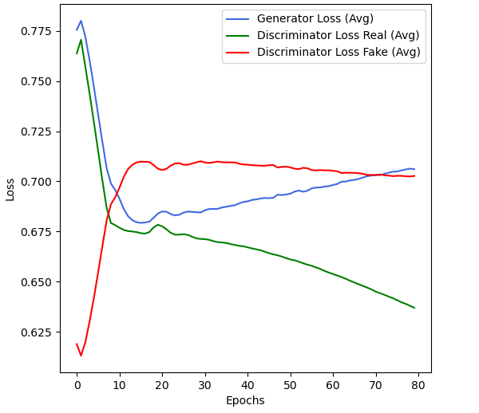
Loss plot
The highest-performing configuration among 4 nodes combines 6 PCA features, the EfficientSU2 ansatz, 3 generator repetitions, and 128 discriminator neurons.
This setup achieves an accuracy of 0.9125 and an F1 score of 0.9034.
Intrusion Detection Using Quantum Generative Adversarial Networks: A Federated Approach With Noisy Simulators– Franco Cirillo– fracirillo@unisa.it
Notes:
The plot shown in Figure represents the loss of the generator and the discriminator (for both real and generated data), focusing on the configuration with the best performance. The generator's loss starts relatively high at the beginning of the training process, as it initially produces poorly generated samples. As the epochs progress, the generator's loss gradually decreases, indicating its improved ability to produce data that closely resembles the real dataset. By the end of the training process, the generator achieves a relatively stable loss, suggesting that it has effectively learned the underlying data distribution.
Instead, the loss for generated data follows a complementary trend to the generator's progress. By the end of training, this loss also stabilizes, balancing the adversarial dynamics.
The overall stability in loss values across the epochs demonstrates that the adversarial training between the generator and discriminator has reached equilibrium.

Slide 17
Noisy Simulation
Evaluated using IBM’s FakeBackend to compare performance degradation and convergence time.
This backend simulates quantum devices based on system snapshots.
Simulations were performed with the Qiskit-Aer package using the Sampler primitive.
While noisy simulations yield different results, starting with noise-free simulations provides a useful baseline before assessing the impact of noise.
Intrusion Detection Using Quantum Generative Adversarial Networks: A Federated Approach With Noisy Simulators– Franco Cirillo– fracirillo@unisa.it
Notes:
When analyzing quantum circuits, it is crucial to consider real-world imperfections such as qubit decoherence, gate errors, and environmental noise, which affect computational reliability. The proposed QGAN configurations were first tested under noiseless conditions and then evaluated using IBM’s FakeBackend to compare performance degradation and convergence time. This backend simulates quantum devices based on system snapshots, including qubit connectivity and properties. Simulations were performed with the Qiskit-Aer package using the Sampler primitive and 1024 shots. While noisy simulations yield different results, starting with noise-free simulations provides a useful baseline before assessing the impact of noise

Slide 18
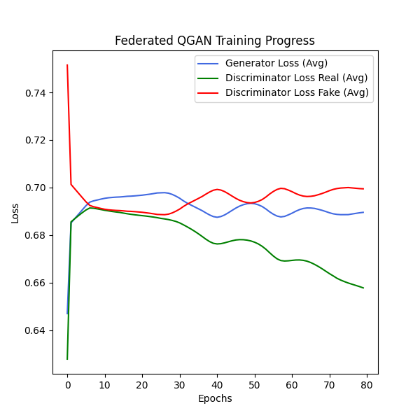
Loss plot
Evaluated on the FakeNairobi backend, a noisy quantum simulator with seven qubits.
To address problems related to the generator loss, the discriminator’s learning rate was reduced, achieving an optimal balance between the two models.
Intrusion Detection Using Quantum Generative Adversarial Networks: A Federated Approach With Noisy Simulators– Franco Cirillo– fracirillo@unisa.it
Notes:
The best-performing configuration was further evaluated on the FakeNairobi backend, a noisy quantum simulator with seven qubits.
To address problems related to the generator loss, the discriminator’s learning rate was reduced, achieving an optimal balance between the two models.

Slide 19
Loss plot
Final model reached an accuracy of 0.8738 and an F1-score of 0.8797.
Importance of balancing the generator and discriminator’s capabilities.
The learning rate proves to be a key tunable parameter in this regard.
Intrusion Detection Using Quantum Generative Adversarial Networks: A Federated Approach With Noisy Simulators– Franco Cirillo– fracirillo@unisa.it
Notes:
With this adjustment, the final model reached an accuracy of 0.8738 and an F1-score of 0.8797, lower than the noiseless version but a solid starting point for further improvements. These results highlight the importance of balancing the generator and discriminator’s capabilities to achieve stable training and reasonable performance in noisy environments. The learning rate proves to be a key tunable parameter in this regard. Further experiments are necessary to refine the model, enhance its performance, and develop strategies to mitigate the effects of quantum noise.

Slide 20
Conclusion
This study evaluated a Federated QGAN for intrusion detection, achieving good performance and improved training efficiency via parallelization.
Testing on noisy simulator highlighted stability challenges, which were mitigated by tuning the discriminator’s learning rate.
Future work will refine the model under noise by exploring quantum feature maps, hybrid strategies, and advanced federated configurations to enhance scalability and robustness.
Intrusion Detection Using Quantum Generative Adversarial Networks: A Federated Approach With Noisy Simulators– Franco Cirillo– fracirillo@unisa.it
Notes:
This study evaluated a Federated Quantum GAN (QGAN) for intrusion detection, achieving high accuracy (0.9125) and F1-score (0.9034) with improved training efficiency via parallelization. Testing on the FakeNairobi noisy simulator highlighted stability challenges, which were mitigated by tuning the discriminator’s learning rate—resulting in an F1-score of 0.8797. Future work will refine the model under noise by exploring quantum feature maps, hybrid strategies, and advanced federated configurations to enhance scalability and robustness.

Slide 21
Franco Cirillo and Christian Esposito
Intrusion Detection Using Quantum Generative Adversarial Networks: A Federated Approach With Noisy Simulators
Contact: fracirillo@unisa.it

